Slide 1
Recommendations Improve the Search Experience Innovations in Activity Data workshop 04 July2011 Richard Nurse
http://www.open.ac.uk/blogs/rise
http://www.flickr.com/photos/jm3/2779185414/sizes/m/in/photostream/

Slide 2
Recommendations Improve the Search Experience?
Can you use search data to make recommendations?
Are recommendations useful for Discovery systems?
http://www.open.ac.uk/blogs/rise
http://www.flickr.com/photos/mag3737/1419690363/sizes/m/in/photostream/
Notes:
So what is RISE all about?
RISE stands for Recommendations Improve the Search Experience.
It’s an experimental project to investigate what you can do with the data that we have at the OU Library from the searches that library users make. And if we can use that data to make recommendations then are they useful to people using discovery solutions
So there’s always an implied question mark with the project name. We think recommendations may improve the search experience, but we’re not sure, and there may be circumstances where they are useful and others where they aren’t. So that is what we’ve set out to investigate.

Slide 3
JISC Activity Data Programme
JISC funded project
February – July 2011
One of eight projects [list at http://bit.ly/gwCmNS]
http://www.open.ac.uk/blogs/rise
http://www.flickr.com/photos/mag3737/3069729100/sizes/m/in/photostream/
Notes:
RISE has been funded as part of the Activity Data strand of the JISC Infrastructure for Education and Research programme
It’s a very short project, just six months, with a small team – developer, project manager
And there are seven other projects in the programme. Some of which are here working in libraries such as SALT and LIDP, others of which are looking at activity data in a range of other areas from VLEs, through repositories, to student systems to video-conferencing data

Slide 4
What is Activity Data?
Usage data
Attention data
http://www.open.ac.uk/blogs/rise
http://www.flickr.com/photos/mag3737/2326898219/sizes/m/in/photostream/
Notes:
Activity data can be broadly broken down into two types of data
> Usage date – actions that a user has performed (e.g. loan transactions, downloads)
> Attention data – items that a user has viewed (e.g. metadata records, tables of contents, reviews)
It has been described as an exhaust trail, a by-product of users interacting with your systems

Slide 5
So what’s the point of this activity data stuff then?
"Every day I wake up and ask, 'how can I flow data better, manage data better, analyse data better?"
Rollin Ford, the CIO of Wal-Mart
http://www.open.ac.uk/blogs/rise
http://www.flickr.com/photos/zerimski/5215633183/sizes/z/in/photostream/
Notes:
The business sector, particularly companies such as Tesco, Amazon and Wal-Mart exploit the data they have about customer activities to support decision making.
Wal-mart have revenues of around $400 billion a year and this is what their CIO has to say.
Some early research by JISC, in the TILE and MOSAIC projects identified that the HE sector also had extensive user data and there was some potential to make use of it, but it was greatly underused. So this JISC programme has set out to explore this area in more detail.
Across the sector we are being told to be more business-like and the use of customer data is one of the areas that businesses seem to be exploiting far more than we do

Slide 6
Library activity data
Loans
Holds
Computer bookings
Library access
e-resources
http://www.open.ac.uk/blogs/rise
http://www.flickr.com/photos/xq311z/2468769929/sizes/m/in/photostream/
Notes:
For a traditional ‘bricks and mortar’ university these are some of the ways that you’d typically interact with your customers.
Well, for the OU things are a bit different

Slide 7
OU environment
http://www.open.ac.uk/blogs/rise
http://www.flickr.com/photos/neilwykes/134162792/sizes/z/in/photostream/
Notes:
Well, we have a library but most of our students never visit it

Slide 8
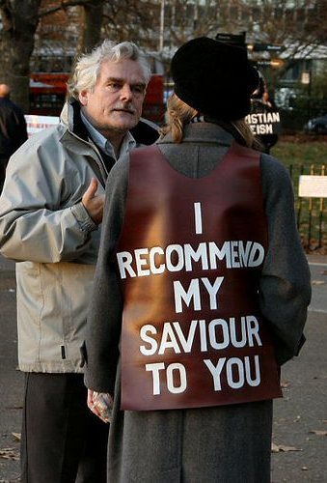
Library activity data
x
Loans
Holds
Computer bookings
Library access
e-resources
x
http://www.open.ac.uk/blogs/rise
http://www.flickr.com/photos/stefz/7913287/sizes/m/in/photostream/
Notes:
So these ones aren’t going to work for us

Slide 9
OU environment
http://www.open.ac.uk/blogs/rise
http://www.flickr.com/photos/julietteculver/4731004168/in/photostream
Notes:
And although we have books in the library, we don’t really lend them to students, or offer them a holds service, as the book stock is mainly aimed at academics

Slide 10
Library activity data
x
x
x
Loans
Holds
Computer bookings
Library access
e-resources
x
http://www.open.ac.uk/blogs/rise
http://www.flickr.com/photos/cassidy/352549326/sizes/m/in/photostream/
Notes:
And this one and this one, nope they won’t work for us either

Slide 11
Library activity data
x
x
x
Loans
Holds
Computer bookings
Library access
e-resources
x
http://www.open.ac.uk/blogs/rise
http://www.flickr.com/photos/lexnger/116314355/sizes/m/in/photostream
Notes:
So it doesn’t really give us too much choice about what aspect of activity data we could look at. All our students are distance learners so they interact with us online and use our resources electronically. And with more than 450,000 unique users of our website and over 100,000 unique users of our e-resources each year then there’s a fair amount of activity data for us to use

Slide 12
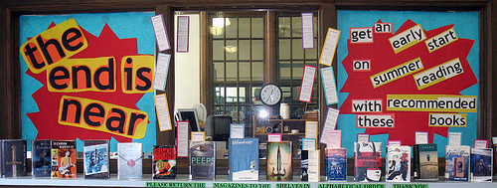
OU systems environment
Athens DA authentication built into local (SAMS) login system
EZProxy remote user authentication
Ebsco Discovery Solution
SFX knowledge base and OpenURL link resolver
http://www.open.ac.uk/blogs/rise
http://www.flickr.com/photos/nataliesap/3553982299/sizes/m/in/photostream/
Notes:
So, if we are concentrating on our e-resources then the systems we use include a local SAMS single sign on solution that we use to provide remote access to university systems. We’ve adopted the EZProxy system from OCLC as most of our users are remote and we can allow them to have access to most of our resources in this way.
We are using SFX from ExLibris as our resources knowledge base and as the OpenURL link resolver and lastly this year we’ve implemented the Ebsco Discovery Solution in place of an older federated search system

Slide 13
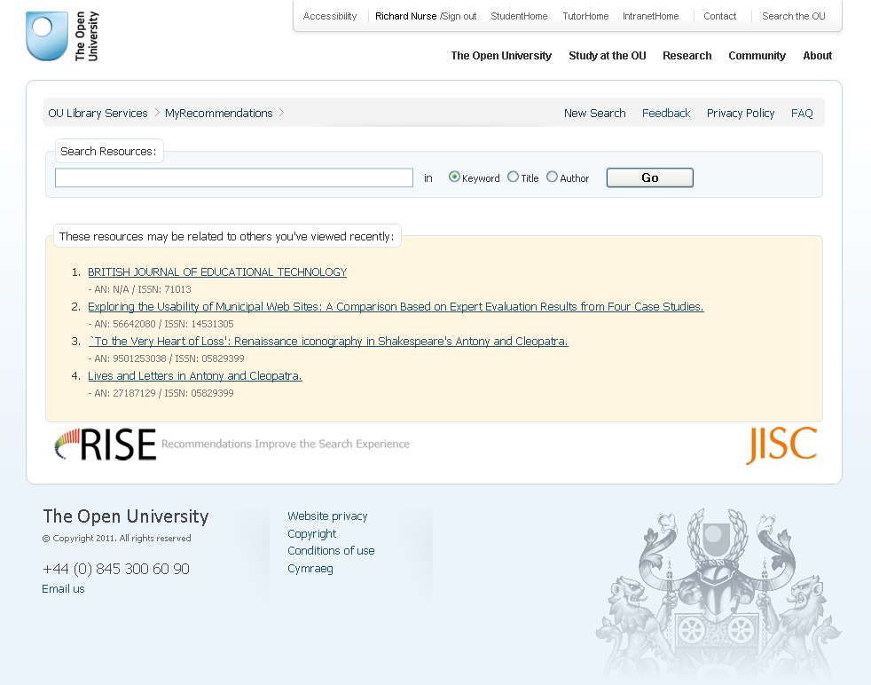
Scope of the project
Notes:
The stages of the project were to build the database and fill it with activity data, write some software to create the recommendations, create a search interface to show the recommendations, then test it with some users and then see if we can openly release some data from the project.

Slide 14
So what about collecting more data?
http://library.open.ac.uk/rise
http://www.open.ac.uk/blogs/rise
Notes:
The interface we created to test recommendations with users uses the Ebsco Discovery Solution API. When you go in you get recommendations based on your previous search history and if you are on a course, recommendations based on what other people on your course are viewing.

Slide 15
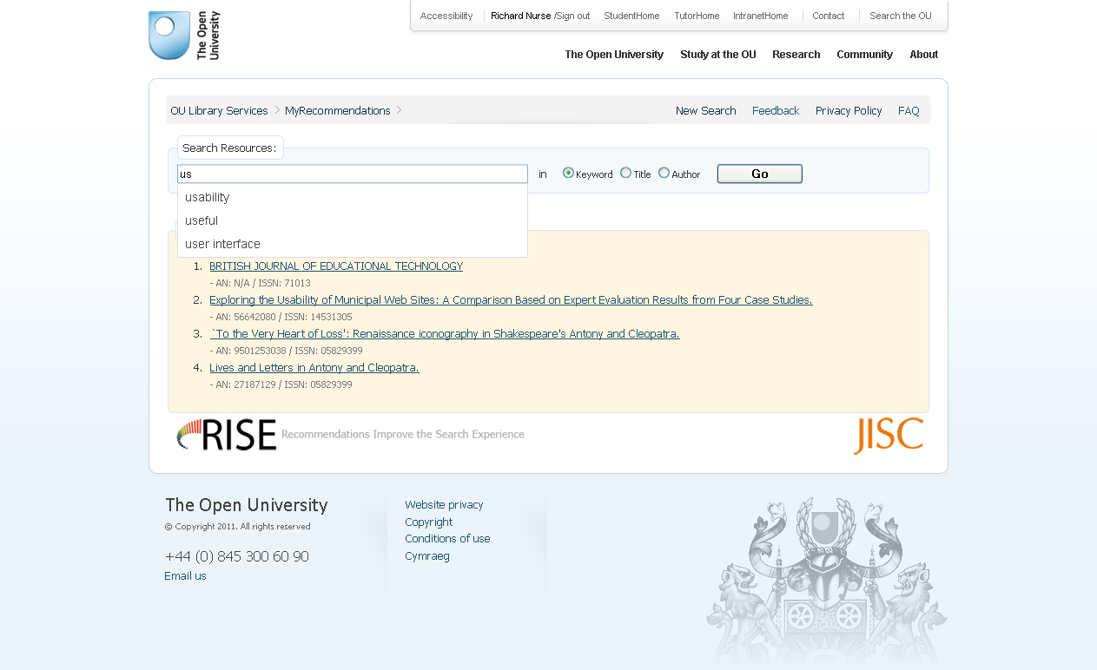
So what about collecting more data?
http://www.open.ac.uk/blogs/rise
Notes:
As you type in your search you get suggested terms based on previous searches

Slide 16
http://www.open.ac.uk/blogs/rise
Notes:
And when you get your search results, you also get recommendations based the articles viewed by people who used similar search terms

Slide 17
http://www.open.ac.uk/blogs/rise
Notes:
If you view one of the recommended resources it will open the record in another window and you are given the chance to rate the usefulness of the recommendation.

Slide 18
http://www.google.com/ig/directory?type=gadgets&url=library.open.ac.uk/rise/google_gadget/risesearch.xml
http://www.open.ac.uk/blogs/rise
Notes:
We’ve also built a second interface – this one is a Google Gadget version with pretty much the same functions as the main interface

Slide 19
http://www.open.ac.uk/blogs/rise
Notes:
Log in sorted out by working with SocialLearn team

Slide 20
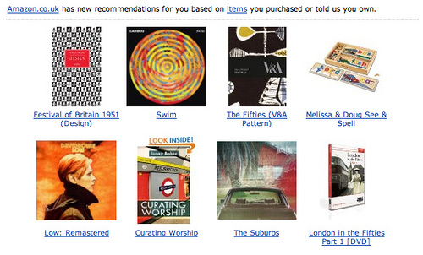
What resources are involved?
E-journal articles
E-journals
E-books
http://www.open.ac.uk/blogs/rise
http://www.flickr.com/photos/smallritual/5393527886/sizes/m/in/photostream/
Notes:
So in terms of the data that we are investigating, it gives us data about people looking for these types of things, E-journal titles and articles, e-books

Slide 21
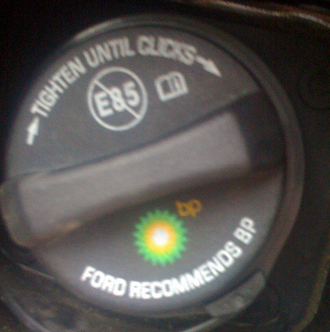
What data is RISE using?
SFX
EZProxy
VLE
bookmarklet
website
EDS
http://www.open.ac.uk/blogs/rise
http://www.flickr.com/photos/cdevers/2665335157/sizes/m/in/photostream/
Notes:
We push as much as possible through ezproxy, so we use it for access through our discovery solution, for links from SFX, for links placed in our VLE. So it seemed the obvious choice as the place to start to look at e-resource activity data. We didn’t have access to the Ebsco Discovery log files and we hadn’t been using that system for long whereas we did have a few months of log files from EZProxy
So we started with the EZProxy log files as the core dataset

Slide 22
So what is in the EZProxy logs?
Remote host
Date/Time
Oucu
Request
Status
Size of response
Referrer
User agent
Session
http://www.open.ac.uk/blogs/rise
http://www.flickr.com/photos/vincentgallegos/5123100365/sizes/m/in/photostream/
Notes:
So when we start to look in detail at what data is contained within the log files you’ve got some useful data and other data that isn’t so useful for activity data purposes.
We know the user name – that’s the oucu the Open University Computer User account name. You know the request, that is the website that is being accessed, but you also know things that aren’t that useful such as the user agent or browser
So when you look at the detail of the record what you get is…

Slide 23
So what is in the EZProxy logs?
\"0\"|||\"137.108.143.168\"|||20110115235421|||\“nn1234\"|||\"GET http://libezproxy.open.ac.uk:80/connect?
Session=st3ShtizgtrS7tU5&url=
http://search.ebscohost.com/login.aspx?direct=true&site=edslive&scope=site&type=0&cli0=FT&clv0=Y&cli1=FT1&clv1=Y&authtype=ip&group=VCStud&bquery=War%20Against%20the%20Panthers
HTTP/1.1\“|||302|||0|||\http://library.open.ac.uk/\
|||\"Mozilla/5.0 (X11; U; Linux i686; en-US; rv:1.9.2.13) Gecko/20101206 Ubuntu/10.10 (maverick) Firefox/3.6.13\"|||\"t3ShtizgtrS7tU5\"
http://www.open.ac.uk/blogs/rise
http://www.flickr.com/photos/smohundro/2449517861/sizes/m/in/photostream/
Notes:
Something that looks like this (we’ve anonymised the oucu for obvious reasons).
It looks a bit mind-numbing, especially when you think that this is one record out of tens of thousands of rows but with a bit of work you can break it down

Slide 24
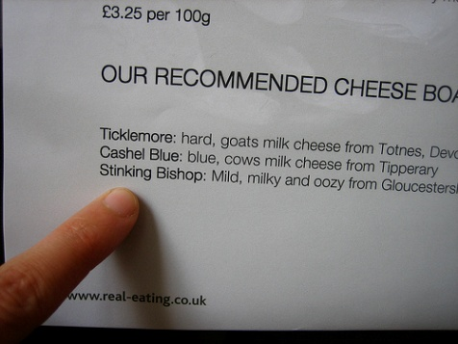
So what is in the EZProxy logs?
\"0\"|||\"137.108.143.168\"|||20110115235421|||\“nn1234\"|||\"GET http://libezproxy.open.ac.uk:80/connect?
Session=st3ShtizgtrS7tU5&url=
http://search.ebscohost.com/login.aspx?direct=true&site=edslive&scope=site&type=0&cli0=FT&clv0=Y&cli1=FT1&clv1=Y&authtype=ip&group=VCStud&bquery=War%20Against%20the%20Panthers
HTTP/1.1\“|||302|||0|||\http://library.open.ac.uk/\
|||\"Mozilla/5.0 (X11; U; Linux i686; en-US; rv:1.9.2.13) Gecko/20101206 Ubuntu/10.10 (maverick) Firefox/3.6.13\"|||\"t3ShtizgtrS7tU5\"
date and time
http://www.open.ac.uk/blogs/rise
http://www.flickr.com/photos/adactio/225402453/sizes/m/in/photostream/
Notes:
So you’ve got the date and time – useful to be able to know when something happened

Slide 25
So what is in the EZProxy logs?
\"0\"|||\"137.108.143.168\"|||20110115235421|||\“nn1234\"|||\"GET http://libezproxy.open.ac.uk:80/connect?
Session=st3ShtizgtrS7tU5&url=
http://search.ebscohost.com/login.aspx?direct=true&site=edslive&scope=site&type=0&cli0=FT&clv0=Y&cli1=FT1&clv1=Y&authtype=ip&group=VCStud&bquery=War%20Against%20the%20Panthers
HTTP/1.1\“|||302|||0|||\http://library.open.ac.uk/\
|||\"Mozilla/5.0 (X11; U; Linux i686; en-US; rv:1.9.2.13) Gecko/20101206 Ubuntu/10.10 (maverick) Firefox/3.6.13\"|||\"t3ShtizgtrS7tU5\"
User name
http://www.open.ac.uk/blogs/rise
http://www.flickr.com/photos/dlytle/422738735/sizes/m/in/photostream/
Notes:
An the name of the user

Slide 26
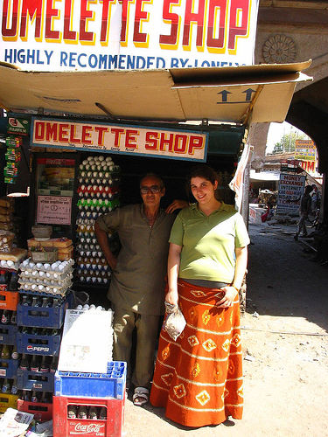
So what is in the EZProxy logs?
\"0\"|||\"137.108.143.168\"|||20110115235421|||\“nn1234\"|||\"GET http://libezproxy.open.ac.uk:80/connect?
Session=st3ShtizgtrS7tU5&url=
http://search.ebscohost.com/login.aspx?direct=true&site=edslive&scope=site&type=0&cli0=FT&clv0=Y&cli1=FT1&clv1=Y&authtype=ip&group=VCStud&bquery=War%20Against%20the%20Panthers
HTTP/1.1\“|||302|||0|||\http://library.open.ac.uk/\
|||\"Mozilla/5.0 (X11; U; Linux i686; en-US; rv:1.9.2.13) Gecko/20101206 Ubuntu/10.10 (maverick) Firefox/3.6.13\"|||\"t3ShtizgtrS7tU5\"
Request
http://www.open.ac.uk/blogs/rise
http://www.flickr.com/photos/spoinknet/35410171/sizes/m/in/photostream/
Notes:
And the request that has been made – in this case an ebsco host search

Slide 27
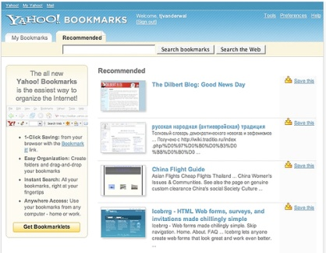
RISE database
http://www.open.ac.uk/blogs/rise
http://www.flickr.com/photos/vanderwal/279135451/sizes/m/in/photostream/
Notes:
So our database starts to build up with details of users, courses and resources

Slide 28
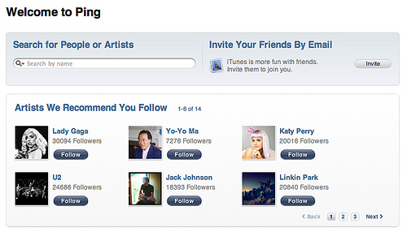
RISE database
Remote host | Date/Time | Oucu | request | status | size of response | referrer | user agent | session
user type | course code(s)
EZProxy
CIRCE
http://www.open.ac.uk/blogs/rise
http://www.flickr.com/photos/dw/4950924376/sizes/m/in/photostream/
Notes:
So we could get data about the courses that students were studying from our internal student information system

Slide 29
RISE database
http://www.open.ac.uk/blogs/rise
http://www.flickr.com/photos/vanderwal/279135451/sizes/m/in/photostream/
Notes:
So that added a bit more to the mix

Slide 30
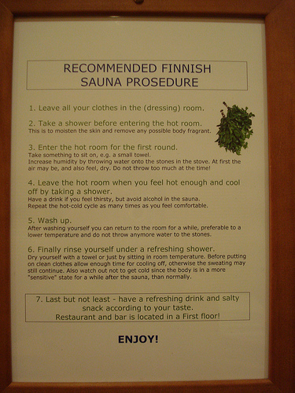
But what isn’t there?
ISSNs
DOI
Article information
Subject terms
http://www.open.ac.uk/blogs/rise
http://www.flickr.com/photos/clankennedy/3022286303/sizes/m/in/photostream/
Notes:
But there are limitations. You don’t always know what search terms were used or have much information about the item that is being accessed
And if you want to make a recommendation you don’t even have an article or journal title to show as the recommendation
So we’ve been investigating how we could improve the data. At the moment we use another EDS API call to extract bibliographic details so we can show them as a recommendation. Ideally it would be preferrable to find alternative sources of metadata that could be stored locally to save having to make multiple API calls.

Slide 31
What can the data tell us?
People on course ‘A’ viewed resource ‘B’
People who looked at resource ‘C’ also looked at resource ‘D’
Course recommendation
Relationship recommendation
Which are the most popular resources, subjects
http://www.open.ac.uk/blogs/rise
http://www.flickr.com/photos/vblibrary/5190554053/sizes/m/in/photostream/
Notes:
So, the data we have so far can tell us which courses people are on, so we can make recommendations based on that, i.e. these are the most popular resources that people on your course are looking at. We can also start to say that if you looked at resource C and then straightaway looked at resource D that there is a likelihood that there is some relationship between resource C and resource D.
And we can also say which overall are the most popular articles or journals or subject terms most often seen.
But there are limitations to the ezproxy data, we don’t have the search terms that are used to find these resources.

Slide 32
So what about collecting more data?
http://www.open.ac.uk/blogs/rise
Notes:
We needed to build an interface to be able to show users the recommendations and to use for the evaluations. So we thought, actually why not collect the data from the activity carried out within that search interface as well add that into the database and use that data to improve the recommendations

Slide 33
RISE database
http://www.open.ac.uk/blogs/rise
http://www.flickr.com/photos/vblibrary/5052421946/sizes/m/in/photostream/
Notes:
Now we can add search terms that are being used and start to record the values for the different types of relationships for our recommendations

Slide 34
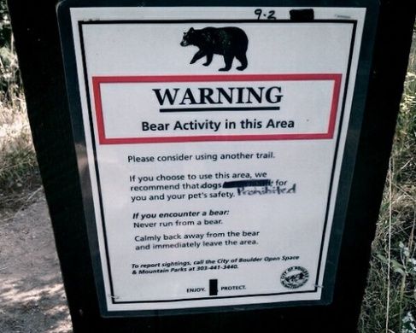
So how do you improve your data?
Remote host | Date/Time | Oucu | request | status | size of response | referrer | user agent | session
user type | course code(s)
Searches in RISE
EZProxy
CIRCE
RISE
http://www.open.ac.uk/blogs/rise
http://www.flickr.com/photos/suttonhoo22/5004250051/sizes/m/in/photostream/
Notes:
Having gone through this process

Slide 35
What can the data tell us?
People on course ‘A’ viewed resource ‘B’
People who searched for subject ‘E’ looked at resource ‘F’
People who looked at resource ‘C’ also looked at resource ‘D’
Course recommendation
Relationship recommendation
Search recommendation
People are looking at resources on this subject
Subject data
This resource is being used by people studying this course
Resource management
http://www.open.ac.uk/blogs/rise
http://www.flickr.com/photos/vblibrary/4581698063/sizes/m/in/photostream/
Notes:
So we’ve ended up with a set of data that can give us a range of different types of recommendations
From ‘people on your course are looking at these articles’ through ‘people who looked at this article also looked at this article’ and ‘to people using this search term looked at these resources’
And we are sure that you could put the data to other types of use.

Slide 36
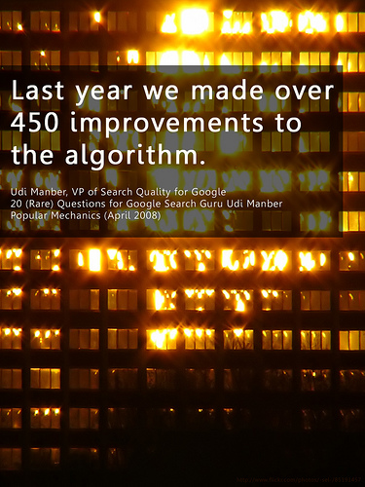
So how do you get a recommendation?
http://www.open.ac.uk/blogs/rise
http://www.flickr.com/photos/will-lion/2442088335/sizes/m/in/photostream/
Notes:
Once you’ve established a database of activity data you’ve got to create some software that decides which articles get shown to a user.
With a new small project like RISE we are starting from scratch with something quite simple.
What drives the recommendations is a set of relationship values. Values are assigned based on resource views and subsequent relevancy ratings
The relationships are ranked according to the value so the top ones get shown as recommendations.

Slide 37
So how do you get a recommendation?
User A Course A123
Views
Resource B RV=14
Views +1
Resource B RV=15
User C Course A123
Recommended +1
Resource B RV=15
Views +1
Resource B RV=16
User C Course A123
Rate Useful +1
Resource B RV=17
User C Course A123
Rate Not Useful -2
Resource B RV=14
http://www.open.ac.uk/blogs/rise
Notes:
Each relationship starts as value 0
+1 each time the resource is viewed
+1 each time the recommendation is viewed
+1 each time the recommendation is rated as ‘Useful’
-2 each time the recommendation is rated as ‘Not Useful’
Recommendations are displayed in value order

Slide 38
Interface usage
 | Page views
Browser | 7,462
Gadget | 855
http://www.open.ac.uk/blogs/rise
Notes:
We’ve had a steady stream of use across a six week period. About 10% of the use has been through the gadget.

Slide 39
Data Protection and privacy
Added a privacy policy to RISE, EDS and SFX interfaces
Provided an opt-out feature
Privacy and opt-out URL
http://library.open.ac.uk/rise/?page=privacy
http://www.open.ac.uk/blogs/rise
Notes:
Any system that deals with personal data has to be mindful of privacy and data protection requirements. After discussion within the Activity Data programme and some helpful information particularly from EDINA’s OpenURL project we put together a specific privacy policy and discussed it with our data protection people at the University. The policy explicitly covered activity data and we have linked to it from the RISE interfaces, from our main EDS page and from SFX.
The policy gives people an opt-out to have their data removed from the recommendations, even though they aren’t identified personally in any of the recommendations.
With the new EU ‘cookies’ legislation we are doing some more work to ensure that we are legally compliant. Ideally we would want any institutional ‘cookie’ policy and agreement to cover permission to use data for this type of activity.

Slide 40
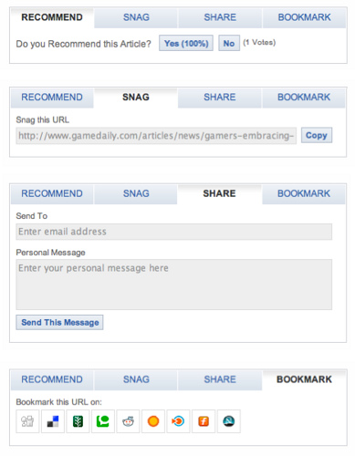
Open Data
Release data openly
E-Resource accesses
Search terms
Course subjects
http://www.open.ac.uk/blogs/rise
http://www.flickr.com/photos/narisa/2720873442/sizes/m/in/photostream/
Notes:
One of the objectives of the project is to openly release the data that we are collecting so that others can find ways to use it.
So in theory within the RISE database we’ve got details of which resources are being used, by people on which courses, and what subject terms are being used.
But when it comes to opening up your data it doesn’t necessarily mean that just because you’ve collected it into your database you can just go ahead and make it openly available
There’s a bit of a contradiction between what you might want to do to help improve your recommendations – by taking data from a variety of sources – and what you might be able to make openly available
The main problem we have with making any data available is that a large proportion of our EZProxy data just consists of an ebscohost url, there is no bibliographic data and no way to easily link it.

Slide 41
Anonymization
Ensure compliance with Data Protection requirements
Get agreement to release data
http://www.open.ac.uk/blogs/rise
Notes:
But, before you can release a data set openly you need to be sure that you are legally able to do so. And there is at least a couple of angles to this.
Are you collecting the data in a way that complies with Data Protection and privacy laws?
And do you have the right to release the data you have collected?
I talked earlier about how we have enhanced the EZProxy data with data from other sources. So we’ve used an EBSCO API to get bibliographic data from a commercial source. So the question then becomes who owns the rights to that data?

Slide 42
Anonymization
Remove the user name
Remove all records for courses with less than x students
Replace the course code with a generic subject
http://www.open.ac.uk/blogs/rise
Notes:
But assuming you have your data set
So you need to make sure that you’ve removed anything that could identify a user, even indirectly. You may want to aggregate the data at a course level and then anonymise the course by relating it to the course subject.

Slide 43
Data formats and standards
XML
CSV
Linked Data
OpenURL
MOSAIC
KE Usage Statistics standard
http://www.flickr.com/photos/mararie/4121128381/sizes/m/in/photostream/
Notes:
You also need to decide how you are going to release the data. What format or standards do you use?
CSV is popular for releasing

Slide 44
Hypothesis
“That recommender systems can enhance the student experience in new generation e-resource discovery services”
http://www.open.ac.uk/blogs/rise
http://www.flickr.com/photos/mag3737/3318791086/sizes/m/in/photostream/
Notes:
At the start of the project we had to propose a formal hypothesis
For RISE the hypothesis is
“That recommender systems can enhance the student experience in new generation e-resource discovery services”
So to test it we’ve carried out three types of evaluation activity

Slide 45
Evaluation
Online Survey
Face to Face interviews
Review of web analytics
http://www.open.ac.uk/blogs/rise
http://www.flickr.com/photos/8lettersuk/148685757/sizes/m/in/photostream/

Slide 46
Survey results 1
http://www.open.ac.uk/blogs/rise

Slide 47
Survey results 2
http://www.open.ac.uk/blogs/rise

Slide 48
Survey results 3
http://www.open.ac.uk/blogs/rise

Slide 49
Survey results 4
http://www.open.ac.uk/blogs/rise

Slide 50
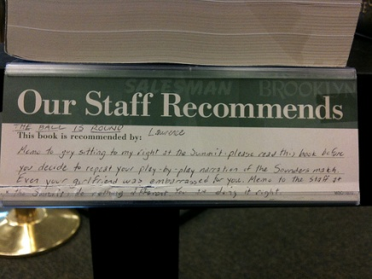
Face to Face evaluation
Like ratings and reviews from other students
Which module studied?
Postgraduates
‘other people’s experiences valuable’
Undergraduates
Citation as a recommendation
Wary of provenance
Feed to module website
Want synonyms
Trust repository
How high a mark?
http://www.open.ac.uk/blogs/rise
http://www.flickr.com/photos/ryanhealy/3729881896/sizes/m/in/photostream/
Notes:
As part of our evaluation of the Discovery system we’ve been running some focus groups and were able to ask some questions about the use of recommender systems.
And there’s a distinct split between what undergraduates and postgraduates want. And perhaps that isn’t too surprising. So we are exploring that in more detail in a series of face to face interviews.

Slide 51
Should we have a recommender system?
“I think it would be a very good useful feature. It would be definitely very very useful” postgraduate Maths student
“So it would be interesting to see what other people are looking at. Yes, I would definitely use that because my limited knowledge of the library might mean that other people were using slightly different ways of searching and getting different results.” undergraduate English Literature student
I have just had a go, it was good with suggested papers that I had already found (which shows potential in my view) through Google.
http://www.open.ac.uk/blogs/rise
http://www.flickr.com/photos/earlg/337743409/sizes/m/in/photostream/
Notes:
We are still at the stage of writing up the full evaluations but these are some of the comments we are getting.
Generally, there is support for the concept amongst most users

Slide 52
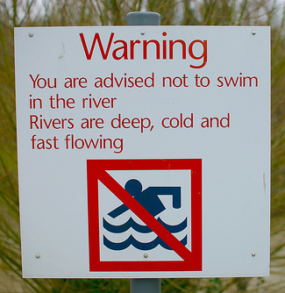
Should we have a recommender system?
“I'm afraid my first reaction is to be a bit sceptical - it presumably doesn't tell you if fellow students found the information/article useful or relevant to what they were looking for. I would hate to waste time following unproductive links laid down by others who might be failing students or think that any "lazy" students might develop poor practice by relying on what others had looked at. It sounds like a good idea but I think caution needs to be exercised. ”
http://www.open.ac.uk/blogs/rise
http://www.flickr.com/photos/rob-sinclair/2189457309/sizes/m/in/photostream/
Notes:
But there is some urge for caution which ties in with wanting to understand where the recommendations are coming from.

Slide 53
Why they prefer course-related recommendations
“I can’t be bothered with knowing what everybody else is interested in. I take a really operational view you know, I’m on here, I want to get the references for this particular piece of work, and those are the people that are most likely to be doing a similar thing that I can use.” H800 student
“I suppose if I wasn’t so sure on an assignment it would perhaps be quite useful to see what other people were looking at to know if I was thinking along the right lines.” - Undergrad literature student
http://www.open.ac.uk/blogs/rise
Notes:
Pretty much all of the students so far said they would find the Course-related recs most useful.
One undergrad philosophy student said he would normally go for course related recs but in this instance definitely not because the people on his course were “complete fruit cakes”.

Slide 54
Suggestions for improvement
“Maybe include a date. It would be interesting to know when a resource was last looked at” Postgraduate political philosophy student
“If somebody used similar search but three years ago, is that going to carry the same weight?” Postgraduate maths student
Include course drop-down choice. “I would be looking at that and saying “which of my courses does it refer to?”
http://www.open.ac.uk/blogs/rise

Slide 55
Rating the recommendations
8 out of ten so far would be happy to rate the recommendation
Most people understood why we were asking them to rate it.
http://www.open.ac.uk/blogs/rise
Notes:
It’s just one click
Rating the recommendation not the article itself
Make it clear that it will help rank future recs

Slide 56
Recommendations usage
http://www.open.ac.uk/blogs/rise
Notes:
We’ve been using Google Analytics to track the use of the tools. As part of this work the developer created a custom report to try track which recommendations are being used.
So we can see how many times each type of recommendation is being used. But bear in mind that not everyone gets every type of recommendation every time

Slide 57
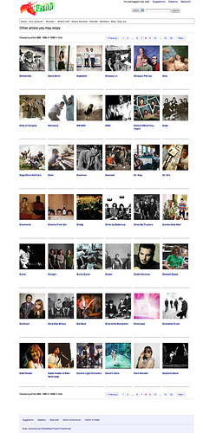
Recommendations usage
http://www.open.ac.uk/blogs/rise
http://www.flickr.com/photos/antrover/5810373016/sizes/m/in/photostream/
Notes:
The custom report that has been developed for RISE also lets you see which number recommendation is most popular.
So for search term recommendations users most frequently choose the first of second recommendation but rarely choose the third or fourth. So maybe we could just show two recommendations?

Slide 58
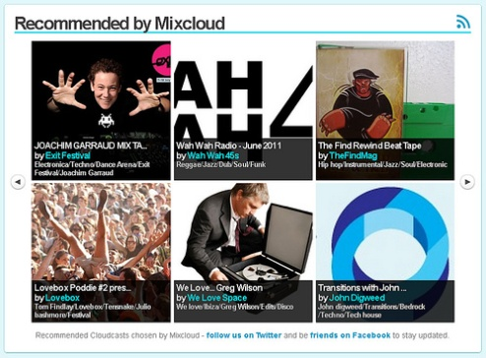
Recommendations usage
http://www.open.ac.uk/blogs/rise
http://www.flickr.com/photos/exitfestival/5835349579/sizes/m/in/photostream/
Notes:
But with course recommendations people most often pick the second result.

Slide 59
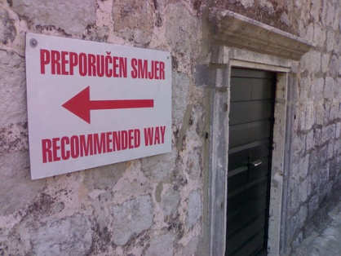
Recommendations usage
http://www.open.ac.uk/blogs/rise
http://www.flickr.com/photos/oldton_tim/479685673/sizes/m/in/photostream/
Notes:
For the final type of recommendation the first recommendation is most often chosen again

Slide 60
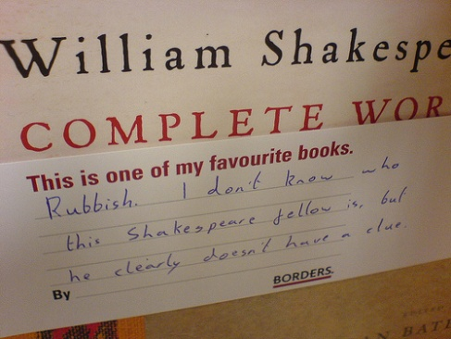
Recommendations usage
http://www.open.ac.uk/blogs/rise
http://www.flickr.com/photos/smin/613285324/sizes/m/in/photostream/
Notes:
Overall the first and second recommendations seem to be by far the most popular. That seems to indicate that users clearly expect that there is some relevance ranking and rating taking place. Selecting the first two also reinforces their value as recommendations
We’ve some more work to do to dig into the analytics, such as segmenting the users between google gadget and rise interface and seeing if there behaviour is different.

Slide 61
Interim findings
EZProxy data
Need more data!
Use other data sources
Search terms
Users like recommendations ‘in principle’
Recommendations provenance
Interest in the search tools
Quality of recommendations isn’t high
Limited use of it so far
http://www.open.ac.uk/blogs/rise
Notes:
EZProxy data – on its own it there are limits to the recommendations you can make, they would mostly be about which are the most popular resources
Our main issue is to get access to bibliographic data about the articles being accessed and recommended.
You need to combine the ezproxy data with other stuff, such CIRCE data
You need search terms ideally
The more data you can get the better. Unfortunately our Information Management policies dispose of valuable activity data far too readily, you really should be keeping a couple of years worth of data – it’s like throwing away the family silver! The more data you get hold of the better you can make the recommendations
The One-Stop focus groups and the feedback show that users like the idea of recommendations, there seem to be differences between undergraduates and post-graduates, but there’s a need for them to know the provenance.
There’s interest in the search tools from students
But currently the quality of the recommendations isn’t that high and the best way to improve the quality is to make it more widely available

Slide 62
Still to do
Release of code via Google Code
Release of data
Final blog posts and write ups
Dissemination
Complete evaluation work

Slide 63
Recommendations Improve the Search Experience Innovations in Activity Data workshop 04 July2011 Richard Nurse
http://www.open.ac.uk/blogs/rise
http://www.flickr.com/photos/jm3/2779185414/sizes/m/in/photostream/

