Slide 1
Open Access Publishing
Nadine Lewycky, Senior Manager, Research Strategy & Planning
Chris Biggs, Metadata and Repository Specialist

Slide 2
What is Open Access Publishing
The research publication is free to read (at least) by anyone.

Slide 3
How do Researchers do Open Access Publishing
Green Open Access
Where a version of the publication is made freely available on a repository or other website.
Gold Open Access
Where the final version the publication is made freely available on the publisher’s website.
Notes:
But it’s not really free…

Slide 4
Why do Researchers do Open Access Publishing
They do it because it’s the right thing to do – “Research from public money should publicly available”.
They do it because removing the paywall increases the dissemination of the research. (Downloads & Increased Citations)
They do it because policies mandate it!

Slide 5
RCUK Policy
Gold
Green
Requires
The journal provides immediate and permanent access to the published version of the paper, free of charge at the point of use
The publisher must allow re-use of the content of the paper under the Creative Commons - Attribution (CC-BY) license
Requires
The author, or the publisher on the author's behalf, must deposit the accepted, peer-reviewed version of a paper in an institutional or discipline-specific repository
An embargo may apply, this should be no longer than 6 months (STFC, BBSRC, NERC, MRC, EPSRC) or 12 (AHRC & ESRC)
A longer embargo period is permitted where funding is not available.
The paper must be accompanied by a licence allowing reuse for (at least) non-commercial purposes, text and data mining

Slide 6
Paying for RCUK Gold
Has been submitted for publication on or after 1 April, 2013, AND
Is the result of research that is wholly or partly funded by RCUK, AND
The lead author is employed by the Open University
RCUK Open Access Fund

Slide 7
HEFCE Policy
Requires
To be eligible for submission to the post-2014 REF, the final peer-reviewed (author accepted) manuscript of all articles and conference papers (with an ISSN) submitted from 1 April 2016 must be deposited in an open access institutional (such as ORO) or subject repository within three (3) months of acceptance.
HEFCE requires maximum embargo periods of 12 months for REF Main Panels A & B, and 24 months for REF Main Panels C & D.

Slide 8
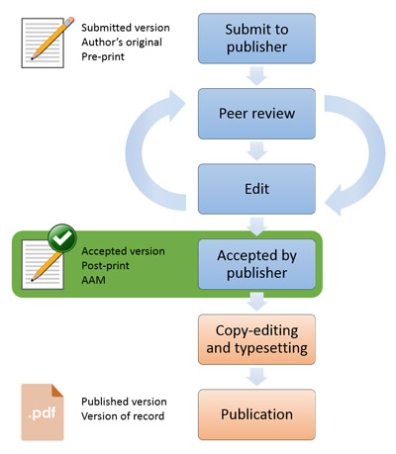
HEFCE Workflow

Slide 9
OU Open Access Publication Policy
Requires:
The full text of journal articles and published peer review conference proceedings must be deposited in ORO as soon as possible and not later than 3 months of publisher’s acceptance
The depositing of monographs, book chapters and all other long form publications is recommended where copyright allows
The version to be deposited should be the author’s accepted manuscript
Publications subject to a publisher’s embargo must still be deposited as soon as possible and no later than within 3 months

