Slide 1
Lightning Talk
The New Direction for Learning and Development
Andy Lancaster
Head of Learning, CIPD
©

Slide 2
Chartered Institute of Personal and Development; epicenter of L&D thinking
Research
New Profession Map
Thought-leadership
Credible career partner
Professional courses
Qualifications
Online resources
Networking
Consultancy
Google “CIPD Epicentre”
©

Slide 3
Meeting the needs of modern learners
Integrating learning into the organizational ecosystem
Refocusing the activity and personal development of the L&D team
©

Slide 4
Meeting the needs of modern learners
©

Slide 5
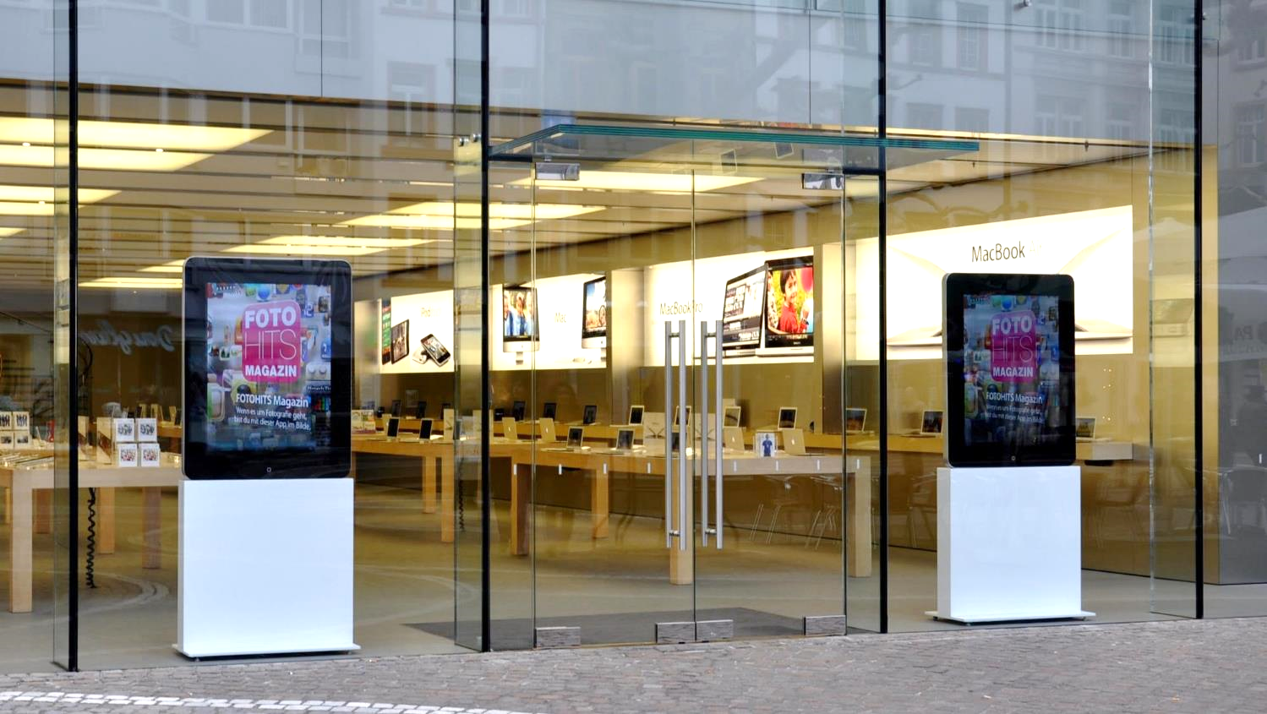
Discerning … used to great customer experiences
©
Notes:
https://commons.wikimedia.org/wiki/File:Frankfurt_Apple-Store.jpg

Slide 6
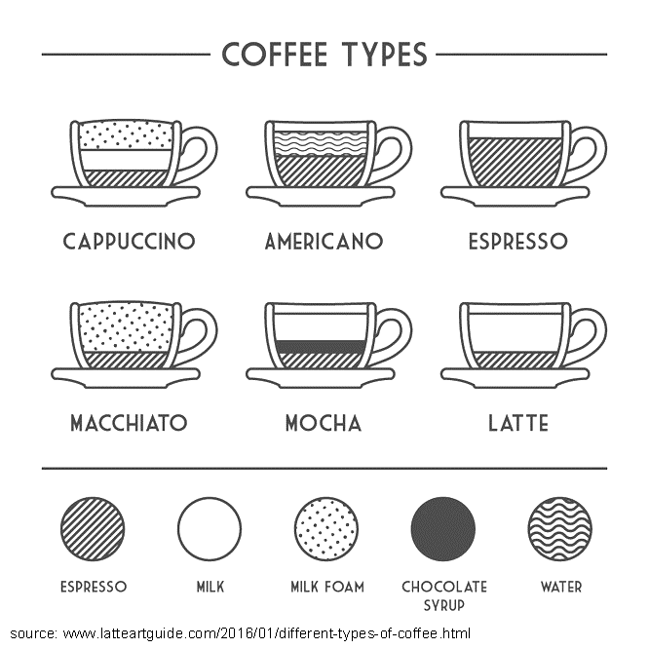
Self-directing and personalizing … the limitations of generic programmes
Deci and Ryan
Dan Pink’s DRIVE
©

Slide 7
Empowering … providing the tools; resources not just courses
©

Slide 8
Connecting with learners with learners
©
Notes:
.

Slide 9
Supporting … life-long career learning
©

Slide 10
Integrating learning into the organizational ecosystem
©

Slide 11
We often separate learning from the true context
Learning in the flow of work – Bersin. Work is learning, and learning is work - Jarche
©

Slide 12
Challenge and reshape leadership concepts of learning
©

Slide 13
Reconsidering design; accessible and agile as well as formal methods
©

Slide 14
Consulting on key organisational issues using data
©

Slide 15
Design in impact tracking … value not just volume
©

Slide 16
Engage operational managers as part of the “learning team”
©

Slide 17
Refocusing the L&D team and their development
©

Slide 18
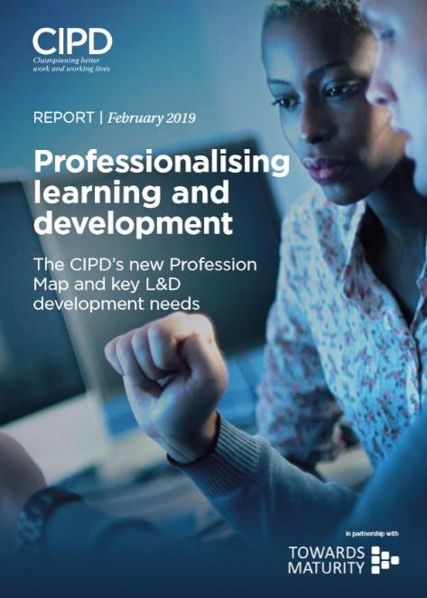
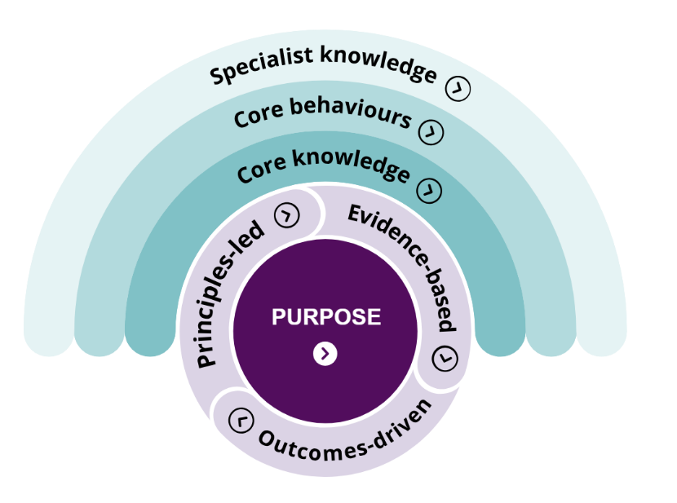
What does this require for L&D teams; New CIPD Profession Map
©
Notes:
The new Profession Map sets the international benchmark for the people profession. Use it to make better decisions, act with confidence, perform at your peak, drive change in your organisation and progress in your career. No matter who you are in the profession, whether you’re a CIPD member or not, the new Profession Map is relevant to you.

Slide 19
Time to invest in the professional development of the L&D team
48% of L&D practitioners are ‘extremely concerned’ with lack of time on own learning
Most effective methods Barriers to overcome
©
https://www.cipd.co.uk/learn/people-development-epicentre

Slide 20
3 key focus and development areas for core knowledge
Business acumen
90% identify business acumen as a priority development area; 42% of business leaders think L&D teams have the business acumen they expect
Analytics and creating value
96% identify using data and analytics as a priority development area; 24% already have these skills in-house
Culture and behaviour
98% of L&D practitioners aspire to build a positive learning culture; 36% have achieved this
©
https://www.cipd.co.uk/learn/people-development-epicentre

Slide 21
3 key focus and development areas for core behaviours
Situational decision-making
More than a quarter (27%) believe they do not have the skills to make informed, evidence-based decisions
Professional courage
28% feel conflict between what their organisation expects of them and their professional beliefs
Passion for learning
48% of L&D practitioners are extremely concerned with the lack of time they can spend on their own learning
©
https://www.cipd.co.uk/learn/people-development-epicentre

Slide 22
3 key focus and development areas for L&D specialism
Learning impact
96% of said learning impact was a concern. Only 22% are actively improving the way they gather and analyse learning impact data
Social collaboration
Organisations that facilitate social learning are 2x as likely to increase learning flexibility and 4x as likely to facilitate continuous learning
Adult learning theories
Less than half integrate new learning concepts in practice. Those that do are 2x as likely to drive transformation and 4x as likely to improve leadership
©
https://www.cipd.co.uk/learn/people-development-epicentre

Slide 23
Time for a revolutionary shift (not evolution) in organizational learning
©

Slide 24
Meeting the needs of modern learners
Integrating learning into the organizational ecosystem
Refocusing the activity and personal development of the L&D team
©

