Slide 1

How to make the Transformation Journey some evidence informed approaches
Denise Martin & Richard Harding
Jean Hartley & Loua Kahlil
Centre for Policing
Research and Learning

Slide 2


Centre for Policing
Research and Learning
The Journey Ahead

Slide 3
Centre for Policing
Research and Learning
Strategic Narrative

Slide 4
Centre for Policing
Research and Learning
Strategic Narrative

Slide 5
Centre for Policing
Research and Learning
Organizational Readiness for Change (Holt et al, 2010)
‘The degree to which those involved [in change] are individually and collectively primed, motivated and technically capable of executing the change’
Holt, D., et al. (2010). "Are You Ready? How Health Professionals Can Comprehensively Conceptualize Readiness for Change." Journal of General Internal Medicine 25(Supplement 1): 50-55.

Slide 6
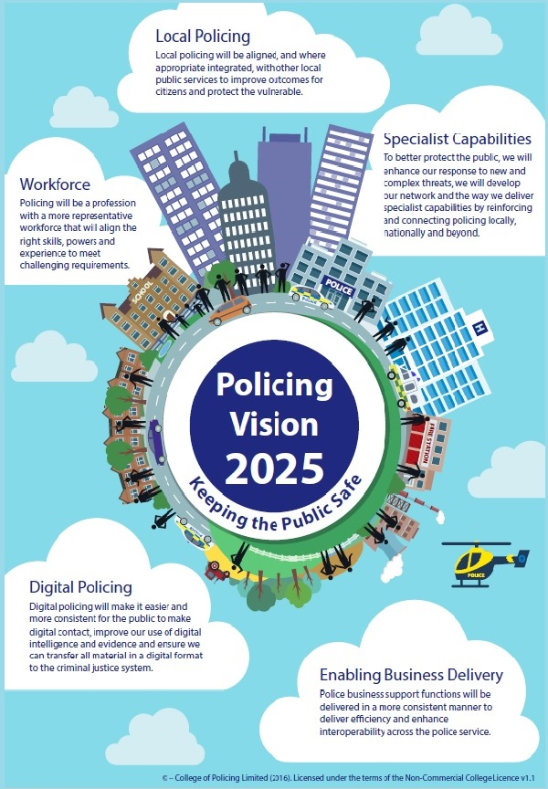
Centre for Policing
Research and Learning
The Change
a profession
“By 2025 policing will be a profession with a more representative workforce that will align the right skills, powers and experience to meet challenging requirements.”
(NPCC and APCC 2016)
?
more representative workforce
right skills
right powers
right experience
meet challenging requirements

Slide 7
Centre for Policing
Research and Learning
Engagement with Change
62% are aware of its impact
55% understand why
51% see the benefit
36% think it will be delivered
2019

Slide 8
Centre for Policing
Research and Learning
The Change
Much of change readiness literature engages:
Individual Organisation
Specific Change
Planned Change
Specific Timeframes
Change Mechanisms Implemented
This change is:
Less certain
Less structured
Wider in scope (depth and breadth)
Systemic as well as specific

Slide 9




Centre for Policing
Research and Learning
Changing – ready or not
Data suggests a potential gap in readiness on an individual and organisational level to engage this change – CDDs, endline survey etc – But NOT a lack of willingness or enthusiasm to engage it
Context emergent, contested and ambiguous – 20k now – constraint 18months ago – law and order agenda back in – BREXIT anyone?
Vision 2025 – provides a high level view – getting to the future is inevitable, but getting to the one you want requires planning, capability and effort
Perhaps not a traditional organisational change journey

Slide 10

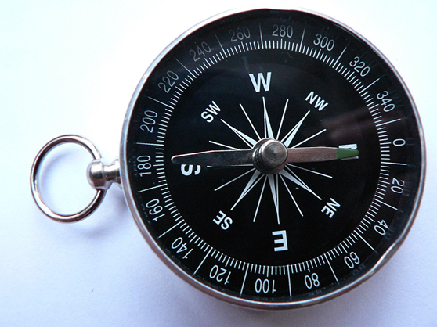
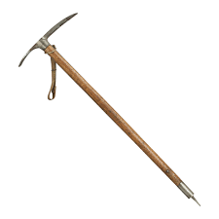
Centre for Policing
Research and Learning
So how can we support you in:
Understanding the journey better?
Developing your readiness and capability to undertake it?
Developing organisational and individual learning and knowledge to make the journey?

Slide 11
Centre for Policing
Research and Learning
Developed a theory of change for policing L&D through the strategic narrative

Slide 12
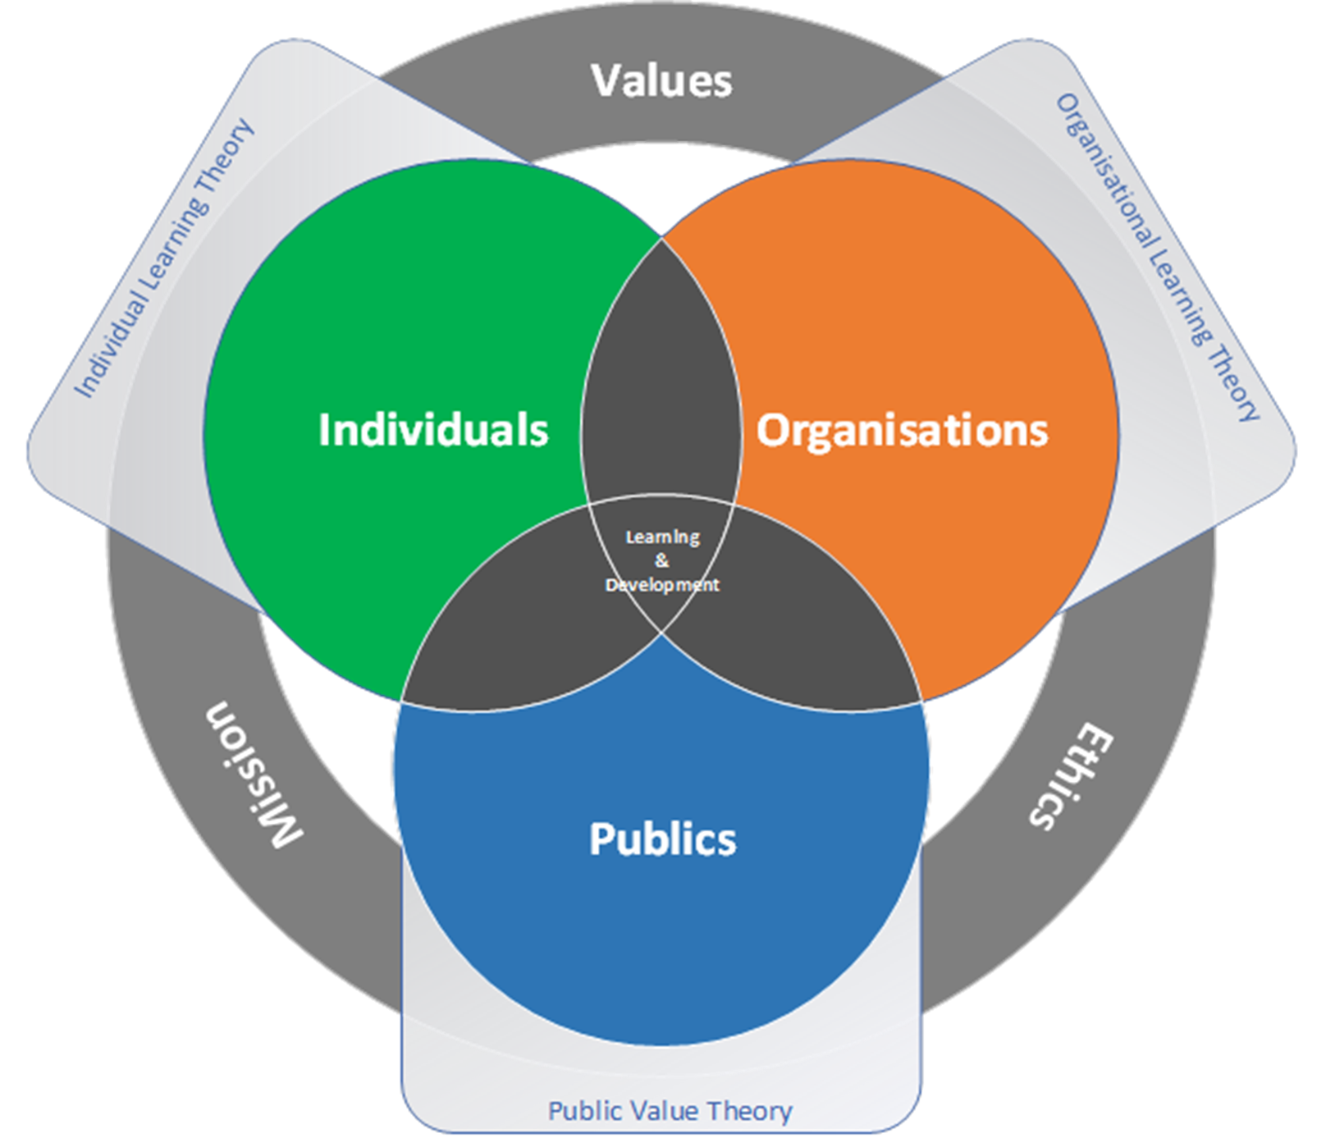
Centre for Policing
Research and Learning
The Destination Map
Developed a vision and description of the ‘destination’
at the end of the journey

Slide 13
Centre for Policing
Research and Learning
Tools, Techniques and Resources (TTR) –
‘a Toolkit for change’
TTR
Learning from other professions
Digital toolkit
Survey results
Talks and presentations
Open University learning resources
College of Policing resources
Other academic and industry information sources
Financial toolkit
Developed a range of evidence informed tools, techniques and resources and collated learning and knowledge from other sources

Slide 14
Centre for Policing
Research and Learning
Tools, Techniques and Resources (TTR)
As Tables, using your laptops or any other smart device you have about your person to log into the wifi [GLA Guest Wi-Fi] or otherwise access the internet
Using a browser of your choice access the following web address:
https://sway.office.com/5vqu6EksUqyZJ1uY?ref=Link
Using the TTR answer the questions
Put your hand up when you’ve got the answer.
First Hand + Right Answer = POINTS
POINTS = Prizes

Slide 15

TTR POP QUIZ
1. What is the TTR intended to do?
Finish
HINT: Copyright is a step too far
Notes:
TIMER!!
HANDOUTS!! - Set task
Review findings – oral discussion
Task was difficult, not enough time?? - no amount of time would have helped resolve the issue NEXT Slide

Slide 16
TTR POP QUIZ
2. How do you select the individual sections of the TTR?
Finish
HINT: How do you use this compendium?
Notes:
TIMER!!
HANDOUTS!! - Set task
Review findings – oral discussion
Task was difficult, not enough time?? - no amount of time would have helped resolve the issue NEXT Slide

Slide 17
TTR POP QUIZ
3. What is the title of section 5 of the full version of the Destination Map?
Finish
HINT: Look near the picture of the bearded, yet oddly alluring, presenter
Notes:
TIMER!!
HANDOUTS!! - Set task
Review findings – oral discussion
Task was difficult, not enough time?? - no amount of time would have helped resolve the issue NEXT Slide

Slide 18
TTR POP QUIZ
4. What is Attribute 6?
Finish
HINT: ‘Use the Attributes’ card stack Luke’
Notes:
TIMER!!
HANDOUTS!! - Set task
Review findings – oral discussion
Task was difficult, not enough time?? - no amount of time would have helped resolve the issue NEXT Slide

Slide 19
TTR POP QUIZ
5. Public Value Theory underpins and informs the design of the Destination Map; what colour chair is Professor John Benington sitting on when he speaks about this important subject?
Finish
HINT: Check out the Tools, Techniques and Resources for the Attributes of the Destination Map
Notes:
TIMER!!
HANDOUTS!! - Set task
Review findings – oral discussion
Task was difficult, not enough time?? - no amount of time would have helped resolve the issue NEXT Slide

Slide 20
TTR POP QUIZ
6. In the slide deck that accompanies Professor Jean Hartley’s presentation on frugal innovation how many bollards are in the foreground of the picture of the zebra crossing?
Finish
HINT: The answer you seek is a click and a read just before the Essential Delivery Criteria
Notes:
TIMER!!
HANDOUTS!! - Set task
Review findings – oral discussion
Task was difficult, not enough time?? - no amount of time would have helped resolve the issue NEXT Slide

Slide 21
TTR POP QUIZ
7. Who wrote the article ‘Capitalizing on Capabilities’ for the Harvard Business review?
Finish
HINT: The counting of the criteria shall be 1,
2 will be too many, and 3 way off………
Notes:
TIMER!!
HANDOUTS!! - Set task
Review findings – oral discussion
Task was difficult, not enough time?? - no amount of time would have helped resolve the issue NEXT Slide

Slide 22
TTR POP QUIZ
8. What colour is Professor Rob Briner’s shirt in his presentation on Psychological Contract Theory?
Finish
HINT: The answer you seek is under 3 Squared
Notes:
TIMER!!
HANDOUTS!! - Set task
Review findings – oral discussion
Task was difficult, not enough time?? - no amount of time would have helped resolve the issue NEXT Slide

Slide 23
TTR POP QUIZ
9. What are the four elements of the QAA Quality Code?
Finish
HINT: Seek out the Criteria that is the square root of 100
Notes:
TIMER!!
HANDOUTS!! - Set task
Review findings – oral discussion
Task was difficult, not enough time?? - no amount of time would have helped resolve the issue NEXT Slide

Slide 24
TTR POP QUIZ
10. Who was the project Academic Director
Finish
HINT: Wisdom lies in asking questions
Notes:
TIMER!!
HANDOUTS!! - Set task
Review findings – oral discussion
Task was difficult, not enough time?? - no amount of time would have helped resolve the issue NEXT Slide

Slide 25
Centre for Policing
Research and Learning
TTR POP QUIZ Answers:
‘They are intended to support Learning and Development professionals to engage the opportunities the changing landscape of policing presents. They are also intended to assist in engaging and implementing the Destination Map, and to this end the individual tools, techniques and resources are aligned against this model.’
‘To select an individual section or move between sections of the TTR click or touch (using a touch screen) the four horizontal lines icon at the bottom right hand corner of the displayed page.‘
L&D Functions as the ‘engines’ of delivery
Values, Ethics and Mission driven
Purple
2
Norman Smallwood and Dave Ulrich
1) Expectations, 2) Core Practices, 3) Common Practices, 3) Advice & Guidance
Blue and White (stripes – secret bonus answer)
Professor Denise Martin

Slide 26
Centre for Policing
Research and Learning
That was (hopefully) fun, but so what?
It was not to illustrate the clothing or seating choices of academics (although coming from the OU these are a rich vein of potential study)
The point is to demonstrate the depth, breadth and level of the approach we have co-developed with practitioners to address the potential gap in police L&D readiness for change
This co-production seeks to provide academically rigorous but timely, practical, accessible and ultimately usable outcomes from academic research that provide immediate value to you as practitioners

Slide 27
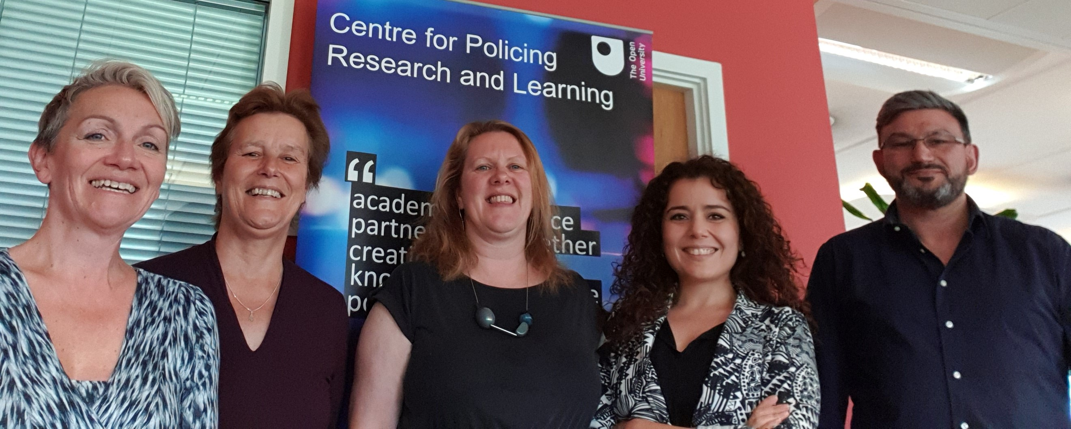
Centre for Policing
Research and Learning
The CPRL project team
Rachel Large – Senior Project Manager
Professor Jean Hartley - Academic Director of the Centre For Policing Research and Learning
Professor Denise Martin - Project Academic Director
Dr Loua Khalil - Research Fellow
Richard Harding - Research Fellow
Details of the Destination Map and the Tools, Techniques and Resources can be found at:
https://www.open.ac.uk/centres/policing/implementing-transformation-police-ld/outputs
Details of the Project can be found at:
https://www.open.ac.uk/centres/policing/implementing-transformation-police-ld

Slide 28
Centre for Policing
Research and Learning
What next?
Professor Jean Hartley
Academic Director of the Centre for Policing Research & Learning

Slide 29

Centre for Policing
Research and Learning
What surprises you and what resonates with you in this work?
How might the Destination Map help shape your vision for the future?
How could you use the TTR yourself?
How could you use the TTR to engage others?

