Slide 1
Front Cover Title 2
Transforming learning and wellbeing support for police officers who investigate Rape and Serious Sexual Offences (RASSO)
Dr Linda Maguire and Dr Emma Williams
The Centre for Policing Research and Learning, The Open University
Operation Soteria Bluestone – Pillar 4
Together for Transformation Conference, University of Suffolk, 24th May 2023

Slide 2
Theoretical framework: the six pillars
1. Suspect focused investigation
2. Repeat offenders
3. Procedural Justice approach to victim engagement
4. Learning, development and officer well-being
5. & 6. Data, digital forensics & performance
Pillar leads:
Dr Lovett and Dr May
Pillar lead:
Prof Horvath
Pillar lead:
Dr Davies
Pillar leads:
Dr Johnson/ Dr Smith
Pillar lead:
Dr Williams
Academic leads: Prof Stanko OBE and Dr Hohl
Bluestone is a team effort. Lead researchers: K Davies, K Hohl, M Horvath, K Johnson, J Lovett, O Smith, B Stanko and E Williams

Slide 3
Page Title 1
Overview
Sharing findings from Operation Soteria Bluestone, a Home Office funded project, to improve the investigation and outcomes in RASSO cases
Discuss the fundamental link between learning & development and officer wellbeing
Equipping officers with access to specialist training and wellbeing support - enabling organisational justice from the inside

Slide 4
Page Title 1
Background
A lack of organisational support has resulted in a loss of RASSO specialism, impacting on officers’ wellbeing and competency (Williams et al., 2022)
Specialism in policing can enhance investigations and the care for victim-survivors and officers (Dalton et al., 2022)
Higher levels of workplace burnout are associated with lower job satisfaction and a lack of organisational commitment (Lambert et al., 2018)
The burden of emotional responsibility has resulted in an increase in stress and burnout among RASSO officers (Maguire and Sondhi, 2022)

Slide 5
Quote Style 1
Interviews and Focus Groups
Self-resilience covering lack of organisational resilience
‘I refuse to go off sick because I didn't want my colleagues to pick up my work. My GP and the counsellor both continuously said to me, you need to go off sick. You need to do this. You need to do that. And I kept saying, I can't. The moment I do that, I am then affecting my colleagues and putting them under more pressure. And that's the problem. That's the position we were in. There wasn't a solution. And although we're not as bad as we were then, it's still the same premise.’

Slide 6
Quote Style 1
Interviews and Focus Groups
‘Toxic Coping’
‘I’ve had to put someone back together again, because I know I need them to come in tomorrow and I put them back together again because I need another day out of them and that makes me feel dirty and horrible […] it makes me cross because we’re not doing right for the public and we’re not doing right by the staff that work for us’

Slide 7
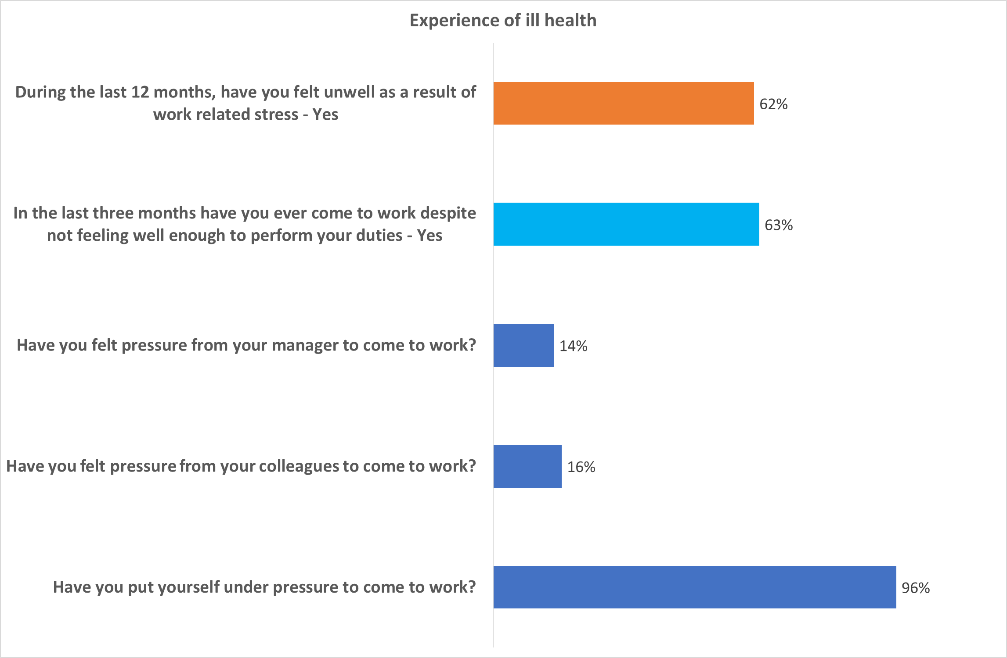
Quote Style 1

Slide 8
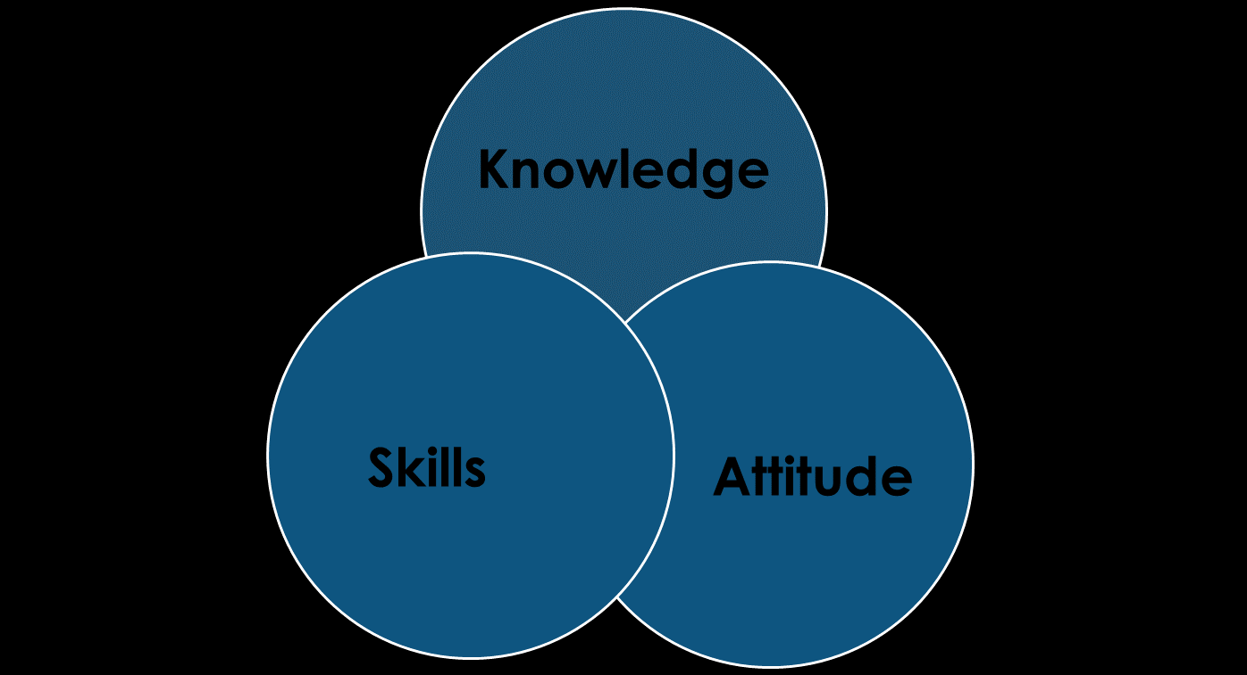
Quote Style 1
Things can change …
‘The next step was to give them protected time where we’d sit down and just talk through some of the issues for an hour and a half, two hours, which was doable in the short term. So, we could do that straight away’ [Strategic Lead]
‘It was mentioned around that correlation, which I think is dead right, around if we can give people the right training in CPD, it’s got a massive benefit for wellbeing as well, because they feel that they’re equipped to do their job’ [Strategic Lead]
‘It was really, really clear for me that Pillar 4 was going to be our priority in terms of the current staffing, health, wellbeing issues that had been flagged... If I haven't got a workforce that are healthy, engaged, focused, productive when they're at work, how am I going to deliver anything else?’ [Strategic Lead]

Slide 9
Page Title 1
References
Dalton, C., Barrett, S., Horvath, M., and Davies, K., 2022. A systematic literature review of specialist policing of rape and serious sexual offences. International Criminology. Available at: https://doi.org/10.1007/s43576-022-00062-1 [Accessed: 07.04.23].
Lambert, E. G., Qureshi, H., Frank, J., Klahm, C., & Smith, B. (2018). Job Stress, Job Involvement, Job Satisfaction, and Organizational Commitment and Their Associations with Job Burnout Among Indian Police Officers. Journal of Police and Criminal Psychology, 33(2), 85–99.
Maguire, L., and Sondhi, A., 2022 [online]. Stress-related psychosocial factors among police officers working on Rape and Serious Sexual (RASSO) cases in one Police Force Area in England: a mixed methods study. The Police Journal: Theory, Practice and Principles. Available at: https://journals.sagepub.com/doi/10.1177/0032258X221128398 [Accessed: 11.04.23].
Williams, E., Norman., J., Ward., R., and Harding, R., 2022 [online]. Linking professionalism, learning and wellbeing in the context of rape investigation: early findings from Project Bluestone. Available at: https://doi.org/10.1007/s43576-022-00059-w [Accessed: 07.04.23].

Slide 10
Thank you for listening. Any questions?

