Slide 1
“People tell me I'm very odd all the time”: Proposing a theoretical framework for the study of autism, knowledge, and power
Hannah Ebben
Autism Centre
Sheffield Hallam University
© Hannah Ebben, 2017. Please do not cite without permission.

Slide 2
How do I practice ‘Critical Autism Studies’?
Social justice approach
Critical Ableism Studies (Kumari Campbell, 2008)
Mapping the genealogy of autism/ableism: the traces of the past in the present concerning power imbalance
© Hannah Ebben, 2017. Please do not cite without permission.

Slide 3
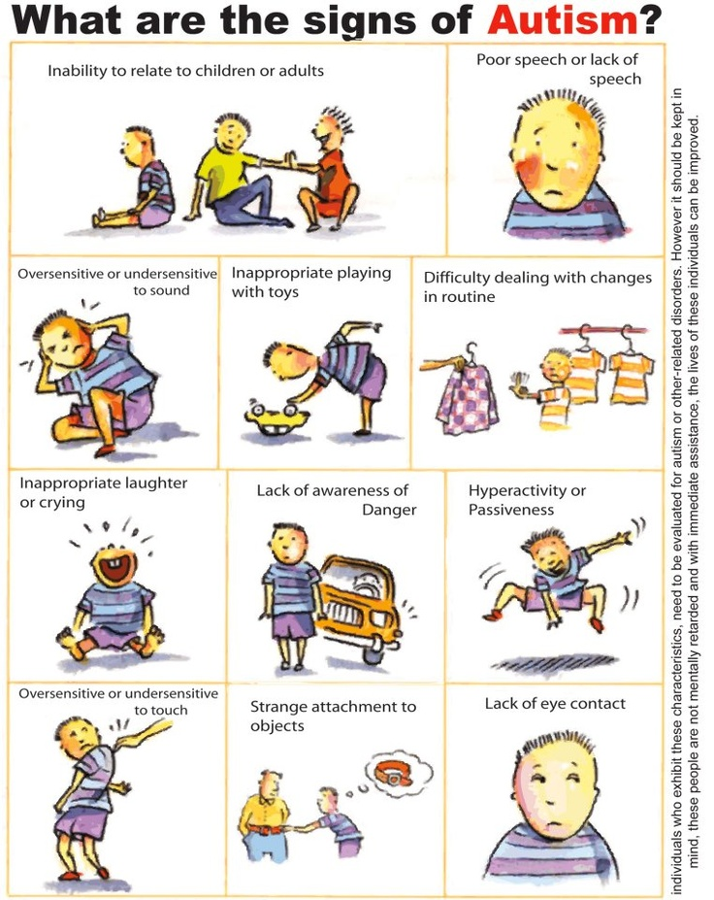
The social production of a “war on autism”
Anne McGuire (2011): how to think about the normative gaze as a militant discipline of a readiness for intervention
research on autism ‘red flag’ posters to ‘learn’ the ‘warning signs’ of autism
© Hannah Ebben, 2017. Please do not cite without permission.

Slide 4
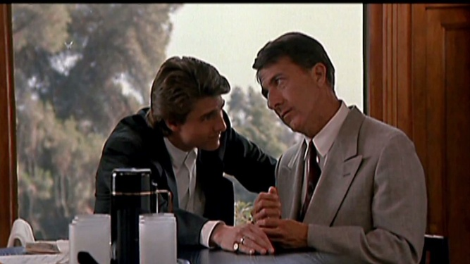
The gaze
Feminist film criticism (Mulvey, 1999; De Laurentis, 1984)
Desire to know, recognise, intervene
Practice of looking (Sturken and Cartwright, 2009) → not a mimetic approach to autism as evident in Murray (2008)
© Hannah Ebben, 2017. Please do not cite without permission.

Slide 5
In/visibility and the autism ‘sign’: Piercian semiotics
Semiotics: study of signs
Three ways in which a sign refers to an object: icon, index, symbol
Applying this to disability: offers expectation of indices
→ no visual signs? Compensating strategies
Index:
Smoke → Fire
Sneeze → Cold or Flu
Disability → ???
“I don’t see you as disabled”
© Hannah Ebben, 2017. Please do not cite without permission.

Slide 6
Case study: Extremely Loud and Incredibly Close (Daldry, 2011)
“People tell me I am very odd all the time. I was tested once to see if I had Asperger’s disease [sic]. Dad said it's for people who are smarter than everybody else but can't run straight. Results weren't definitive”
Trauma or autism?
© Hannah Ebben, 2017. Please do not cite without permission.

Slide 7
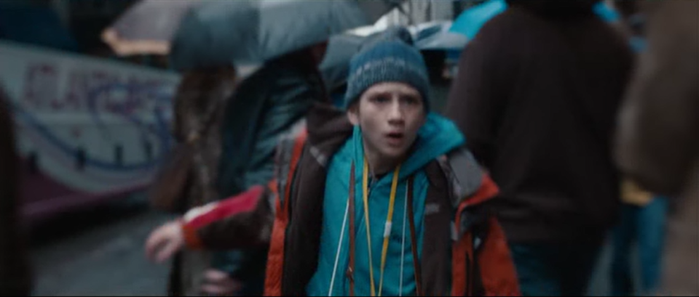
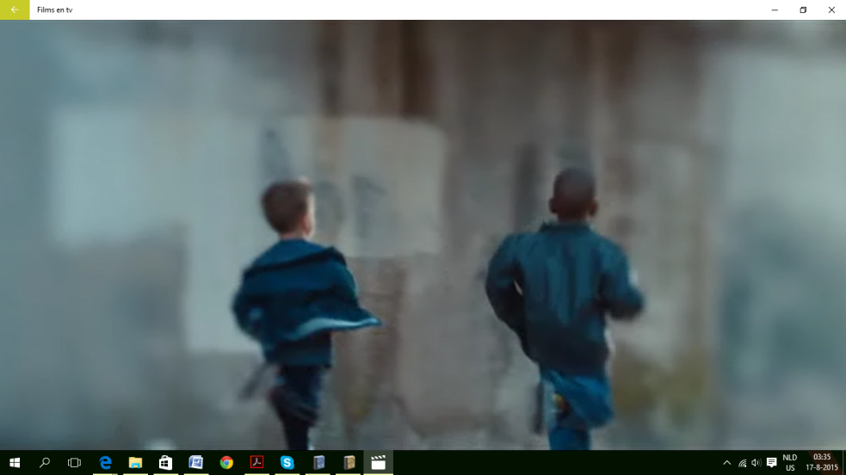
‘Warning signs’ of sensory overload or trauma triggers?
© Hannah Ebben, 2017. Please do not cite without permission.

Slide 8
Some thoughts to conclude with
Expanding work that has already been done, sustaining a field of Critical Autism Studies
Be cautious with supposed nuanced representations! The concept of autism gets reified and organised around senses of doubt!
© Hannah Ebben, 2017. Please do not cite without permission.

Slide 9
List of references
Extremely Loud & Incredibly Close. Daldry, S. (2011) USA: Scott Rudin Productions.
De Laurentis, T. (1984) Alice Doesn’t. Feminism, Semiotics, Cinema. Bloomington: Indiana University Press.
Kumari Campbell, F. (2008) “Exploring internalised ableism using critical race theory”, in: Disability and Society, vol. 23, no. 2: 151-162.
McGuire, A. (2011) “The War on Autism: On Normative Violence and the Cultural Production of Autism Advocacy.” Doctor of Philosophy Thesis, University of Toronto.
Mulvey, L. (1999) “Visual Pleasure and Narrative Cinema”, in: Film Theory and Criticism: Introductory Readings. L. Braudy and M. Cohen (eds.). New York University Press: 833-844.
Murray, S. Representing Autism: Culture, Narrative, Fascination. Liverpool University Press, 2008.
Peirce, C. S. (1955) “Logic As Semiotic: The Theory of Signs”, in: Philosophical Writings of Peirce, J. Buchler (ed.). New York City: Dover Publications: 98-119.
Sturken, M. and L. Cartwright. (2009) Practices of Looking. An Introduction to Visual Culture. Second Edition. Oxford: Oxford University Press.

