Slide 1

Building Bridges Research Group
Social History of Learning Disability
Tuesday 15th July 2014
Notes:
Maxine

Slide 2
Who are we?
We are 12 people with a learning disability who do not get support from learning disability services.
We are all unemployed
We all live in the Black Country
We have lots of shared experiences
But we all support different football teams!
Notes:
Satnam

Slide 3

Our research project
Our lives, Our Research, Small things that make a big difference.
One year project about our lives.
We made a film, a report and some leaflets
Notes:
Satnam

Slide 4
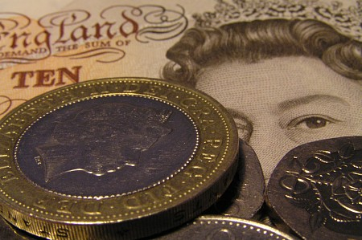
Today we are going to talk about parts of our research project
Money
Easy read information
Bedroom tax
Being a parent
Church
Notes:
Glenn

Slide 5
Having a voice
The research group gives us a chance to have a voice and say what we think is important
Notes:
Kevin

Slide 6
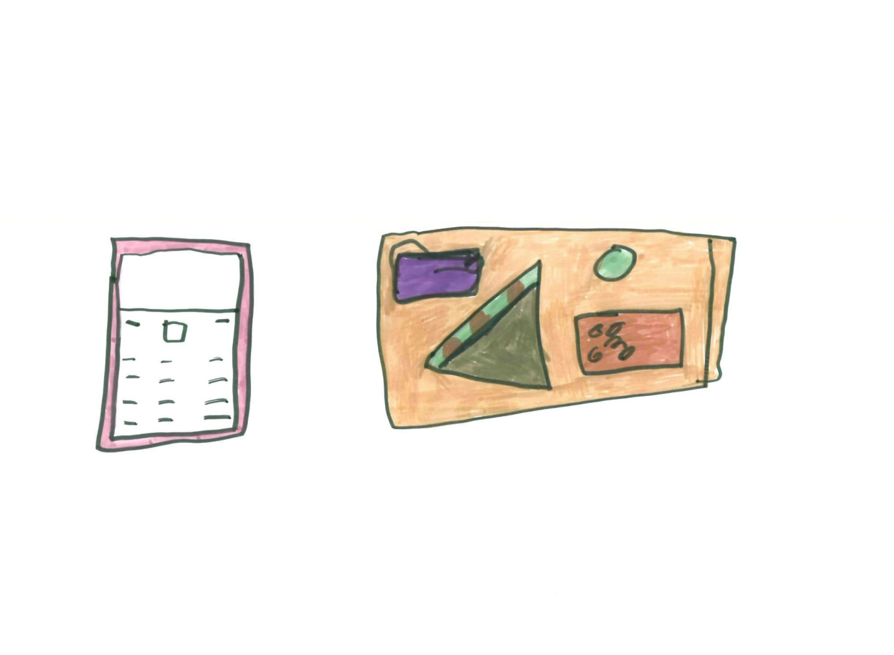
About our research group meetings
Notes:
Samantha

Slide 7

What do our traffic light cards mean?
Stop! e.g. I want to ask a ?
I don’t understand
Warning! e.g. don’t all talk at a time
too much jargon
O.K! e.g. you can carry on - its
OK now
Notes:
Glenn

Slide 8
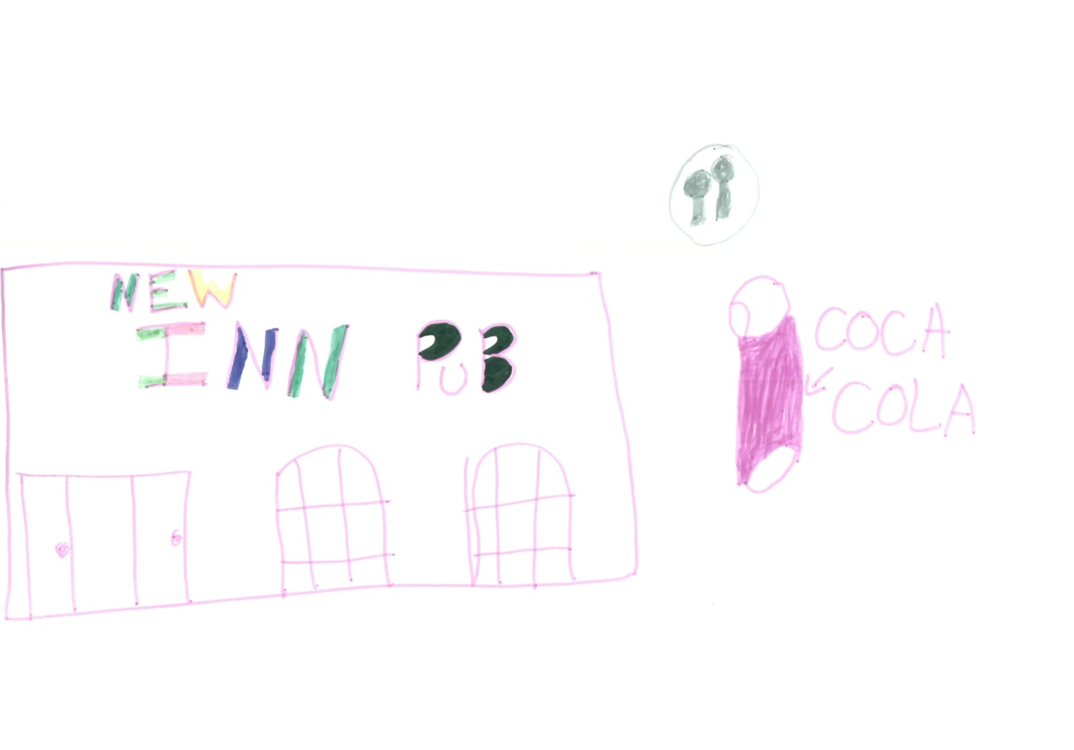
Where we meet
Notes:
Maxine

Slide 9
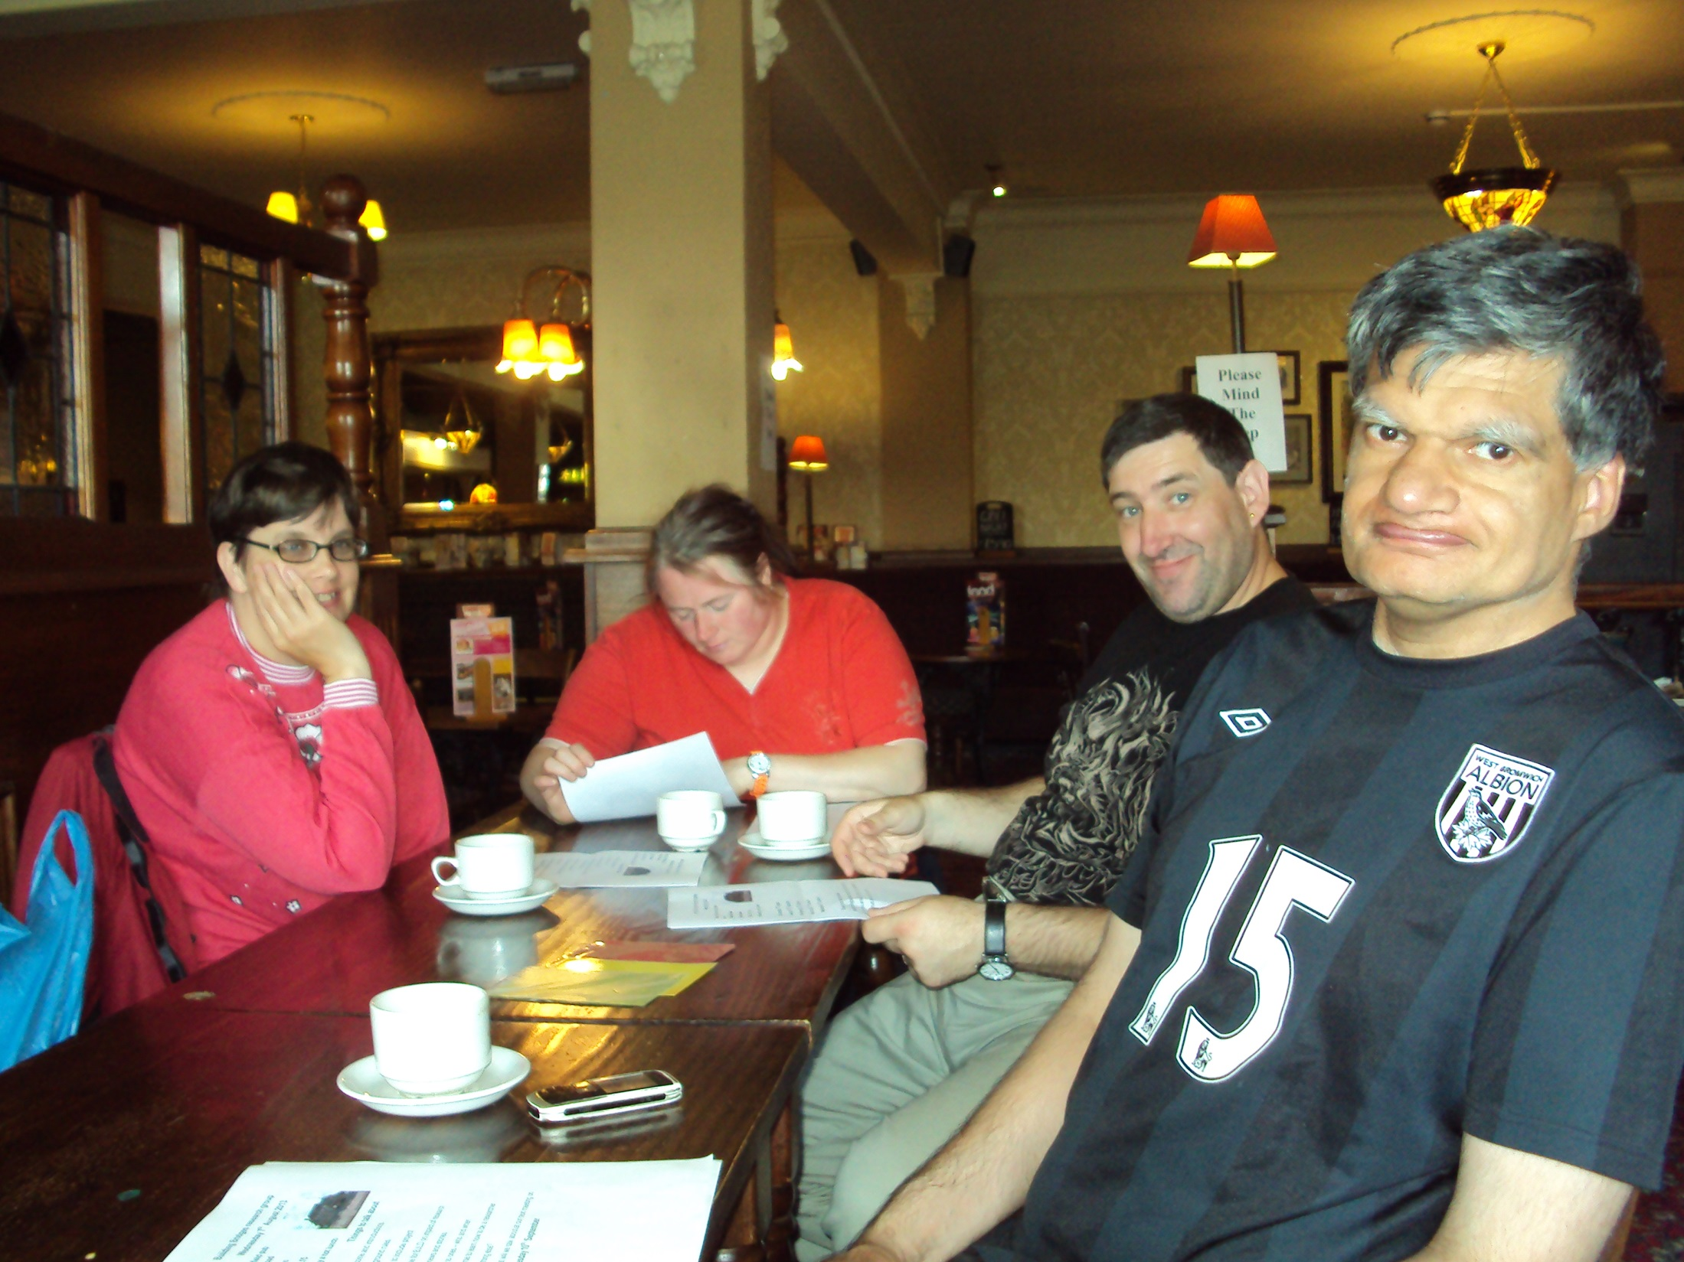
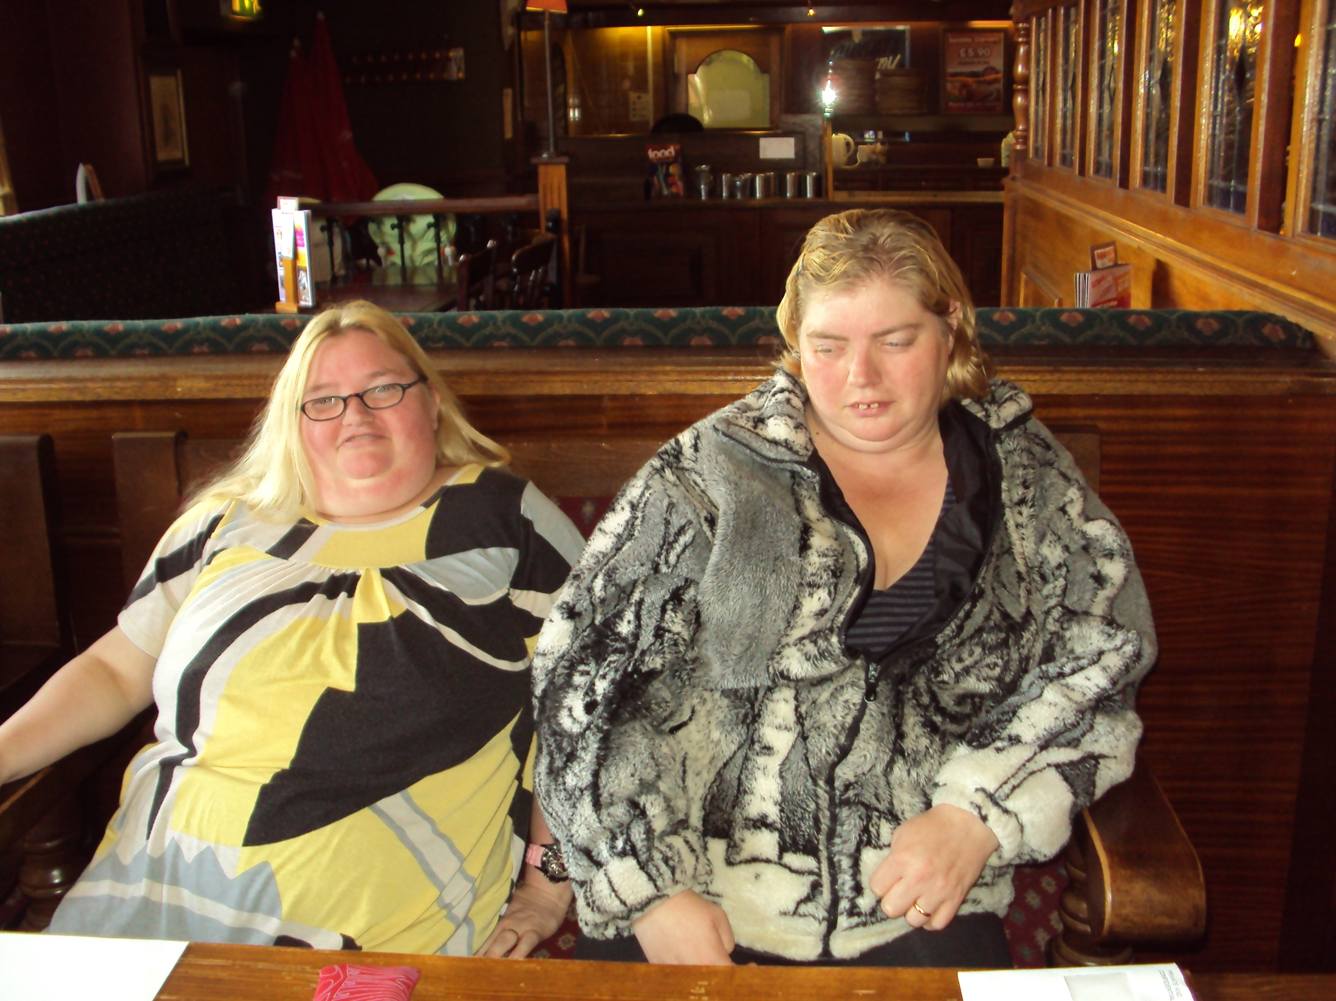
Notes:
Sam

Slide 10
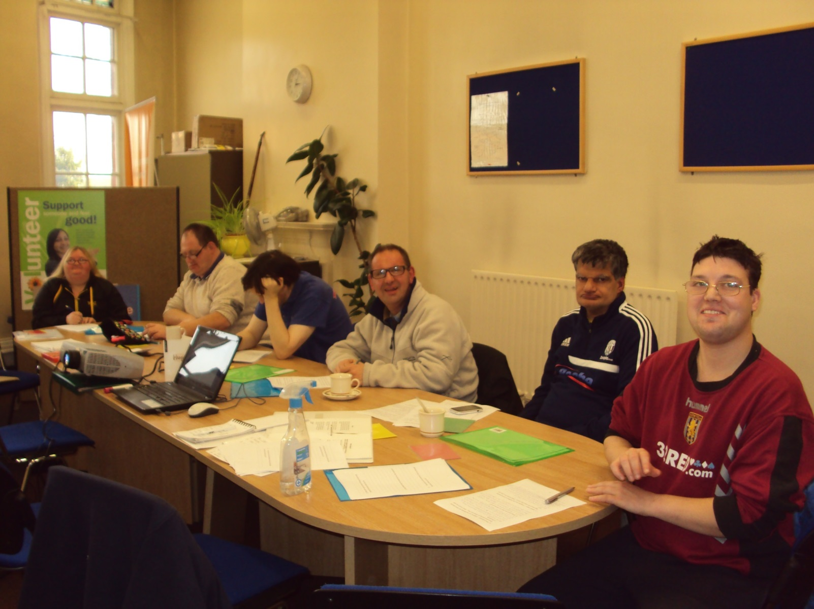
Research course

Slide 11
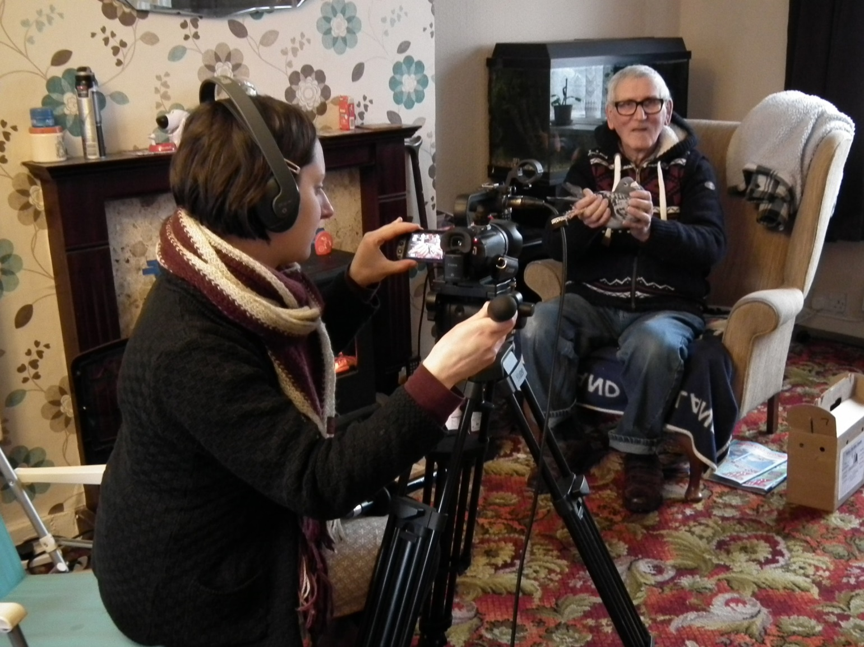
Making our film
Notes:
Kevin

Slide 12
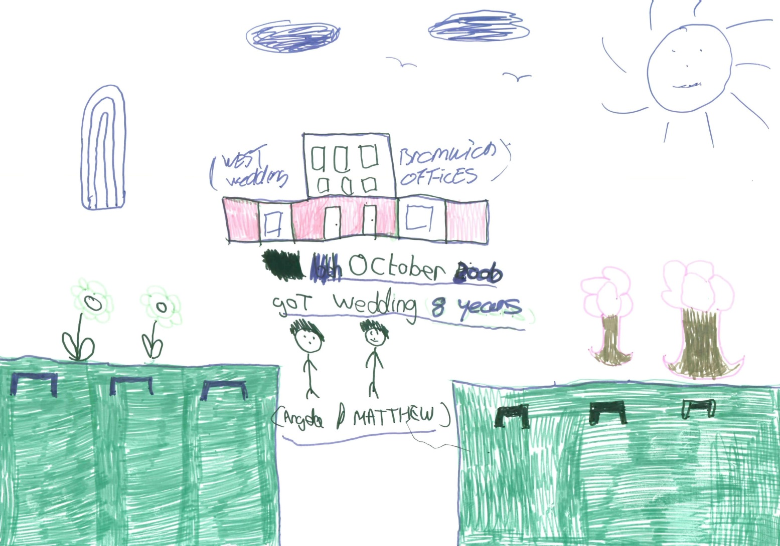
We talked about the importance of family
Notes:
Angela

Slide 13
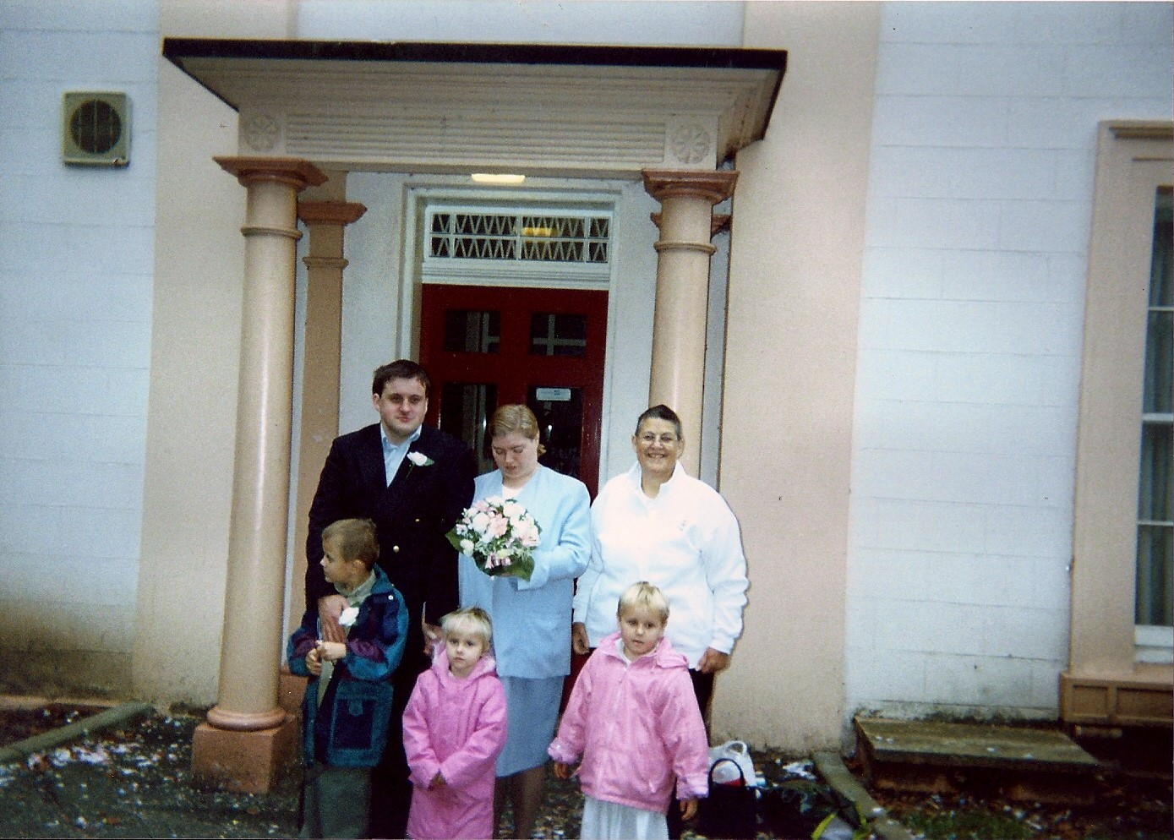
Notes:
My wedding

Slide 14
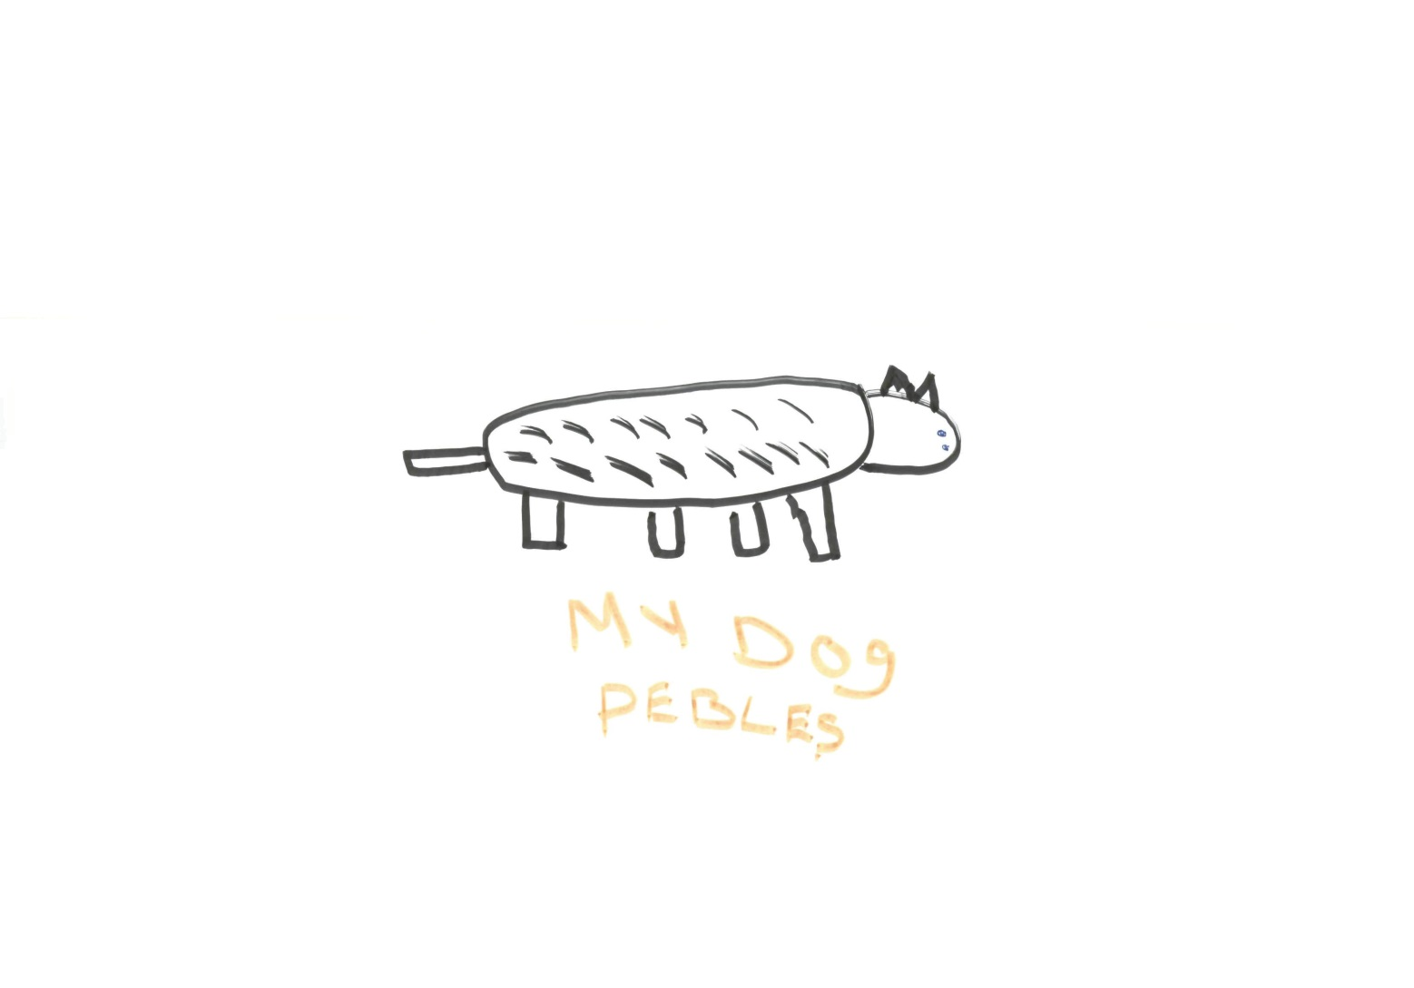
We all have pets and look after them well
Notes:
Kevin

Slide 15
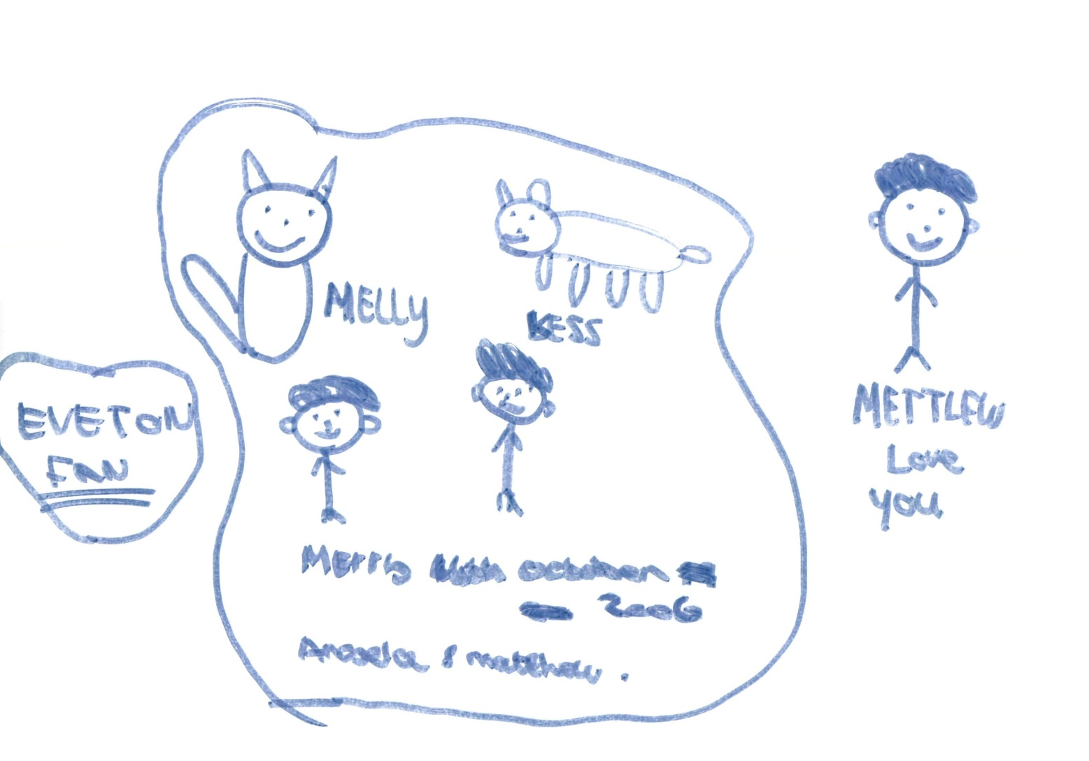
They are part of the family
Notes:
Angela

Slide 16
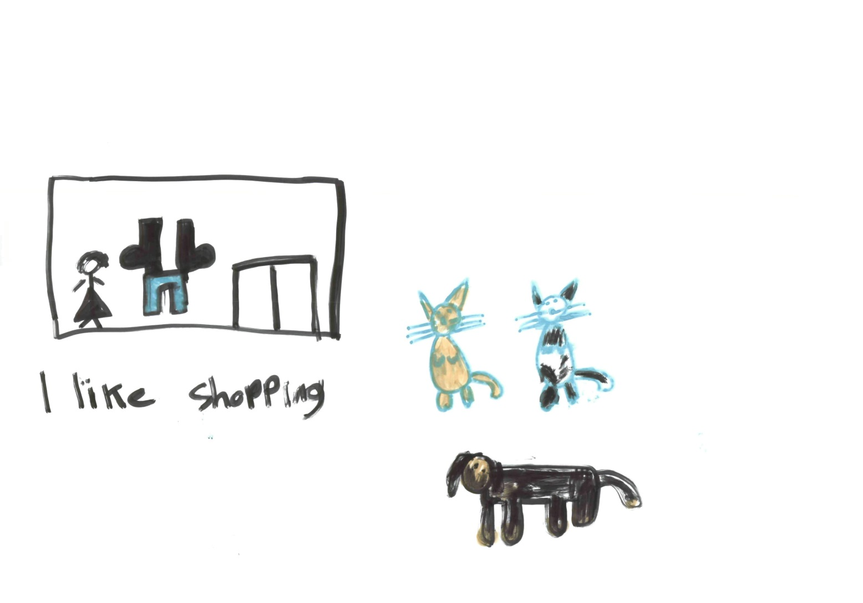
Notes:
Samantha

Slide 17
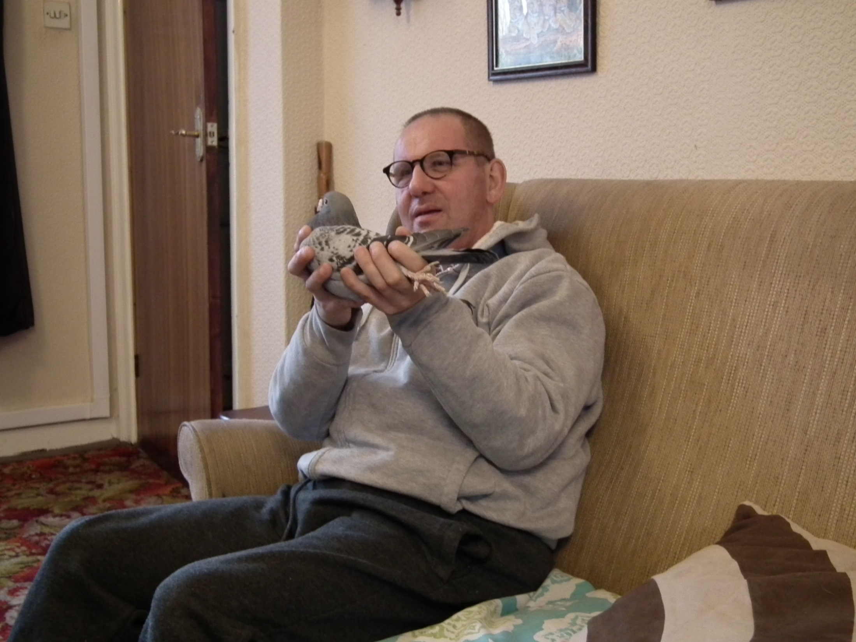
Notes:
Kevin

Slide 18
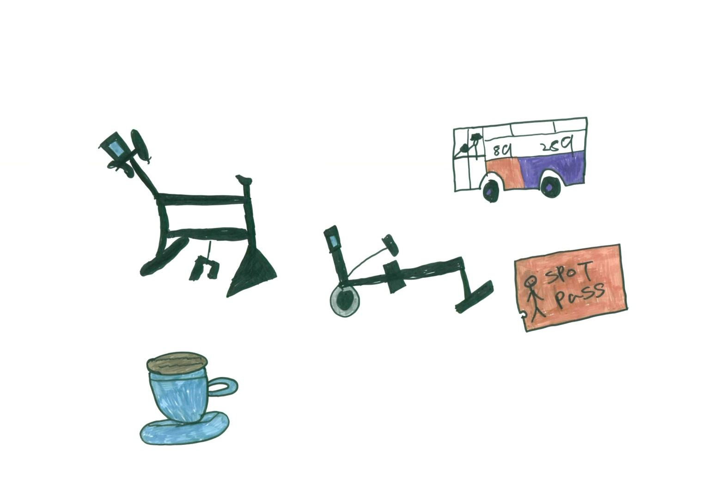
Free facilities in the community are important
Notes:
Sam

Slide 19
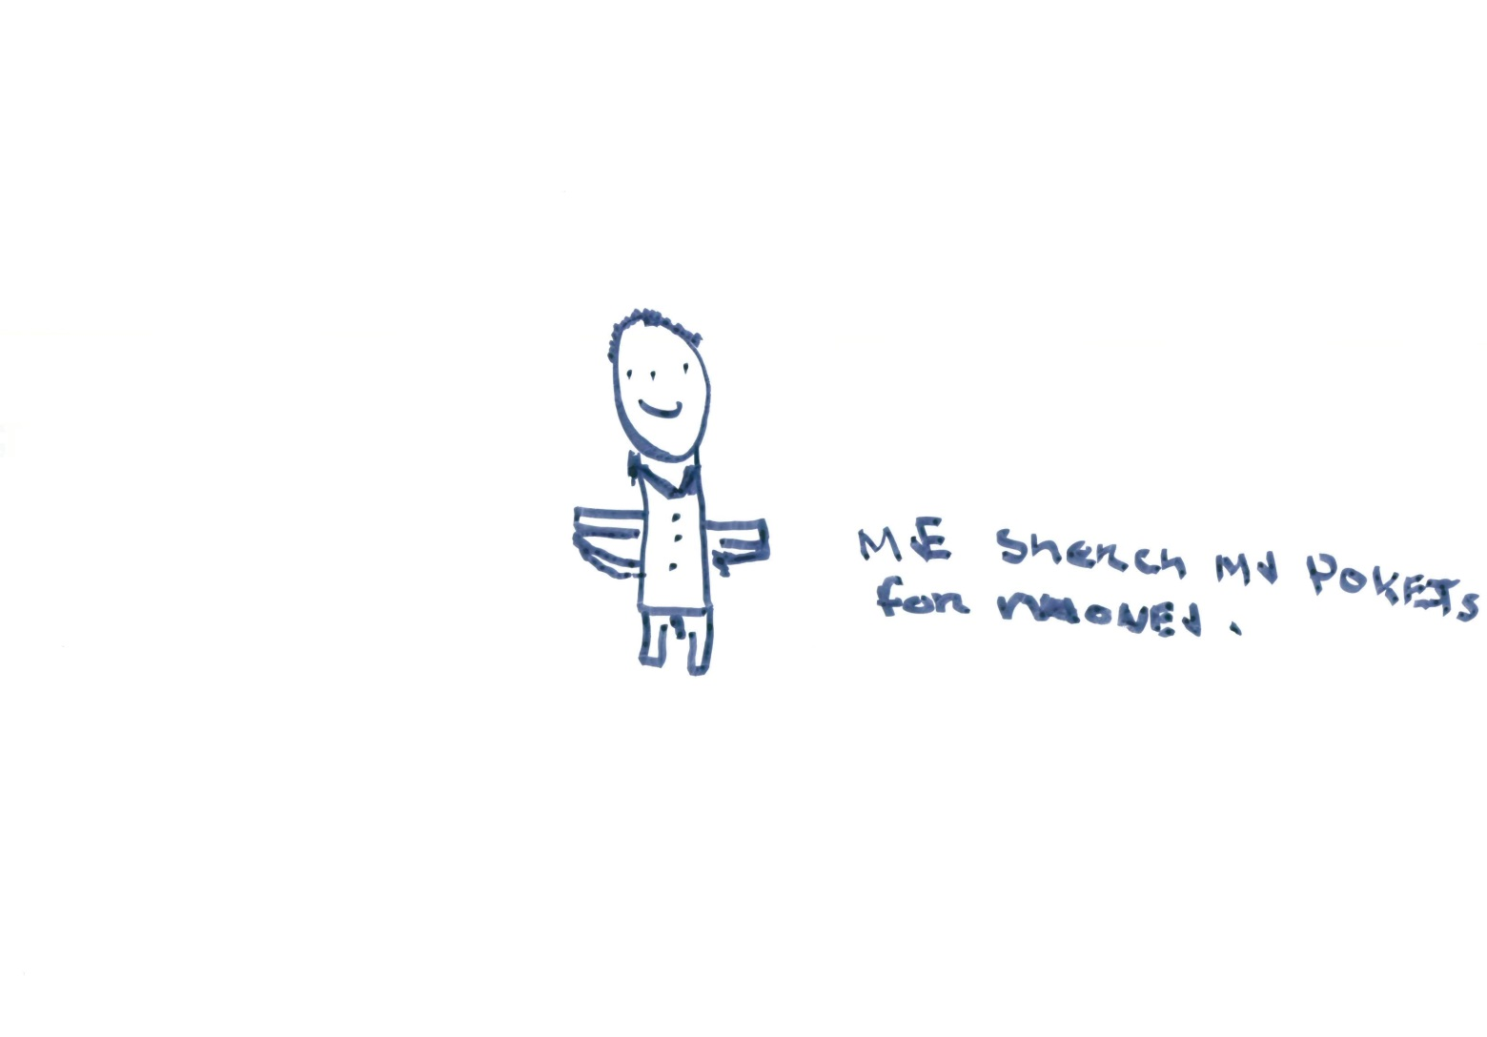
Having a free bus pass is important
Notes:
Kevin

Slide 20
DVD – Concessionary bus pass

Slide 21
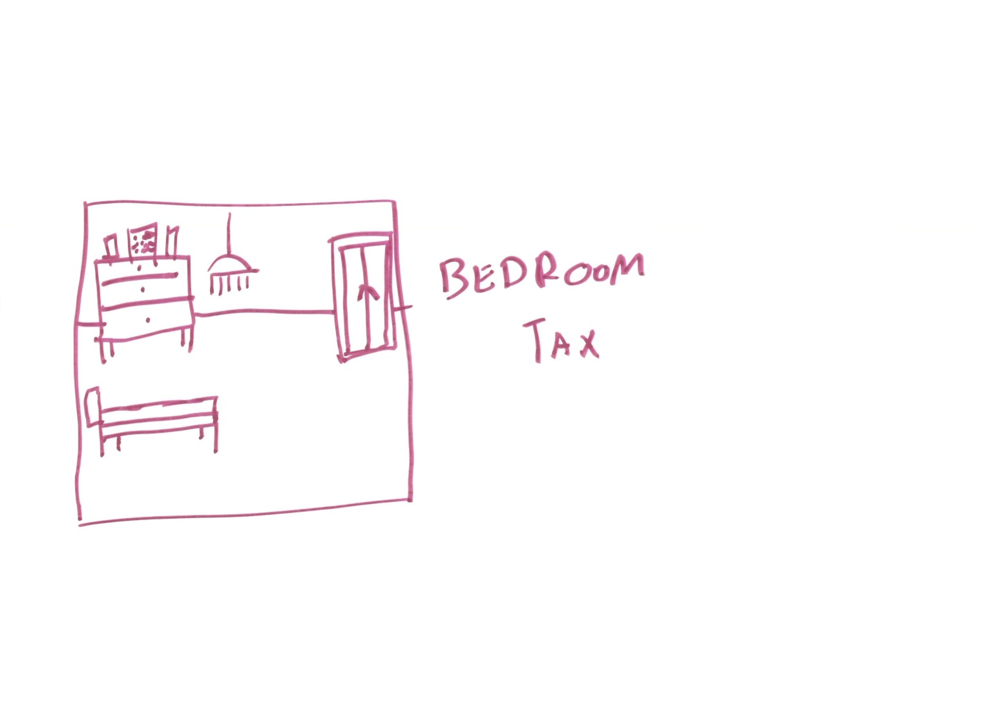
The bedroom tax!
Notes:
Maxine and Chrissie

Slide 22
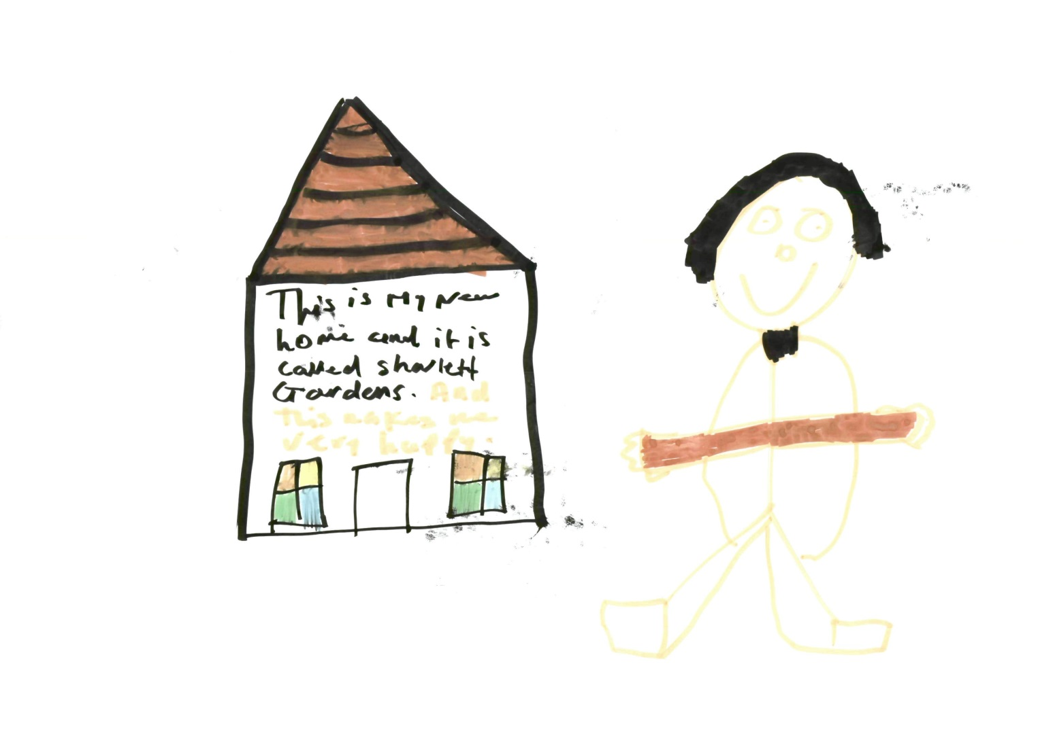
Notes:
Paul

Slide 23
DVD – The bedroom tax

Slide 24

We have a lot of problems with Jobcentre Plus
Notes:
Glenn

Slide 25
Why do they keep making us look for jobs when there ain't jobs out there for people like us
Notes:
Satnam

Slide 26
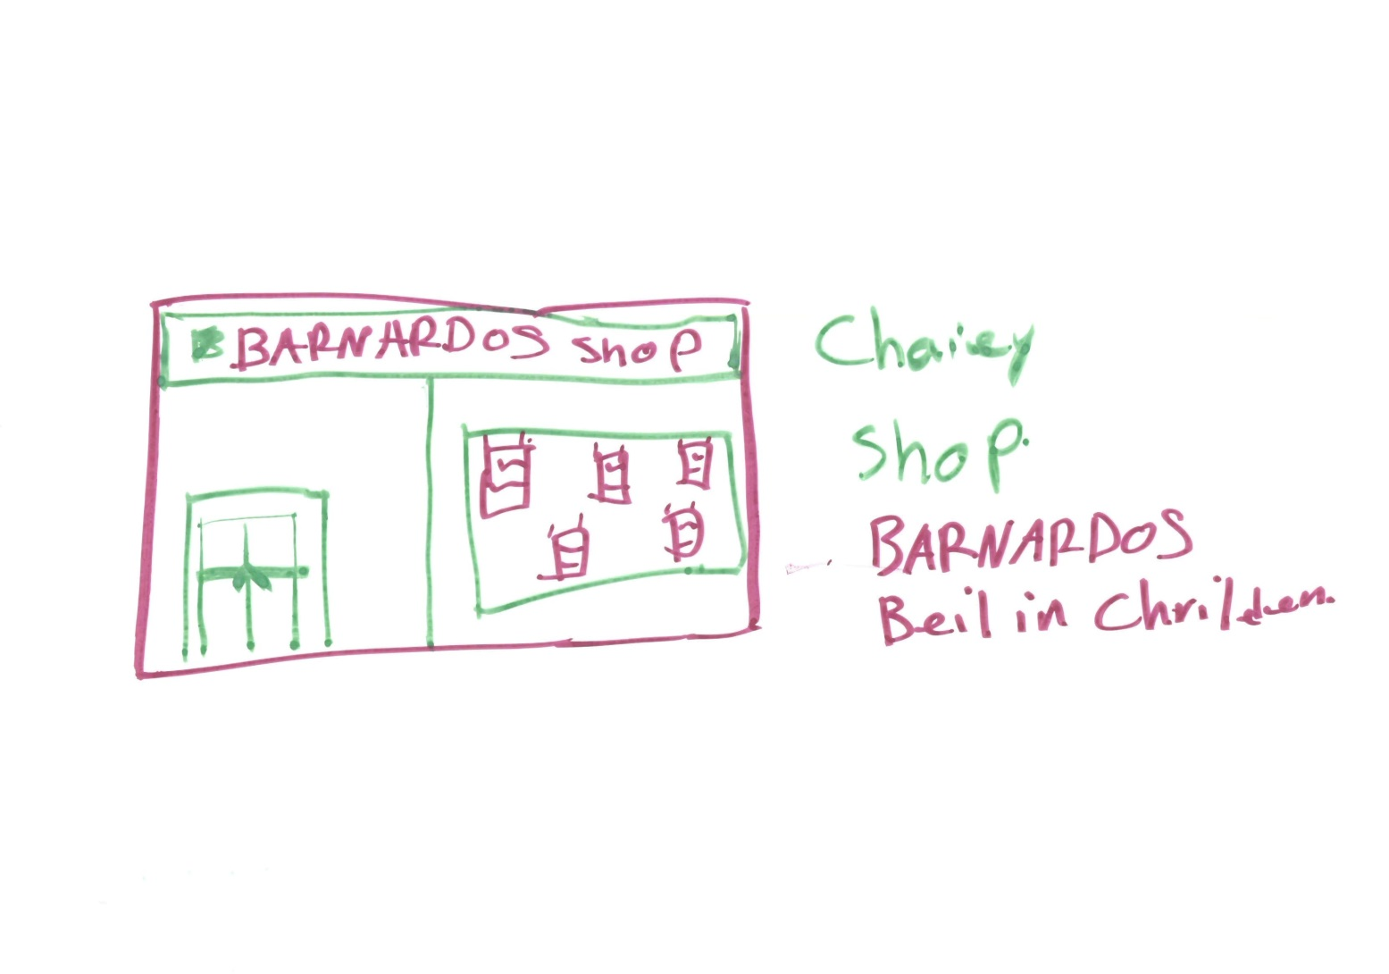
We have to prove we are looking for work
Notes:
Glenn

Slide 27

This is hard if we can’t use a computer
Notes:
Maxine

Slide 28

And if you have no phone credit
Notes:
Glenn

Slide 29
DVD – Jobcentre Plus

Slide 30
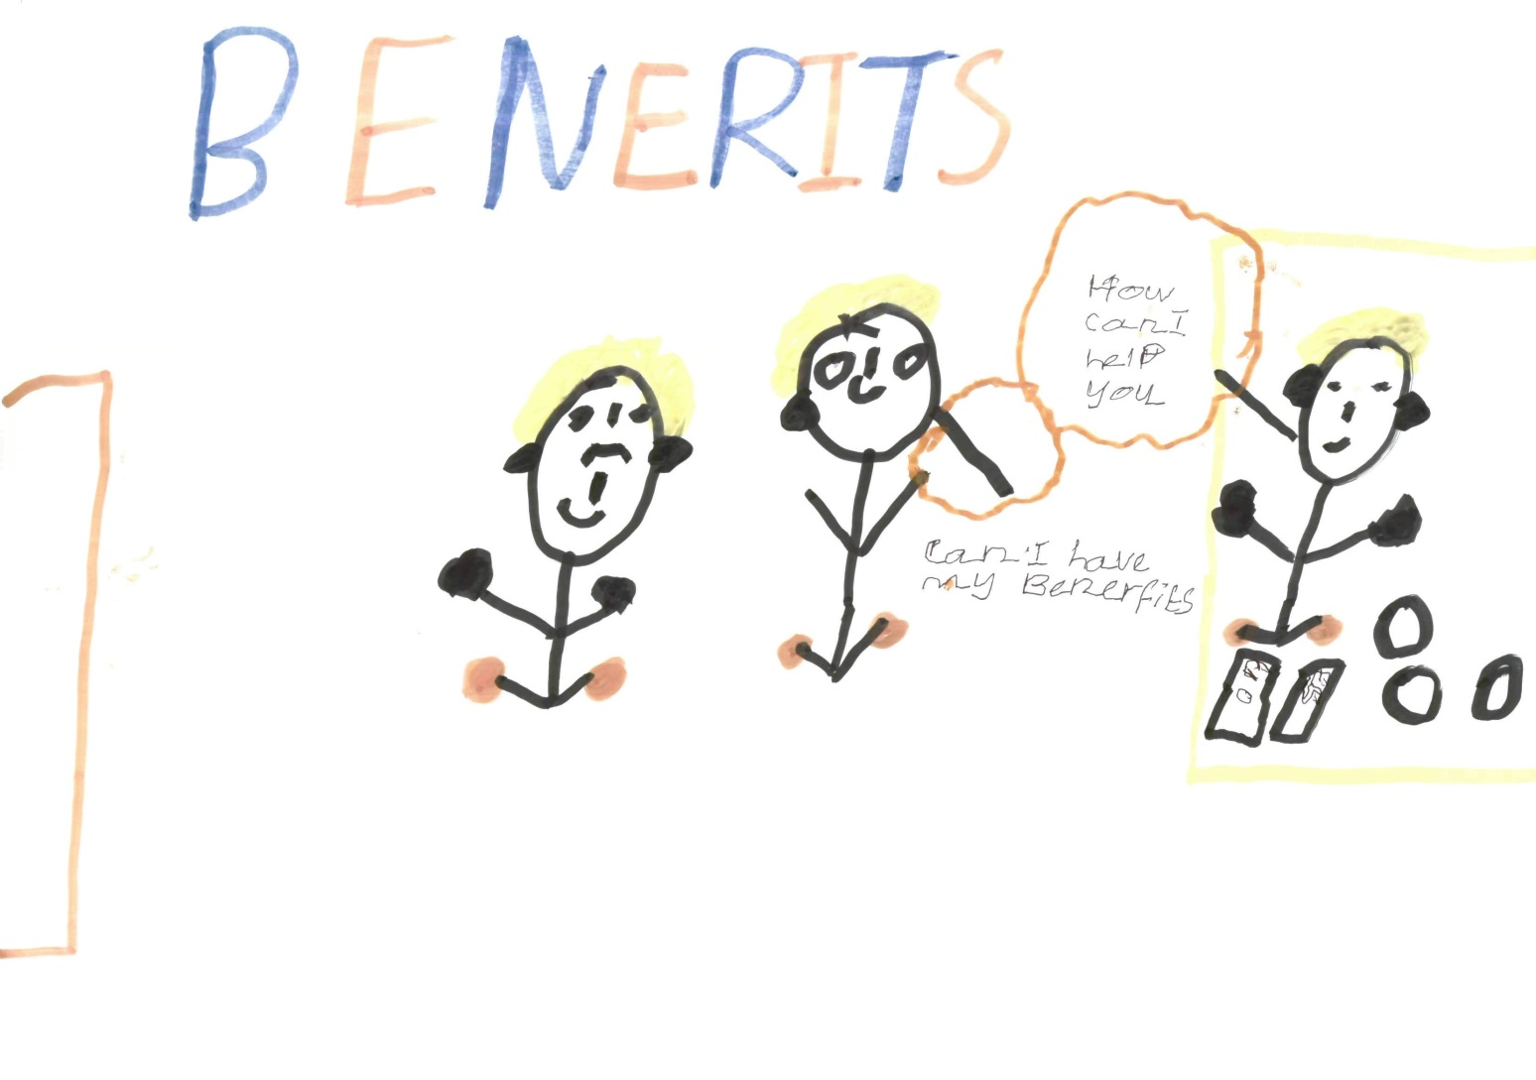
We all struggle to live on benefits
Notes:
Maxine

Slide 31
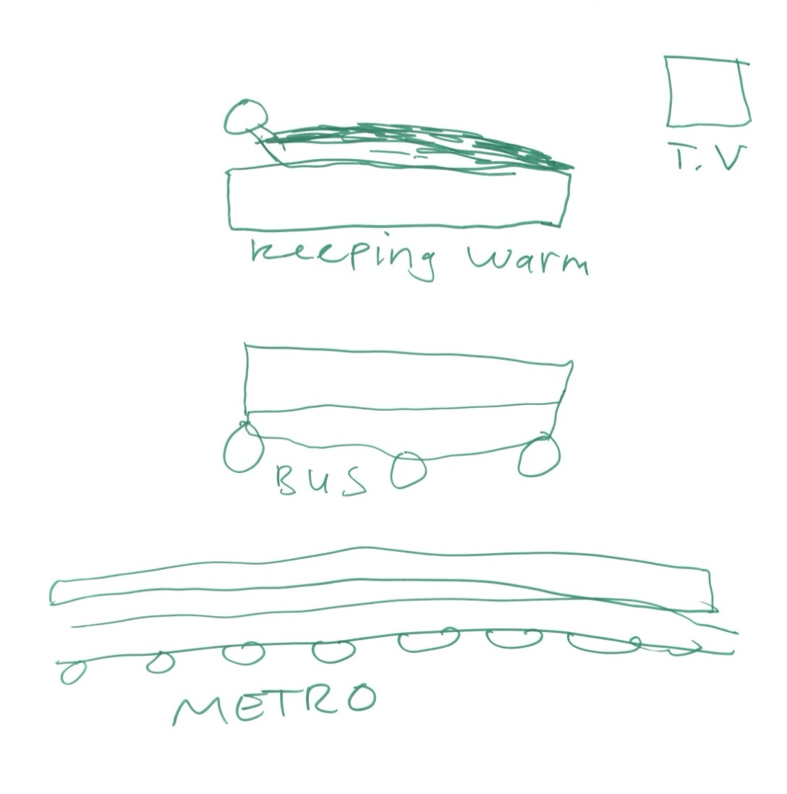
I have to watch the TV wrapped in a blanket
Notes:
Satnam

Slide 32
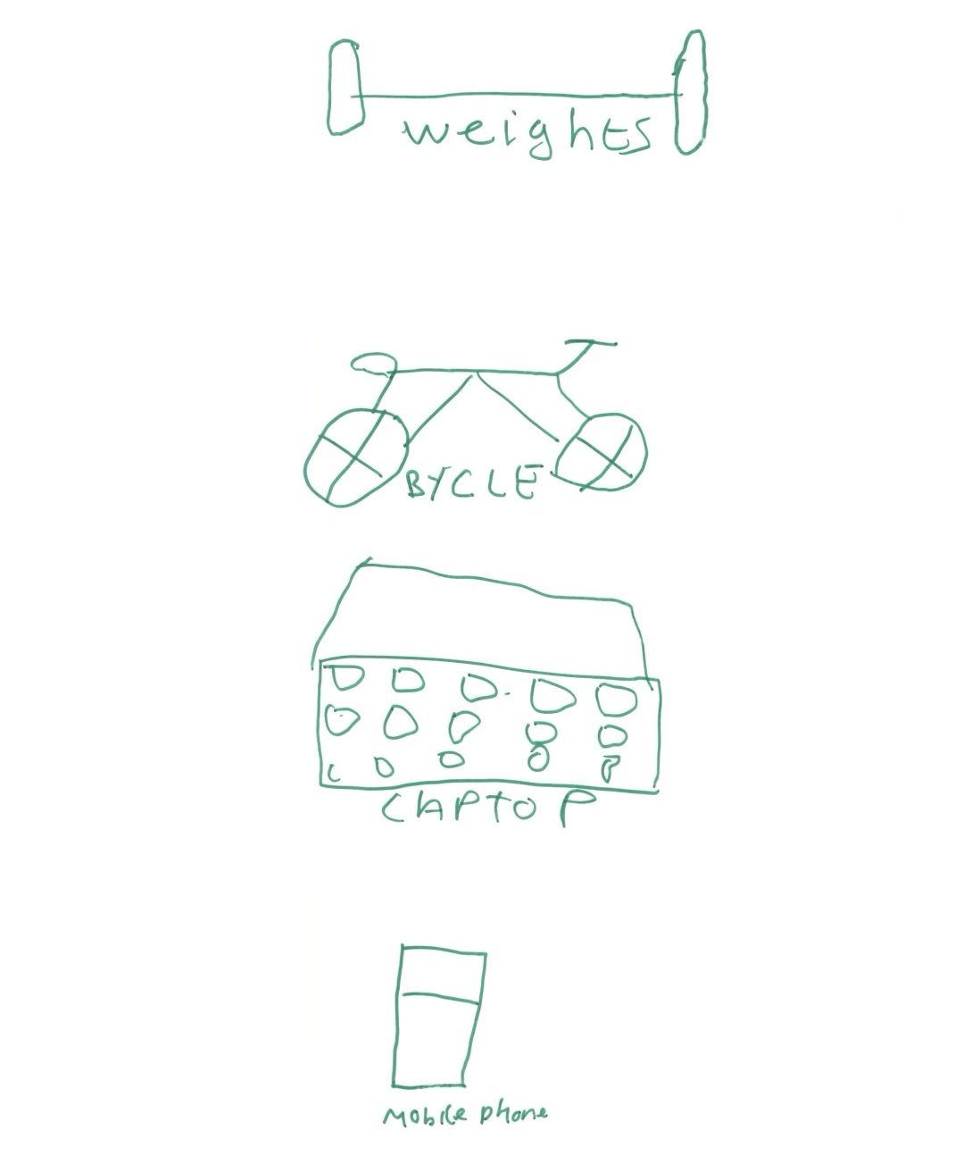
Managing on a low income

Slide 33

Replacing white goods is hard
We have to wash by hand
Notes:
Maxine and Matthew

Slide 34
DVD – Managing my Money

Slide 35
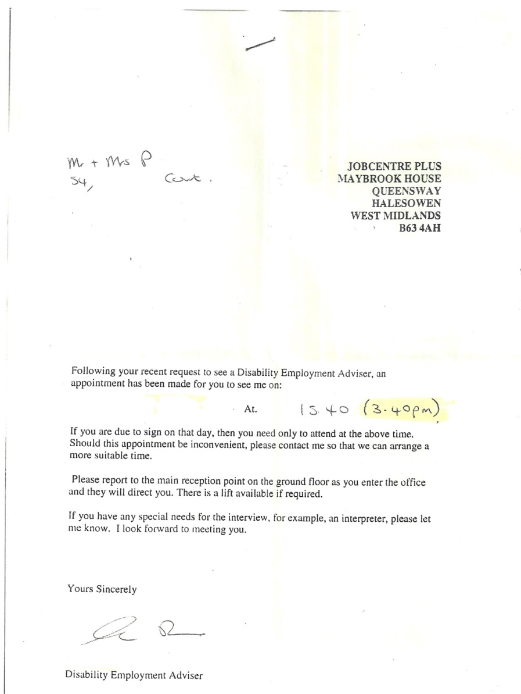
We get too many letters we can’t read
Notes:
Glenn

Slide 36

We get too many forms to fill in!
Notes:
Sam

Slide 37
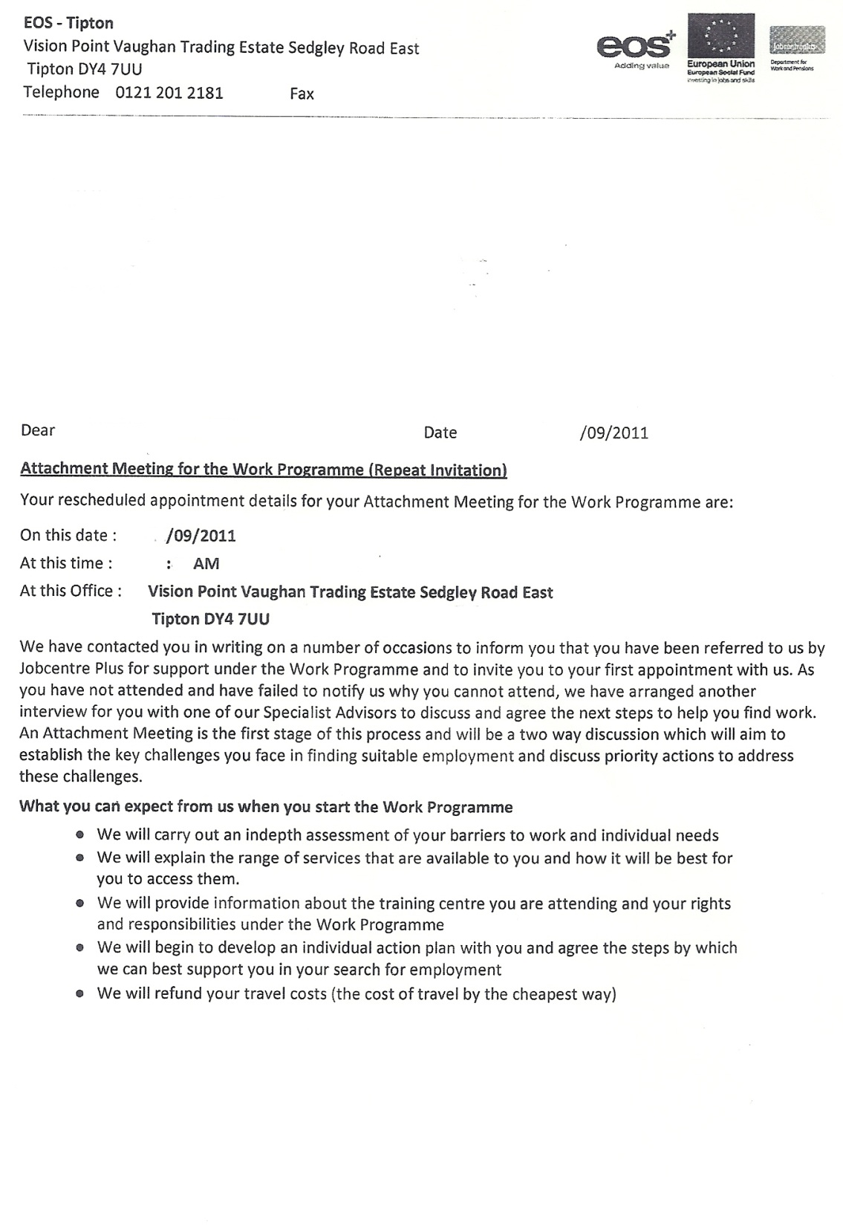
Notes:
Matthew

Slide 38
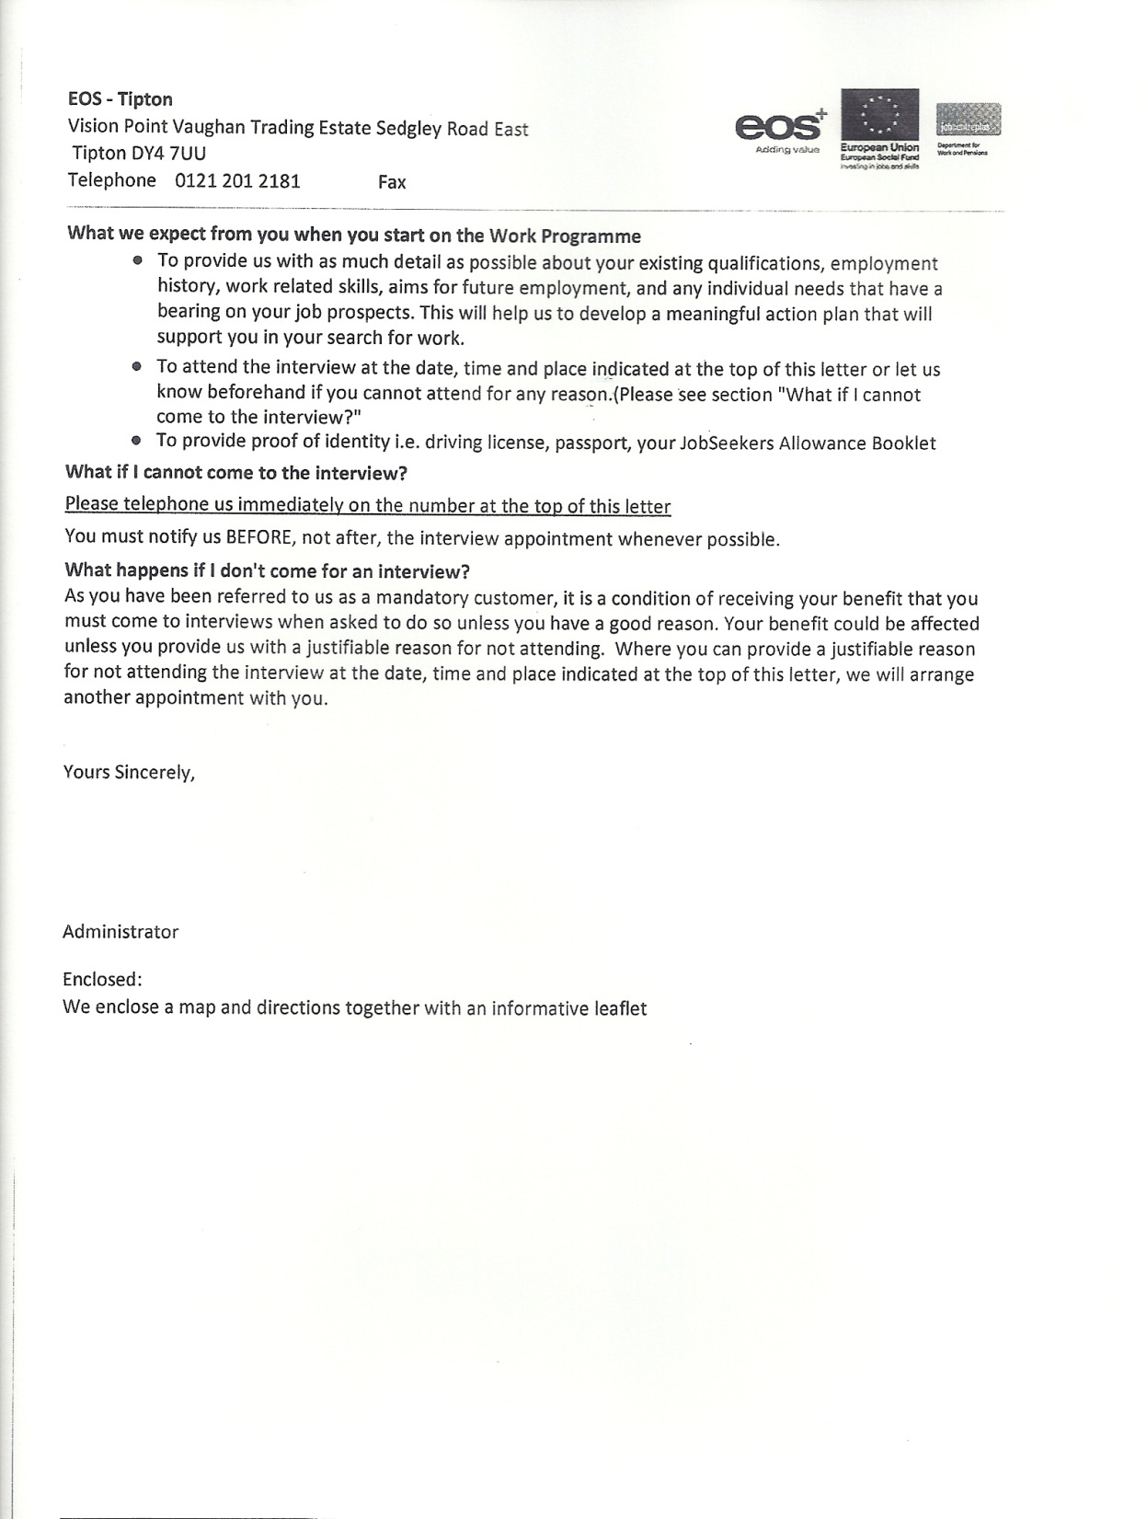
Notes:
Matthew

Slide 39
We should be given easy read information
Notes:
Kevin

Slide 40
DVD – easy read information

Slide 41
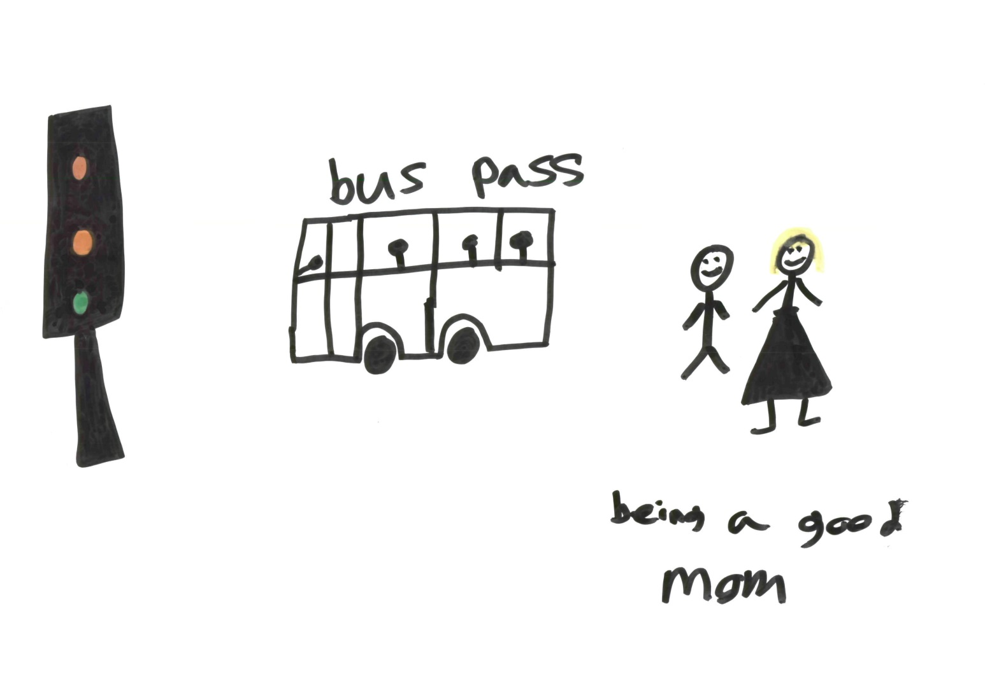
Other things we did research about
Notes:
Samantha

Slide 42
Research report and film
We are going to put the film on the internet
Please let us know if you would like an electronic or a real copy of the report
Notes:
Satnam

Slide 43
Any questions?

Slide 44
What next for Building Bridges Training
New website – same address – www.building-bridges-training.org
Lots of courses for people with a learning disability
Able to Include – smart phone project
The research group is continuing

Slide 45
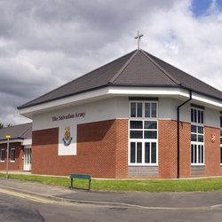

Training event on producing easy read
Wednesday 30th July 2014
10am to 12.30pm
£40 including lunch and a copy of Building Bridges Training’s Guide to Producing Easy Read Information to take away and use

Slide 46
Thank you for coming
Good bye and safe journey home

