Slide 1
Ethical issues and inclusive research
Dr Liz Tilly
18.6.15 SHLD Conference

Slide 2
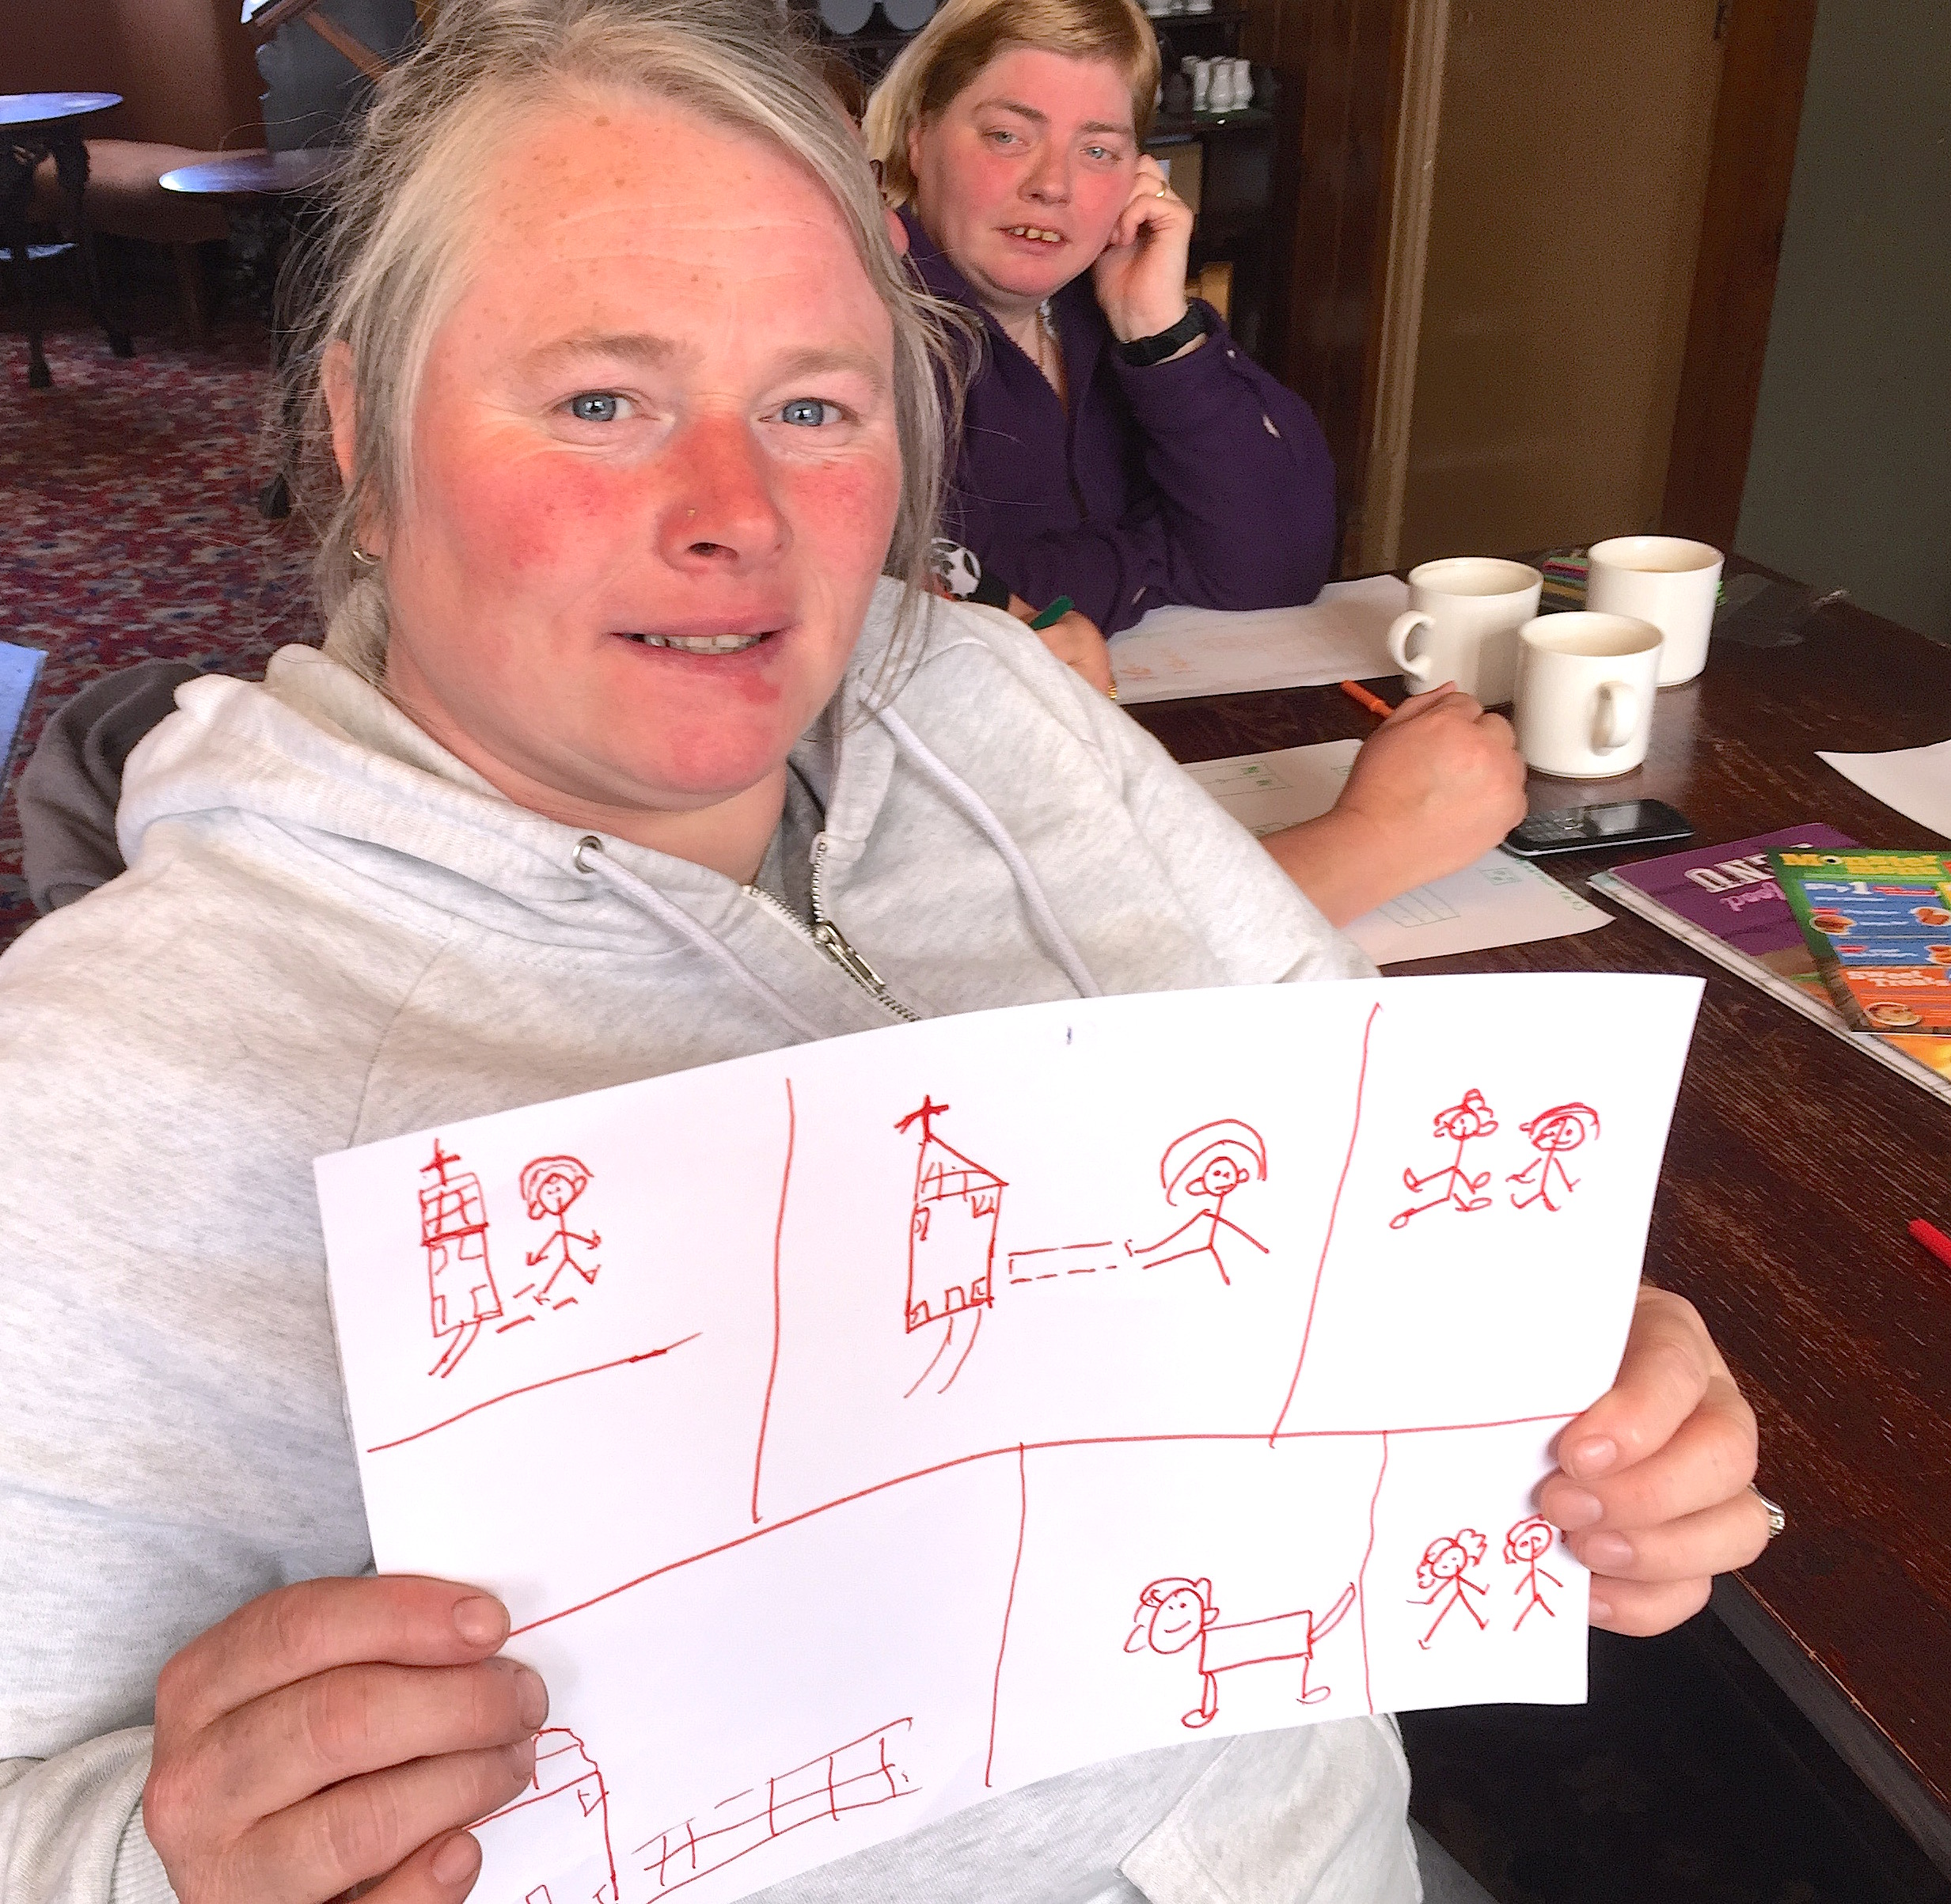
Anonymity
How do we balance the tension between protecting identities and letting people be proud of who they are and their story?
What about consent and capacity?

Slide 3
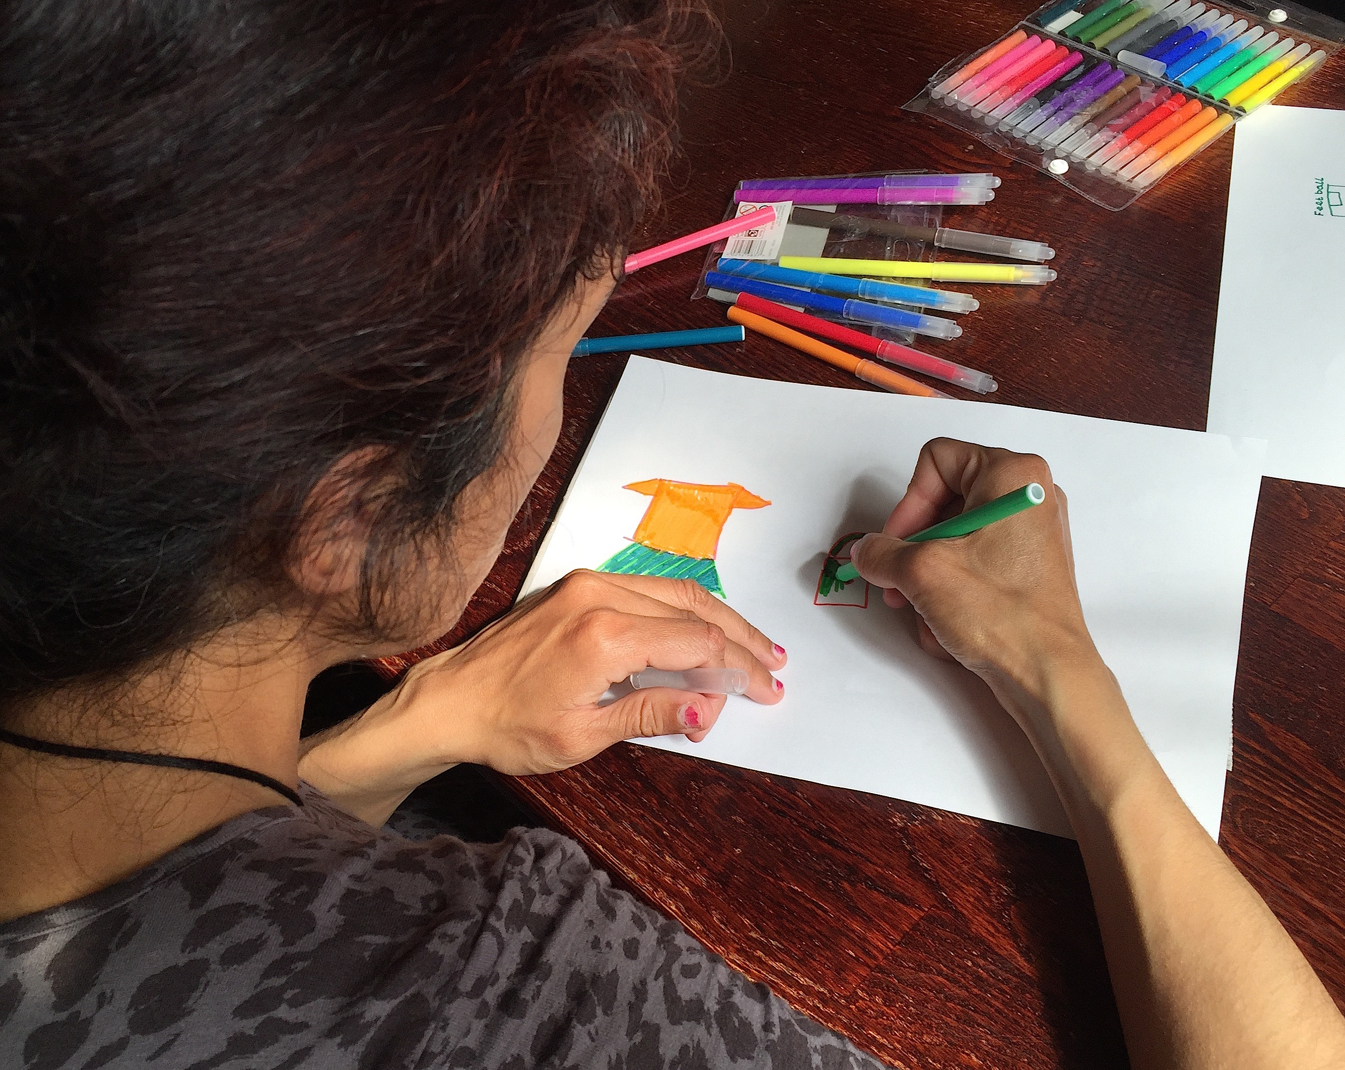
If dissemination is a key part of inclusive research
How can we enable people with a learning disability to
Present
Contribute to writing articles
Be part of campaigning

Slide 4
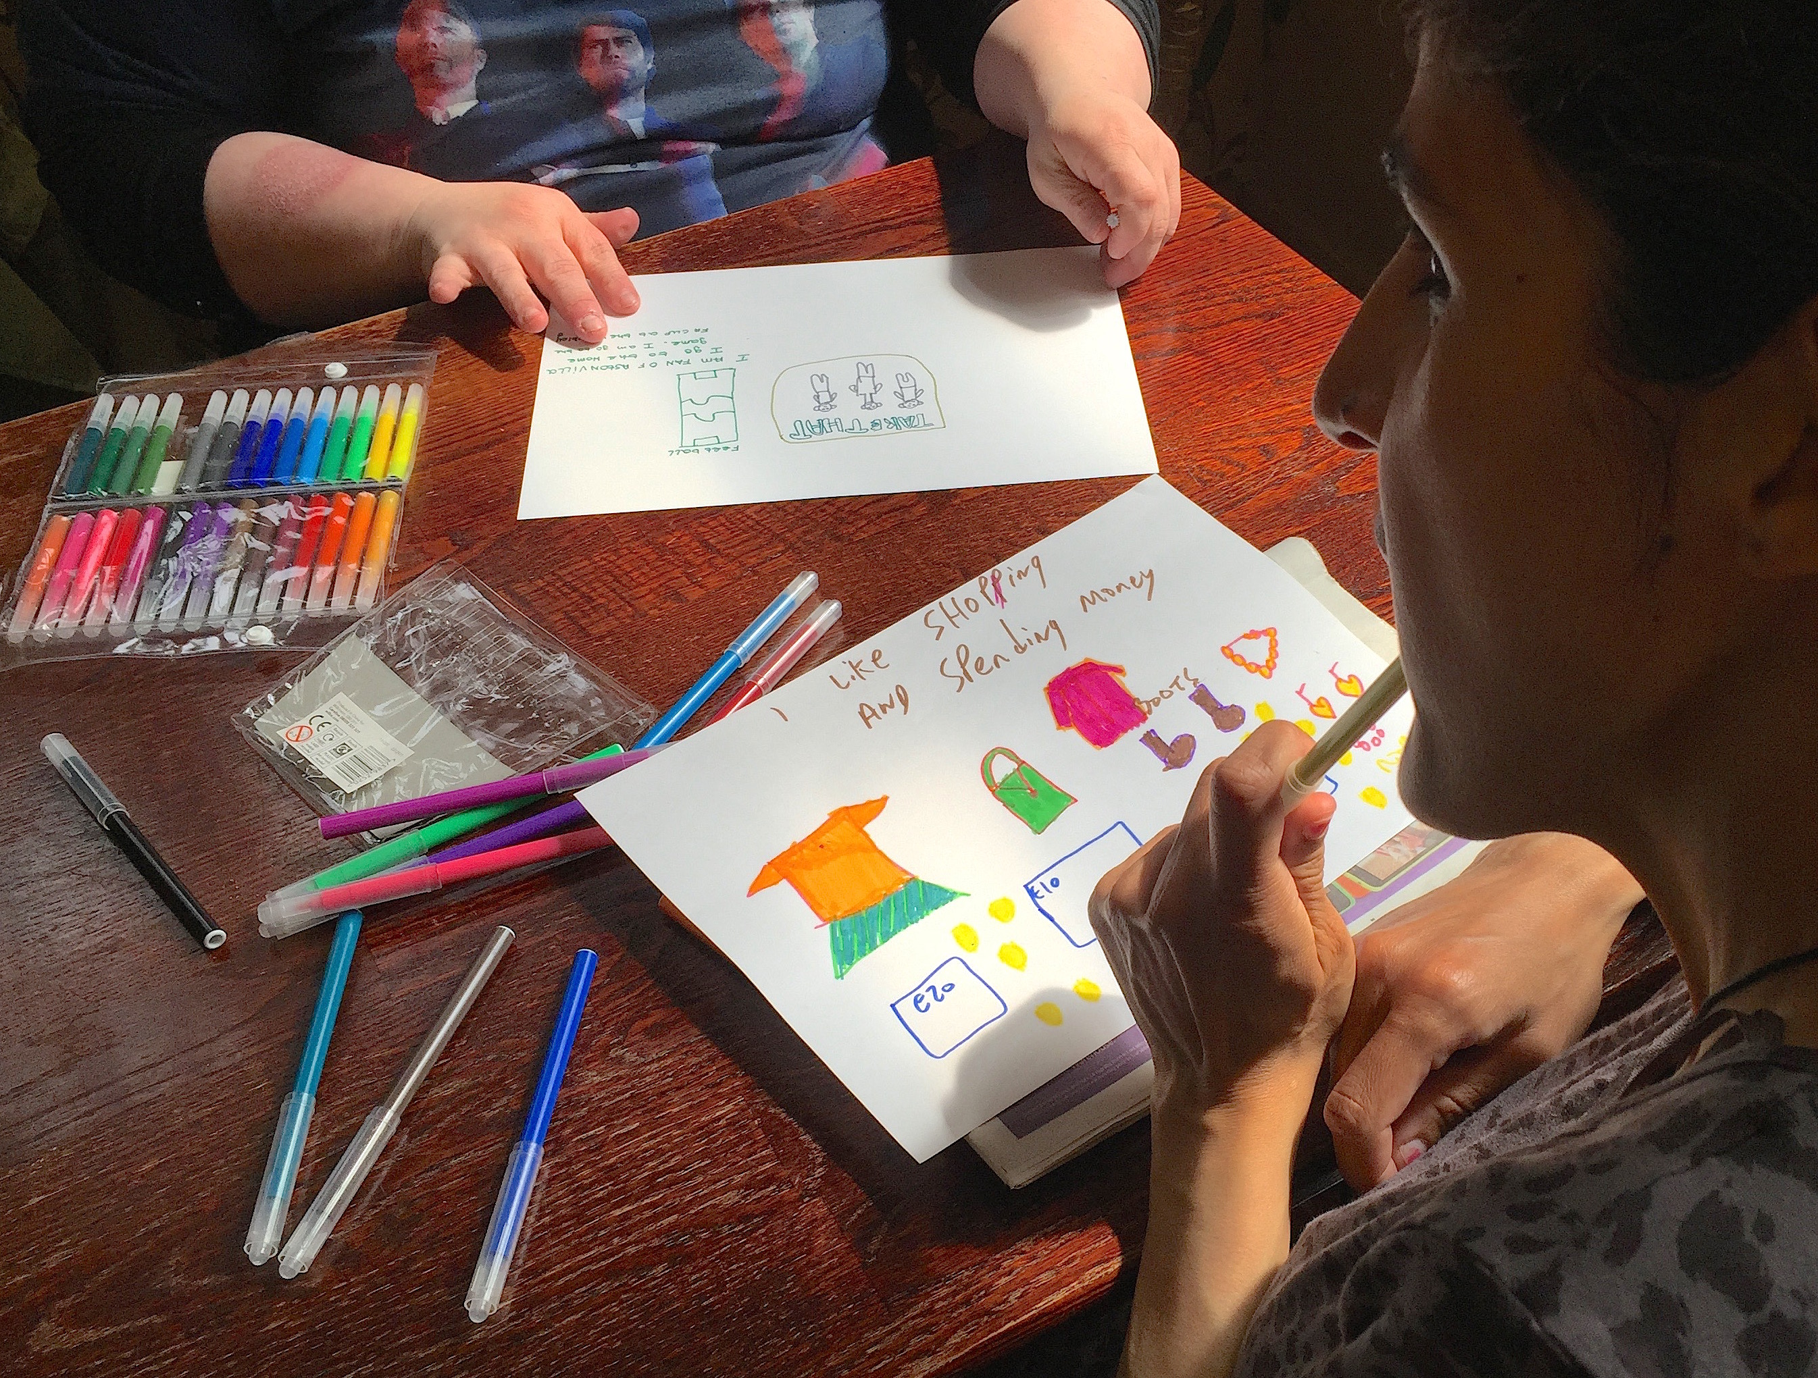
Making inclusive research valid
And not becoming a self help group, advocacy, support service or a place to moan and gripe!

Slide 5
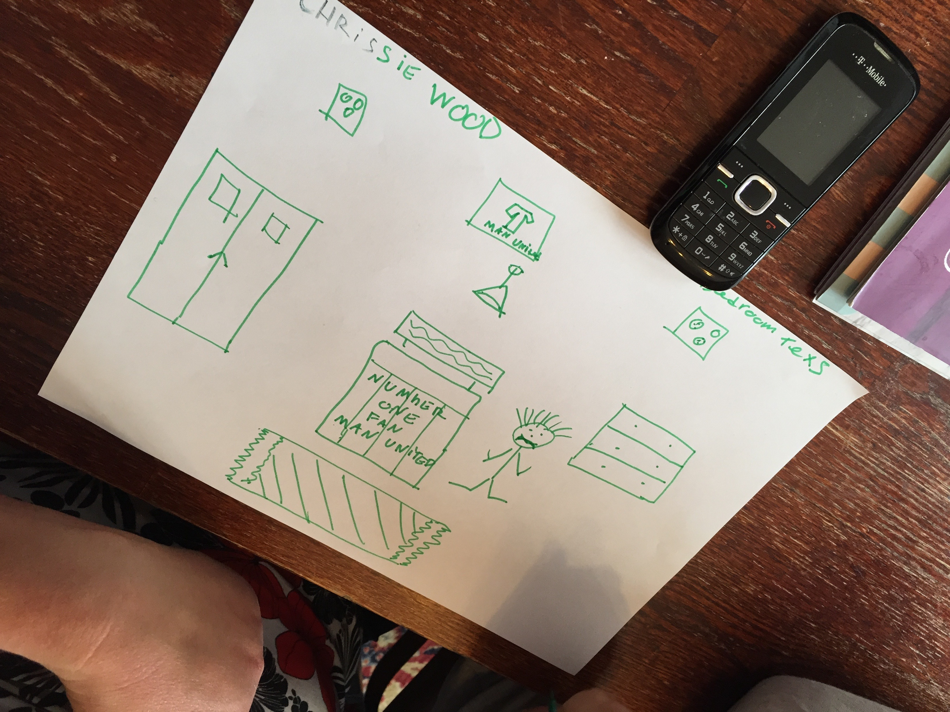
If research is also political ….
How can we let people’s voices be heard?

Slide 6
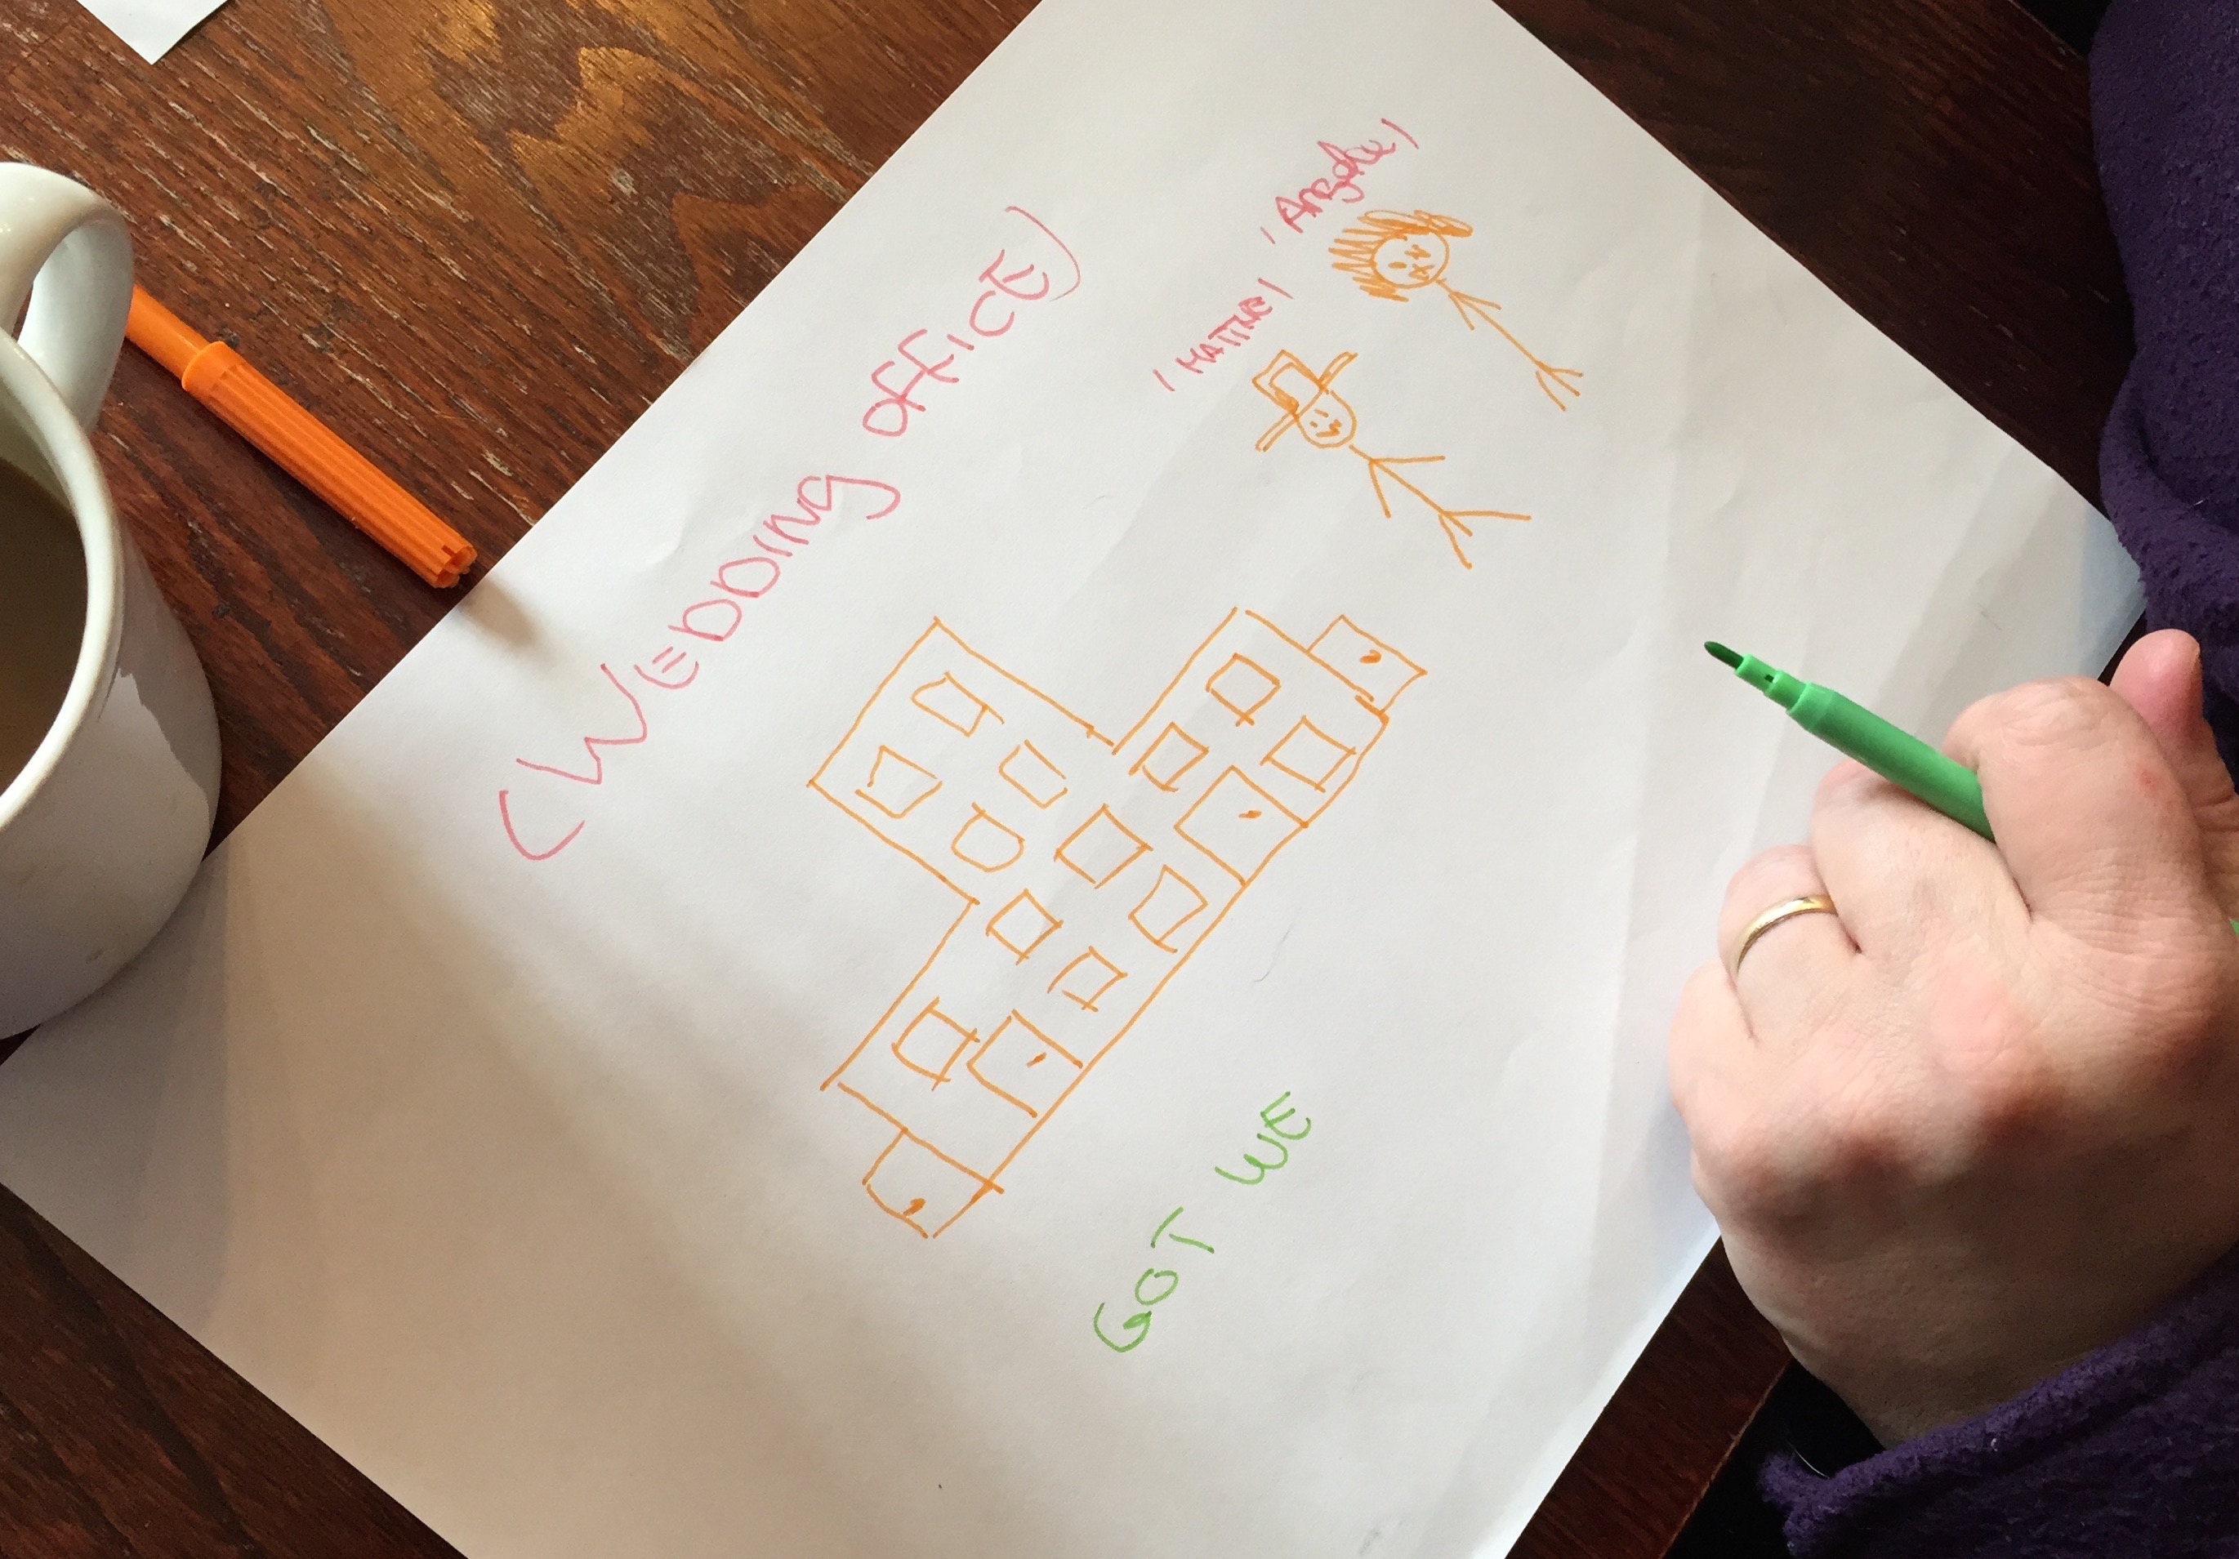
Tensions with roles
What do collaborative researchers do when they find out about
Neglected pets
Oppressive relationships
Debts

Slide 7
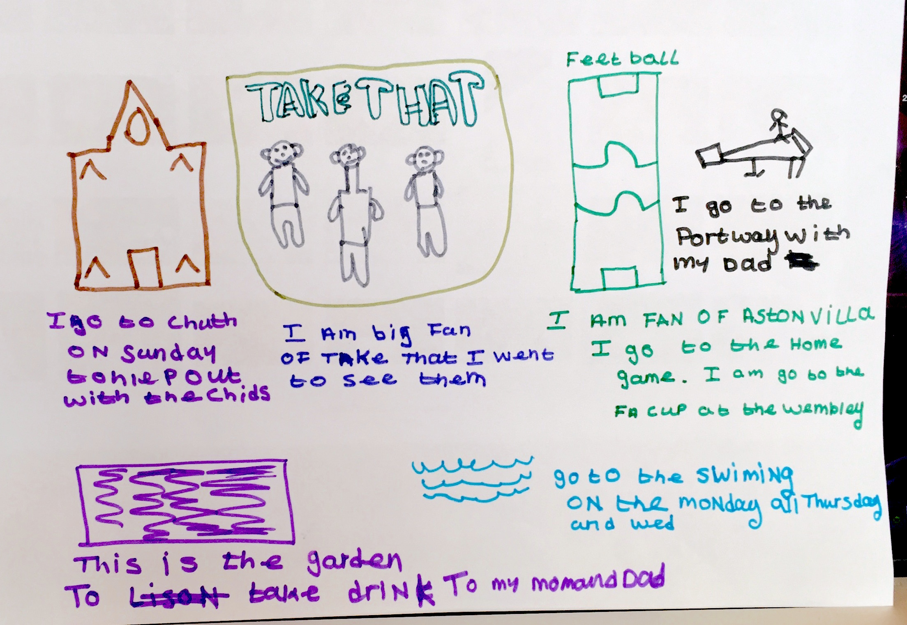
Time and costs
What do we do when the funding doesn't pay for the true costs for time for inclusive research

Slide 8
Contact details
Website – www.building-bridges-training.org
Email – mail@building-bridges-training.org
Telephone – 0121 559 9197
Fax number – 0121 559 9197

