Slide 1
Kathi Lampert within Austrian Remembering: the impact of the Nazi regime on learning disability history and Austrian Culture Gerhart Hofer
Social History of Learning Disability Conference. The Open University Milton Keynes 2016 07

Slide 2
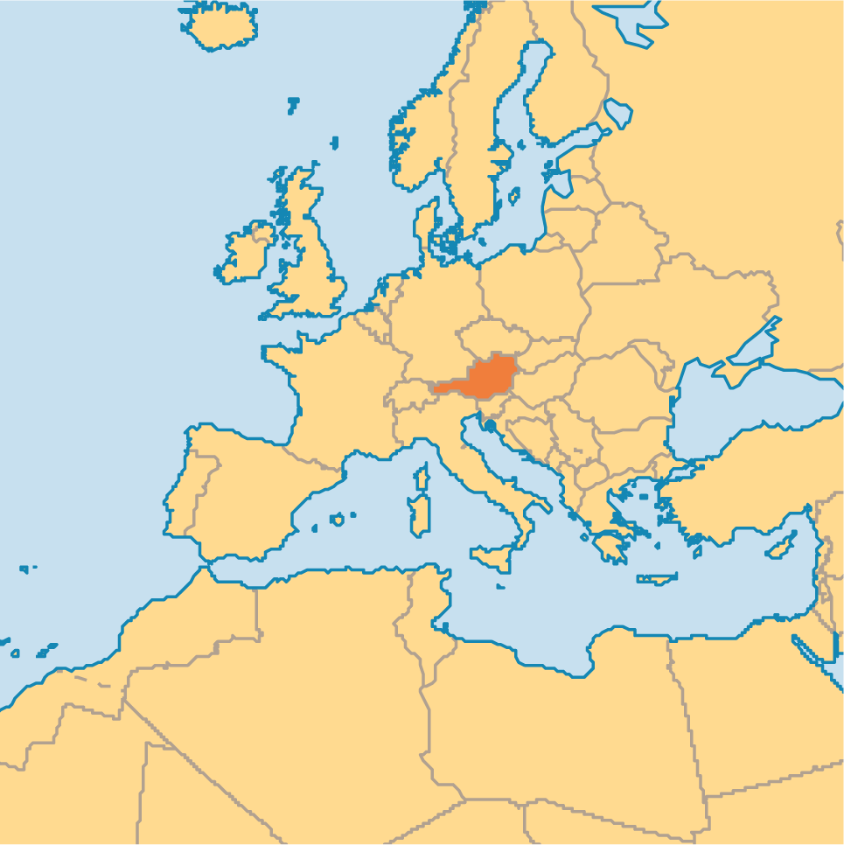

Slide 3
Eugenics
In the beginning of 20th century the idea of improving the genetic quality of the human population grew popular around the world.
While in most countries the eugenics movement was reversed, conditions in Germany had the opposite effect. Only in Germany and later in Austria this concept was brought into brutal practice.
Wehmeyer 2013
✓ Plant breeding
✓ Animal breeding
? Breeding the human race

Slide 5
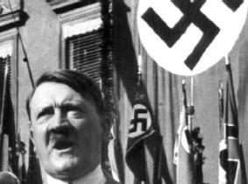
Adolf Hitler
Dictator 1934- 45
We are THE BEST in the world. We will do everything to become a better population!

Slide 6
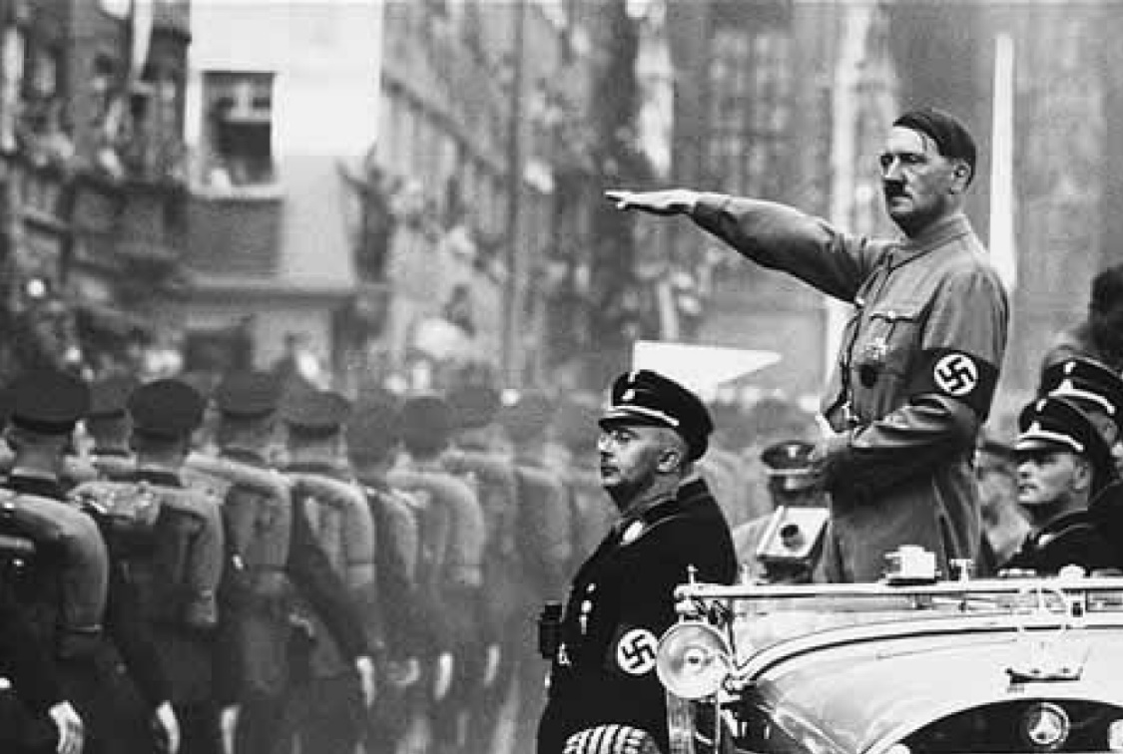
We are THE BEST in the world. We will do everything to become a better population!

Slide 7
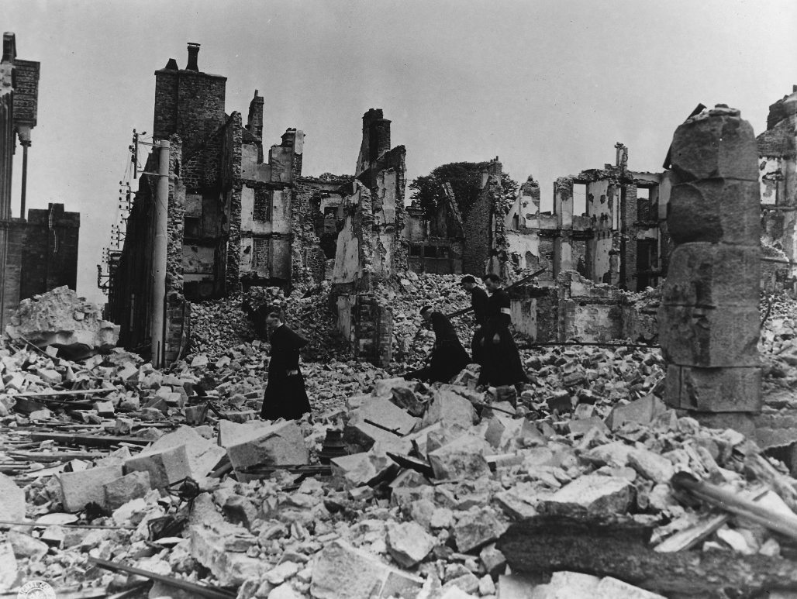
We are THE BEST in the world. We will do everything to become a better population!

Slide 8
1933 – 1945 in Germany and Austria A cruel time

Slide 9
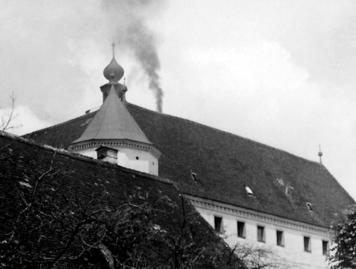
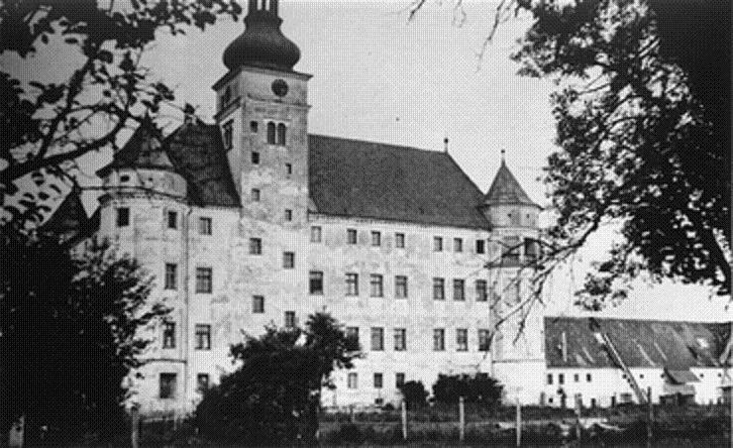
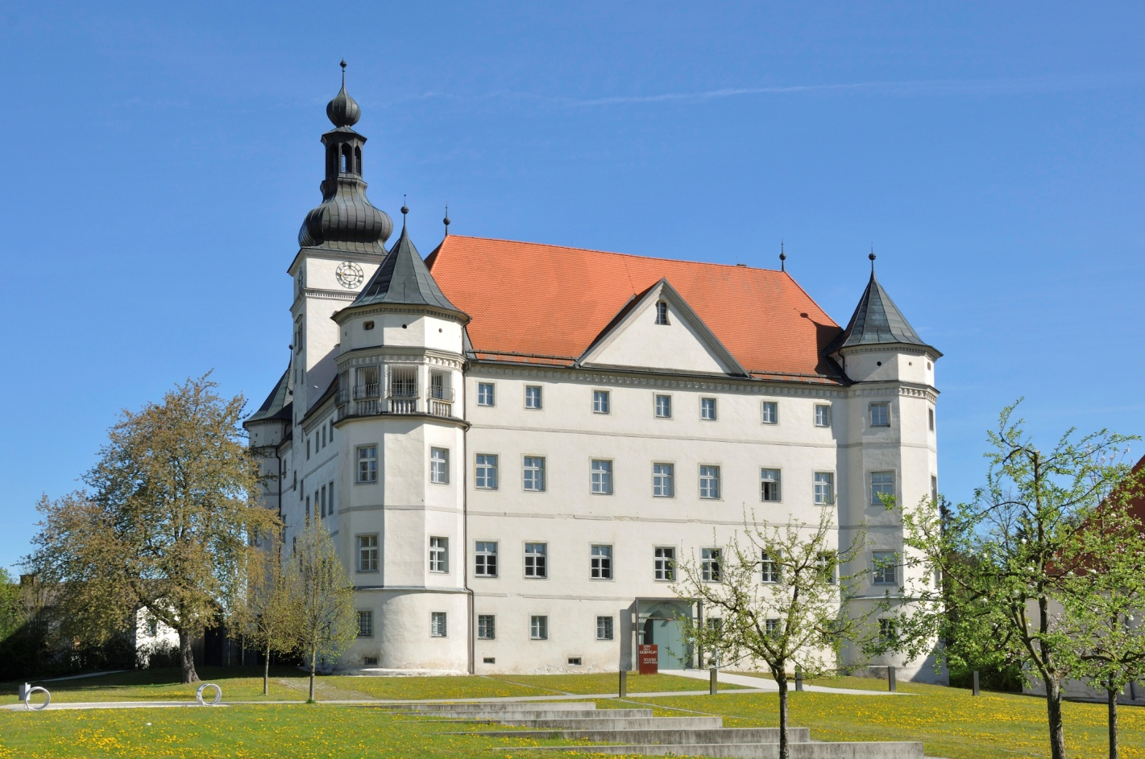
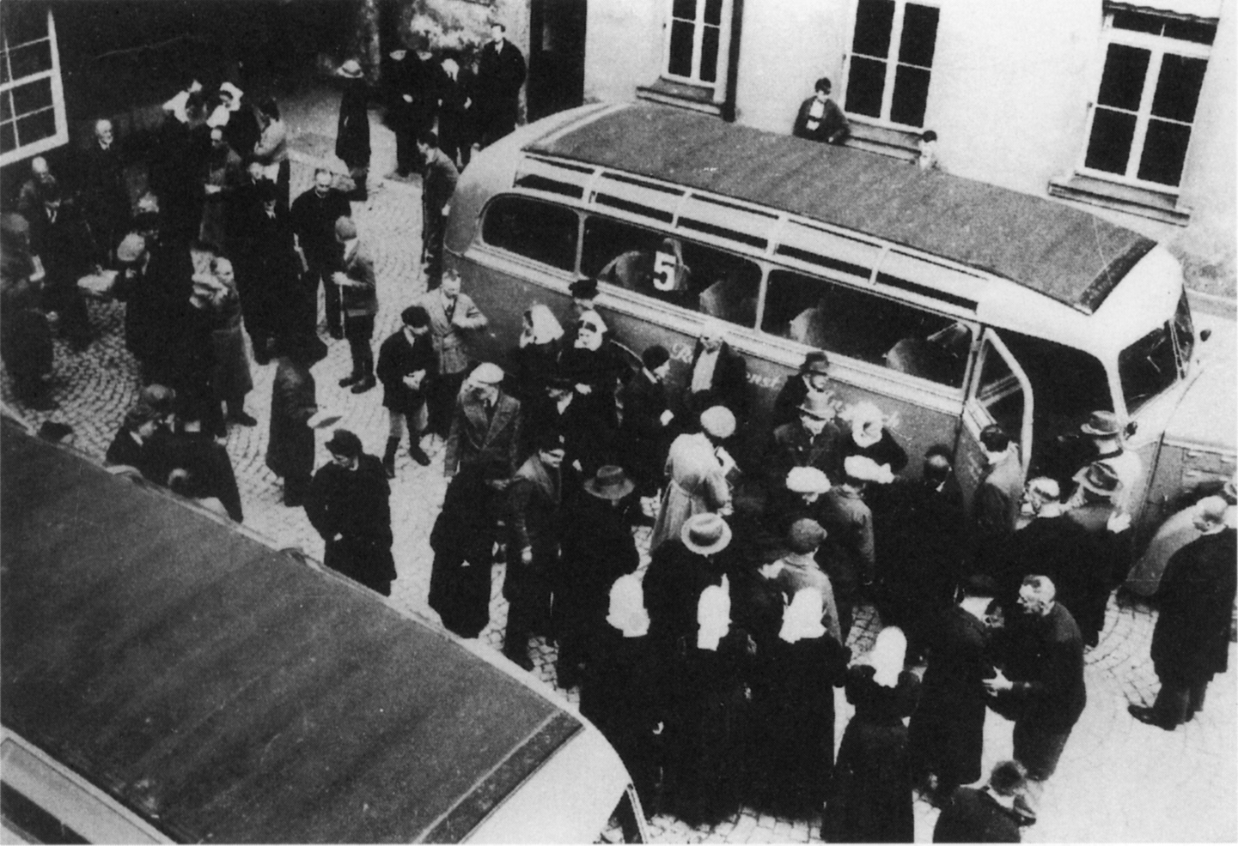
Schloss Hartheim / OÖ

Slide 10
Schloss Hartheim / OÖ
Former institution for children
Starting murdering by gas in 1940
About 30.000 people died
Testing house for killing masses in KZ
1945: all tracks were destroyed, covered
Starting 1946 with social housing again
Since 1999 Memorial
Exhibition: „Value of Life“

Slide 11
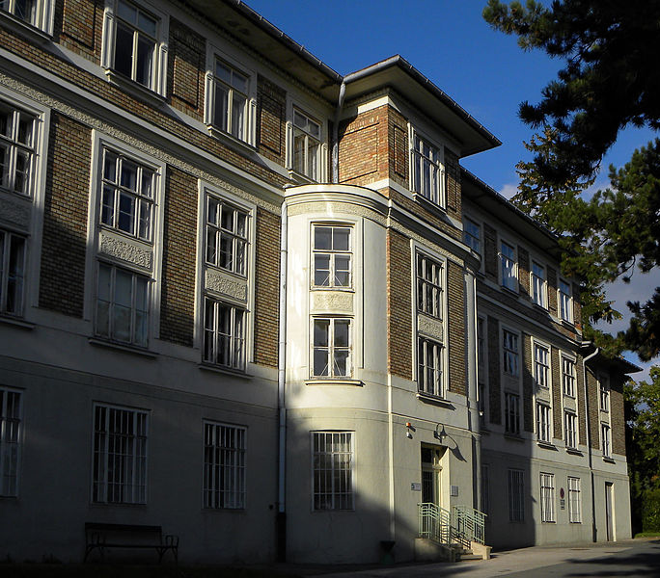
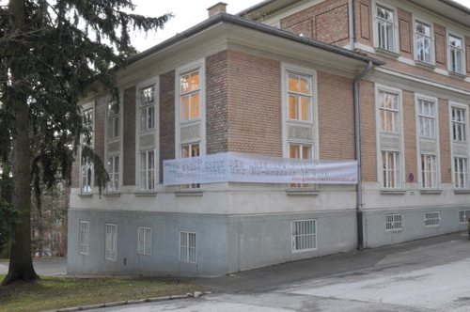
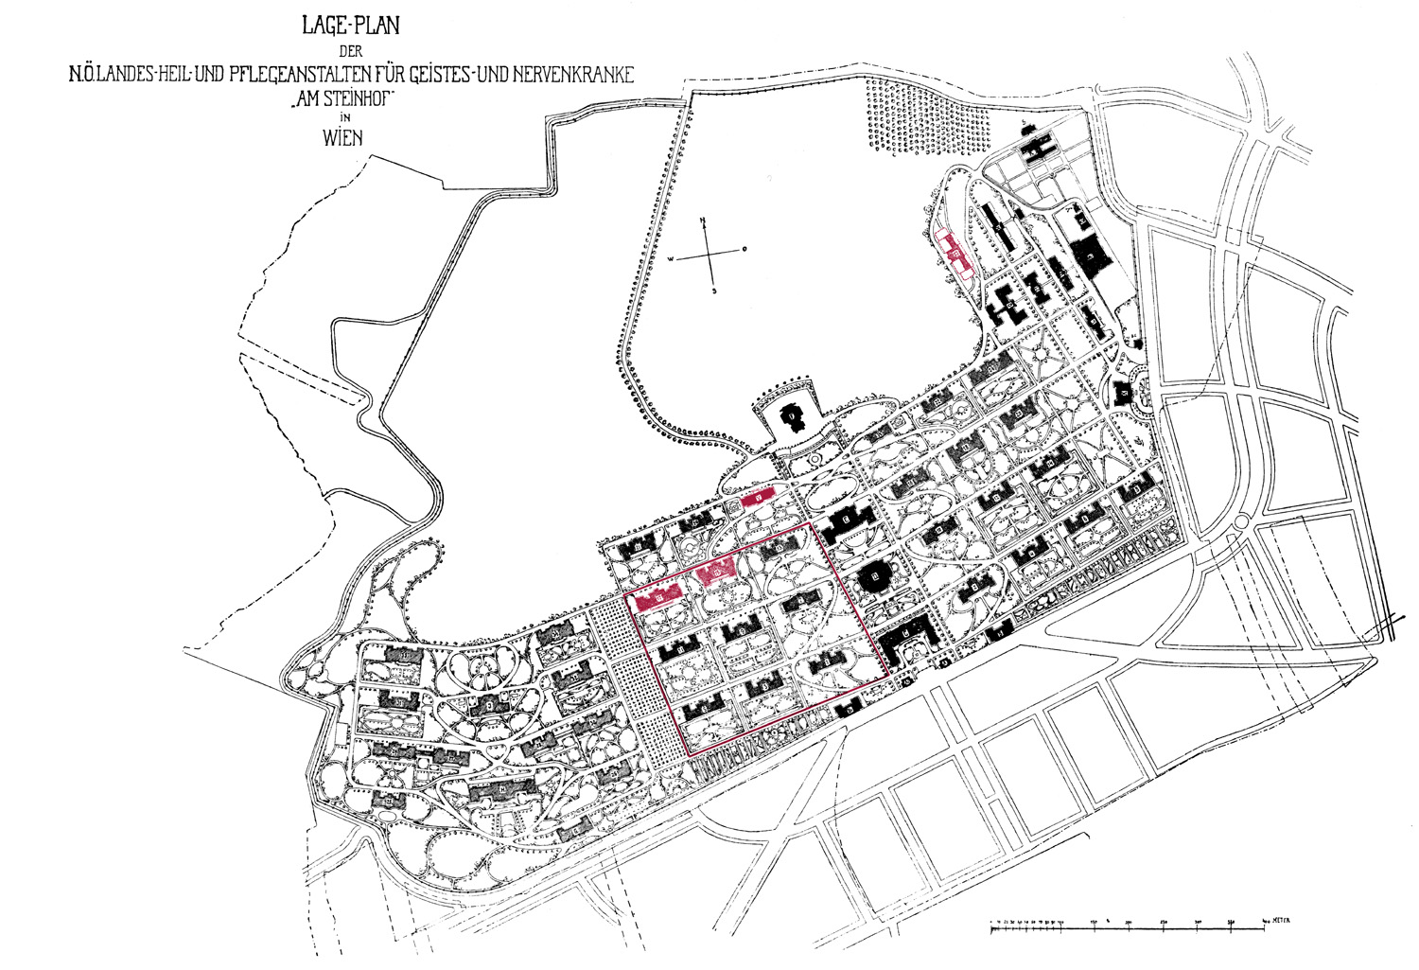
Steinhof – Spiegelgrund Vienna

Slide 12
After the war 1938/45
Shame all around
People with disability only survived when living at home, often hidden
Belief: sheltered living is the only secure setting for vulnerable people
Being invisible is a chance to survive
Profound distrust of relatives/families in medical institutions and their staff.
Nearly no coming to terms with the past.

Slide 13
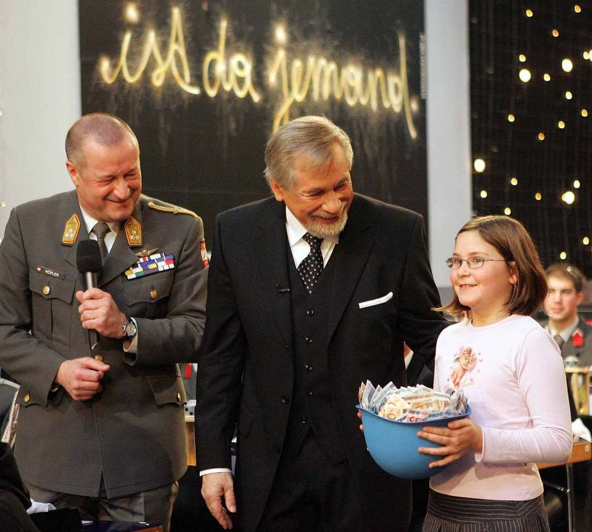
Since 45 years
National TV
X-Mas Charity Action
Licht ins Dunkel
Light into darkness
What does this title tell us?

Slide 15
You say: we bring freedom and security. But I see people die. You say: We distribute the goods of the world. But I see people starve. You say: we bring peace. But I see people wage war. You say: we will win. But my eye turns to the victims. Wilhelm Bruners: Apokalypse (2005)

Slide 16
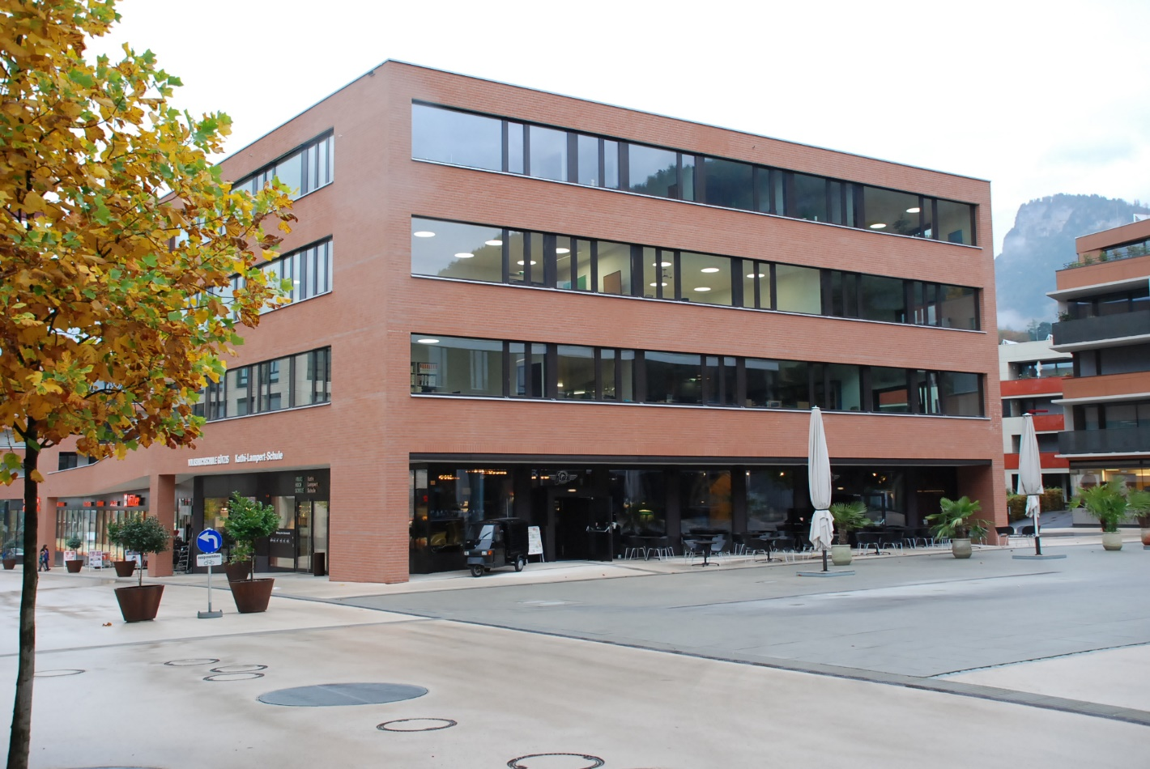
Since 2006

Slide 17
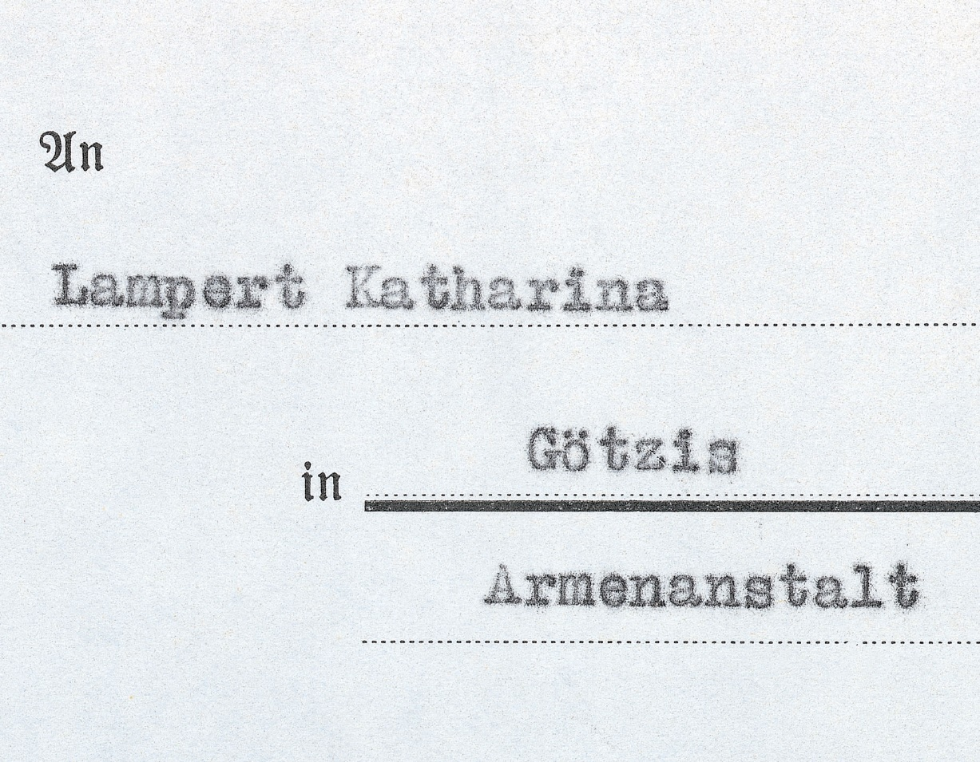
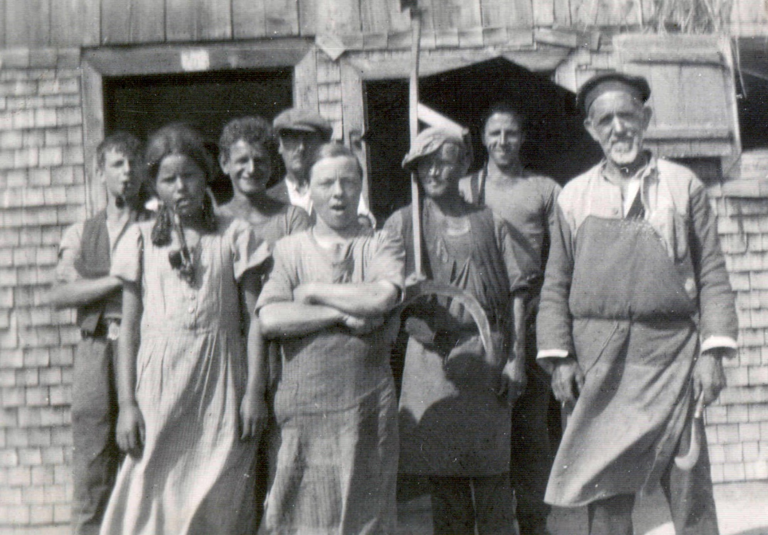
Kathi Lampert from the poorhouse Götzis
1913-1941

Slide 20
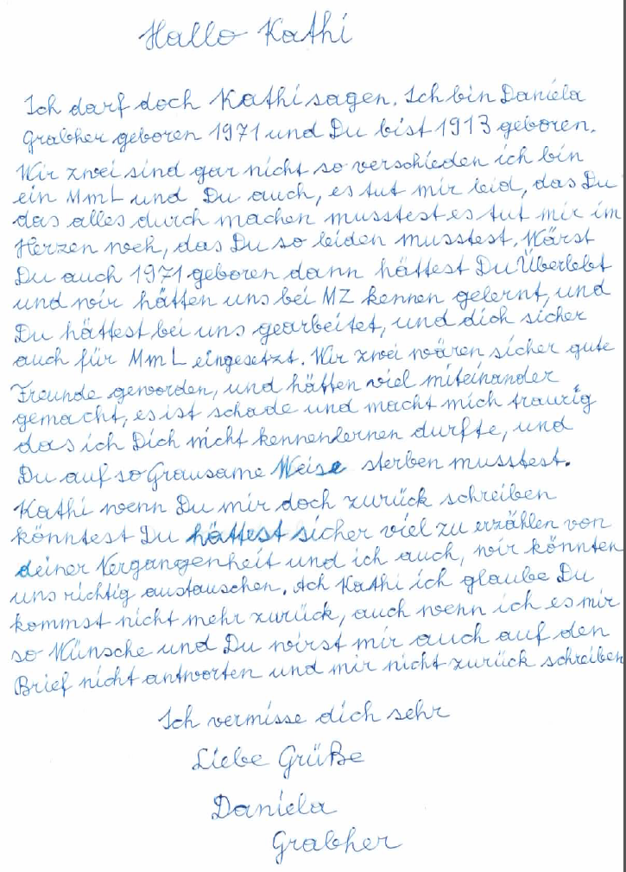
Daniela Grabher

Slide 21
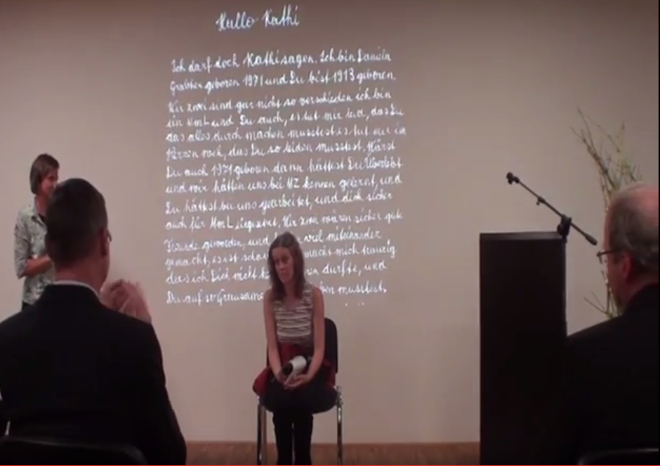

Slide 22
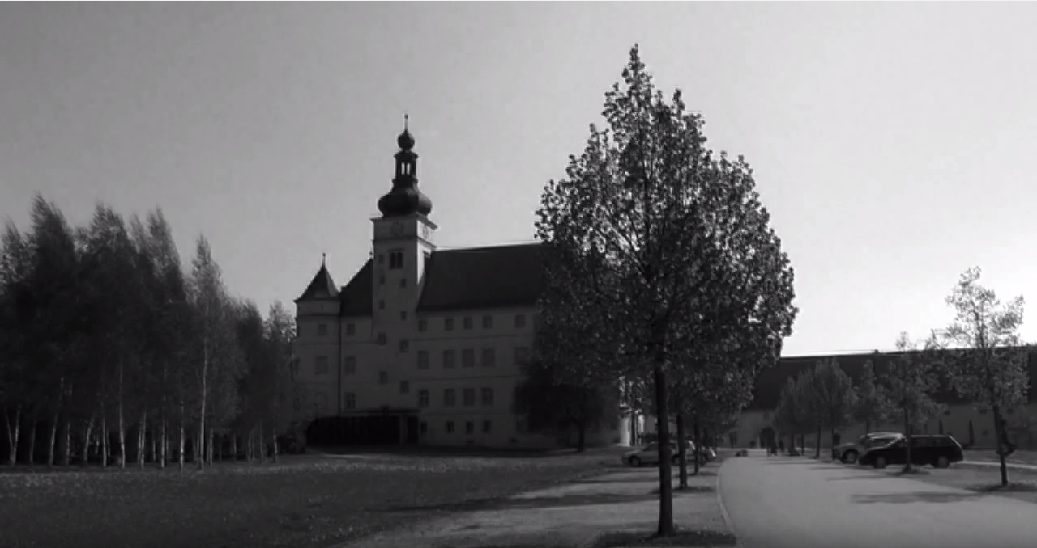

Slide 23
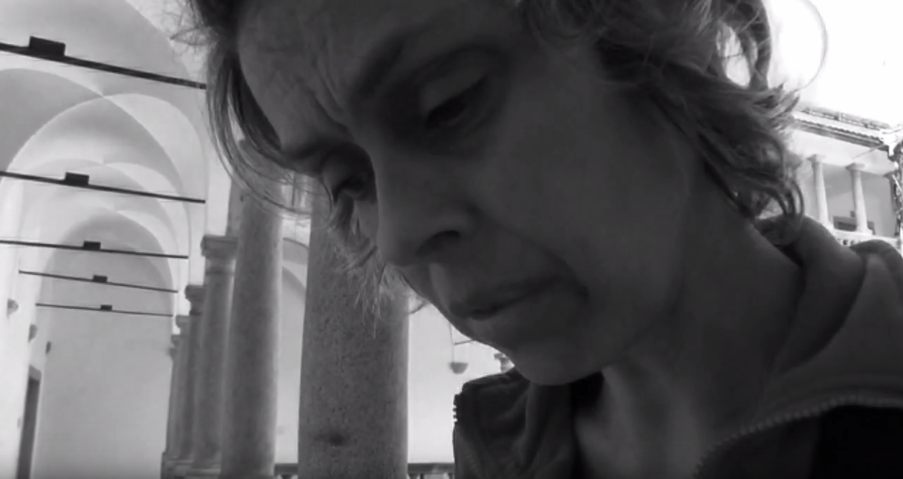

Slide 24
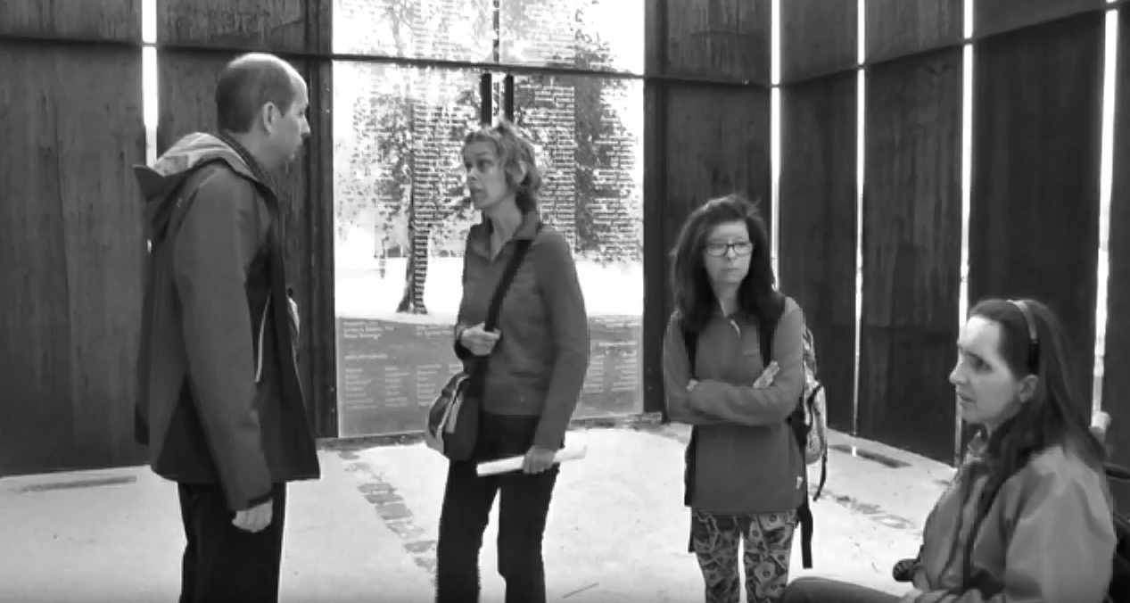

Slide 25
Erich Fried: Die Maßnahmen
Die Faulen werden geschlachtet, The lazy will be slaughtered
die Welt wird fleißig. The world is getting diligent
Die Häßlichen werden geschlachtet, The ugly are slaughtered
die Welt wird schön. The world is getting beautiful
Die Narren werden geschlachtet. The fools will be slaughtered
die Welt wird weise. The world is getting wise
Die Kranken werden geschlachtet, The ill will be slaughtered
die Welt wird gesund. The world is getting healthy
Die Alten werden geschlachtet, The elderly will be slaughtered
die Welt wird jung. The world is getting young
Die Traurigen werden geschlachtet, The sad will be slaughtered
die Welt wird lustig. The world is getting funny
Die Feinde werden geschlachtet, The enemies will be slaughtered
die Welt wird freundlich. The world is getting friendly
Die Bösen werden geschlachtet, The bad will be slaughtered
die Welt wird gut. The world is getting well.
aus: Erich Fried: gesammelte Werke. Bd. 1.
Wagenbach Verlag. München 1993, S. 565. © Claassen.

Slide 26
Raoul Hilberg: In Austria and Germany the holocaust is part of every family‘s history.
Forgetting the extermination is the final act of the extermination itself.
Petra Fuchs, Maike Rotzoll, Ulrich Müller, Paul Richter and Gerrit Hohendorf

