Slide 1
The history of the history of learning disability
Simon Jarrett
Birkbeck, University of London
SHLD Conference, July2016
Supported by

Slide 2
Beugo’s ‘Guide to caricature’ 1801
Drivelling idiocy
Stupidity

Slide 3
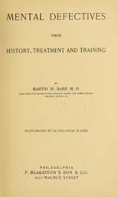
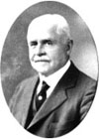
Martin W Barr Mental Defectives: their history, treatment and training 1904

Slide 4
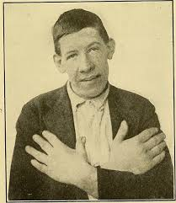
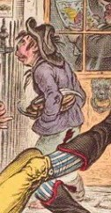
Always the same people?

Slide 5
The ‘first wave’: medical history Stanley P Davies ‘Social control of the feeble-minded’ 1923 ‘Social Control of the mentally deficient’ 1930 ‘The mentally retarded in society’ 1959 Albert Deutsch ‘The mentally ill in America’ 1937 Leo Kanner ‘A history of the care and study of the mentally retarded’ 1964 R C Sheerenberger ‘A history of mental retardation’ 1983 ‘A history of mental retardation: a quarter century of promise’ 1987 Kathleen Jones ‘History of the mental health services’ 1972

Slide 6
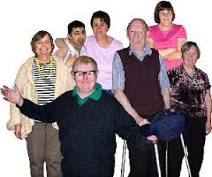
The ‘second wave’ – social history

Slide 7
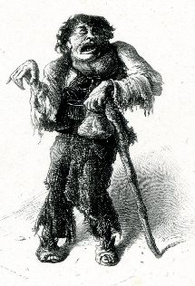
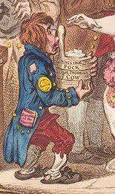
The ‘third wave’ – cultural history

Slide 8
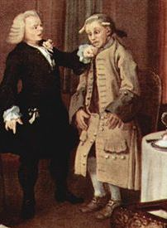
The history of the history of learning disability
Do we see the person as a product of the institutions they lived in?
Do we work backwards, looking for what we know today?
Why does language change so much – is it to assert claims to control?

Slide 9
Some thoughts
Learning disability is what we say it is
Language is an expression of power
The present isn’t always right and the past isn’t always bad
A person should not be defined by the services they receive, or the place where they live
It is not the historical norm to live in an institution
Enjoy history, but read it with caution

Slide 10
Thank you! Simon Jarrett simonj@jarr.demon.co.uk

