Slide 1
The history of institutions in Hungary: what can we learn from it for the future?
Agnes Turnpenny – Gabor Petri – Julie Beadle-Brown
Open University, Milton Keynes
08. 07. 2016

Slide 2
Outline
Overview of the history of institutions in Hungary
Current reforms
What can learn from history (in Hungary and elsewhere)?
You are welcome to tweet and take photos. Please, include @TizardCentre in your tweet.

Slide 3
About Hungary
Part of the “Eastern bloc”
Population of about 9.5 million people.
Political transition in 1989.
Much of the 1990s characterised by economic and social crises and administrative reforms.

Slide 4
In the 19th century
Family was the main provider of care.
“Often families keep [disabled people] hidden in the house or sometimes they are abandoned by the family or placed with families or charitable hospitals at the lowest possible cost.” (Frim, 1884)
The municipality issued begging licence to those who were not supported by their family.
In 1880 the Population Census found that 3 out of 4 people with learning disabilities were “paupers”.
First residential school and institution opened in 1875; strong influence of “orthopedagogy”.
Hungary “lagging behind” Western Europe.

Slide 5
Before the 2nd World War
First charitable association to support adults with learning disabilities was established in 1930 and it opened 2 institutions (campuses).
Eugenics – the Nazi “Euthanasia” programme did not extend to Hungary. There was less concern about the “control and containment” of people with learning disabilities.
People with disabilities are not part of the Holocaust history in Hungary. A recent initiative to teach pupils and young people about the Euthanasia programme: http://www.mindeneletertek.hu/
Notes:
The Parliament debated a bill on the sterilisation of PWLD in the 1930s but they rejected it.

Slide 6
Between 1950-70
“Communist welfare state” based on the idea of full employment.
Disabled and vulnerable people did not fit into this (although many people in institutions worked). Pressure on families to move disabled family members into institutions.
Looking after vulnerable people in institutions was seen as an opportunity to create employment in rural areas.
No purpose built institutions, they were created in nationalised buildings, often in rural areas, far from people’s homes.
These were not disability-specific and they were simply “warehousing” people.

Slide 7
Between 1970-89
Reorganisation in the 1970s. This meant moving people without much planning.
Three types of institutions created for people with learning disabilities:
Rehabilitation institution
Care institution
Institutions for children with severe disabilities (they were considered “uneducable” until 1993)
Number of places increased from a few thousand to about 10 thousand.
No community-based services
Ideas of deinstitutionalisation first appeared in the 1980s.
Notes:
Although more families decided to look after their disabled children at home they did not get any support

Slide 8
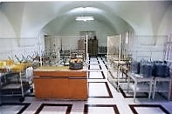
Institutions in the early 1990s
source: Hungarian Soros Foundation

Slide 9
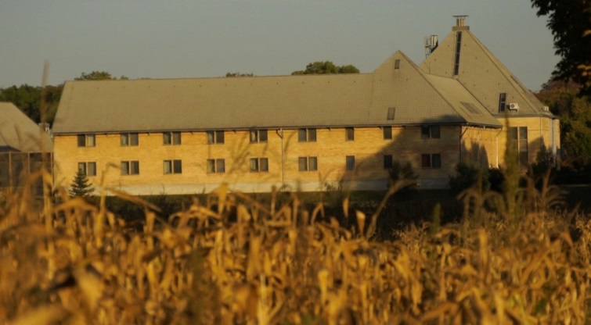
The 1990s
New social policy preserved institutions.
Attempts to create alternatives to institutions: group homes, village communities.
Activism of parents and charities driven by discontent.
Source: TASZ, Hungarian Soros Foundation

Slide 10
The 2000s
Dominated by the “modernisation agenda”, institutions still going strong.
Group homes became “institutionalised”: strict regulation and size requirement (8-14 places).
EU funding to support “deinstitutionalisation and community living”.
Hungary ratified the UN Convention on the Rights of Persons with Disabilities: right to living in the community.

Slide 11
The 2010s
In 2011: 43,000 people with learning disabilities and 5,000 people with autism (half of these under 14). 1 in 3 people with a learning disability lives in a residential setting (most likely institution).
Attempts to use EU funding to refurbish/build institutions met by strong opposition from charities and the EU;
Government adopted a 30-year “deinstitutionalisation strategy” (that would keep “rehabilitation institutions” and institutions of up to 50 places);
First institutional closure programme started in 2011 and 6 institutions were replaced by “supported accommodation”

Slide 12
Key issues
Partial closure: out of 770 people only 660 people moved out, the others were considered “too old” or “too disabled” to move;
New settings are large – 8-12 and 25 places;
Involvement of individuals: lack of person-centred or individual support planning.
Staff training;
Institutions enjoy high levels of public approval, physical infrastructure is seen as the main problem and group homes as the only alternative;
Situation of those living with their family: poverty and lack of support as a result of decades of austerity.

Slide 13
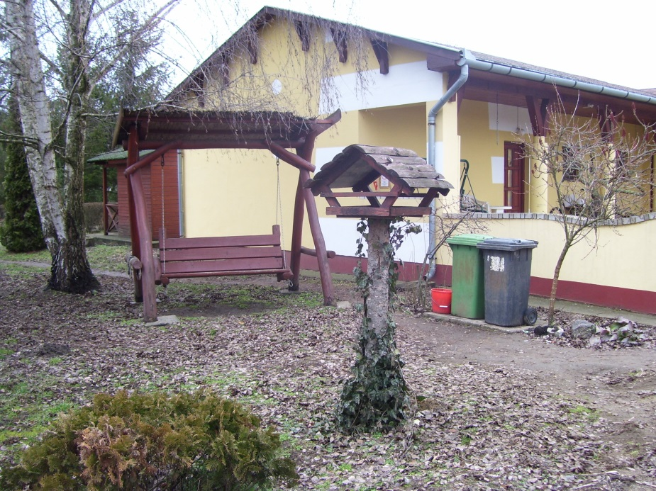
Experiences of people moving out from an institution
Most of them lived in institutions for many years (decades). Many uncertainties around the move.
Photos taken by residents of one institution.
They are looking forward to moving out.

Slide 14
Experiences of people moving out from an institution
Involvement in everyday decisions:
Housemates;
Colours and some furniture.
People are looking forward to having more independence and better conditions.

Slide 15
Lessons and learning from other countries
Understanding our history can help us avoid the same mistakes (in this case, how community-based group homes became institutionalised)
Every country is different. What works in one country might not work elsewhere.
It is often more useful to look at the mistakes others make to learn from those. Personal stories/testimonies can help us understand these.

Slide 16
References
Turnpenny, A. (2011). Deinstitutionalisation and Community-based Care for Adults with Intellectual Disabilities in Hungary: Policy Change, Challenges and Outcomes. PhD dissertation. Tizard Centre, University of Kent. Available here: http://ethos.bl.uk/OrderDetails.do?uin=uk.bl.ethos.590063
The role of EU funding in deinstitutionalisation (DI) in Hungary and the experiences of the DI programme so far. English summary available here: http://tasz.hu/node/16936
Quality of Life and Costs of Living and Services of Disabled People in Various Residential Arrangements in Hungary. English summary available here: http://www.tarki.hu/en/news/2016/items/20160408_fszk_en.pdf

Slide 17
Thank you!
Contact: a.v.turnpenny@kent.ac.uk

