Slide 1
Biotechnology, bioeconomy and the global economy
David Wield Globelics 2015

Slide 2
The multiple stories of biotech
Of hype and expectation
Of ‘science-based’ capitalism
Of potential to improve global public health
Biotech can be seen through this mix of contradictory elements
We are witnessing the transformation of a significant sector, a complex eco-system (big pharma, biotechs, new public and private actors)

Slide 3
Biotechnology and global economy: main messages
Biotech is now a globally significant industry
It has not evolved as ‘expected’: the biotech revolution is complex and variegated. Pharma has an R&D crisis, and responds in ways that affect biotech
Innovation models have changed towards a complex mix of niched and networked products and processes
This brings opportunitites for other players, including in emerging and developing countries

Slide 4
NASDAQ biotech index over time.
The data cover each year ending on December 31

Slide 5
Bio Pharma 2014
Company | Sales ($bn) | R&D spend ($bn)
Novartis | 47.1 | 9.3
Pfizer | 45.7 | 7.2
Roche* | 39.1 | 8.6
Sanofi-Aventis** | 36.4 | 6.2
Merck | 36.0 | 6.5
Johnson and Johnson | 32.2 | 6.0
GSK | 29.6 | 4.9
Gilead (9th) | 24.5 | 2.7
Amgen (12th) | 19.3 | 4.1
Biogen (29th) | 9.4 | 1.9
* Includes Genentech
** Includes Genzyme

Slide 6
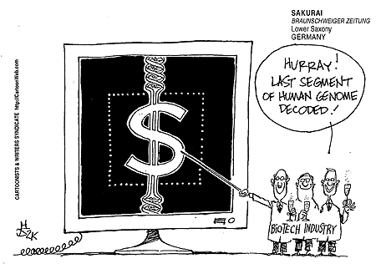
The Promise of Biotech
Bioscience - from lab to product and profit
Start-up to giant

Slide 7
Constraints on start-ups: development times
‘Here [in the US] we are laying a financial model with a two- to three year window [venture capital] onto an industry with a twenty year development cycle’, interview with Biotech CEO, Pisano, 2006, p 128

Slide 8
Overall trend in R&D efficiency (inflation-adjusted)
*Adjusted for inflation. PDUFA, Prescription Drug User Fee Act.

Slide 9
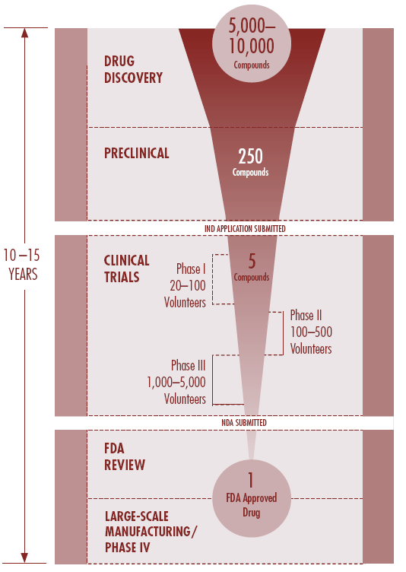
Long, complex and costly
Source: PhRMA Report, 2007

Slide 10
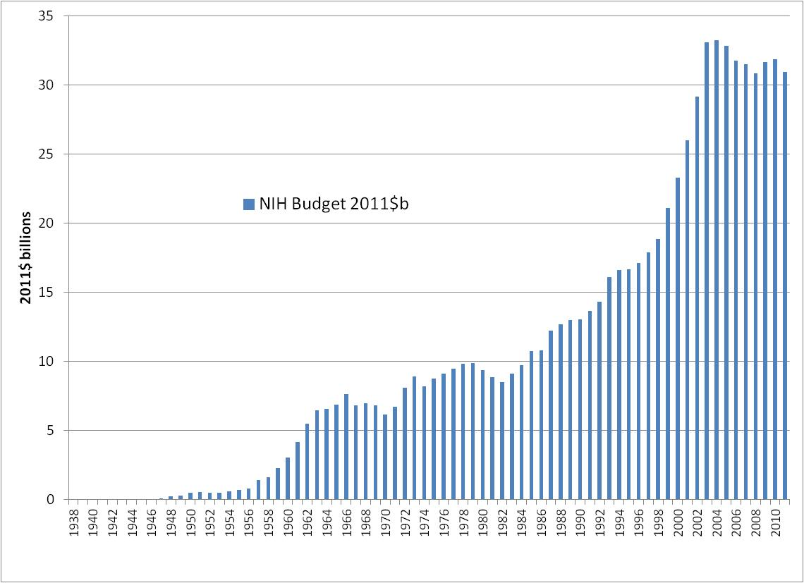
National Institutes of Health budgets 1938-2011
Total NIH spending, 1936-2011 in 2011 dollars=$792 billion
NIH budget for 2012=$30.9 billion
Source: http://officeofbudget.od.nih.gov/approp_hist.html

Slide 11
The Innogen triangle: systemic analysis
Policy makers and government:
respond to new products and processes from industry
licence and regulate products and processes, set standards and penalties
respond to public interests and concerns
balance industry/public interests
Innovation communities:
generate new ideas, processes and products
satisfy customers
generate profits
generate risks and costs to themselves and others (policy and public communities)
Members of the public and stakeholder
groups:
exert political influence
beneficiaries of new products and processes
selective bearers of some risks
motivations often based on values and ideology, rather than self interest

Slide 12
Rule change - orphan drugs
 | Designations 1983-2011 | Approvals1983-2011 |  | OD % of revenue 2009
Pfizer | 62 | 18 | Amgen | 55
Roche | 59 | 18 | Genentech | 67 (2008)
Novartis | 58 | 21 | Genzyme | 52
GSK | 51 | 19 | Biogen | 78

Slide 13
Chronic disease drivers
Health systems organisation
Generic drugs
Innovation capability – imitation, and incremental innovation towards more disruptive innovation

Slide 14
Rule changes – PPPs
IAVI: nexus of development, innovation & product development
Product-based
Innovation
Aims: product & market oriented
Assessment: quantitative
Innovation system based
Approach:
Autonomous action
Development, Capacity building
Aims: diffuse, multisectoral
Assessment: qualitative
Approach: complex, ad hoc, reactive
IAVI
Advocacy
Capacity building
Funding of trials
Fund raising

Slide 15
Drivers for north-south cooperation in biotech
Capacity building (to extend ability to address health problems); individual, organisational and institutional development
Economic development (goals driven more by economic than purely altruistic)
Access to research material (eg biodiversity, clinical trials)
Access to expertise and technologies
Source: Thorsteindottir et al, 2011

Slide 16
Some lessons from Cuba for those developing biotech
Focus on local health needs
Focus on product development, not just basic science
Cuban institutions cover a broad range of actors – they integrate varied actors
Strategic control of resources: financial and organisational

Slide 17
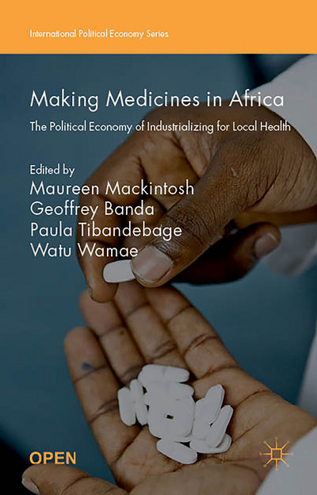
http://www.palgrave.com/page/detail/making-medicines-in-africa-maureen-mackintosh/?sf1=barcode&st1=9781137546463

Slide 18
Thanks to Innogen researchers for research results and to UK ESRC for financial support

