Slide 1
Welsh-medium tuition in Level 1 Mathematics
Addysgu Mathemateg Lefel 1 trwy gyfrwng y Gymraeg
Delyth Tomos, Associate Lecturer in Mathematics & Statistics
Andrew Potter, Staff Tutor in Mathematics & Statistics
Chris Hughes, Staff Tutor in Mathematics & Statistics

Slide 2
In a nutshell…
What are we doing?
Research question
“What are the factors which affect student engagement in a bilingual Welsh/English mathematics distance-learning context?”
MU123-21B Discovering mathematics
Series of bilingual tutorials: using a translanguaging approach; online, recorded, in the module-wide room
Registered students given the opportunity to request a Welsh-speaking tutor
Module-wide Welsh-only student forum set up
Evaluation
Focus groups (in English)
Follow-up one-to-one interviews (student choice: English or Welsh)
A

Slide 3
Background
A series of coincidental events
Increased student numbers on MU123 thanks to Diamond funding from the Welsh Government – more tutors, more tuition hours
The pandemic – all face-to-face cancelled, leaving all tuition events to be scheduled online
Highly experienced, dedicated bilingual tutors – Delyth Tomos and Ann Williams
A good relationship between Staff Tutors and their Associate Lecturers
Original idea
Run a series of Welsh-medium tutorials alongside English-medium equivalents. “Let’s do what we all think is the right thing to do, and then get the students to tell us how wonderful it is.”
A

Slide 4
Support
How talking to others helps shape the project
Talking to WELS colleagues – bilingual is the way to go
(Thank you: Ceinwen Gwilym, Judith Davies, Sally Ogut)
Talking to eSTEeM colleagues – scholarship requires a research question that can be answered positively or negatively!
(Thank you: Trevor Collins, Diane Ford, Nick Hook)
Talking to School colleagues – expectation management, where can this project sit within the module?
(Thank you: Rachel Hilliam, Sally Crighton)
Talking to OUiW colleagues – policy context, community building
(Thank you: Rhodri Davies, Gareth Davies, Ceri Wilcock)
A

Slide 5
Teaching details/Manylion addysgu
D

Slide 6

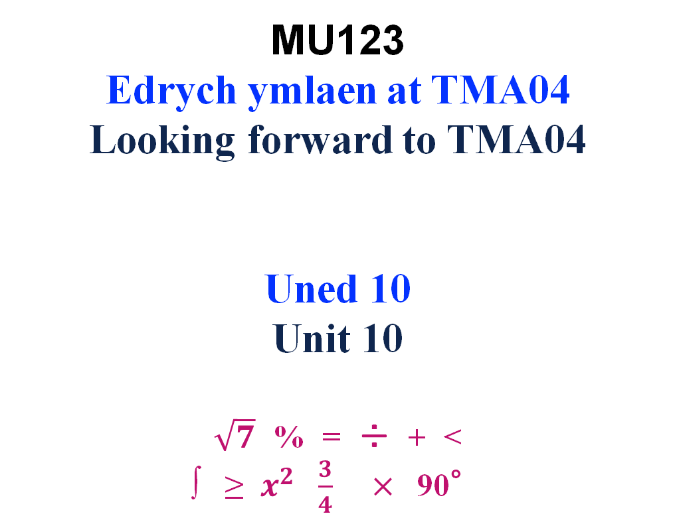
Welcome
Welcome
MU123
Edrych ymlaen at TMA04
Looking forward to TMA04
Uned 10
Unit 10
$\sqrt{7}$ % = ÷ + <
∫ ≥ $x^{2}$ $\frac{3}{4}$ $×$90°
D

Slide 7
Parabolau / Parabolas 2
Strategaeth Llunio graff ffwythiant cwadrtig
Canfyddwch os yw’r graff ar ffurf-u neu ffurf-n.
Dewch o hyd i’r rhyngdoriadau, echelin cymesuredd a’r fertig.
Plotiwch y nodweddion a ganfyddoch, yna brasluniwch y parabola.
Labelwch y parabola gyda’r hafaliad, a gwnewch yn siwr fod cyfesurynnau’r rhyngdoriadau a’r fertig wedi eu dangos yn glîr.
Strategy To sketch the graph of a quadratic function
Find whether the parabola is u-shaped or n-shaped
Find its intercepts, axis of symmetry and vertex.
Plot the features found, and hence sketch the parabola.
Label the parabola with its equation, and make sure that the values of the intercepts and the coordinates of the vertex are indicated.
D

Slide 8
Parabolau / Parabolas 5
Ar gyfer y parabola y = x² − 6x + 5
(a) Nodwch os mai ffurf-u neu ffurf-n sydd i’r parabola.
(b) Dewch o hyd i ryngdoriadau x ac y .
(c) Dewch o hyd i’r echelin cymesuredd a chyfesurynnau’r fertig.
Brasluniwch y parabola.
For the parabola y = x² − 6x + 5
(a) State whether the parabola is u-shaped or n-shaped.
(b) Find the x- and y-intercepts.
(c) Find the equation of the axis of symmetry, and the coordinates of the vertex.
(d) Sketch the parabola.
D

Slide 9
Parabolau / Parabolas 6
Ar gyfer y parabola y = x² − 6x + 5 For the parabola y = x² − 6x + 5
Nodwch os mai ffurf-u neu ffurf-n sydd i’r parabola.
Mae cyfernod x² yn bositif, felly, ffurf-u sydd i’r parabola
State whether the parabola is u-shaped or n-shaped.
The coefficient of x² is positive so the parabola is u-shaped.
(b) Dewch o hyd i ryngdoriadau x ac y Find the x- and y-intercepts.
Gan roi x = 0 cawn y = 5, felly, rhyngdoriad-y yw 5.
Putting x = 0 gives y = 5, so the y-intercept is 5.
Gan roi y = 0 , cawn 0 = x² − 6x + 5
Putting y = 0 gives 0 = x² − 6x + 5
Felly / So (x − 5)(x − 1) = 0
x − 5 = 0 neu / or x − 1 = 0
x = 5 neu / or x = 1
Felly, rhyngdoriadau-x yw 5 ac 1 / So the x-intercepts are 5 and 1.
D

Slide 10
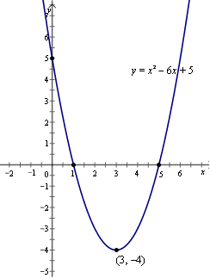
Parabolau / Parabolas 7
Ar gyfer y parabola y = x² − 6x + 5 For the parabola y = x² − 6x + 5
(c) Dewch o hyd i’r echelin cymesuredd a chyfesurynnau’r fertig.
Y rhif sydd hanner ffordd rhwng y rhyngdoriadau-x yw (5 + 1)/2 = 3,
felly, yr echelin cymesuredd yw’r llinell gyda’r hafaliad x = 3.
Cyfesuryn-x y fertig yw 3.
Amnewidiwn x = 3 i hafaliad y parabola
cawn y = 3² − 6 × 3 + 5 = −4.
Felly, y fertig yw (3, −4).
Find the equation of the axis of symmetry, and the
coordinates of the vertex.
The number halfway between the x-intercepts
is (5 + 1)/2 = 3,
so the axis of symmetry is the line with equation x = 3.
The x-coordinate of the vertex is 3.
Substituting x = 3 into the equation of the parabola
gives y = 3² − 6 × 3 + 5 = −4.
So the vertex is (3, −4).
(d) Brasluniwch y parabola /Sketch the parabola.
D

Slide 11
Parabolau / Parabolas 11
Cydweddwch yr hafaliadau â'r graff cywir
Match the equations to the correct graph.
(i) y = 2x²
(ii) y = − x²
(iii) y = x²
(iv) y = ½ x²
(v) y = − ½ x²
(vi) y = 5 − x²
(vi) y = x² + 5
(vii) y = x² + 2x − 3
(viii) y = x² − 2x − 3
D

Slide 12
Adolygiad o Uned 10. Review of Unit 10
Hafaliad echelin cymesuredd y parabola y = x² − 6x − 9 yw x = 3
The equation of the axis of symmetry of the parabola y = x² − 6x − 9 is x = 3.
2. Mae’r parabola y = 5 − x² gyda ffurf-u.
The parabola y = 5 − x² is u-shaped.
3. Mae’r parabola y = x² − 6x − 9 yn mynd drwy’r pwynt (1, −14).
The parabola y = x² − 6x − 9 goes through the point (1, −14).
4. Fertig y parabola y = (x + 2)² + 4 yw (2, 4).
The vertex of the parabola y = (x + 2)² + 4 is (2, 4).
5. Mae gan yr hafaliad x² + 2x + 6 = 0 ddau ddatrysiad.
The equation x² + 2x + 6 = 0 has two solutions.
6. Mae’r parabola y = 2x² − 5x + 1 yn mynd drwy’r pwynt (−2, −19).
The parabola y = 2x² − 5x + 1 goes through the point (−2, −19).
D

Slide 13
MU123 Welsh language forum
D

Slide 14
D

Slide 15
D

Slide 16
email greetings and signature
Good evening / Noswaith dda, …
Good morning /Bore da, …
Mae croeso i chi gysylltu a mi yn y Gymraeg neu'r Saesneg
You are welcome to contact me in Welsh or English
D

Slide 17
The Future
Next steps…
Focus groups – to take place July/August 2021
Interviews – to take place September 2021
Low participation?
Data analysis – anxiety about mathematical study, anxiety about University study?
21J presentation?
Building a community of Welsh-speaking staff?
C

Slide 18
Diolch/Thank you

