Slide 1
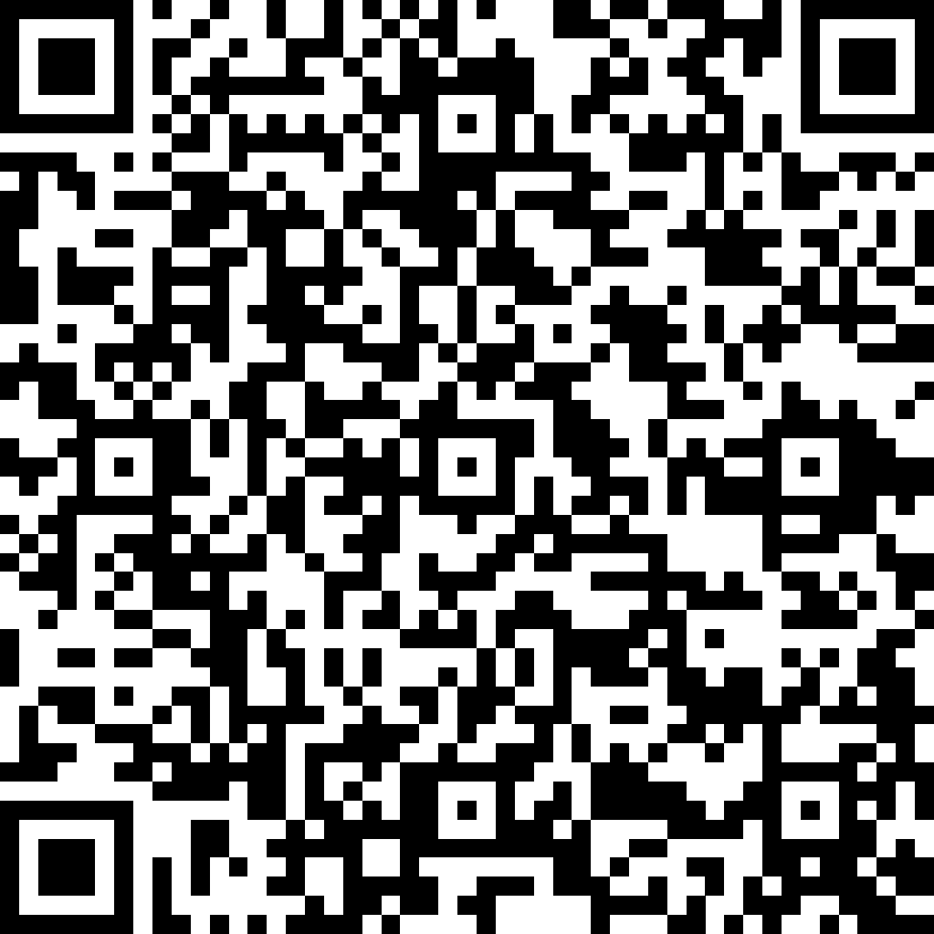
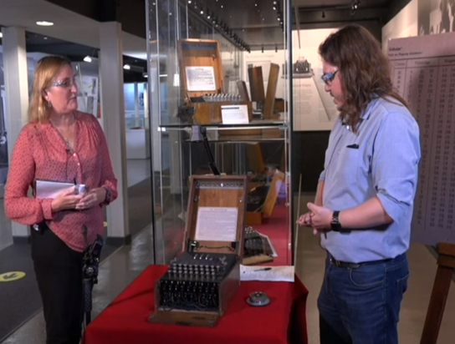
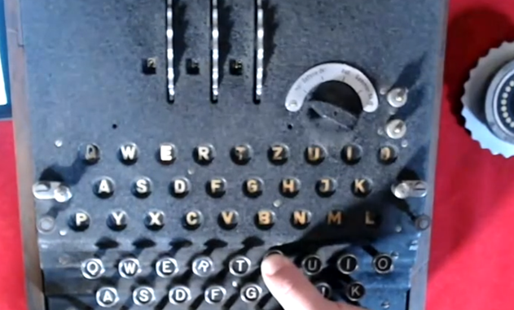
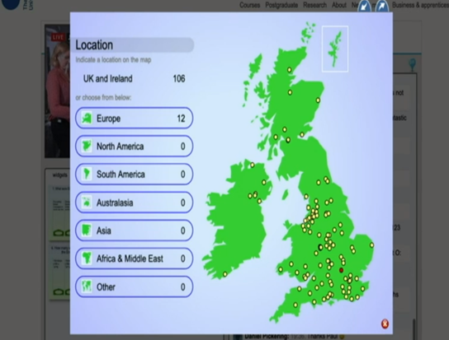
Are virtual insight visits an effective way of engaging learners?
Introduction
Field trips and insight visits can have wide-ranging benefits to students including:
Reinforcing and expanding upon taught learning
Improving ability to relate theory to practice
Encouraging collaborative learning
Enhancing motivation
(Chang 2007. Higgins et al 2012. Jakubowski et al 2003. Kali et al 2015. Sachatello-Sawyer et al 2002)
David.Conway1, Christine.Gardner, Janet.Hughes@open.ac.uk
Results
101 students participated
Age: mean (SD) 38±14​
42% of student participants were identified as being in the lowest 50% of the Index of Multiple Deprivation
54% of respondents would find it difficult to attend Bletchley Park Museum in person
100% of respondents said they would attend relevant virtual visits/webcasts in future
Benefits may lead to enhanced student experience, outcomes and employability as well as widening museum participation
Interactive visit to Bletchley Park
Questions
Can a live virtual insight visit to Bletchley Park Museum provide mature distance learners with effective interaction with a real-world environment?
Can interactive virtual insight visits provide mature distance learners with similar benefits to traditional insight visits?
Conclusion and recommendations
Results indicate that live interactive visits may be an effective way of engaging distance learners
​Further investigation is required

Slide 2
Acknowledgements and References
Tom Briggs - https://tkbriggs.co.uk/contact/
Kate Travers (Head of Learning, Bletchley Park, 2020)
Bletchley Park Trust
Trevor Collins and Knowledge Media Institute
The eSTEeM team at the OU Centre for STEM Pedagogy
A recording of the webcast can be watched here -https://player.open.ac.uk/share/5da0d3d6eb
A short film detailing our research can be watched here - https://youtu.be/e8pAajojGVY
Chang, Eunjung (2007). Making Personal Meaning from a Museum Experience: Undergraduate Students’ Art Learning Experiences at the Indiana University Art Museum. PhD Thesis. Indiana University. Available at https://search.proquest.com/openview/79d332901f768cdc45f0b7950ec8cd6f/1?pq-origsite=gscholar&cbl=18750&diss=y (6/10/2020).
Higgins, Noelle, Dewhurst, Elaine and Watkins, Los. (2012). ‘Field trips and teaching tools in the Law curriculum’. Research in Education. 88, p102-106.
Jakubowski, Lisa Marie (2003) ‘Beyond book learning: Cultivating the pedagogy of experience through field trips’. Journal of Experiential Education. 26 (1), pp 24-33.
Y. Kali, O. Sagy, T. Kuflik, O. Mogilevsky and E. Maayan-Fanar. (2015) ‘Harnessing Technology for Promoting Undergraduate Art Education: A Novel Model that Streamlines Learning between Classroom, Museum, and Home’. in IEEE Transactions on Learning Technologies, vol. 8, no. 1, pp. 5-17, 1.
Sachatello-Sawyer, B., Fellenz, R. A., Burton, H., Gittings-Carlson, L., Lewis-Mahony, J., & Woolbaugh, W. (2002). Adult museum programs. Walnut Creek: Altamira.

