Slide 1
Instructor Perceptions of Quality Learning in MOOCs
Jacob Askeroth
Purdue University
November 6, 2018

Slide 2
Brief Overview
This was a short pilot study that used semi-structured interviews to explore the perceptions that MOOC instructors have regarding the quality of learning that occurs in their MOOCs.
Three MOOC instructors participated in the study.
FLAN November 6, 2018
Jacob Askeroth

Slide 3
Current Conversations on MOOCs
What value do MOOCs offer?
Does meaningful learning occur in MOOCs?
What do MOOC instructors think about this?
FLAN November 6, 2018
Jacob Askeroth

Slide 4
Reviewing the Literature
Heavy focus on student experience and outcomes in MOOCs
Studies that do give voice to instructor perspectives
Highlight challenges of development and teaching (Najafi et al., 2015)
Try new pedagogical approaches in a new platform (Evans & Myrick, 2015; Toven-Lindsey et al., 2015)
Evans & Myrick, 2015
Do MOOC learners learn as well as learners in more traditional courses?
Mixed responses
Loenthal et al., 2018
MOOC instructors believe their own MOOC provides a high quality learning experience but think that MOOCs overall might not be as good as face-to-face courses.
FLAN November 6, 2018
Jacob Askeroth

Slide 5
Research Questions
What perceptions do instructors regarding the quality of learning in the MOOCs they teach?
How do instructors perceive social interactions influence quality learning in their MOOC?
What perceptions do instructors have of the impact or influence that social learning has on the quality of learning in a MOOC?
FLAN November 6, 2018
Jacob Askeroth

Slide 6
Theoretical Frameworks
Fixed: Social Constructivism
Emergent: Self-Regulated Learning
Instructor perceptions of quality learning in the MOOCs they teach
Social Constructivism
Self-Regulated Learning
FLAN November 6, 2018
Jacob Askeroth

Slide 7
Methods
Data collection followed similar approach to Najafi et al. (2015) and Zelinski et al. (2017)
In-person semi-structured interviews
~45 minutes each
Interview protocol questions focused on
Personal definitions of quality learning
Social learning in MOOCs
MOOC affordance impact on learning
Participants
Purposive sampling
3 MOOC instructors at Purdue, all offered on same platform (FutureLearn)
Laura
Dave
Jane
FLAN November 6, 2018
Jacob Askeroth

Slide 8
Data Analysis
Inductive Approach (Creswell, 2012) and codes-to-theory approach to identify categories (Saldana, 2013)
Creating a list of a priori codes
Coding interviews and transcribing code segments relevant to research questions
Identifying any emergent codes
Collapsing codes into emergent themes and categories with sentence-level analysis
Preparing descriptive accounts of main themes from the data
FLAN November 6, 2018
Jacob Askeroth

Slide 9
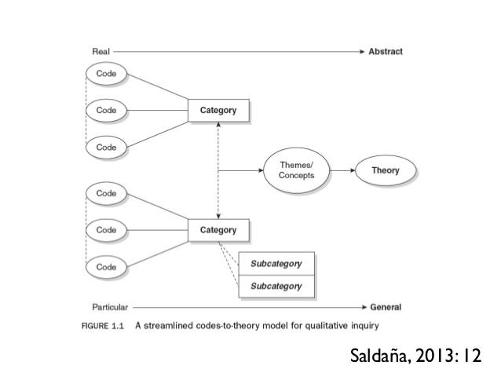
Saldaña, J. (2013). The coding manual for qualitative researchers. Sage.
Sept. 13, 2018
Jacob Askeroth

Slide 10
Results
Three main themes emerged:
Instructors perceive that social interactions in MOOCs can foster quality and meaningful learning experiences for both learners and instructors
Instructors perceive that learner goals and interests can ultimately influence their participation and learning in MOOCs
Instructors perceive or witness social learning in MOOCs through learner interactions through learner discussions
Sept. 13, 2018
Jacob Askeroth

Slide 11
Themes
Instructors perceive that social interactions in MOOCs can foster quality and meaningful learning experiences for both learners and instructors
“I have learner's that are 70 and I have learner's that are 18, and when they're participating and sharing their ideas with one another I think that really contributes to how everyone's looking at the information… [it prompts them to] think about things in a different way and it allows them to express what they're thinking about, what they're feeling about. There has been some disagreements about ideas, which has been interesting, but they work it out.”
Laura
Sept. 13, 2018
Jacob Askeroth

Slide 12
Themes
Instructors perceive that social interactions in MOOCs can foster quality and meaningful learning experiences for both learners and instructors
“I really tried to get into more of the discussion with the learners this last time [in the course]. And I feel like I was energized by it and I would assume the learners maybe felt energized as well, if they were participating.”
Dave
Sept. 13, 2018
Jacob Askeroth

Slide 13
Results
Instructors perceive that learner goals and interests can ultimately influence their participation and learning in MOOCs
“I consider real learning to be allowing the student to get what they want to get out of the course. I think that can happen in a traditional class and I think it happens in a MOOC. You can look at the numbers and see that.”
Dave
Sept. 13, 2018
Jacob Askeroth

Slide 14
Results
Instructors perceive that learner goals and interests can ultimately influence their participation and learning in MOOCs
“MOOCs allow learners to come into the course and participate in only those areas or aspects that are of interest to them or fulfill their individual purpose for taking the course.”
Jane
Sept. 13, 2018
Jacob Askeroth

Slide 15
Results
Instructors perceive or witness social learning in MOOCs through learner interactions through learner discussions
“What I found was that a well-designed discussion was a much better way of evaluating what the students learn than taking quizzes on random historical details because in the end, do I care if they know the exact years of the Spanish Civil War? Or do I want them to remember what was important to them in the course?”
Jane
Sept. 13, 2018
Jacob Askeroth

Slide 16
Results
Instructors perceive or witness social learning in MOOCs through learner interactions through learner discussions
“The online discussion boards in my MOOC seem to make the learning more obvious because learners interact with one another by articulating their own independent thoughts, which can be an indicator of their conceptual knowledge and understanding of the content.”
Jane
Sept. 13, 2018
Jacob Askeroth

Slide 17
Relevance/Importance to the Field
This pilot study took a unique approach to specifically explore the faculty perceptions of learning through the lens of social constructivism, which was not found in the current literature
Validates some of current literature on instructor attitudes towards teaching a MOOC (Evans & Myrick, 2015)
Social learning can be a viable and influential strategy for quality learning in MOOCs and can inform future instructional design for multiple learning contexts
Sept. 13, 2018
Jacob Askeroth

Slide 18
Further Research
Should included larger sample of MOOC instructors
Should employ mixed research methods to understand breadth of application or generalizability
Focus on other aspects of learning theories and types of MOOCS (e.g. xMOOCs)
Sept. 13, 2018
Jacob Askeroth

Slide 19
Questions?
Sept. 13, 2018
Jacob Askeroth

