Slide 1
Understanding MOOC disabled learners: motivations and barriers to learning
Francisco Iniesto
Institute of Educational Technology
francisco.Iniesto@open.ac.uk
FutureLearn Academic Network meeting (FLAN) 22/06/2018
Notes:
Introduction, Phd Research Student at the OU, Institute of Educational Technology, Leverhulme Open World Learning and GO-GN
MOOCs and accessibility, overview of my research Project, achievements, results and work to be done

Slide 2
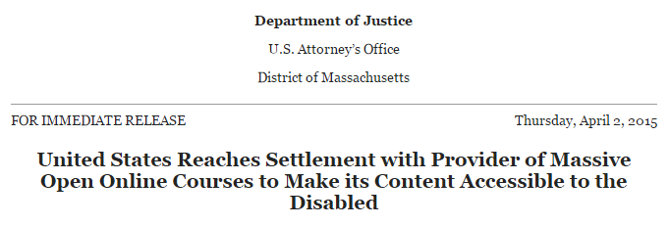
2015 Settlement with edX 2017 Berkeley
Notes:
The settlement requires edX to provide accurate captioning for the deaf, oral navigation signals for the blind, and programing changes so those with dexterity disabilities can navigate content without struggling with a hand-operated mouse.
One sentence from the settlement:
MOOCs have the potential to increase access to high-quality education for people facing income, distance, and other barriers, but only if they are truly open to everyone. This landmark agreement is far-reaching in ensuring that individuals with disabilities will have an equal opportunity to independently and conveniently access quality higher education online
Berkley university removed the more than 20,000 audio and video files from those platforms - and require users sign in with University of California credentials to view or listen to them.
Two different approaches, both driven b legislation, becoming accessible and open or closing down the content and making it inaccessible

Slide 3
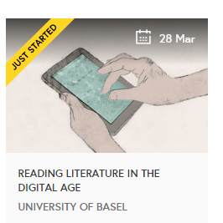
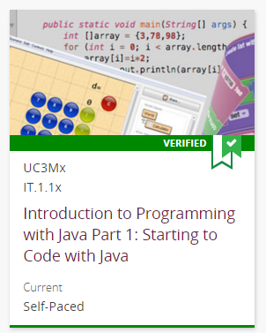
Introduction and related work
MOOC Learning, benefits such as:
Openness
Low cost
Ubiquity (Time, place and pace)
Acquiring knowledge
Social learning: Connectivism
Achieving new competences
Develop professionally
Notes:
This educational paradigm has not developed with an inherent capacity to attend to the needs of all students
This poses a serious problem to its foundation principles of being open to all
Lack of support for disabled students in open learning :
Poor compliance of platforms and contents with web accessibility standards
Lack of information about accessibility preferences of students
Barriers of e-commerce or biometric techniques
Accessibility barriers of third party software and social networks

Slide 4
Studies
Study A: The perspectives of providers
Study B: The perspectives of learners
Study C: MOOC accessibility audit
Accessibility heuristic evaluation
UX walkthroughs and design in learning
Quality of the design
Universal design for Learning (UDL)
Being tested on FutureLearn, edX, Coursera and Canvas.
26 Interviews with MOOC providers and those with a range of expertise in the MOOC community
15 interviews with disabled learners
Pre and post MOOC survey data from 14 Open University MOOCs at FutureLearn
Notes:
RQ1 How do MOOC providers cater for disabled learners?
RQ2 What are the expectations of disabled learners when taking part in MOOCs?
RQ3 How can MOOCs be made accessible for disabled learners?
RQ3 a. What is the current state of accessibility of MOOCs?
RQ3b. How can accessibility issues in MOOCs be identified and resolved?
Literature review
Qualitative approach tend to use very small samples and just one group of disabilities such as vision impairment
Quantitative methods tend to focus on just one platform
The heuristic evaluations do not usually include user-based approaches being just technical reports

Slide 5
Interviews with learners
Pre and post course survey data from 8 Open University MOOCs at FutureLearn (2015)
Total learners interviewed 15
 | Profile
Pre-Course survey | Demographic information, Location Areas of interest and expectations
Post Course survey | Learning outcomes, Completion, Devices used. MOOC structure and interactivity, Learning experience, Educators and Evaluation
Profile
Pre-questionnaire
Interview
Notes:
Question identifying as disabled and acknowledging to being interviewed
Pre-course disabled responded favourably to being interviewed: 746
Post-course disabled responded favourably to being interviewed: 112
Pre and Post common learners: 56
Total learners interviewed 15
Pre interview Bristol online survey
Interview, skype or using the online tool. Two main areas in the semi structured interviews, the motivations on MOOCs and barriers to learning

Slide 6
Interviews with learners
Notes:
Age 36-45 46.60%
Educational qualification School-leaving qualification 26.60% Bachelors university degree 20.00%
Employment status Full-time employed 33.30% Disabled and not able to work 26.60% Retired 20.00%
Gender Female 80.00%
Taken by Text-based with a written record 60.00% Online with audio recording 40.00%

Slide 7
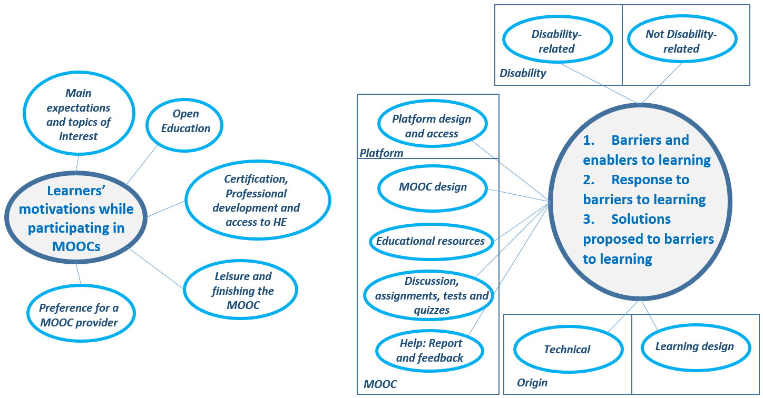
Thematic Map
Notes:
Thematic analysis: inductive approach for coding the interviews has been followed using transcripts of the interviews.
The transcripts were read and annotated using the 6-phase methodology by Braun and Clarke (2006)
Main expectations and topics of interest (General impressions while participating in MOOCs)
Open Education (Access to free and open education)
Certification, Professional development and access to HE (Supplement degree study and better professional development)
Leisure and finishing the MOOC (Occupy the mind and compromise finishing the MOOC)
Preference for a MOOC provider (preferences between MOOC providers)
Barriers and enablers to learning/Response to barriers to learning/Solutions proposed to barriers to learning
Themes that affect barriers, responses and solutions:
Disability:
Disability-related Vision Hearing and speech Motor Psychosocial Cognitive
Not Disability-related (includes those that cannot be identified to be related to a disability) External conditions Language and Cultural Internet access and technology availability
Origin:
Technical / Learning design
Platform
Platform design
MOOC
MOOC design
Educational resource (Articles, videos, podcasts and documents)
Discussion (Forum, course activity or discussions in the course educational) Assignments (Peer to peer assignments or individual assignments) Tests and quizzes (test are scored and have implications to get a certificate, quizzes are designed to give feedback to the learner)
Help
Asking for help from peers or facilitators (Create a self or collaborative motivation with peers, contacting the facilitators
Responding by themselves (better pacing, abandonment, skipping parts, wait for a next run, interacting with the platform or external tools differently)

Slide 8
Relevant quotes: Motivations
“I was interested, as my job at the time was very mundane and unchallenging. I felt I was missing out on learning about new and interesting topics. I felt unchallenged and wanted to challenge myself and use my brain more to better myself and absorb more knowledge.”
Rebecca (LD , 26-35, Undergraduate, Full-time employed) - Expectations
“Education and information is power! Education shouldn't be only for the wealthy. Everyone should have the opportunity to access high quality educational materials to inspire future learning and personal advancement.”
Cecilia (LD, 36-45, College diploma, Full-time employed) - Open Education
“It only helps me on a personal level as a sense of achievement that I have completed the course and so a pat on the back. When talking about the MOOCs to other people which I do a lot of, recommending them, I can share my Certificate and say if I can do it so can you!
For other learners it is showing their employer that they are interested in learning more and especially if is in relation to their work.”
Deborah (DHH, 56-65, School-leaving qualification, Full time carer for severely disabled familiar) - Professional development
Notes:
Deaf or hard of hearing DHH
Dyslexia or other specific learning difficulties LD
Example of Expectations, open education and professional development
Challenge yourself and get more knowledge
Access to quality educational materials
The use of certificate and why it could be useful for some learners

Slide 9
Relevant quotes: Barriers
Gemma, PC, FP, UD, 36-45, Postgraduate, Disabled and not able to work
“My health issues (fatigues, concentration issues, seizures limiting screen time) mean I can't always do the whole course as set out and I'm usually weeks behind and trying to catch up. Also any that are just videos of lectures put up with little extra info (no transcript for example)”
Barrier
“I emailed FutureLearn to complain about the changes to their structure and got a standard reply and a link to an online discussion which had been closed to further comment.
For edX, the university involved was happy to tell me that the course was still available and encouraged me to be sure and read other learners responses and uploads to learn from even if there was no longer tutor access.”
Response
“Ensuring a transcript is available for video lectures would help a lot (edX is the best at this and should be emulated, their transcript scrolls up in a window alongside the video as it plays).
Not removing access to courses as soon as the deadlines have been reached, or in the case of FutureLearn's new policy, allowing more time before it all reverts to paid access only.”
Solution
Notes:
Personal Care Support PCS
Fatigue or pain FP
Unseen disabilities UD
A case of barrier, response and solution
Related to lack of time, time issue is commonly appearing on the interviews, and is not necessarily linked to a disability, we all can have difficulties to find time to finish a MOOC
We can understand the three situations: the problem, how a learner react to the problem and how the learner would like the problem to be solved

Slide 10
Online surveys
Analyse pre and post course survey data from 14 Open University MOOCs at FutureLearn (2013-2015)
 | Pre-Course Survey | Post-Course Survey
Name of course | % Disabled Learners (Total)
Basic Science Understanding Experiments | 13.3% (804) | 20.9% (163)
Elements of Renewable Energy | 11.6% (974) | 11.3% (150)
Get Started with online learning | 15.2% (1668) | 15.7% (280)
Introduction to Cyber Security | 9.4% (6065) | 9.9% (1049)
Introduction to Ecosystems | 13.1% (734) | 12.1% (240)
Learn to code for data analysis | 8.8% (3454) | 7.6% (158)
Managing My Money | 13.1% (1401) | 12.4% (394)
Moons | 11.8% (1251) | 12.2% (935)
Smart Cities | 5% (1020) | 2.9% (137)
Start Writing Fiction | 14.2% (5215) | 16.0% (714)
The Business of Film | 8.3% (977) | 9.6% (240)
The Lottery of Birth | 13.5% (1426) | 7.3% (96)
The Science of Nutrition | 10.5% (2813) | 12.0% (702)
Understanding Musical Scores | 12.8% (1631) | 14.0% (371)
Total | 29433 | 5629
 | Profile
Pre-Course survey | Demographic information, Location Areas of interest and expectations
Post Course survey | Learning outcomes, Completion, Devices used. MOOC structure and interactivity, Learning experience, Educators and Evaluation
Notes:
Percentage of cases

Slide 11
Demographics
Notes:
Percentage positive responses for all learners, non-disabled and disabled.
We compare the response levels in percentage terms between non-disabled and disabled learners where significance is indicated at p<0.01 using z-test, p-value adjusted for multiple comparisons using Bonferroni method.

Slide 12
Interest and online learning (PRE)
Notes:
Disabled learners are particularly interested in taking up MOOCs, for personal interest, to determine if they can study at a higher educational level and to get flexibility and free education.
They are less interested in the relevance of the MOOC to their work, or professional development.

Slide 13
Expectations (Post)
To what extent did FutureLearn meet your expectations in terms of the following?
Notes:
To what extent did FutureLearn meet your expectations in terms of the following?

Slide 14
Following actions (Post)
As a result of using this Open University course, are you more or less likely to do the following?
Notes:
As a result of using this Open University course, are you more or less likely to do the following?

Slide 15
Conclusions
Disabled learners are particularly interested in taking up MOOCs, for personal interest, to determine if they can study at a higher educational level and to get flexibility and free education.
They are less interested in the relevance of the MOOC to their work, or professional development.
Disabled learners have previous experience in online courses that allows them to get university credit, which is related to their interest in studying at a higher educational level.
They have less experience of participating in online courses for continuing professional development.
Notes:
From the survey data

Slide 16
Limitations and Future work
A simple disability marker may not reflect diversity within the population.
It should not be assumed that these results generalise to the whole of the disabled learner population.
Including categories of disability will provide greater insight into differences within the population of disabled learners.
Extensions to the analysis approach to include clustering of responses, and identification of correlations.
Deeper understanding of the qualitative data.
Work in validation with the quantitative data.

Slide 17
Understanding MOOC disabled learners: motivations and barriers to learning
Francisco Iniesto
Institute of Educational Technology
francisco.Iniesto@open.ac.uk
FutureLearn Academic Network meeting (FLAN) 22/06/2018
Notes:
Introduction, Phd Research Student at the OU, Institute of Educational Technology, Leverhulme Open World Learning and GO-GN
MOOCs and accessibility, overview of my research Project, achievements, results and work to be done

