Slide 1
Educators’ participation in MOOC discussions and learners’ engagement: what do free-flowing discussions tell us?
Fereshte Goshtasbpour
University of Leeds
LondonFLAN
June 2018

Slide 2
Research Questions
How are educators’ contributions to discussions in Massive Open Online Course (MOOC) characterised based on the Community of Inquiry framework?
To what extent and in what ways do educators contribute to MOOC discussions?
How do the level and type of their contributions change over time?
What prompts educators to contribute to MOOC discussions?
What roles do educators play in learning by contributing to MOOC discussions?
3. To what extent and in what ways do learners engage with educators’ contributions?

Slide 3
Research Design
Type of contributions | Qualitative content analysis of 818 conversations between learners and educators based on the Community of Inquiry Framework
Level of contributions | Number of conversations educators contributed to
Changes over time | Variations in the type and level of contributions over the course of a MOOC
Learners’ engagement with educators’ contributions | (1) Engagement by both liking and responding to an educator’s comment (2) Engagement by responding to an educator’s comment (3) Engagement by liking an educator’s comment (4) No engagement

Slide 4
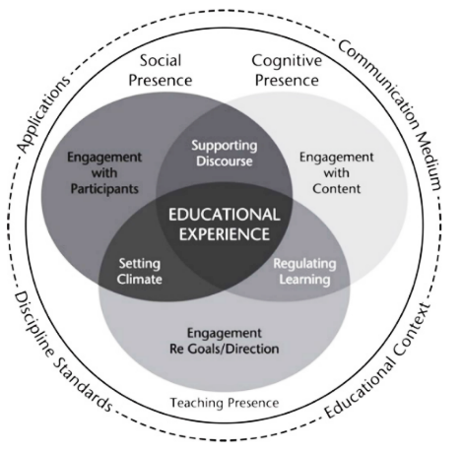
Findings: Types of contributions

Slide 5
Findings: Changes over time

Slide 6
 | Lead Educators | Educators | Mentors
Social Presence | 34% | 23% | 43%
Teaching Presence | 34% | 37% | 29%
Cognitive Presence | 32% | 38% | 30%

Slide 7
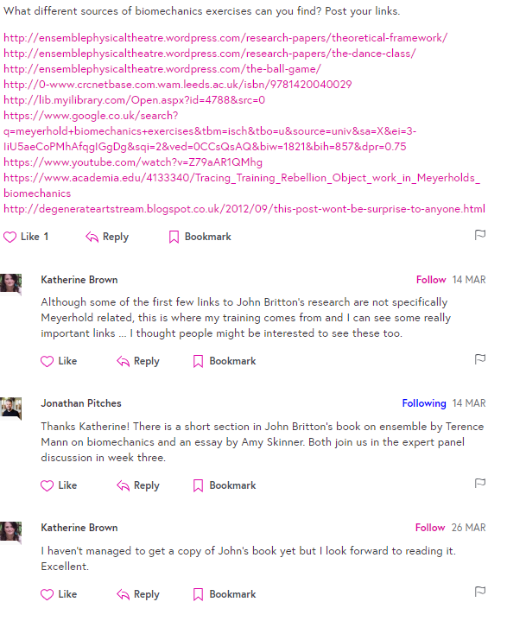
Learner 1
Learner 2
Educator
Learner 2

Slide 8
Research Design
Explicit and implicit Implicit no
Engagement engagement engagement

Slide 9
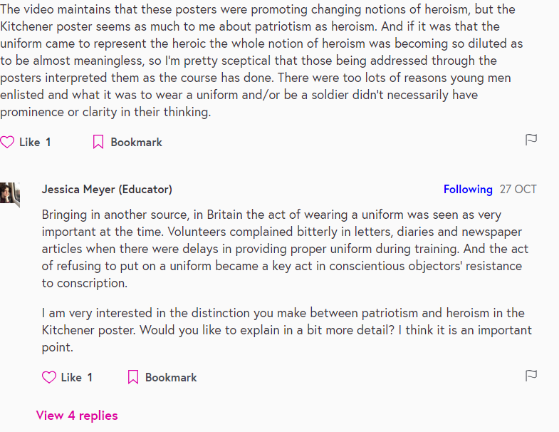
Liked and responded to

Slide 10
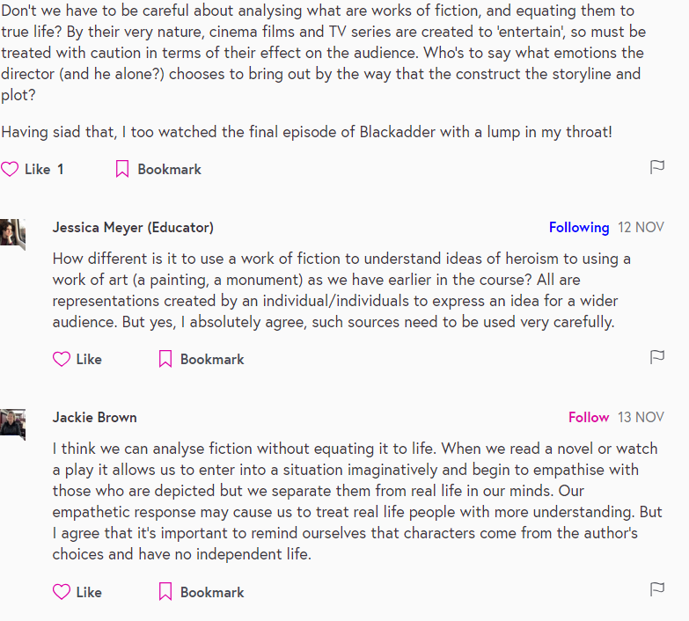
Only responded to

Slide 11
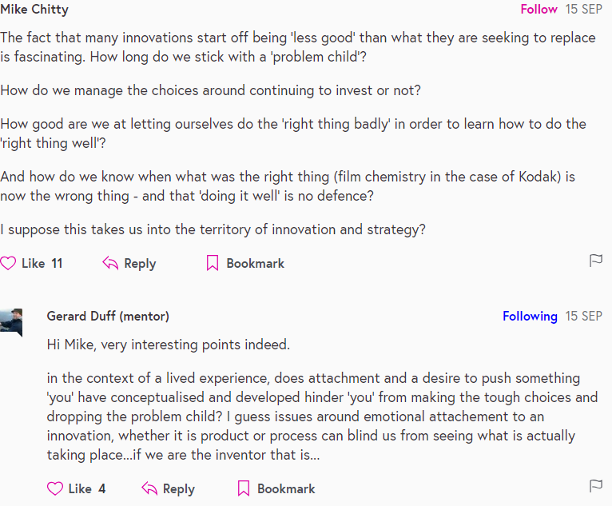
Only liked

Slide 12
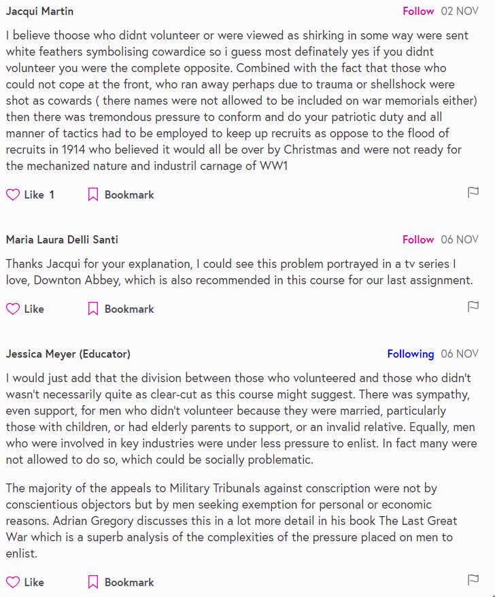
No Engagement

Slide 13
Findings
47%
19% (n=152) 13% (n=106) 15% (n=120) 54% (n=54)
Explicit and implicit Implicit no
Engagement engagement engagement

Slide 14
Findings

Slide 15
Liked and Responded | Only responded | Only liked | No engagement
A variety of conversation lengths Short (73%), medium (22%), long (4%) | A variety of conversation lengths Short (85%), medium (12%), long (2%) | Mainly short conversations (99%) no instances in long exchanges | All short conversations
Mainly pedagogical comments | A balance of pedagogical and social comments | A combination of social and pedagogical comments, but social comments are predominant | nearly the same combination as “only liked” postings, but there is a qualitative difference
learners like and respond to educators’ comments more than postings made by mentors or lead educators | learners tend to respond to educators more than mentors and lead educators | learners engaged with educators’ and mentors’ postings equally and at a higher level than they engaged with the lead educators’ contributions | mentors’ comments are the least attractive to learners, while educators’ postings indicate the lowest percentage of learners’ non-engagement

Slide 16
Summary
Learners engage with 47% of educators’ overall comments.
They engage with educators more than lead educators and mentors. Comments made by mentors are least attended by learners.
They show a higher level of engagement when educators’ comments are pedagogical ( providing direct instruction or facilitates the discourse)

Slide 17
Thank you
Fereshte Goshtasbpour edfg@leeds.ac.uk
@GFereshte

