Slide 1
What I want from learning conversation
guidelines & analytics dashboards:
A mentor’s wish list
Joshua Underwood, British Council Bilbao

Slide 2
Why?
“...there was a lack of published research on MOOC facilitators’ experiences and practices”
Ferguson, Coughlan, Herodotou, Scanlon (2017)

Slide 3
Outline
Who am I
Why I do what I do when I mentor
Some questions that trouble me
What if...
Towards enabling mentors “...to be more strategic and to make informed choices about how to spend time and invest energy…” (Ferguson et al., 2017)

Slide 4
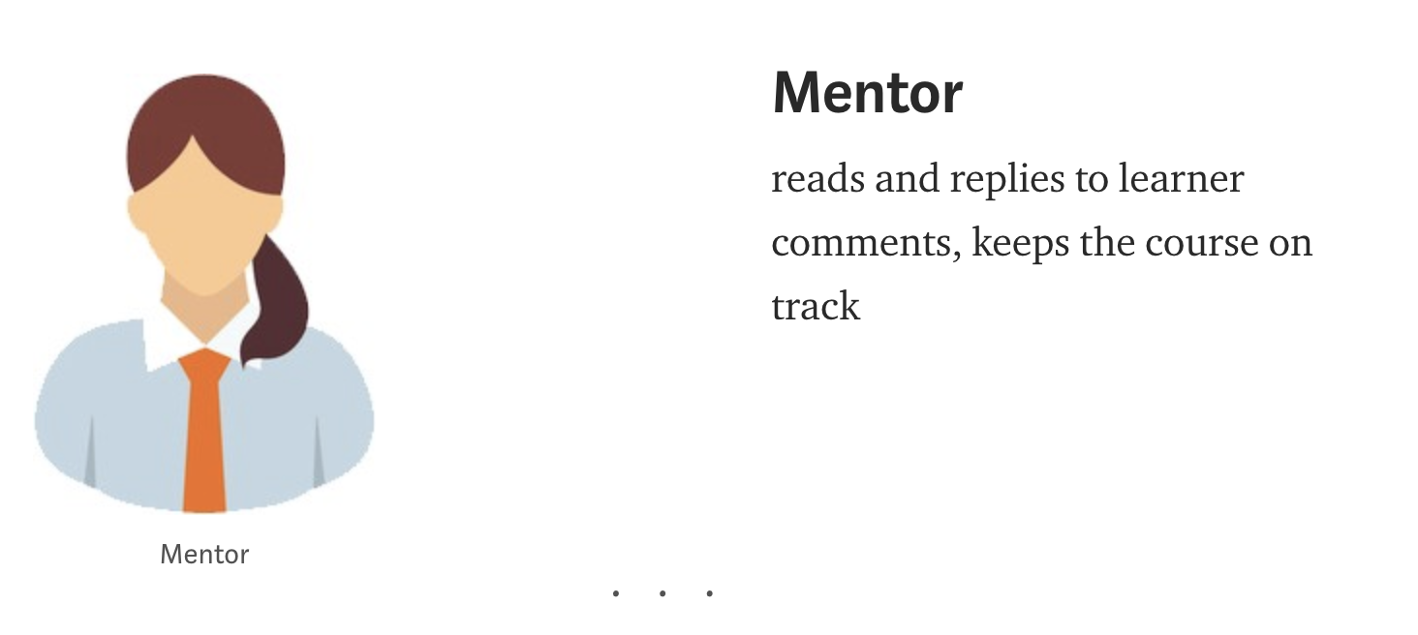
Who am I? Mentor
Image & quote from Jenner (2016) https://medium.com/@FutureLearn/whos-involved-in-the-making-of-a-futurelearn-course-245c3783b98b

Slide 5
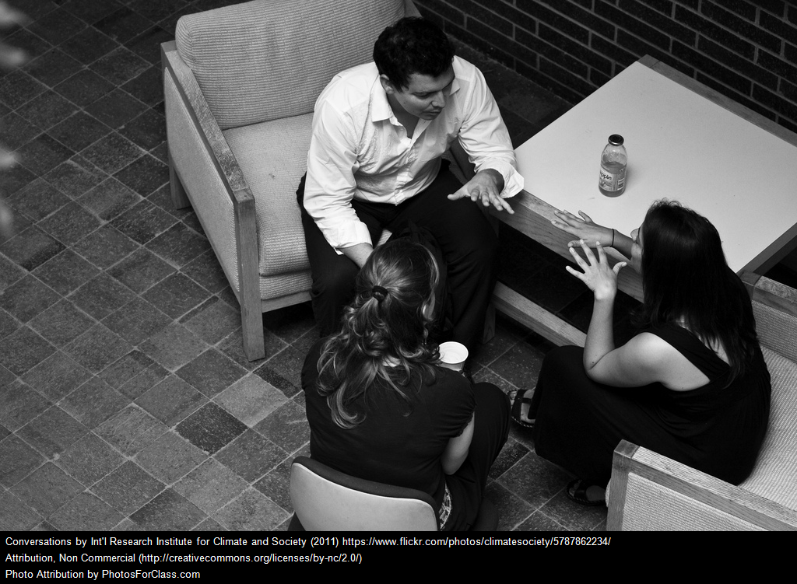
Who am I? Language Teacher
Designer
Facilitating conversation

Slide 6
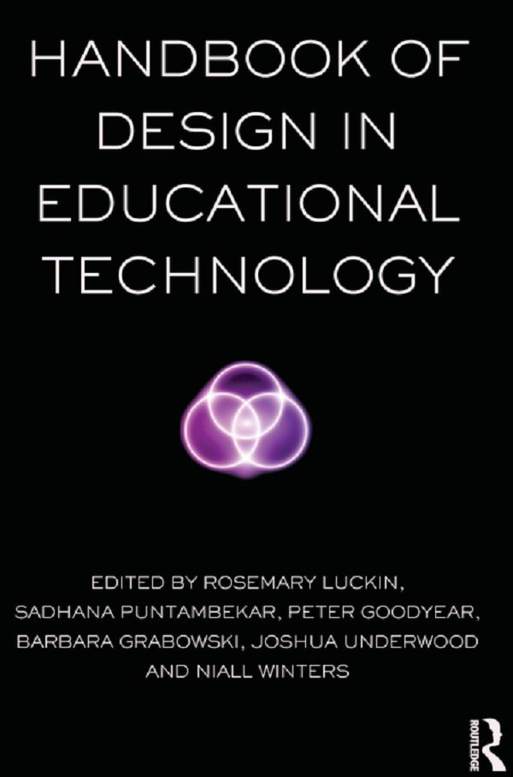
Who am I? Designer
Observing what is
Imagining what might be

Slide 7
I’m a novice
Since OLDSMOOC 2013
Mentor on 10+ course runs on FutureLearn
11,000+ followers 😊
4 week courses, an hour or so a day
200+ hours - way off 10,000
I ❤️ FutureLearn “...we put conversation at the heart of learning” Sharples, M. (2017)

Slide 8
But...
https://pixabay.com/photo-195926/
Notes:
I am aware I am just dipping in the stream of comments… “conversation stream”

Slide 9
Some questions
Where should I start?
What should I say?
How should I connect people?
Who should I connect?
Does liking help?
How can I make myself more visible?
Where have the other mentors been?
Who’s getting no attention?
How can I do this faster & better?

Slide 10
My beliefs
I should be:
giving the impression comments are being read
asking questions, opening up, and extending conversations
answering questions, being helpful
connecting people who are talking about similar things, have contrasting opinions, etc…
encouraging people to join the conversation
making people welcome
being friendly, smiling
drawing in people who are not participating

Slide 11
& the FutureLearn UI
Easy
to ❤️ comments, to reply, to smile 😊
to find the most liked comments, the most replied to comments, the most recent comments
to find replies to me
Possible but not easy
to see where the other mentors have been
to welcome people - respond to first comment
to connect related conversations

Slide 12
And then there is what I can’t see
https://pixabay.com/photo-2038736/
Notes:
What don’t I see?

Slide 13
And some more questions
Who is participating but never got a like or a reply? 😞
How many people are seeing the conversation but not joining? 👀
Who are they? How might I draw them in?

Slide 14
What if...
it showed me where no other mentor had been
it notified me of first comments
it suggested related comments
it offered me reply ‘starters/frames’
it told me who had never had a like or reply
it highlighted questions for me to answer
it suggested questions for me to ask
it showed me who was looking but not participating
it greeted people for me and smiled
…?

Slide 15
Towards enabling mentors
to record and reflect on their activity and its impact
to question their beliefs through collaborative ‘action research’ facilitated by the community & analytics (efficient communication between mentors, analysts, and designers around the questions they have, the actions they take, and impact)
to relate specific, current, conversations and cases to trends, historical data and what worked in the past.
to work with AI and bots to find related conversations; to prioritise where to start; to welcome people & draw them into the conversation

Slide 16
References
Ferguson, R., Coughlan, T., Herodotou, C., Scanlon, E. (2017). MOOCs: What the research of FutureLearn UK partners tells us. Institute of Educational Technology, The Open University, Milton Keynes.
Jenner, M. (2016) Who’s involved in the making of a FutureLearn course? https://medium.com/@FutureLearn/whos-involved-in-the-making-of-a-futurelearn-course-245c3783b98b
Sharples, M. (2017) In FutureLearn’s MOOCs, Conversation Powers Learning at Massive Scale. IEEE Spectrum https://spectrum.ieee.org/tech-talk/at-work/education/conversation-powers-personalized-learning-in-futurelearn-mooc
Sharples, M., de Roock , R., Ferguson, R., Gaved, M., Herodotou, C., Koh, E., Kukulska-Hulme, A., Looi, C-K, McAndrew, P., Rienties, B., Weller, M., Wong, L. H. (2016). Innovating Pedagogy 2016: Open University Innovation Report 5. Milton Keynes: The Open University.

