Slide 1
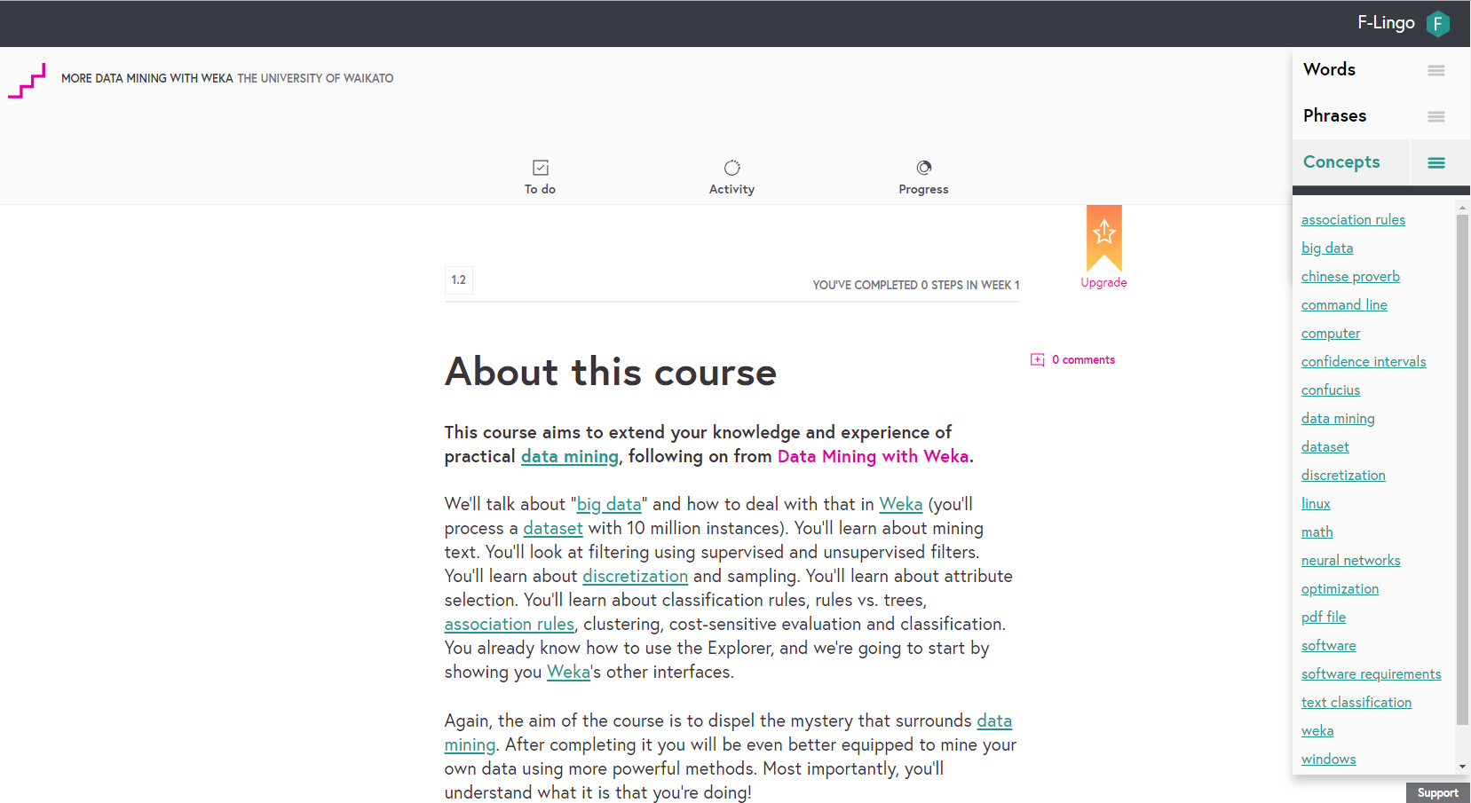

Integrating lexical features and language tools into the FutureLearn platform
Jemma König, University of Waikato
FLAN London, November 2018

Slide 2
About F-Lingo
Demonstration
Lexical Features
Language Tools
Case studies
F-Lingo can be use with three FutureLearn courses: Data Mining with Weka, More Data Mining with Weka, and Advanced data Mining with Weka.
But it can be added to any course – even yours! *Only on Chrome Browsers*

Slide 3
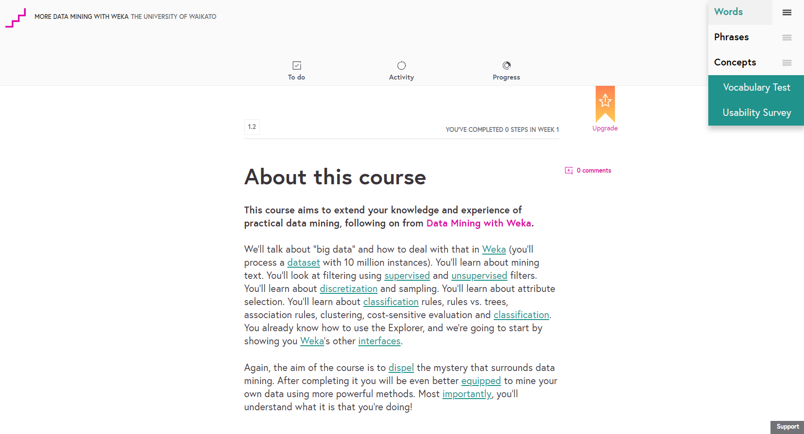
About F-Lingo
Demonstration
Lexical Features
Language Tools
Case studies

Slide 4
About F-Lingo
Demonstration
Lexical Features
Language Tools
Identifying key words, phrases, and concepts in the text you’re reading.
Words
Phrases
Concepts
Key words
Words that do not appear in the first 2,000 BNC/COCA list (Nation, 2012)
Lexical bundles
Identified based on a pre-existing list of commonly used bundles
Collocations
Identified using existing FLAX software, based on syntactical patterns.
Wikipedia concepts
Tagged using Wikipedia Miner

Slide 5
About F-Lingo
Demonstration
Lexical Features
Language Tools
F-Lingo provides definitions, example sentences, related collocations, Wikipedia definitions, and related articles.
Words
Phrases
Concepts
Wiktionary definitions
Example sentences
(from the course)
Related collocations
Wikipedia definitions
Related Wikipedia articles
Example sentences
(from FLAX)
Wikipedia links

Slide 6
About F-Lingo
Demonstration
Lexical Features
Language Tools
Case studies
Longitudinal study
Participants: Learners enrolled in the Data Mining with Weka courses
Methodology: F-Lingo tracks the words, phrases, and concepts that are clicked.
Research questions:
Do learners use it?
Are the word lists useful?
Which do they use the most, words, phrases or concepts?
Do they only click words that they don’t know?
Other evaluations: Optional vocabulary test and usability survey
Task-based study
Participants: Local students
Methodology: Students answers
questions relating to the course
material.
Research questions:
Did using F-Lingo enrich their answers?
Did they find F-Lingo useful?
I would like to run the longitudinal study on other courses – if you are interested, I would love to hear from you!

Slide 7

Thank you
Jemma König, University of Waikato
FLAN London, November 2018
If you are interested in hearing more about our work, would like F-Lingo made available for your students, or would be interested in us running a longitudinal study with your course, please contact me, Jemma König (jlk25@students.waikato.ac.nz)

