Slide 1
FL Archetypes and L2 motivation research: Commonalities and contrasts
Conchúr Mac Lochlainn, Dr. Mairéad Nic Giolla Mhichíl, Stiofán Ó Bríain, Elaine Beirne

Slide 2
Our project – Fáilte ar Líne
Irish 101, 102, 103 and 104!
Ab-initio language learning to A1 level
Strong cultural element
Difficulties of teaching a minority language – my research focuses on ‘who are our learners (identity) and what do they wish to achieve (motivation)?’

Slide 3
L2 learning motivation defined
A complex topic, involving cognitive, social, environmental and situated aspects (Williams and Burden, 1997).
Simple explanation – why, how long and with what intensity? (Dörnyei and Ushioda, 2011)
Generally considered to have some unique or unusual aspects (Dörnyei, 2009) (Gardner, 1985), though much in common with other subjects also (Ushioda, 2009) (Crooks and Schmidt, 1991).

Slide 4
Identity, both social and individual….
Learning a language can be thought of as an expression of identity, both from a self-concept perspective (Mercer, 2011) all the way to a form of social investment (Norton, 1995).
MOOC learning, for casual purposes, could speak to many identities (Zimmerman, 1998) .…
Which ones are the critical question!

Slide 5
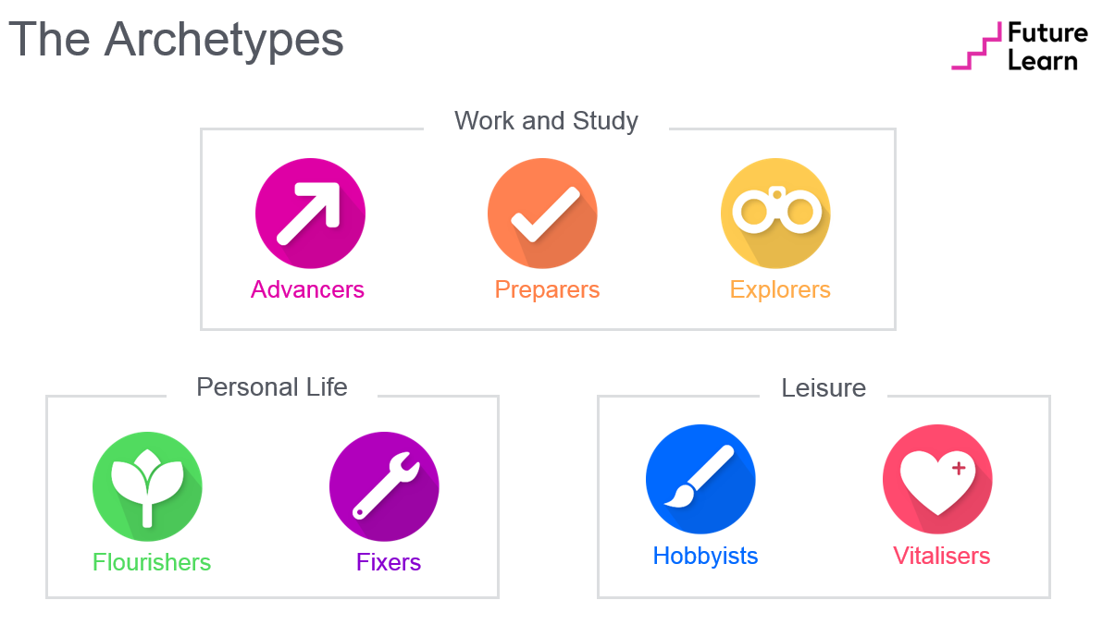
….bringing us to FL Archetypes
“An archetype is a pattern of behaviour that others are likely to follow” – FL Archtypes Deep dive.
7 main archetypes, split into 3 categories.
To what degree does an archetype represent sustained behaviour?
Methodology is clear but implications less so…

Slide 6
Research commonalities - examples
In our course, vast majority categorised as Hobbyists, or Vitalisers.
Compatible with notions of intrinsic motivation, and learning for its own sake.
Such MOOC learning as a casual pursuit? Evidence of real meaning.
SLA research concerned with acquisition and continuation, archetypes (to a degree) likewise.

Slide 7
Contrasts
Psychological focus on learner motivation within SLA has tended to look for holistic learning patterns, with a shift towards considering context (Ushioda, 2009) (Dornyei, Henry and Muir, 2015).
Understanding the process of acquisition has tended to focus on certain temporal points of interest over a lifetime, rather than on underlying traits or behaviour alone.
Social attitudes and interaction with others likely critical.

Slide 8
The limits of archetypes
Famous person-situation debate (Mischel, 1968) speaks to limits of categorising human behaviour…it often depends!
Are they posited to have predictive power?
Do they hold across differing contexts?
What is their ultimate purpose?
Credit – Flower Travellin’ man/ Shutterstock

Slide 9
Our research into Irish L2 learner motivation
I am on ill-health early retirement because of a head injury which affects my memory. My specialist told me that to learn a language, the less like English the better was the best treatment. I have also always felt a little foolish at not being able to speak my own language.
- Learner, Irish 101

Slide 10
Conclusion – mixing archetypes and L2 learning
Rich lines of research are possible on linking academic motivation (e.g self-concept) of various fields and the concept of learner archetypes.
L2 Archetypes research tends to focus more on academically-salient personality traits: ‘e.g. motivated + low proficiency+ unconfident’ (Chan, Dornyei and Henry, 2015: 6).
Focus on learning important, not purely behaviour or traits.

Slide 11
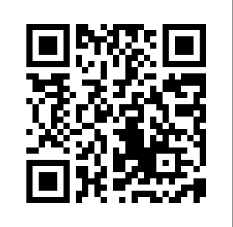
Go raibh maith agaibh! (Guh rav moh ah gwiv)
To register for Irish 101 - https://www.futurelearn.com/courses/irish-language
Our website - https://www.failteonline.ie/
Follow us on twitter @failteonline

Slide 12
References
Chan, Letty, Dornyei, Zoltan and Henry, Alastair. 2015. Learner Archetypes and Signature Dynamics in the Language Classroom: A Retrodictive Qualitative Modelling Approach to Studying L2 Motivation.
Crookes, Graham and Schmidt, Richard. 1991. Motivation: Reopening the research agenda. University of Hawai’i Working Papers in ESL, Vol. 8, No. 1. PP 217-256.
Dörnyei, Zoltán. 2009. The L2 Motivational Self System. In ‘Motivation, Language Identity and the L2 self’, Dörnyei, Zoltán and Ushioda, Ema (Eds.). Bristol: Multilingual Matters. PP 9-43.
Garder, Robert. 1985. Social Psychology and Language Learning: the role of attitudes and motivation. London: Edward Arnold.
Mercer, Sarah. 2012. Self-concept: situating the self. In Mercer, Sarah, Williams, Marion and Ryan, Stephen (Eds.) ‘Psychology for Language Learning: Insights from theory, research and practice’. Springer Press. PP 10-25.
Mischel, Walter. 1968. Personality and assessment. New York: Wiley.
Norton Peirce, Bonnie. (1995) Social identity, investment, and language learning. TESOL Quarterly Vol. 29, No. 1. PP 9-31.
Ushioda, Ema. 2009. A Person-in-Context Relational View of Motivation. In In Z. Dörnyei, & E. Ushioda (Eds.), ‘Motivation, language identity and the L2 self’. Bristol: Multilingual Matters. PP 215-228.
Williams, Marion and Burden, Robert. 1997. Psychology for Language Teachers: A social constructivist approach. Cambridge: Cambridge University Press.
Zimmerman, D. H.1998. Discoursal identities and social identities. In C. Antaki and S. Widdicombe (Eds.): Identities in Talk . London: Sage, pp. 87–106.

