Slide 1
Metrics for MOOCs & Masters
Sir Timothy O’Shea
University of Edinburgh

Slide 2
What has changed
Cost
Reach
Scale
Speed
Volume of Data
Collaboration
Sensing

Slide 3
Taxonomy
Massive / Small
Open / Closed
Universal / Niche
Group / Individual
Open Source / Proprietary
For Interest / Award Bearing
Understanding / Competency
Cohort / Random Entry

Slide 4
Two Extreme Points
Edinburgh Online Master’s in Advanced Surgery
Only Surgeons in Hospitals
Oversight of Royal College
Obligatory visit to City of Edinburgh
Versus
Uruguay & Edinburgh - MOOC Code Yourself!
Any aspirant programmer
Spanish, Arabic or English speakers
Partnership ORT Uruguay & U of Edinburgh

Slide 5
EDINBURGH POSITION
80 Online Masters
40 MOOCs
Variety of Platforms
Devolved Course Invention
Central Quality Assurance
Exciting Innovations
Professional Schools Leading
All Colleges & Schools
MSc in Digital Education
Aspiration for Scale

Slide 6
Distance Learning Course Anatomy
Correspondence Text
Tutor Marked Assessments
Computer Marked Assessments
Instructional TV
Instructional Radio
Course Timetable
Home Experiment Kit
Course Reader

Slide 7
Distance Learning Course Anatomy 2
Study Group Tutorials
Summer School Week
Computer Assisted Learning
Final Exam
Tutor Notes
Marketing Strategy
Developmental Testing
Summative Evaluation

Slide 8
Distance Learning Course Anatomy 2
Correspondence Text
Tutor Marked Assessments
Computer Marked Assessments
Instructional TV
Instructional Radio
Course Timetable
Home Experiment Kit
Course Reader

Slide 9
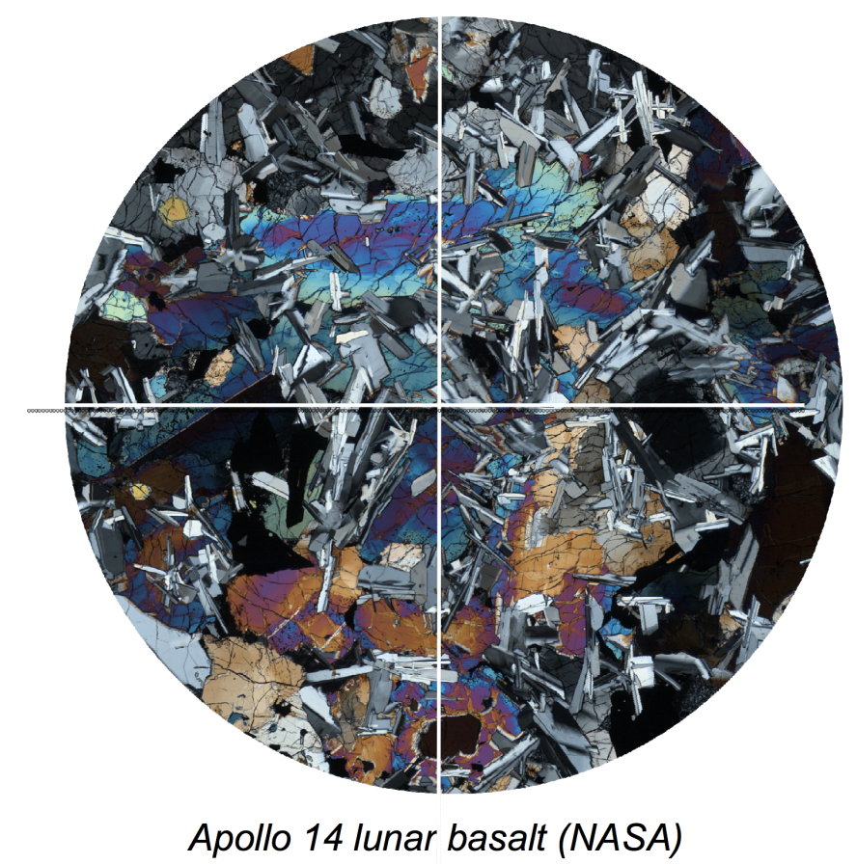
Science: Virtual microscope
Mid-1990s: 12 rock sections on CD-ROM
Now:
Huge library of rocks online:
- UK, Beagle, Meteorites, Moon
Histology/histopathology

Slide 10
Distance Course Team Roles
Course Team Chair
Text Author
Text Editor
Graphic Designer
TV Producer
Radio Producer
Home Kit Technician

Slide 11
Distance Course Team Roles 2
Educational Technologist
Exam Board Chair
Course Manager/Co-ordinator
Personal Tutor
Marketing Specialist
Student Voices
Quality Assurance

Slide 12
Rough Ratios 1970 - 1980
~50 : 1 / Text Writing Weeks : Study Weeks
~200 : 1 / CAL Programming Hrs :Interaction Hr
~25 : 1 / Students in a Group : Personal Tutor
~30 : ~2000 / Team Size :Minimum Student Nos
~35% dropouts reporting workload pressure
~90% high satisfaction among completes

Slide 13
1980 - 2012 Increasing
Computer Assisted Learning
Virtual Online Study Groups
Online Tutorial Support
Online Simulations
Online Databases
OERs
Narrower Vocational Courses
Distance Teaching Universities

Slide 14
1980 - 2012 Decreasing
TV
Radio
Specialist Team Roles
Summer Schools
Physical Home Experiment Kits
Reader Style Collections of Articles
Survival Times of EdTech Companies
Course Production Timescales

Slide 15
MOOC Revolution 2012!
Very very short ‘courses’
High student numbers
Very high non-completion
Very small or one person course teams
Lightweight ‘assessment’
Intensive use of OERs
Respectable University Providers
Surprising Outcomes

Slide 16
Introduction to Philosophy
Michela Massimi & colleagues
One of the very first UoE MOOCs launched in January 2013
The most popular MOOC ever in Coursera
over half-million enrollments across old Coursera platform and new on-demand platform

