Slide 1
Evaluating educational impact and learners support within OU MOOCs
Rebecca Ferguson The Open University
FLAN: September 2014

Slide 2
Challenge
Actions: Define a framework for evaluation of/comparison of support models being deployed by OU MOOCs. Evaluate the support models. With reference to JIFL, help to identify indicators of performance and key performance indicators that can be used to assess the progress, developments and achievements of MOOCs.
Actions: Devise a framework to establish whether MOOCs achieve their stated learning outcomes, supporting learners appropriately to achieve their goals. Make use of basic data supplied by OMU (including click through, income, number of views and dwell time). With reference to JIFL, help to identify indicators of performance and key performance indicators that can be used to assess the progress, developments and achievements of MOOCs.

Slide 3
Who for?
Pro-vice chancellor
FutureLearn team
Course teams
Learning Teaching Solutions
Marketing
Faculties
Library
Quality assurance
Research community

Slide 4
Why?
Quality assurance
Internal comparison – with formal and informal
Internal comparison – across MOOCs
External comparison
Offer a good learner experience
Job satisfaction
Support journeys from informal to formal
Research

Slide 5
Which MOOCs?
Ecosystems (2013)
Moons
Start Writing Fiction (spring)
Ecosystems (2014)
Managing My Money
Forensic Psychology
Talk the Talk
Basic Science: Understanding Numbers
Basic Science: Understanding Experiments

Slide 6
What learning? Whose learning?
Learning about subject
Learning about tools
Learning about people
Learning by learners
Learning by course team
Learning by Facilitators
Learning by the university

Slide 7
Headline figures

Slide 8
Survey data
 | Ecosystems | Moons
I know a lot more about this subject now | 55% | 73%
I know a little more about this subject now | 44% | 26%
My knowledge of this subject has not changed | 1% | 1%
 | Ecosystems | Moons
This course made me want to study more | 83% | 79%
I would like to study with The Open University | 10% | 14%

Slide 9
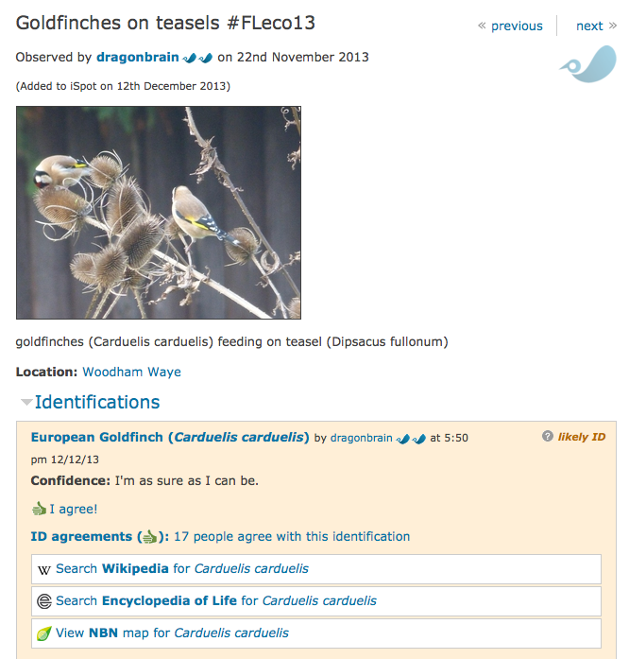
Course-inspired activity
Try and find four different organisms living in a habitat near you and suggest the place that they might occupy in an ecosystem. Ideally, for each you should take a photograph and upload it to iSpot. You will find instructions on how to do this in the downloadable PDF document below.
3296 signed up
1075 added course tag to pics

Slide 10
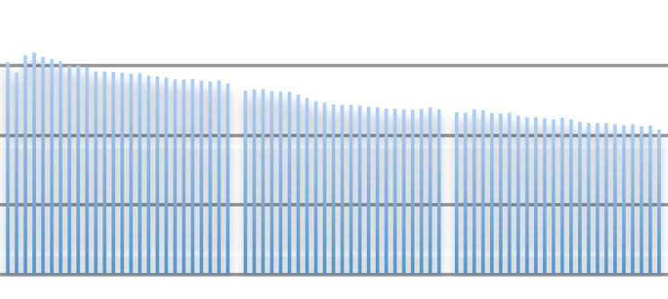
Relate activity to learning design

Slide 11
Assessment

Slide 12
Online discussions
83: ‘I learned / I learnt / I have learned/ I have learnt’
I was a bit concerned at first that the course would be too "catalogue-type" - e.g., "What is the biggest / smallest moon" and while there was a bit of that, I learned a lot about tides, cryo-vulcanism and other mechanisms in moon formation.
Educational impact

Slide 13
Online discussions
29: ‘Thought provoking / thought-provoking’
22: Now know / now understand
120: ‘Informative’
Thank you for the explanation. I chose the other 3 options for Q 8 and got it wrong. I now understand why
Must thank everyone on here for such an interesting and informative dialogue throughout the course so far
Educational impact

Slide 14
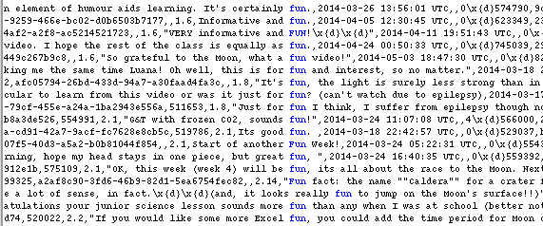
Toast / toaster / toasters / fun
Educational impact

Slide 15
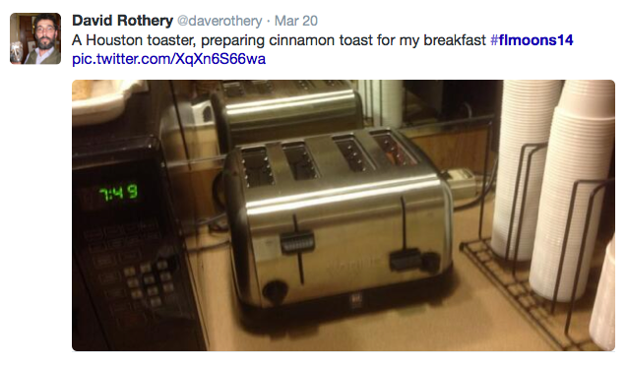
Can an orbiting object the size of a toaster qualify as a moon?
Educational impact

Slide 16
Clearly, the OU have introduced a new unit of measurement into this course so here are some equivalents*;
Height of an elephant = approx 103 toasters.
Length of blue whale = approx 1000 toasters.
Equatorial radius of Moon = approx 58 million toasters.
Equatorial radius of Ganymede = approx 87 million toasters.
Equatorial radius of Jupiter = approx 2.4 billion toasters.
From my house to the centre of London = approx 8 million toasters.
I think that, from these dimensions it should be a fairly straightforward job to work out exactly how big a moon should be.
[Mike Pollard]
27 likes
7 replies
Educational impact

Slide 17
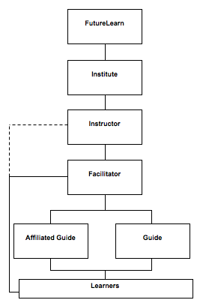
Support structure
Facilitators help with
motivation
socialising
information exchange
knowledge construction
learning development

Slide 18
Support structure risks
Learners fail to learn as effectively as they might (and worse than on other platforms) with implications for both reputation and business
The platform faces the same criticisms as other MOOC platforms (regarding the inadequacies of learner support)
Learners think the inadequate support is representative of Partner support for their registered students
The social space in FutureLearn is not just ineffective, but potentially dangerous (pleas for help left unanswered, unsuitable groups using space for inappropriate or brand damaging activities).

Slide 19
Evaluating the support structure
1. Facilitators are encouraging and facilitating learners to register for OU courses.
2. Learners are clicking through to OU course registration pages.
3. Learners are satisfied with the support provided by the Facilitators
4. Facilitators report that their online moderation skills have increased.
5. Facilitators are supporting effective learning.
6. Learners view the support structure on the MOOC as being as good, or better, than that support provided on other MOOCs.

Slide 20
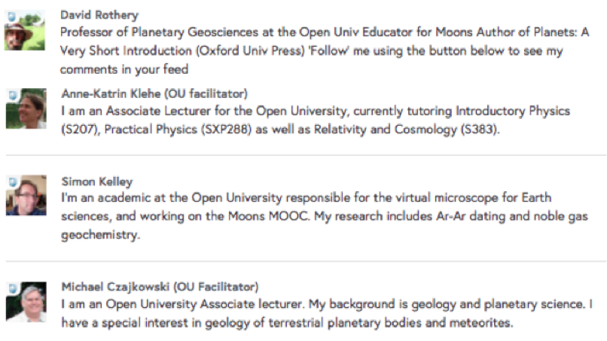
Staff introductions

Slide 21
Facilitator activity

Slide 22
Learner comments
Thanks to the OU facilitators I now get a better understanding of the topic.
The slides are enlightening ... as are the hints given by the OU facilitators.
Thank you David, Jess, Michael & the rest of the OU team. This MOOC has been fantastically informative AND fun, fabulous content full of fascinating insights & up to date research findings.

Slide 23
Facilitator comments
Hi David, well reasoned, I hope other contributors get to read your comments.
You can always look into doing something in Astrophysics with the OU (but I don't know whether I am allowed to advertise their modules). There are some really good ones about.
Hi Richard twitter hash tag #flmoons14 offers a way to alert people to news that risks being lost in a sea of posts in these comments/discussions threads

Slide 24
Facilitator interviews
Need to be able to access the course site before it opens to learners
New messages flagged clearly.
Ability to pin messages at the top of discussion – for example, an answer to a question that is asked on several occasions.
Ability to log on in different roles – without appearing on different courses badged as an OU Facilitator.

Slide 25
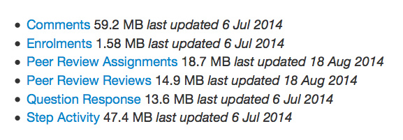
‘Business as usual’
Standard format for reports
Ongoing concerns and questions
Appropriate software
Systems in place to deal with feedback

