Slide 1
Learning design & learning analytics – building the links
Rebecca Ferguson The Open University
FLAN: May 2014

Slide 2
Why learning design?
Provides a set of tools and information to support a learner-activity based approach
Helps to show the costs and performance outcomes of design decisions
Puts the learning journey at the heart of the design process
Enables the sharing of best practice
Helps partners choose and integrate a coherent range of media, technologies and pedagogies
Enables a consistent and structured approach to review and analytics

Slide 3
Just found out that squirrels eat lichen
Analytics and design
What have students on my course learned?
I just found out that there are Fens here in Ireland
Have committed to this course… it will give me the opportunity to learn how to write a blog
Have students on my course learned what I expected them to learn?
Notes:
I’m from the UK’s largest University. Over 40 years old
Runs its own courses and awards its own degrees
342 undergraduate modules, 60 CPD modules and 141 post-grad modules
43% have 1 A level or lower at entry

Slide 4
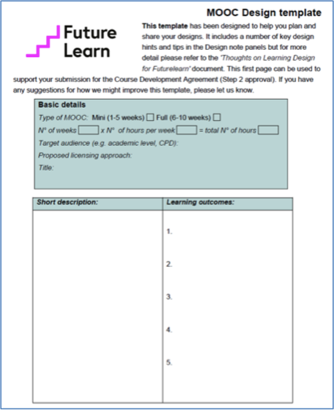
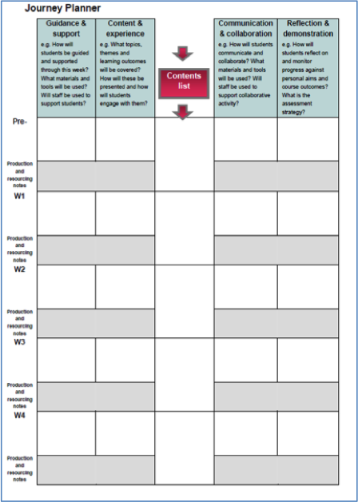
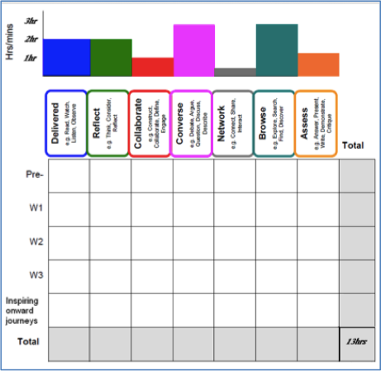
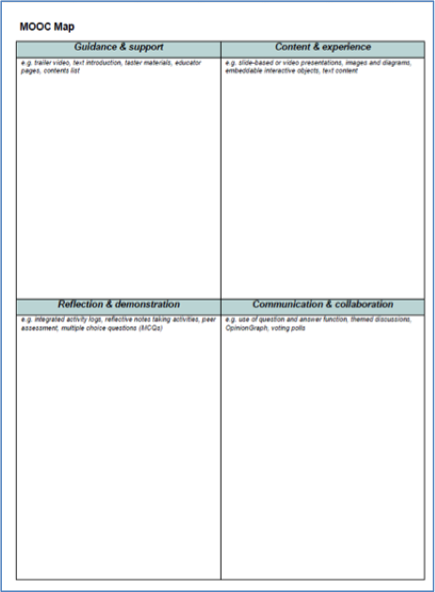
MOOC learning design tools
MOOC design template
MOOC planner
MOOC map
Journey planner

Slide 5
MOOC design template
Requires a short description of the course and a list of intended learning outcomes

Slide 6
Outcomes and analytics
Learning outcome
How this is assessed
Be able to define an ecosystem.
Have joined the iSpot community and obtained identifications for animals, plants or fungi.
Multiple choice. Week 1, question 5
Self report.
Analytics
How many attempted that question? How many got it right 1st / 2nd / 3rd time? How many followed the link back to resources?
Access to iSpot data. Use of MOOC hashtag. Persistence over time. Ethical implications of tracking off-site.

Slide 7
MOOC planner
Prompts designers to block out different types of learning activity
Delivered
Reflection
Collaboration
Conversation
Networking
Browsing
Assessment

Slide 8
Planner and analytics
Delivered Content (reading, watching, listening and observing)
Analytics: amount of content viewed, dwell time
Reflection
(thinking, considering and reflecting)
Analytics: returns to the same material, reflection exercises completed, quality of reflection
Collaboration
(constructing, collaborating, defining and engaging)
Analytics: collaboration exercises completed, quality of collaboration

Slide 9
Planner and analytics
Conversation
(debating, arguing, questioning, discussing…)
Analytics: number and length of contributions to discussion, quality of discussion
Browsing
(exploring, searching, finding and discovering)
Analytics: Number of click-throughs to external links, number of visits, number of resources
Assessment
(answering, presenting, demonstrating, critiquing…)
Analytics: Assessments completed, scores, dwell time on hints, persistence in answering questions

Slide 10
MOOC map
Production checklist
Identifies key features of the course

Slide 11
MOOC map and analytics

Slide 12
Journey planner
Coherent narrative view of the learning journey
Shows relationships between tools, resources, activities and content narrative

Slide 13
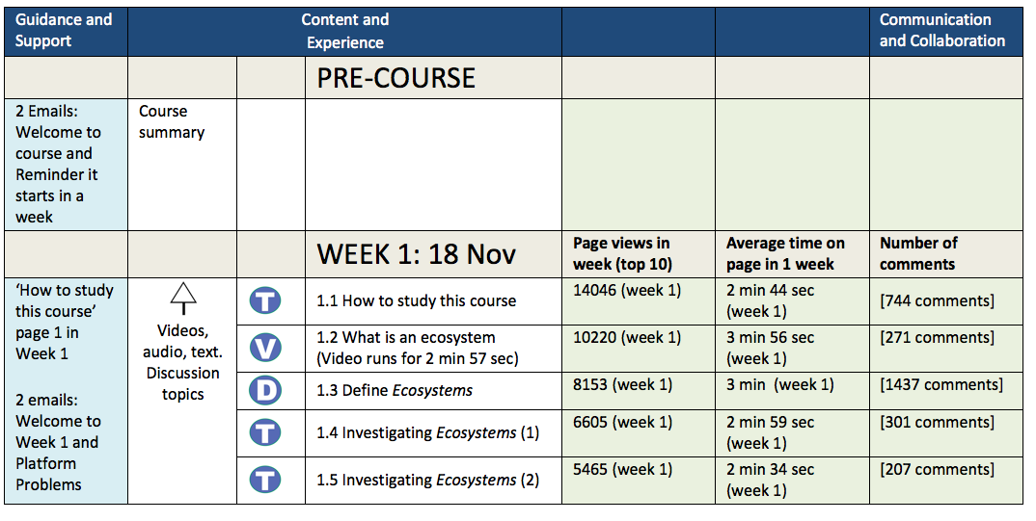
Relating analytics to design

Slide 14
Advantages of design for analytics
Helps to frame and focus analytics questions
What did they learn?… in relation to learning outcomes
Were they social?... when they were collaborating
Did they share links?... when encouraged to browse
Did they return to steps?... when encouraged to reflect
Helps to identify appropriate forms of analysis
The same step, but with a focus on
Number of visits if content
Length, quality, number of comments if conversational
Dwell time and repeat visits if reflection

Slide 15
Advantages of design for analytics
Helps to identify useful analytics
What do learners need to know in order to network, collaborate, browse or reflect?
What do educators need to know to support them?
Helps to identify gaps in the data
Which data do we need from FutureLearn?
Helps to identify gaps in our toolkit
Which design elements can we look at easily?
Which ones still pose problems?

