Slide 1
A keyword analysis between lone posts and initiating posts
FLAN meeting in Glasgow 6 September 2018
Why did nobody reply to my post?
Shi Min Chua @shiminchua
Notes:
Information packaging
Feedback: what is the difference between initiating post and lone post which use the same keywords (explicitly ask for replies)
Explicit vs. not intending to ask for reply: manual coding

Slide 2
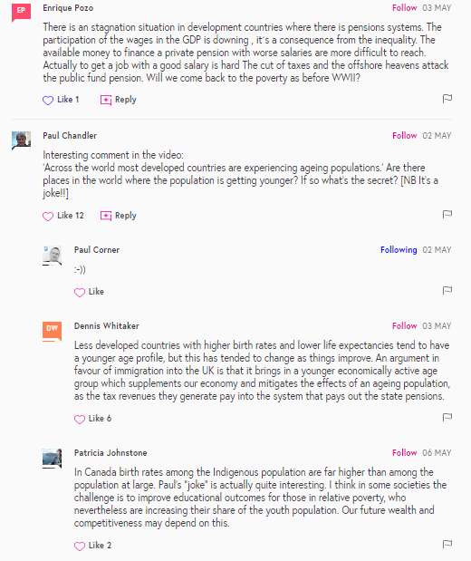
Types of Posts
Number of Posts | Number of Tokens
117863 | 6162230
32080 | 2401795
54172 | 2642195
Lone Post
Initiating Post
Reply

Slide 3
Why?
Overabundance of Lone Posts in CMC
Usenet groups (Burke et al., 2007; Himelboim, Gleave, & Smith, 2009)
Online news commenting spaces (Ziegele, Breiner, & Quiring, 2014)
Distance learning online discussion (Dennen & Wieland, 2007)
Levelling ground, not constrained by face-to-face conversation (Cavangah, 2007)
Content (Joyce, Anand, Kraut, 2014; Ziegele et al., 2014)
Time of posting (Jeong & Frazier, 2008)
Size & topic (Himelboim, 2008)
Stylistic and linguistic features

Slide 4
Motivation for examining Initiating Posts vs. Lone Posts
Probability of posting again increased (Joyce & Kraut, 2006)
Join the discussion for interactive purposes rather than cognitive gains (Springer, Engelmann, & Pfaffinger, 2015)
Initiate direct and explicit interaction,
which is essential for dialectical, critical discourse and argumentation (Rourke & Kanuka, 2007)
Meaning-making and co-construction (Stahl, 2003)
MOOC learners may feel frustrated if their posts are seldom responded to (Hew & Cheung, 2014)

Slide 5
Motivation for examining Initiating Posts vs. Lone Posts
Conversation with oneself or learning materials (Laurillard, 2012).

Slide 6
Keyword Analysis: Cut-off Criteria
Comparing initiating posts to lone posts
the log-likelihood ratio test, p < 0.000000000001 (Flowerdew, 2015)
Keyness indicator (effect size): Bayes Factor > 10 (Wilson, 2013)
Normalized frequency > 5 per 100,000 (McEnery, 2016)
Dispersion Measure, Gries’ Deviation of Proportion (Gries’ DP, Gries, 2008; Lijffijt & Gries, 2012) < 0.30
Learners | Lone Posts | Initiating Posts
Keywords | 77 | 70
example
Raw frequency | 2574 | 1324
Normalized Frequency | 0.00042 | 0.00055

Slide 7
Analysis of Keywords
Labelling
Step 1
Concordance lines of each keyword
Salient meaning/function (McEnery, 2016)
Biber et al (1998), Wmatrix (Rayson, 2017),
Step 2
Functional grouping of keywords
Interpretations based on groups of keywords
Categorized based on function related to dialogic learning and MOOCs
Step 3
Discourse/conversation analysis of selected keywords (O’Keeffe & Walsh, 2016)
Grouping
Case Studies

Slide 8
Dialogic Expansion
v.s.
Dialogic
Contraction
Martin & White (2004)
Heteroglosia (Baktin, 1986)
Alternative voices
“Represents the proposition as but one of a range of possible positions”
Allows dialogic alternatives
“In my view the banks have been greedy.”
Monoglossic
Categorical or bare assertion
No reference of others’ viewpoint
“The banks have been greedy.”
Modals, Hedges, Boosters, Pronouns, Evaluatives (Fairclough, 2003)
Stance and intersubjectivity (Du Bois, 2007)

Slide 9
Stance Expression
 | Initiating Posts | Lone Posts
Modal expression | might, would, could | will, need, able
Hedging | perhaps, seems, sort
Quantifier | any | all, lot, much, every
Epistemic expression | wonder, wondering | aware, understanding, learned
…this is perhaps because we tend to…
…This might mean actually walking…
…I wonder would the microbial diversity also mirror…
We need to be more exact…
…I need to be ambidextrous…
...money taken in by a Company is not all down to their own effort, it relies on…

Slide 10
Stance Expression
 | Initiating Posts | Lone Posts
Booster | surely, just, rather, else | really, very, definitely, always
Mental verbs |  | feel, feeling, think, agree, keen, hope, hoping, looking, forward, enjoy, enjoyed, love
Evaluative | wrong | difficult, easy, excellent, better, interesting, informative, great, important, good, new
Negation | cannot, ca, n't
…I really don’t see the point of…
…Really looking forward to learn…
…I enjoyed this course and definitely learned a lot in…
Excellent range of resources, thanks!
I agree with this definition regarding health

Slide 11
Pronouns
 | Initiating Posts | Lone Posts
Pronouns | he | I, my, our, their
Indefinite pronouns | anybody, anyone | everyone
Addressing general audience, instead of “you” which is used in one-to-one setting (Tagg, 2012)
Arbitrary instead of all inclusive (Biber et al, 1998)
Notes:
Addressing general audience with these unspecified pronouns suggested that learners were trying to engage with other learners in a dialogue in their initiating posts with a personal touch despite not knowing any name, and it could be weird to use “you”, which was not a keyword in initiating posts Yes, and this stands in contrast to personal one-to-one text messaging, for example, in which the most frequent word is ‘you’ – Tagg (2012)!
508 instances of “anyone” (60%) and 45 instances of “anybody” (32%) were used in a sentence ended with a question mark
75 instances of “anybody” (53%) were modal, “be” verb or auxiliary verbs, suggesting question format. For example, “can anybody”, “does anybody”, “has anybody”, “did anybody”, “could anybody”, “is anybody” and “would anybody

Slide 12
Keyword: anybody in initiating posts
Request for recommendation
“…So, does anybody have a good suggestion for a text book on Anaconda, Python and Pandas?”
Offering recommendation
“…Suggest anybody else that may still be receiving 'file not found' for exercise 6 could try the same thing…”
Looking for shared experience
“Is it just me or does anybody else have issues find <sic> the PwC paper?” Is this a frequent phrase?
Notes:
involvement, agency

Slide 13
Keyword: everyone in lone posts
Greetings:
Among 4375 instances, 975 “Hi everyone”, 868 “Hello everyone”
Appreciation:
428 “Thank(s)… everyone”
Making stances
-104 “not everyone…”
-”…we need everyone to control our daily waste…”
Narrative
“…especially when considering the spread of disease and how closely everyone lived in the cities…”
Notes:
Every inclusive quantifier (Biber et al, 1998)
Addressing general audience with these unspecified pronouns suggested that learners were trying to engage with other learners in a dialogue in their initiating posts with a personal touch despite not knowing any name, and it could be weird to use “you”, which was not a keyword in initiating posts Yes, and this stands in contrast to personal one-to-one text messaging, for example, in which the most frequent word is ‘you’ – Tagg (2012)!
508 instances of “anyone” (60%) and 45 instances of “anybody” (32%) were used in a sentence ended with a question mark
75 instances of “anybody” (53%) were modal, “be” verb or auxiliary verbs, suggesting question format. For example, “can anybody”, “does anybody”, “has anybody”, “did anybody”, “could anybody”, “is anybody” and “would anybody

Slide 14
Questions and Request
Keywords in initiating posts:
anybody, anyone, question, please, ?, wonder, wondering, why
“Question: does anybody knows what kind …?”
 | Initiating Posts | Lone Posts
Discourse Particles | please, sorry | thanks, thank
Punctuation | ,…-();?"': | !.
Meta-language | question, article | information, course, knowledge

Slide 15
Connectors
 | Initiating Posts | Lone Posts
Connectors | if, or, then, example, e.g. | also, and
qualify or elaborate on a proposition by specifying a condition
if- conditionals
“…If the aggregate is predominately very fine, the gaps between particles are …If the aggregate is all very large, ….
An example of this could be that, a person with depression that comfort eats and does very little else thus causing them to be obese
Notes:
Addressing general audience with these unspecified pronouns suggested that learners were trying to engage with other learners in a dialogue in their initiating posts with a personal touch despite not knowing any name, and it could be weird to use “you”, which was not a keyword in initiating posts Yes, and this stands in contrast to personal one-to-one text messaging, for example, in which the most frequent word is ‘you’ – Tagg (2012)!
508 instances of “anyone” (60%) and 45 instances of “anybody” (32%) were used in a sentence ended with a question mark
75 instances of “anybody” (53%) were modal, “be” verb or auxiliary verbs, suggesting question format. For example, “can anybody”, “does anybody”, “has anybody”, “did anybody”, “could anybody”, “is anybody” and “would anybody

Slide 16
Others
 | Initiating Posts | Lone Posts
Connectors | if, or, then, example, e.g. | also, and
Comparative terms/relational | than, same | more
Grammatical | the, that, there, here, does, did, was, were, 's, on, by | am, 'm, have, for, about, with, to
Punctuation | ,…-();?"': | !.
Speech act | mean, explain, tell, says, say, told, called
Verbs in past tense/passive form | used, tried, came | joined
Verbs in present tense/infinite form |  | affects, helps, achieve, work , gain, meet, improve
Uncategorized | 1, one, two, numbers, missing, following, why, whether | like, well, week, main, currently, working, opportunity, education, environment, mind

Slide 17
Conclusions
Initiating posts:
Questions and hedging to show uncertainty
Addressing with indefinite pronouns, so anyone could respond, give agency to others
Negation to voice out alternatives
Lone posts:
Appreciation, Emotion, Evaluation
Agreement
Self-mention

Slide 18
Acknowledgement
Dr Caroline Tagg, Prof Mike Sharples, Prof Bart Rienties
Leverhulme Trust
Course Providers
shimin.chua@open.ac.uk

