Slide 1
Are we afraid of participation rates in short courses/ MOOCs or are we just dodging the bullet?

Slide 2
Platforms, do they overly influence learning design decisions and misshape instead of enhance the learning experience or do they ensure consistency and comparability?

Slide 3
“If you are not paying you are the product”, are we treating our learners equitably or are we taking advantage of them?

Slide 4
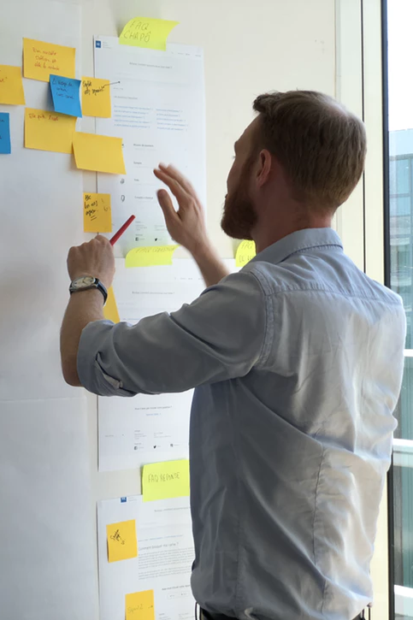
Do it yourself learning otherwise known as autonomous learning - is there an overemphasis on this particularly when we know the importance of the teacher/instructor in learning contexts?

Slide 5
Are the value propositions for research at scale being realised, or are we left with big questions and limited answers?

