Slide 1

A Statistical Analysis of Engagement in Arabic Language MOOCs
Dr. Alan Hayes
This work was obtained from the PhD thesis of Dr. Shahad Almansour (shahad.almansour@gmail.com)
The PhD thesis was supervised by Dr. Alan Hayes and Dr. John Power

Slide 2
Introduction
In 2013, MOOCs reached the Arabic region with the launch of two Arabic-language platforms, Edraak and Rwaq (Mutawa, 2017).
Our objective: improve the understanding of Arabic learners’ use of MOOCs.
Mutawa, A.M., 2017. It is time to MOOC and SPOC in the Gulf Region. Education and Information Technologies, 22(4), pp.1651-1671.

Slide 3
Arabic MOOCs
Platform | Founded | Number of MOOCs | Daily visitors* | Topics
Rwaq.org | 2013 | 300 | 34,844 | Multidisciplinary
Edraak.org | 2013 | 110 | 37,579 | Multidisciplinary
Nadrus.com | 2014 | 153 | 354 | Multidisciplinary
Doroob.sa | 2014 | 114 | 695 | Multidisciplinary
Maharah.net | 2015 | 294 | N/A | Multidisciplinary
Zadi.net | 2015 | 139 | 3205 | Islamic and Sharia law
Aanaab.com | 2016 | 45 | 893 | Education
N/A = Data not available *From CuteStat.com

Slide 4
Project challenges
Limited published literature on Arabic MOOCs
Limited data available from Arabic platforms

Slide 5
English MOOCs
 | (Kizilcec et al. ,2013) | (Ferguson and Clow, 2015)
Platform | Coursera | Futurelearn
MOOCs | Computer Science for high school level Computer Science for undergraduate level Computer Science for graduate level | Physical Science for beginner level Life Science for beginner level Art for beginner level Business for beginner level
Clustering method | K-means clustering | K-means clustering
Clustering variables | Watching video lectures Solve assessments | Watching video lectures Solve assessments Engagement in discussion forum
Kizilcec, R.F., Piech, C. and Schneider, E., 2013, April. Deconstructing disengagement: analyzing learner subpopulations in massive open online courses. In Proceedings of the third international conference on learning analytics and knowledge (pp. 170-179).
Ferguson, R. and Clow, D., 2015, March. Examining engagement: analysing learner subpopulations in massive open online courses (MOOCs). In Proceedings of the fifth international conference on learning analytics and knowledge(pp. 51-58).

Slide 6
English MOOCs
 | (Kizilcec et al. ,2013) | (Ferguson and Clow, 2015)
Results | Sampling: Learners watched only one or two video lectures at the beginning of the course before dropping out. Disengaging: Learners completed the assessments at the beginning, then gradually dropped out. Auditing: Learners engaged with the course only by watching video lectures and did not do the assessments. Completing: Learners engaged fully by watching most of the video lectures and completing the assessments. | Samplers: Few completed one assignment. Strong Starters: engaged strongly with the course at the beginning, then dropped out. Returners: completed the first assignment then returned to complete the second assignment before dropping out. Midway Dropouts: completed three to four assignments before dropping out. Nearly There: completed most assignments, then dropped out before the end of the course. Late Completers: completed the last assignment. However, some assignments were submitted late and some were missed. Keen Completers: completed all assignments on time.

Slide 7
Research Questions
Who are the users of the Arabic MOOC platforms?
What are the engagement types of the Arabic-speaking learners?
How is the engagement of Arabic-speaking learners in a MOOC similar to or different from the engagement of English-speaking learners in a MOOC?

Slide 8
Methodology
Obtain data from an Arabic MOOC
Perform K-means clustering algorithm to identify the engagement types of Arabic-speaking learners
Compare the engagement types of Arabic- and English- speaking learners to identify similarities and differences.

Slide 9

Edraak MOOC
Title: Java Programming 1
Presented by: the Arab Open University, in Jordan
Duration: 5 weeks
Assessment: 1 per week

Slide 10
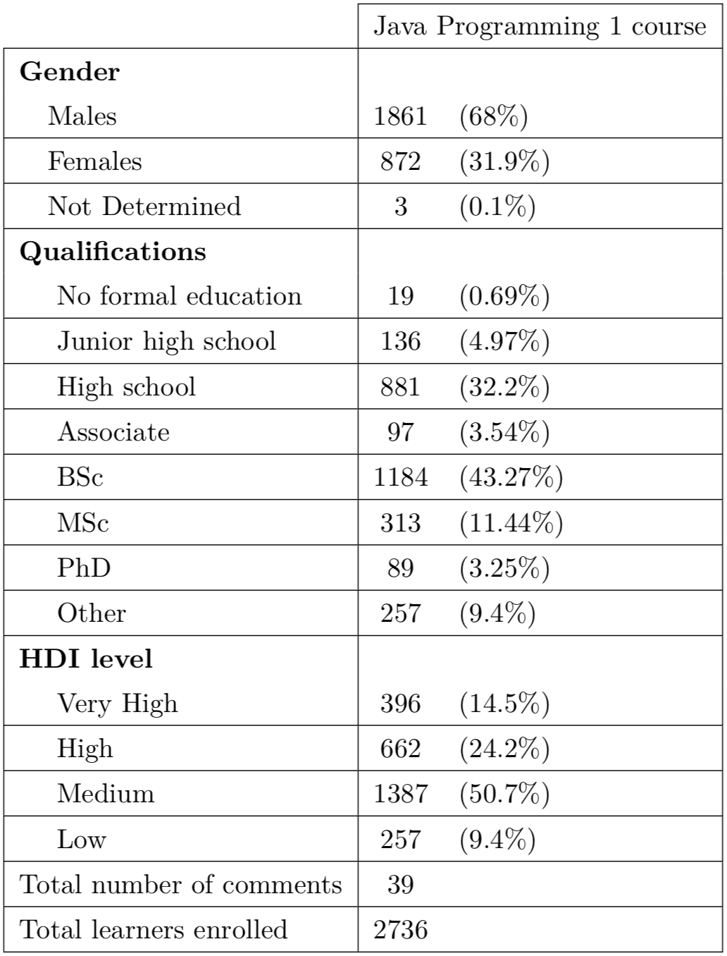
Edraak learners
Males have a higher enrolment rate than females.
Bachelor’s degree holders followed by high-school degree holders represent the majority of learners.
The majority of Edraak learners come from countries with Medium HDI level.
Poor use of the discussion forum.

Slide 11
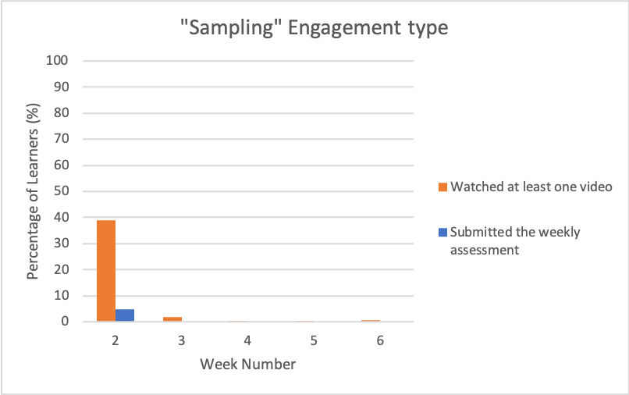
Arabic learners’ Engagement types
Sampling:
learners who had no interaction with the MOOC contents or dropped out from the MOOC after the first week.

Slide 12
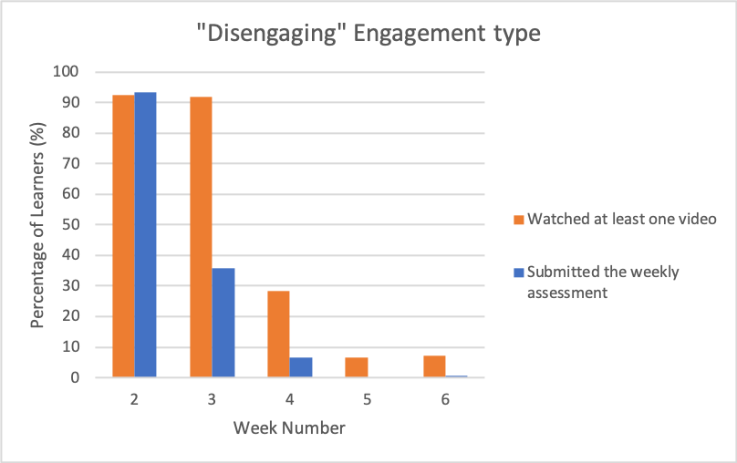
Arabic learners’ Engagement types
Disengaging:
learners who had a good interaction with the MOOC contents at the first week of the MOOC, and gradually dropped out by the middle of the course.

Slide 13
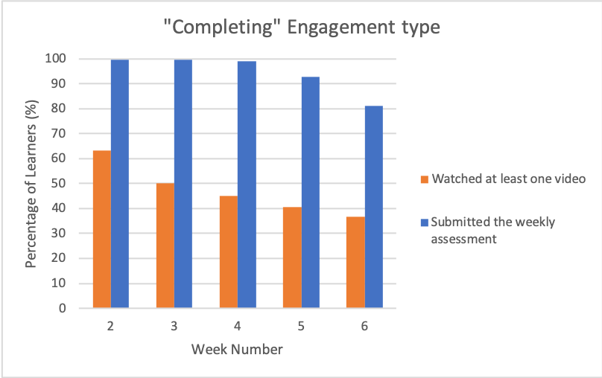
Arabic learners’ Engagement types
Completing:
learners who had a good interaction with the MOOC contents, especially the weekly assessments, throughout the MOOC duration.

Slide 14
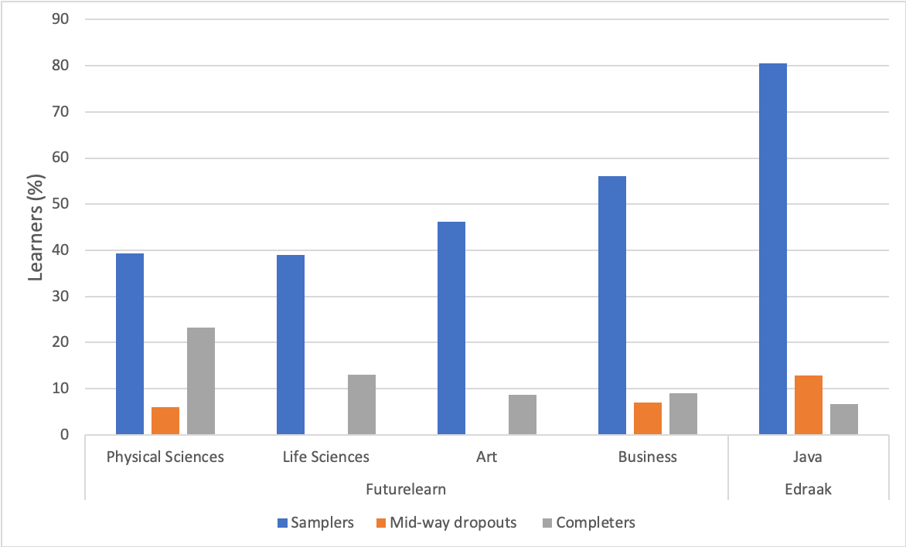
Similarities and differences
Futurelearn VS Edraak
Proportion of Completers in Futurelearn is significantly higher than Edraak.
Proportions of Samplers and Mid-way Dropouts in Futurelearn is significantly lower than Edraak.

Slide 15
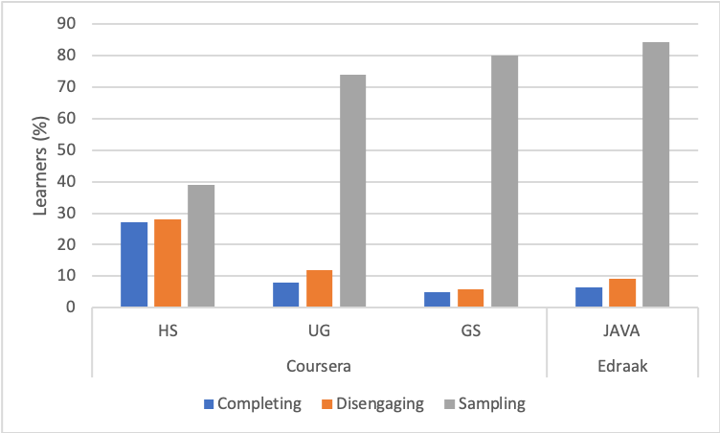
Similarities and differences
Coursera VS Edraak
Coursera’s HS MOOC had significantly higher proportion of Completing and Disengaging, and significantly lower proportion of Sampling than Edraak’s Java MOOC.
Coursera’s UG and GS MOOCs had similar proportions of engagement with Edraak’s Java MOOC.

Slide 16
Similarities and differences
Coursera VS Edraak
Similarities | Gender proportion in both the overall enrolment and within each engagement type.
 | Poor use of the discussion forum.
Differences | Edraak’s learners are mostly from countries with a medium HDI level Coursera’s learners are mostly from countries with a very high HDI level
 | Edraak has more “Completing” learners from countries with high, medium and low HDI levels. Coursera has more “Completing” learners from countries with very high HDI level.

Slide 17
Conclusion
Arabic MOOC platforms provide discussion forums; however, they are rarely used for sharing or exchanging knowledge with the educational community.
Arabic MOOC platforms are designed as traditional classrooms in an online platform where the teacher provides the knowledge and learners are expected to study it and apply it to the weekly assessment to pass the MOOC.
No clear pedagogical approach adopted by the Arabic MOOC platform.

Slide 18
Future work
Obtaining more data and creating a complex classification method for an Arabic MOOC platform
Examining the effect of adopting a pedagogical approach on the engagement of Arabic learners.
Using the result from our initial result to design further analysis (e.g. questionnaire, interview)

Slide 19
Acknowledgments
All thanks to Edraak research team for their cooperation in this research.

Slide 20
Thank you…

