Slide 1
How a "shuffle" link transformed our experience of the peer review engine
Paul Browning
National STEM Learning Centre p.browning@stem.org.uk

Slide 2
About us
National STEM Learning Centre
University of York campus
JVC of White Rose University Consortium
Funded (mainly) by Wellcome Trust, DfE and Gatsby Foundation
Deliver CPD activities to pre-university STEM teachers and technicians
11th operating year – mainly F2F until 2015
By 2017 30% online

Slide 3
Our brief FL history
MOOC pilots – FutureLearn & Canvas Network
Assessment for Learning in STEM Teaching – April 2015 – University of Leeds (AfLV1)
AfLV2 – February 2016 – as Specialist organisation
DfL – June 2016
BfL – Sept 2016

Slide 4
AfLV1
Peer Review then Share

Slide 5
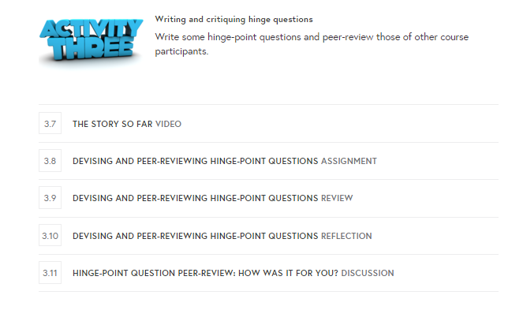
AfLV1 and Peer Review
Peer Review
Share

Slide 6
Everyone Peer Review savvy?
Share

Slide 7
Peer Review Engine – the flow
Earlier step
X.1 Assignment
X.2 Review
X.3 Reflection
POOL of
assignments
Random
Later step
Private to submitter and reviewer

Slide 8
Hinge-point questions (HPQs)
HPQs are designed to help the teacher to check on learning so that they can decide what to do next.
An HPQ enables the teacher to know whether it is appropriate to move on, to recap, or completely re-teach, a concept before moving on – “the most important decision a teacher has to make on a regular basis”.
Typically HPQs:
Have wrong answers that match the most common student misconceptions or alternative conceptions;
Are difficult for a student to get the correct answer(s) with the wrong reasoning or knowledge;
Are quick to answer (in less than two minutes, and ideally in less than one minute);
Allow the teacher to realistically view and interpret all students’ responses in 30 seconds or less and so will often be in multiple choice format.
e teacher to check on learning so that they can decide what to do next.
Writing good HPQs is hard.
Unlike lesson plans HPQs can be usefully shared between teachers.

Slide 9
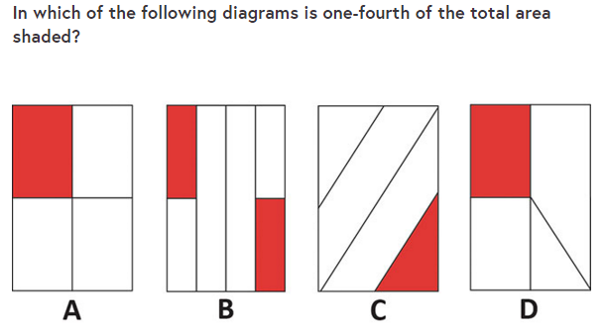
An example HPQ …

Slide 10
Another example HPQ …

Slide 11
AfLV1 – the problem?
3.7 The story so far
3.8 Assignment
3.9 Review
3.10 Reflection
POOL of
assignments
3.11 How was it for you? (Share)

Slide 12
The problem
STEM teachers might be doing:
Biology, Physics, Maths, Chemistry, Computing, D&T, Etc
Biologists didn’t like the Peer Review Engine giving them physics questions

Slide 13
AfLV2 – ideal – multiple pools - parallel?
3.7 The story so far
3.8 Maths
3.9 Maths
3.10 Maths
3.8 Physics
3.9 Physics
3.10 Physics
3.8 Chemistry
3.9 Chemistry
3.10 Chemistry
3.8 Biology
3.9 Biology
3.10 Biology
3.11 How was it for you? (Share)

Slide 14
AfLV2 – workaround – multiple pools - sequential?
3.7 The story so far
3.8 Maths
3.9 Maths
3.10 Maths
3.11 Physics
3.12 Physics
3.13 Physics
3.14 Chemistry
3.15 Chemistry
3.16 Chemistry
3.17 How was it for you? (Share)

Slide 15
AfLV2 – the SHUFFLE solution – still one pool!
3.7 The story so far
3.8 Assignment
3.9 Review
3.10 Reflection
POOL of
assignments
SHUFFLE
choose another one
The "SHUFFLE" link in the review step links to the non-stable path found in the step address on the to-do list (rather than the URL you end up on when you click on it).
Asked learners to put SUBJECT in first line of assignment.
3.11 How was it for you? (Share)
Thank you David Major & Finola Lang!

Slide 16
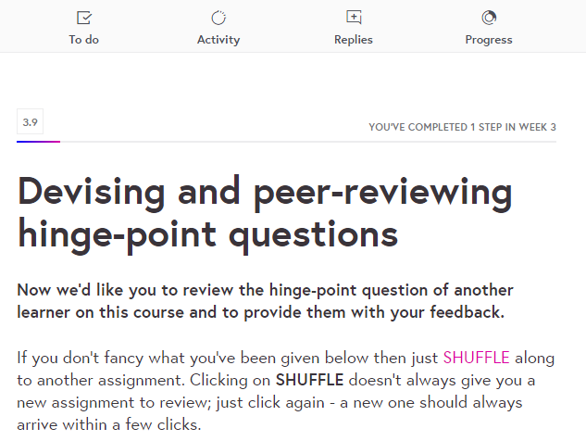
The solution – the SHUFFLE link
https://www.futurelearn.com/courses/assessment-for-learning-stem/1/steps/58217

Slide 17
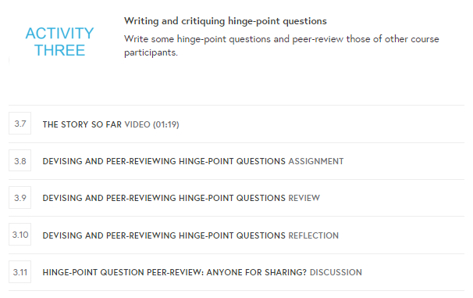
The solution – the SHUFFLE link
https://www.futurelearn.com/courses/assessment-for-learning-stem/1/steps/58217

Slide 18
AfLV2

Slide 19
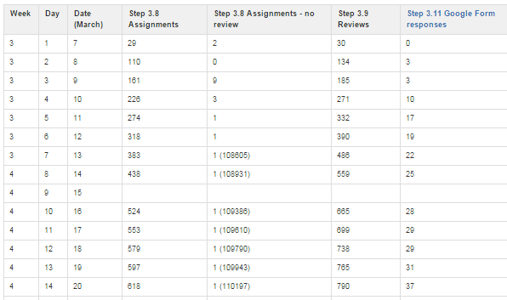
Potential issues?
Growing sub-pool of unpopular assignments?
Not realised – “no review” < 9 and mainly ~ 1

Slide 20
AfLV1 vs. AfLV2 Peer Review
 | V1 | V2
Peer review submissions | 759 | 1507 | V1: 2 HPQs sought in 1 peer review triplet V2: 1 HPQ sought in each of 2 peer review triplets with SHUFFLE link
HPQs shared | 93 | 94 | V1: Community Group (in months after course ended) V2: Google Form
Ignores disparity in joiners – V1:9799 V2:8871

Slide 21
AfLV3 Oct 2016?
Your peer review assignment will be shared!
Crowd-sourced HPQ repository ….
“Share” option on Reflection step (with settable default)?
We need support for embedded images (in discussions too!)

Slide 22
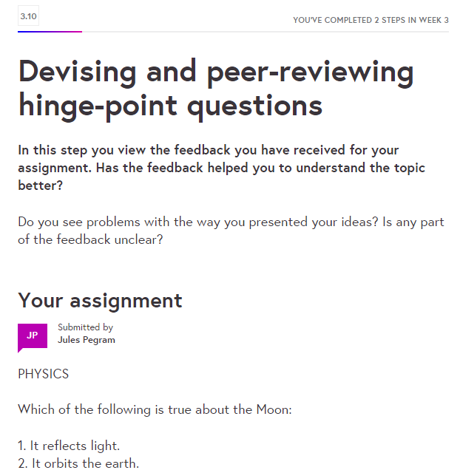
“Share” option on Reflection step?
Share my assignment
Share my assignment and any reviews

