Slide 1
Life-long learning through a research-led MOOC: between rigour and relevance
Doris Dippold
@roadtobabel
School of Literature and Languages
Notes:
Trying to show the stereotypes in the media – implicit bias?
8-10 mins presentation – 15 minutes for q&A
Lots of people from FASS, FEPS and FHMS – students (PGRs)
Drawing out common themes that other researchers could use in their research – communicate findings – engage people in topics – interest
Showcasing your research

Slide 2

We offer a diverse selection of courses from leading universities and cultural institutions from around the world. These are delivered one step at a time, and are accessible on mobile, tablet and desktop, so you can fit learning around your life.
We believe learning should be an enjoyable, social experience, so our courses offer the opportunity to discuss what you’re learning with others as you go, helping you make fresh discoveries and form new ideas.
Source: https://www.futurelearn.com/about-futurelearn

Slide 3


Slide 4

Course design
targeted at professionals who communicate regularly across linguistic and cultural boundaries
a language-led approach to intercultural communication which is NOT drawing on models of cultural difference, but on theories / models from applied linguistics (e.g. English as a lingua franca, politeness theory, interactional sociolinguistics)
an approach which encourages reflection on personal communication rather than providing simple, one-size-fits-all solutions

Slide 5
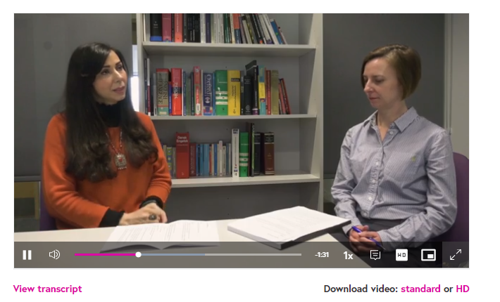
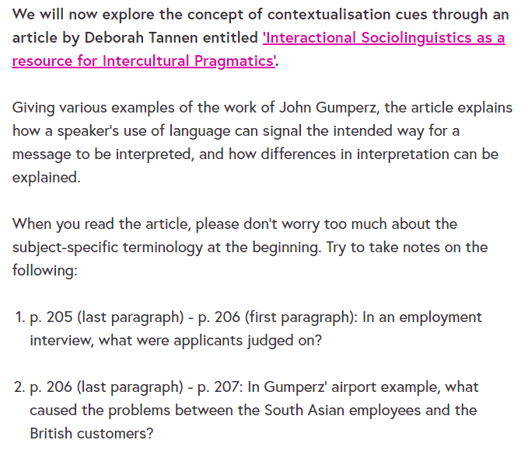
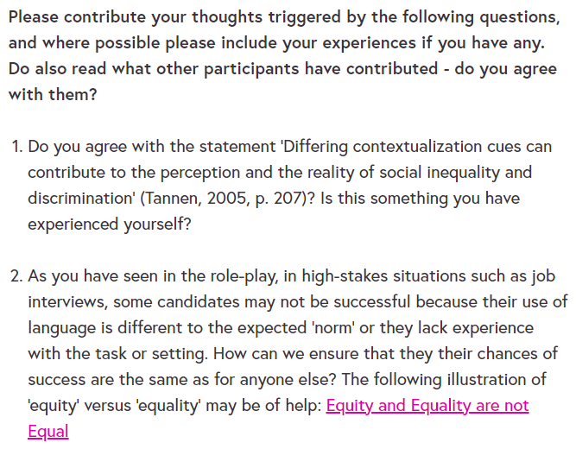
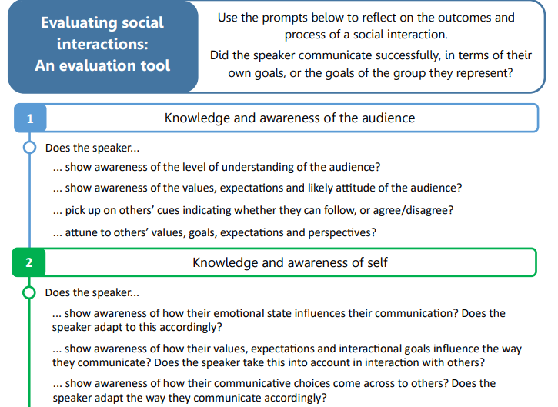
Course design

Slide 6

The awareness, attitudes or understanding of (sections of) the public have been informed, and their ability to make informed decisions on issues improved, by engaging them with research.
Impact aim 1: to engage learners with a language-led perspective on intercultural communication, allowing them to make informed changes to their professional practice
Impact aim 2: to change the practices of intercultural trainers / coaches in terms of how they design the delivery of training
Influencing the design and delivery of curriculum and syllabi in schools, HEIs or other educational institutions.

Slide 7
Course impact: yes….

Slide 8
Course impact: yes…
Impact aim 1: to engage learners with a language-led perspective on intercultural communication, allowing them to make informed changes to their professional practice
The content of Week 3 was really rich and helpful. I can say that the whole course is really useful for me as I belong to an expanding circle country and I had to use English in my 15 years professional life dealing with people from different multicultural circles. I, now, understand how communication can be affected by norms, rules, customs, (Mis) conceptions, and the English we use. I learnt how I can use the communication tool to make my communication and understanding more successful. Thanks to University of Surrey!
I have suggested improvements to our intercultural understanding training so will put forward new ideas created from this course whilst developing of the replacement course. Step back from awareness days, have an action plan for how to do this in general etc
Impact aim 2: to change the practices of intercultural trainers / coaches in terms of how they design the delivery of training

Slide 9
…. but also:
To me, all the advice was simple common sense. No need for the technical jargon.
Course was full of academic jargon. Many participants understood somewhat & seemed to increase their understanding as we went along. However, I have a mental dislike of it as it propagates elitism. Nevertheless, I found useful information in each unit, so thank you.
For a MOOC aimed at students from across the world. The content is too centred around one geographic area. The quizzes tested typical school curriculum thresholds instead of providing value to the student. How is knowing the name of the person who voiced a particular opinion/ introduced a theory going to help me in a situation ? It is not. Providing case studies - problems & solutions format would have been much more beneficial to the audience base of FutureLearn.

Slide 10

Between rigor and relevance?
Kieser, A., Leiner, L., 2012. Collaborate with practitioners: but beware of collaborative research. Journal of Management Inquiry 21, 14–28.
the ‘rigor-relevance gap’:
gap between academic rigor and relevance to professionals and their work
… in practice:
How do we navigate the challenge of providing relevant, accessible content without compromising academic integrity and oversimplifying issues?
How do we assess a course which centres on reflection?

