Slide 1
The UCL Knowledge Lab
Institute of Education,
UCL, London
Welcome to UCL Knowledge Lab
Institute of Education,
University College London
From UCL Knowledge Lab Director, Professor Allison Littlejohn
FLAN meeting January 2021
FLAN meeting January 2021

Slide 2
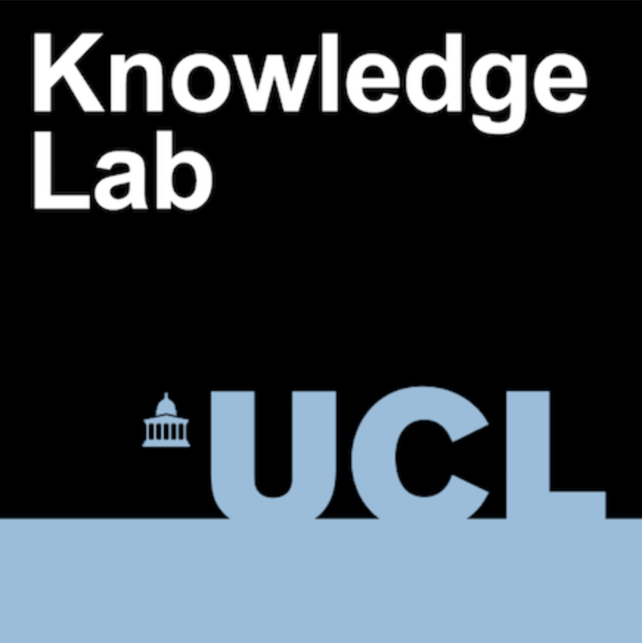
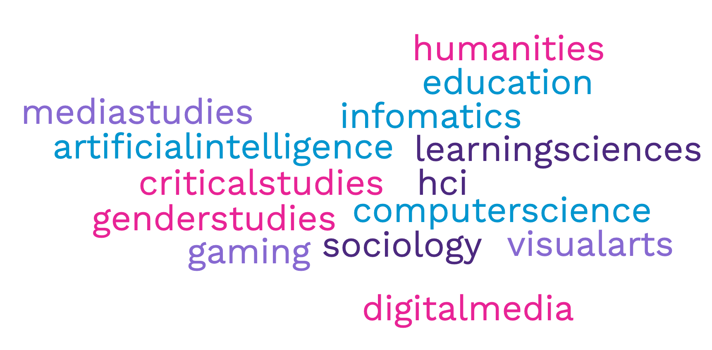
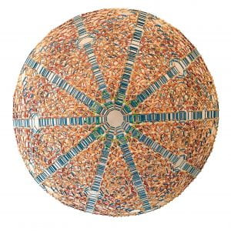
We are a group of curious people
Discover our polytope https://www.youtube.com/watch?v=xsd1qwNBnDE
Notes:
We investigate the ways technologies profoundly reshape society.
We are interdisciplinary and have around 50 researchers spanning
Arts, Performance, Social Science, to Artificial Intelligence,
Human Computer Interaction and Design Science, to Media,
Cultural Studies, and Education.
So for example our research investigates technologies and…
#Human Learning exploring technologies and learning from cradle to grave
– not only formal education but also professional learning (done work
With Chartered Institute of Securities and Investments).
#Body and cognition exploring movement, gestures and technology across
Diverse contexts – Carey will explain more later.
#ExchangingKnowledge – use of digital platforms to support work to
Help address the UN Sustainalble Development Goals (Quality education,
Healthcare)
#Play – eg gaming, interactive digital art.
#technology and culture, examining effects of social media on society

Slide 3
We work to reduce social injustices
we find out about technology & society -> research
we make stuff -> enterprise
we work with people & organisations -> impact
we prepare the next generation ->teaching
Discover our polytope https://www.youtube.com/watch?v=xsd1qwNBnDE
Notes:
We investigate the ways technologies profoundly reshape society.
We are interdisciplinary and have around 50 researchers spanning We carry out research and also design and build educational technologies, working with enterprise organisations.
A unique characteristic is the Lab’s interdisciplinary focus allowing researchers to pursue knowledge and its practical applications across traditional disciplinary boundaries.
We can work with donors on areas they are passionate about – from helping investment bankers to work at the boundary of knowledge, to
Supporting disenfranchised communities to develop financial literacies, to
Making sure children learn about sustainablility (and supporting teachers)

Slide 4
Our research examines digital technology &…
#Body&
Cognition
#&Human
Learning
#Communication
&
Knowledge
#Culture
&Society
#MediaArts
&Play

Slide 5
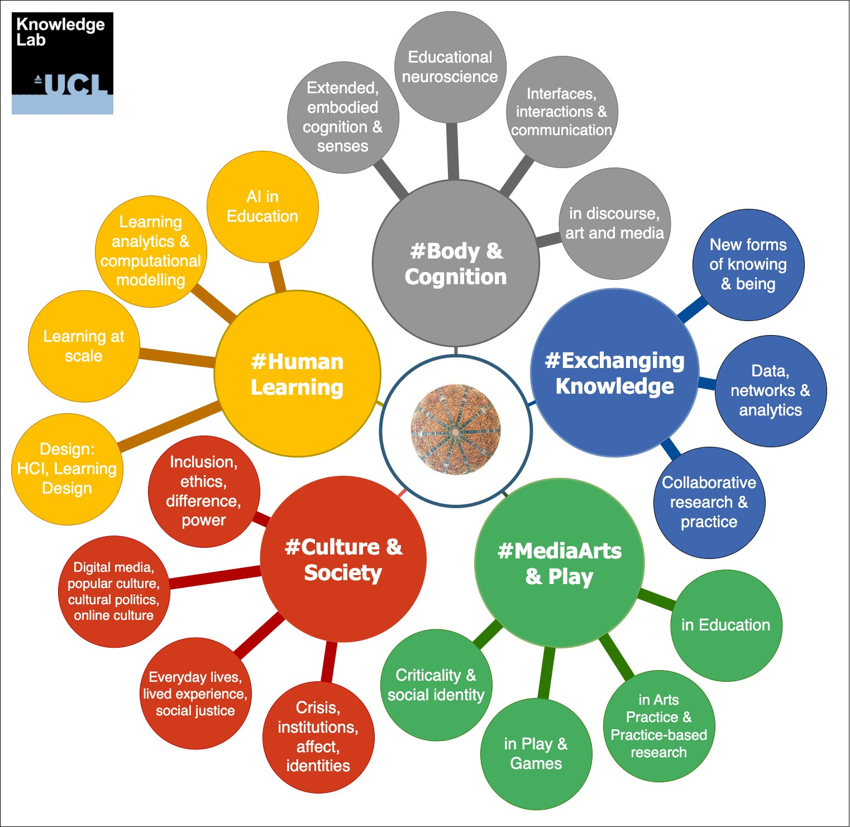
Our research examines digital technology &…

Slide 6
Welcome to FLAN:the Academic network
associated with FutureLearn
FLAN meeting January 2021

