Slide 1
Integrating TED Translators in language and translation education
Anna Comas-Quinn
School of Languages and Applied Linguistics
CALRG Annual Conference, 17-18 June 2019

Slide 2
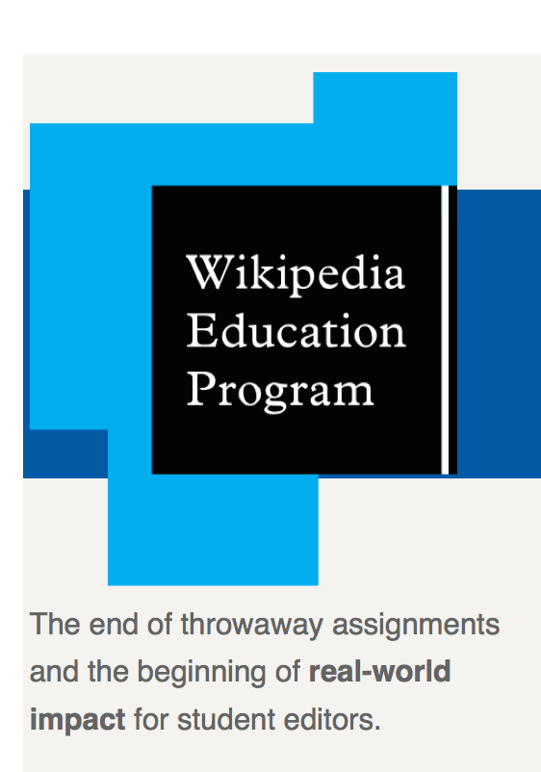
Open pedagogy
Using open technologies, tools and resources
From the ‘disposable assignment’ (Wiley, 2013) to ‘service learning’ & using ‘cognitive surplus’
Wikipedia Education Programme
Writing skills development
Media and Information Literacy
Critical Thinking and Research Skills
Collaboration
Technical and Communication Skills

Slide 3
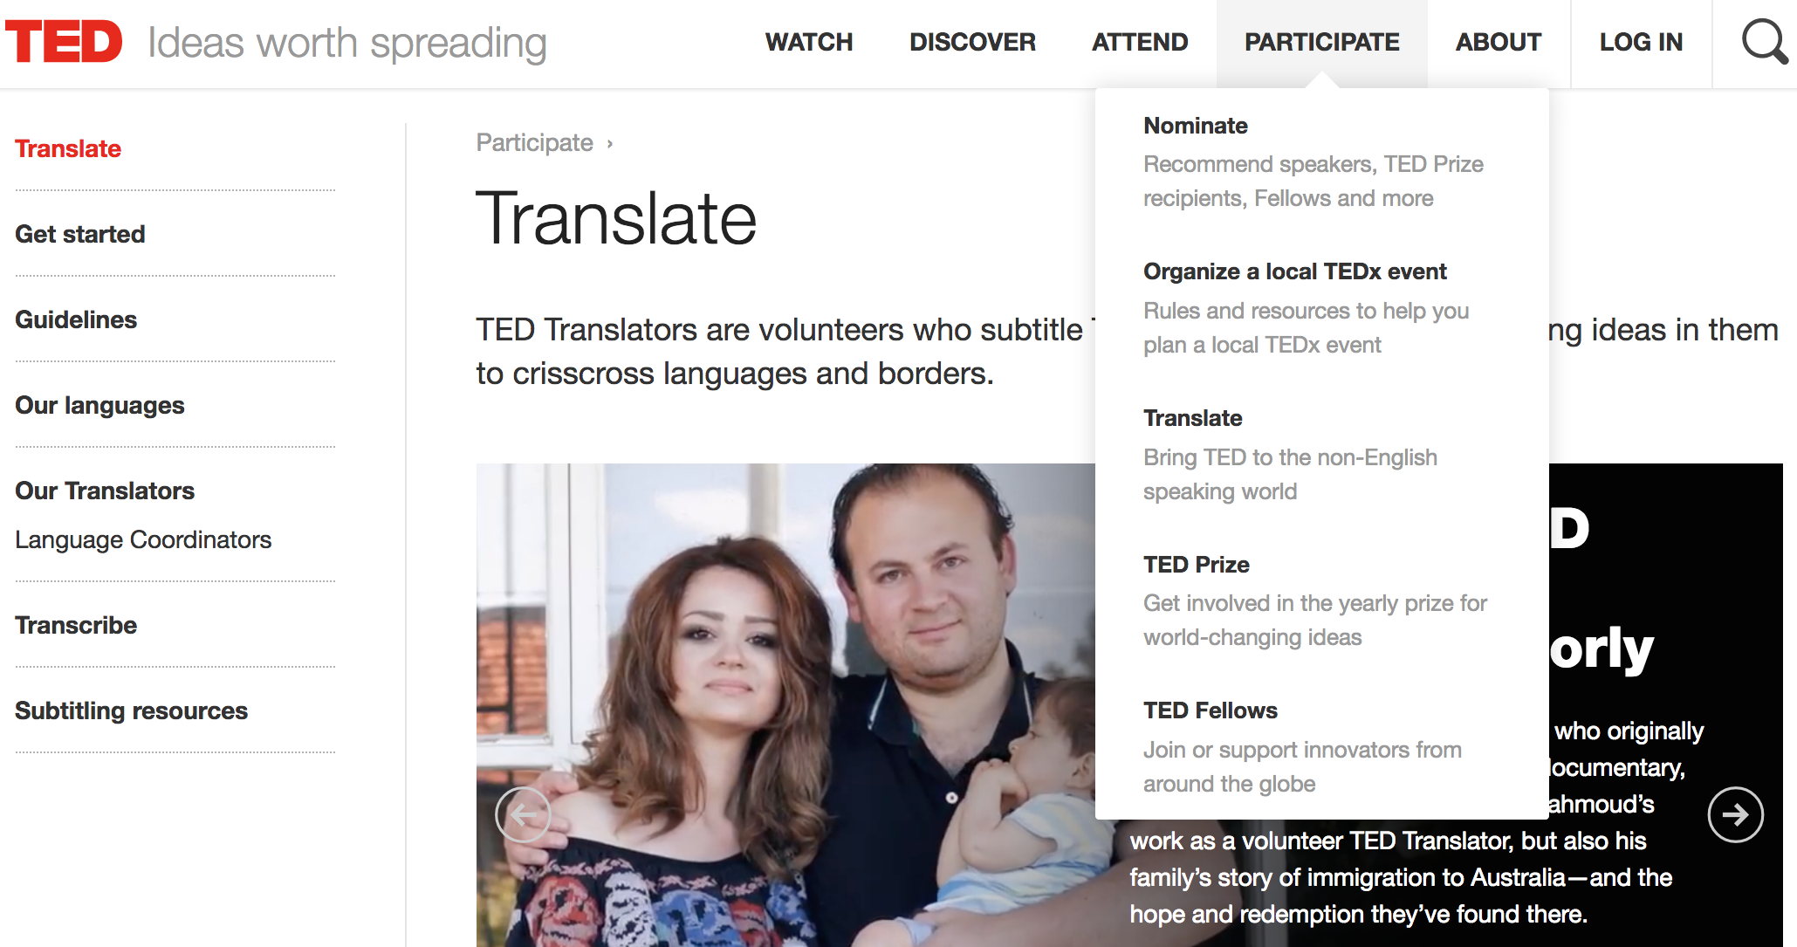

Slide 4
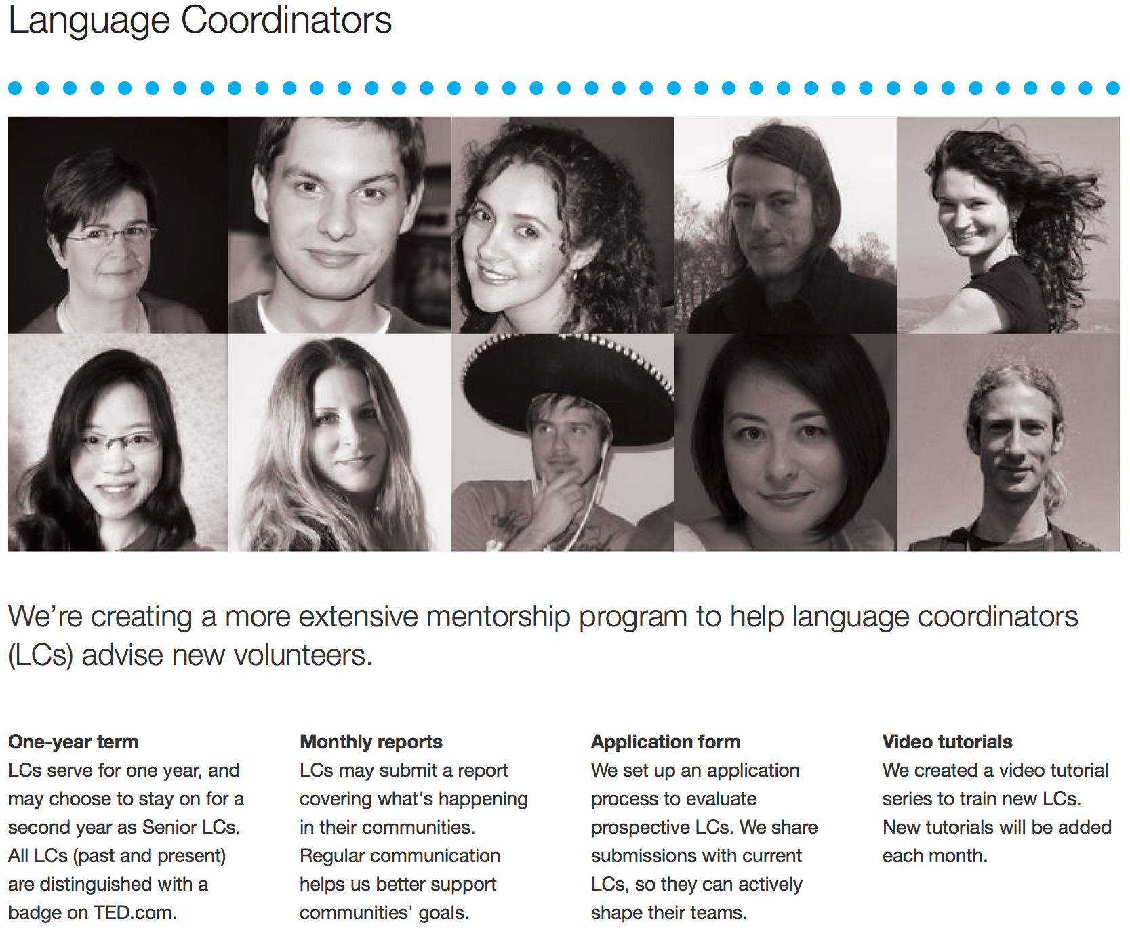
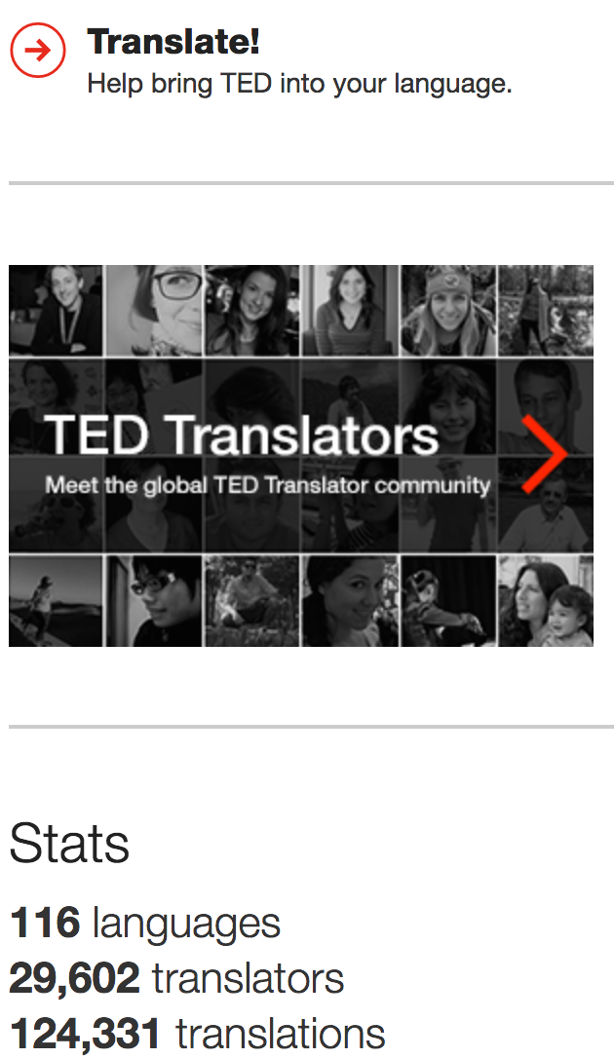

Slide 5
Advantages
Develop professional skills in translating, reviewing, proofreading… in the real world.
Develop digital skills, collaboration and sharing.
Network and benefit from feedback from more experienced translators.
Choose to work on topics and activities of their interest.
Increased motivation through choice and making a real contribution.
Externally sourced resources remain current, up-to-date and relevant (new content, open subtitling platform, guidelines and training videos, etc.).
Assemble a visible portfolio of work.

Slide 6
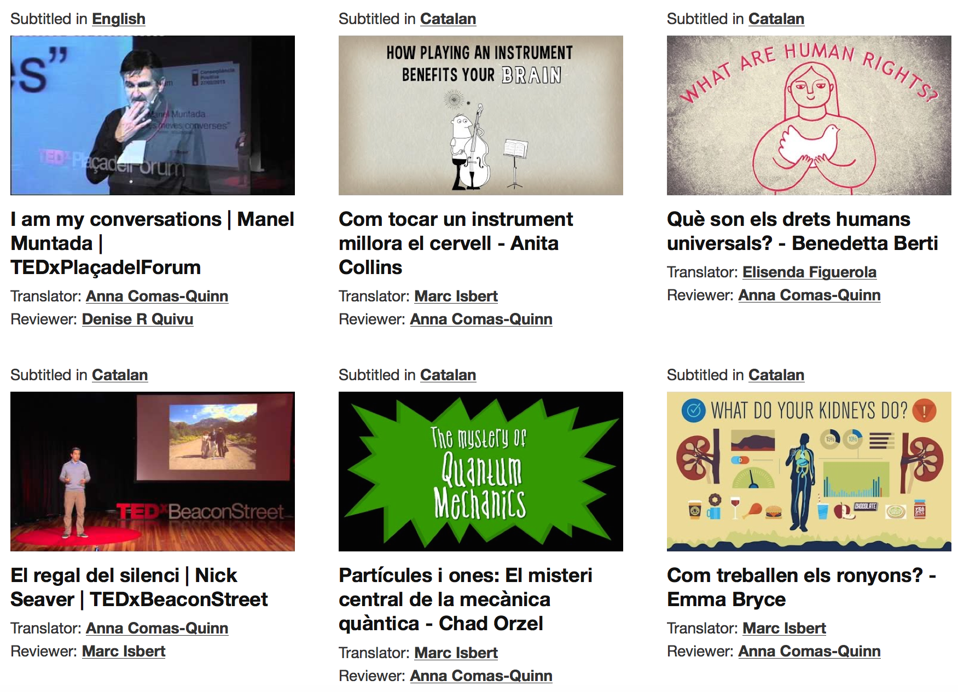

Slide 7
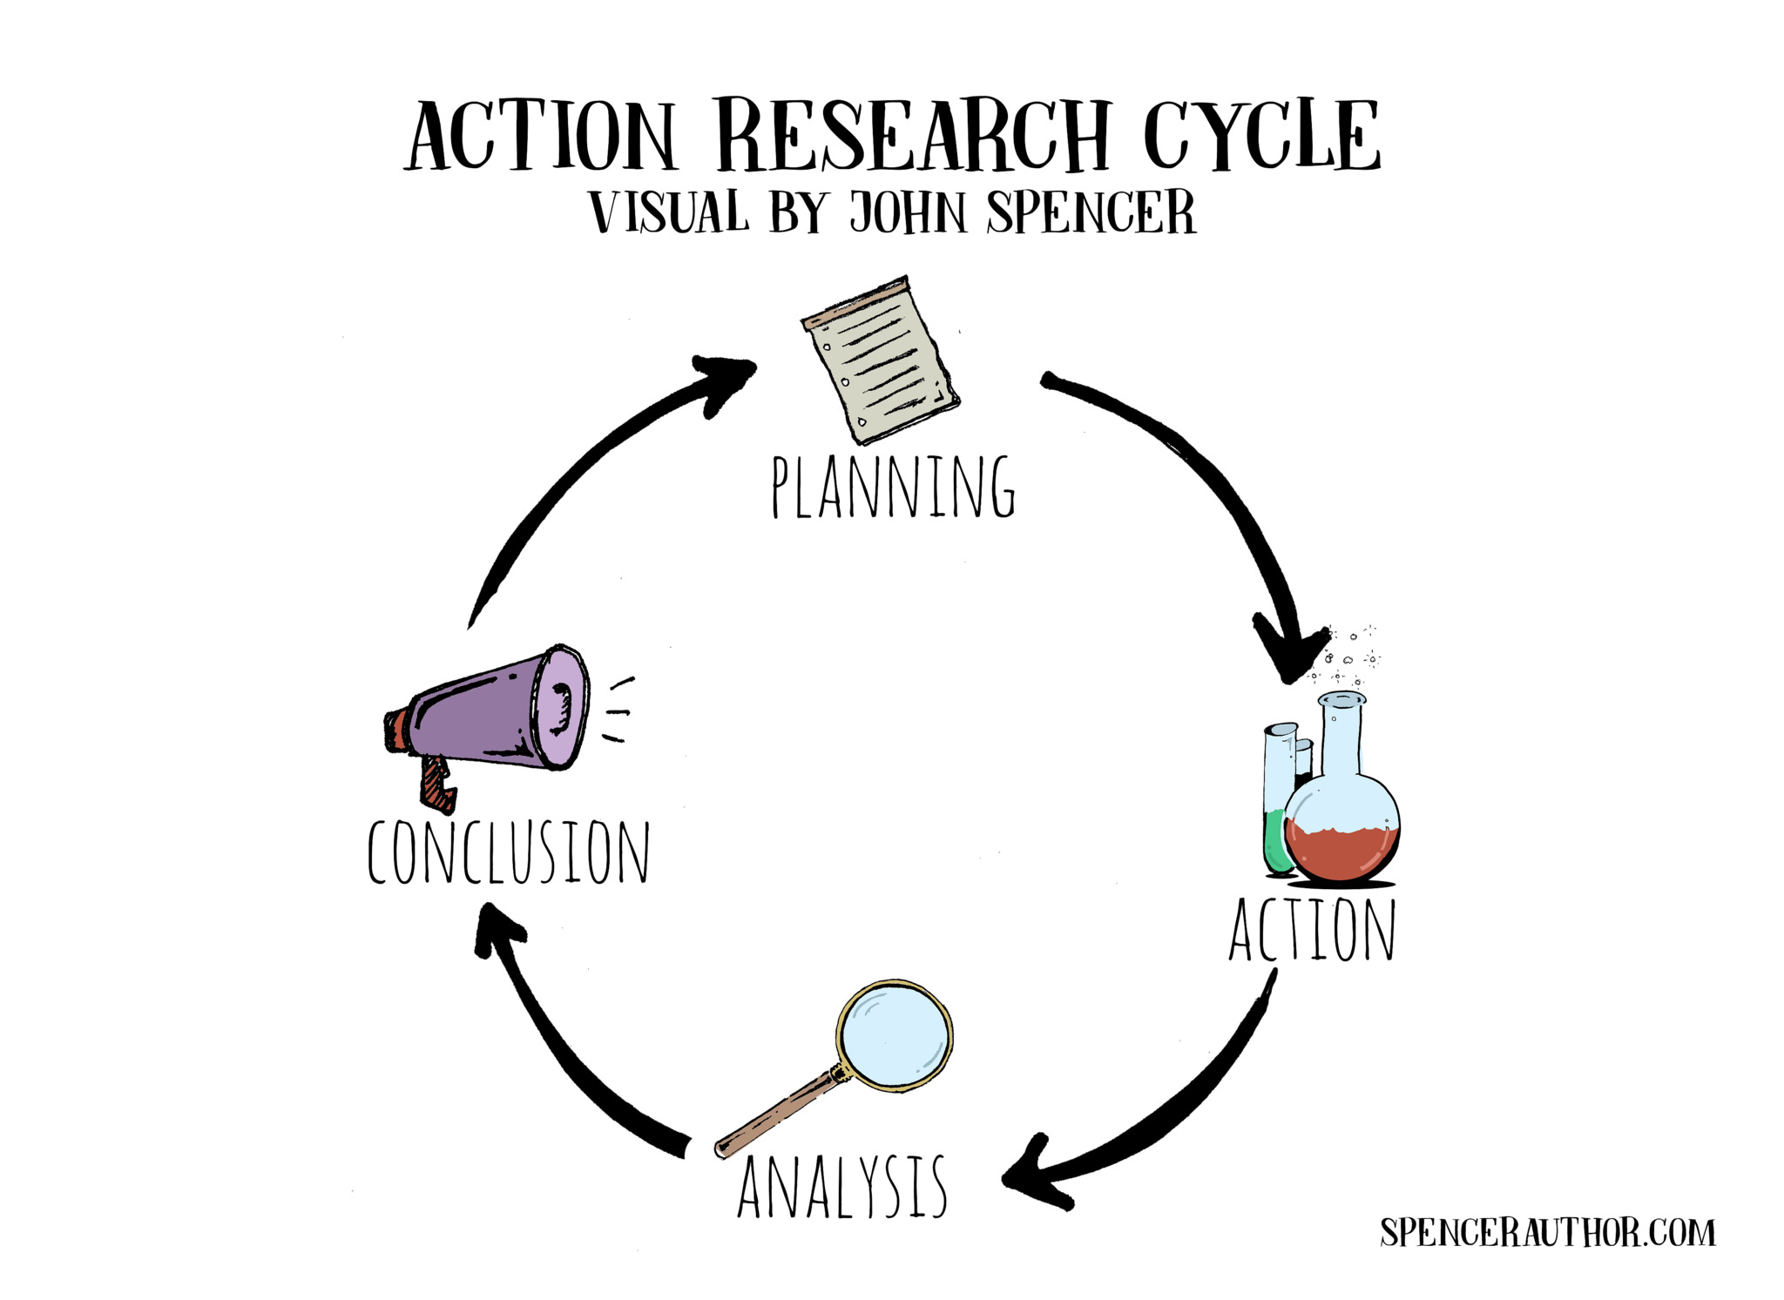

Slide 8
Phase 1 (2015)

Slide 9
Graduate translation students
Teacher/volunteers to review and publish work
Challenges:
Technical challenge
Accepting community customs
Not scalable
Rejection of volunteering
http://loro.open.ac.uk/4802/ TED Translators activity

Slide 10
Phase 2 (2016)

Slide 11
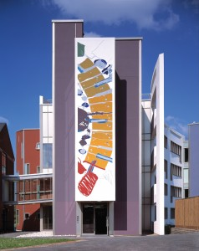
- translation and subtitling
- keeping up language skills

Slide 12
To use existing open resources, tools and communities
To get students to find and generate content instead of providing them with everything
To strengthen information and digital literacy skills
To engage with the world outside the classroom

Slide 13
Introduction to TED Translation Project
Choose a talk & translate it
Share with peers and tutors and discuss it
Refine and submit to TED reviewer
Reflection on cultural, linguistic and task-related challenges
Set-up

Slide 14
Evaluation
Gains
Language skills development (mother tongue and second language)
Applied language skills development (translation, subtitling) & intercultural awareness
Personal interest (mission, topics, enjoyment)
Drawbacks
Technical complexity
Finding suitable content to translate
Timescales
Undecided
Peer review
Tutor involvement

Slide 15
Phase 3 (2016-18)

Slide 16
Open University MA in Translation
Language development
to build up-to-date technical vocabulary in chosen area of specialisation (Beaven, 2019)
Gaining experience
volunteering as a way of practising their translation skills, building up a portfolio of work to showcase to prospective employers and networking with other professionals
Audiovisual translation
gain experience of using a subtitling editor (the open-source tool Amara) and access content on which to practice their subtitling skills

Slide 17
Some considerations
Compulsory or optional (Martínez-Arboleda, 2013), integrated or extra-curricular (Beaven, 2013), supported or unsupported (Martínez-Carrasco, 2017)
Dangers of learning in open social environments, leaving the safety of the group (Dron and Anderson, 2015).
Students need to have developed the necessary participatory and digital skills to engage safely and profitably with open communities (Beaven et al, 2014).
Preserving key components of learning in online communities, such as self-direction, collaboration and engagement (Curwood, 2013)
Respecting the cultures of the communities the learners and teachers are entering (Minkel, 2015)
Notes:
Depending on how volunteering is harnessed for educational purposes, it stops being voluntary
Some point out the dangers and challenges of learning in open social environments, where moving from the safe space of the group, the basic social structure in most formal learning settings, to the more fluid open network can inhibit those who are less confident (Dron and Anderson, 2015). Ensuring that students have developed the necessary participatory and digital skills to benefit from these experience is an essential step to successful and profitable engagement with learning in open communities (Beaven et al, 2014).

Slide 18
References
Beaven, A. (2013). Using MOOCs in an Academic English Course at University Level. In Beaven, A., Comas-Quinn, A. & Sawhill, B. (eds). Case Studies of Openness in the Language Classroom, 176-188, Dublin: Research-publishing http://research-publishing.net/publications/2013-beaven-comas-quinn-sawhill/
Beaven, T., Hauck, M., Comas-Quinn, A., Lewis, T. & de los Arcos, B. (2014). MOOCs: striking the right balance between facilitation and self-determination. Journal of Online Learning and Teaching, 10(1) 31–43. http://jolt.merlot.org/vol10no1/beaven_0314.pdf
Beaven, T. (2019) 'Your language development': harnessing openness to integrate independent language learning into the curriculum, in Beaven, A., Comas-Quinn, A. and Sawhill, B. (2019) New Case Studies of Openness in and beyond the Language Classroom, researchpublishing.net, (forthcoming)
Cámara, L. and Comas-Quinn, A. (2016) ‘Situated Learning in Open Communities: the TED Open Translation Project’, in Blessinger, P. and Bliss, T.J. (eds) Open Education: International Perspectives in Higher Education, Cambridge, Open Book Publishers.
Comas-Quinn, A. and Fuertes-Gutiérrez, M. (2017) ‘‘An interest in translation and a great addition to the CV!’ An evaluation of learners’ experiences of an online volunteering task’, OER17, London, 5–6 April 2017. [Online] Available at http://oro.open.ac.uk/54898/ (Accessed 30 December 2018).
Curwood, J. S. (2013). Fan fiction, remix culture, and The Potter Games. In V.E. Frankel (Ed.), Teaching with Harry Potter (pp. 81–92). Jefferson, NC: McFarland.
Cámara de la Fuente, L. (2014). “Multilingual Crowdsourcing Motivation on Global Social Media. Case Study: TED OTP”, Sendebar. No. 25. http://revistaseug.ugr.es/index.php/sendebar/article/view/1541/2676
Dron, J. & Anderson, T. (2015). Agoraphobia and the Modern Learner, in Littlejohn, A. & Pegler, C. (eds.) Reusing Open Resources: Learning in open networks for work, life and education, 27-42, Abingdon: Routledge.
Martínez Arboleda, A. (2014) The Ethics of Student Digital Publication, Presentation given at the OER14 Conference, University of Newcastle, 29 April 2014, https://oer14.oerconf.org/archive/14/oer14/92/view/index.html
Minkel, E. (2015, March 25) From the Internet to the Ivy League: Fan fiction in the classroom. [Online] Available at http://www.themillions.com/2015/03/from-the-internet-to-theivy-league-fanfiction-in-the-classroom.html (Accessed 30 December 2018).
Wikipedia Education Program (2012) Case Studies: How professors are teaching with Wikipedia. Wikimedia Foundation. [Online] Available at http://upload.wikimedia.org/wikipedia/commons/0/03/Wikipedia_Education_Program_Case_Studies.pdf (Accessed 30 December 2018).

