Slide 2
once upon
a time
the art of telling the story of complex images
Huw Alexander | textBOX

Slide 3
method

Slide 4
1.
2.
3.

Slide 5
element 4
element1
relationship (d)
relationship (a)
focus
LOCUS
LOCUS
relationship (c)
relationship (b)
element 3
element 2

Slide 6
deconstruction
reconstruction

Slide 7
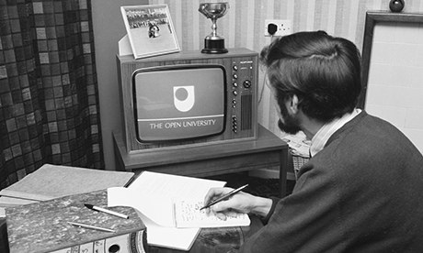

Slide 9
SCENE
SETTING
STORY
TELLING

Slide 10
PATHWAY
OVERVIEW
STRUCTURE
FOCUS ELEMENT
LOCUS ELEMENTS
SCENE-SETTING
STORYTELLING

Slide 11
scene setting rules
OVERVIEW
FRAMEWORK
PUNCTUATION
PATHWAYS
LISTS

Slide 12
story-telling rules
FOCUS
DETAIL
DESCRIBE
TRENDS
LANGUAGE

Slide 13
special circumstances
WHO
WHEN
WHAT
HOW
WHERE
WHY

Slide 14
quality control
precise
informative
consistent
thorough
useful
relevant
engaging

Slide 15
visualising
complexity

Slide 16
A figure shows the recommended focus of wellbeing training inputs as 4 elements, Psychological, Financial, Physiological, and Sociological, juxtaposed together.
Psychological
Financial
Wellbeing Training
Sociological
Physiological

Slide 17
The figure illustrates the recommended focus of wellbeing training inputs. A rectangle is divided into 4 quadrants labelled as follows:
Upper left quadrant. Psychological.
Upper right quadrant. Financial.
Lower left. Sociological.
Lower right. Physiological.
A green box positioned at the centre of the figure is labelled Wellbeing Training.

Slide 18
telling
the
story

Slide 19
…probably the best statistical graphic ever drawn.
Edward Tufte

Slide 20
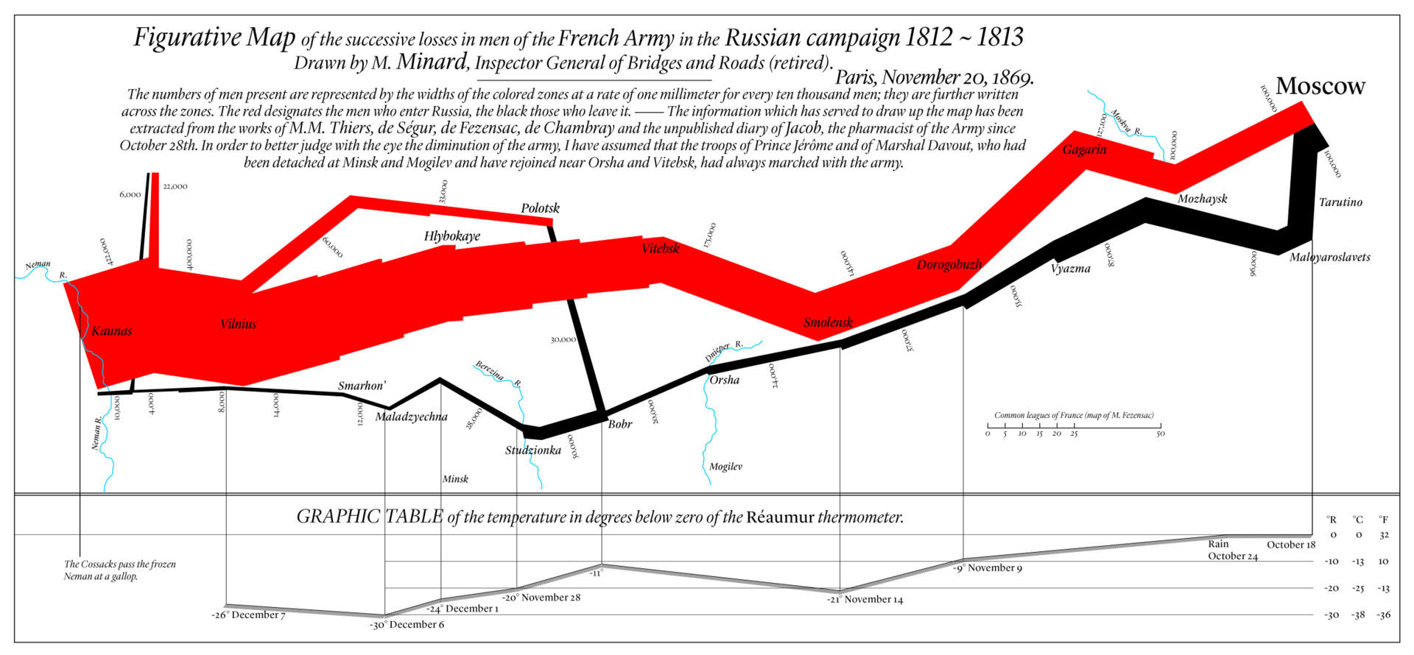

Slide 22
An infographic by Charles Joseph Minard charts the invasion of Russia by French forces led by Napoleon in 1812. The graphic follows the eastwards progress of the French army and their subsequent westward retreat from Moscow. The chart provides details of troop numbers, time, temperature and casualties. The troop numbers are visualized using a red invasion pathway and a black retreat pathway. The decline in troop numbers during the campaign is demonstrated by the width of the pathways becoming narrower. One millimeter represents 10,000 soldiers. The temperature is based on the Reaumur scale. The casualty and temperature data points are as follows:
Part 1. The Invasion of Russia. The path of the army is coloured Red.
Kaunas, 422,000. Crossing the River Neman.
Vilnius, 400,000. At this point Prince Jerome’s detachment separate from the main army.
Vitebsk, 175,000.
Smolensk, 145,000.
Gagarin, 127,100. Crossing the River Moskva.
Moscow, 100,000. Temperature, 0.
Part 2. The Retreat from Moscow. The path of the army is coloured Black.
Maloyaroslavets, 96,000. Temperature, 0.
Mozhaysk, 87,000. Temperature, minus 5. October 18th.
Vyazma, 55,000. Temperature, minus 8.
Smolensk, 37,000. Temperature, minus 15. November 14th.
Orsha, 24,000. Temperature, minus 19. Crossing the River Dnieper.
Bobr, 20,000. Temperature, minus 14.
Studzionka, 50,000. Temperature, minus 15. Crossing the River Berezina. The remnants of Prince Jerome’s army rejoin the retreating army. November 28th.
Maladzyechna, 28,000. Temperature, minus 22. December 6th.
Smarhon, 12,000. Temperature, minus 30.
Vilnius, 14,000. Temperature, minus 27.
Vilnius, 8,000. Temperature, minus 26. December 7th.
Kaunas, 4,000. Crossing the river Neman.
Kaunas, 10,000. The vanguard of the French army rejoins the retreating forces.

Slide 23
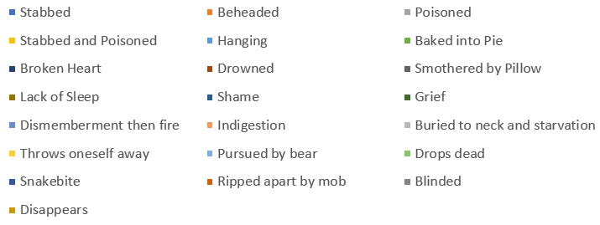
causes of death in Shakespeare’s plays

Slide 24
A pie chart illustrates the various causes of death in Shakespeare’s plays. 22 causes of death are listed within the chart. There are 62 deaths in total. They are listed here in order of frequency together with percentage of total:
Stabbed, 30. 48 per cent of total.
Beheaded, 5. 8 per cent of total.
Poisoned, 4. 6 per cent of total.
Stabbed and Poisoned, 3. 5 per cent of total.
Hanging, 2. 3 per cent of total.
Baked into Pie, 2. 3 per cent of total.
Broken Heart, 1. 2 per cent of total.
Drowned, 1.
Smothered by Pillow, 1.
Lack of Sleep, 1.
Shame, 1.
Grief, 1.
Dismemberment then fire, 1.
Indigestion, 1.
Buried to neck and starvation, 1.
Throws oneself away, 1.
Pursued by bear, 1.
Drops dead, 1.
Snakebite, 1.
Ripped apart by mob, 1.
Blinded, 1.
Disappears, 1.

Slide 25
bar charts

Slide 27
A vertical bar chart illustrates the top 10 films at the worldwide box office in 2019. The box office take, in U,S dollars (in millions), is plotted on the Y-axis with a range of 0 to $3 billion. The 10 films are plotted on the X-axis.​
The data points are as follows:
Avengers: Endgame. Worldwide, $2,797,800,564. U, S Domestic, $858,373,000. International, $1,939,427,564.
The Lion King. Worldwide, $1,655,690,790. U, S Domestic, $543,575,085. International, $1,112,115,705.
Frozen 2. Worldwide, $1,371,384,042. U, S Domestic, $459,384,042. International, $912,000,000.
Spider-Man: Far from Home. Worldwide, $1,131,928,519. U, S Domestic, $390,532,085. International, $741,396,434.
Captain Marvel. Worldwide, $1,128,274,794. U, S Domestic, $426,829,839. International, $701,444,955.
Toy Story 4. Worldwide, $1,073,353,577. U, S Domestic, $433,996,992. International, $639,356,585.
Aladdin. Worldwide, $1,050,693,953. U, S Domestic, $355,559,216. International, $695,134,737.
Joker. Worldwide, $1,066,776,521. U, S Domestic, $334,046,521. International, $732,700,000.
Star Wars: The Rise of Skywalker. Worldwide, $989,569,690. U, S Domestic, $478,169,690. International, $511,400,000.
Fast & Furious Presents: Hobbs & Shaw. Worldwide, $758,910,100. U, S Domestic, $173,810,100. International, $585,100,000.

Slide 28
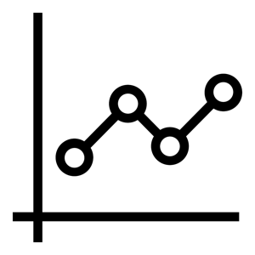
line charts

Slide 29
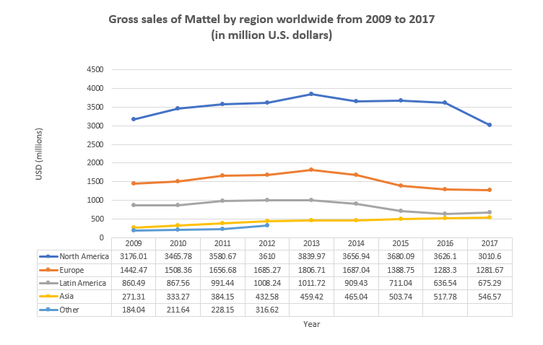

Slide 30
A line chart describes the gross sales of Mattel by region between 2009 and 2017. The chart is measured in U,S dollars in millions on the Y-axis and years on the X-axis. Data are provided for 5 regions: North America, Europe, Latin America, Asia and Other.
​
The data points are as follows:
2009. North America, 3,176.01. Europe, 1,442.47. Latin America, 860.49. Asia, 271.31. Other, 184.04.
2010. North America, 3,465.78. Europe, 1,508.36. Latin America, 867.56. Asia, 333.27. Other, 211.64.
2011. North America, 3,580.67. Europe, 1,656.68. Latin America, 991.44. Asia, 384.15. Other, 228.15.
2012. North America, 3,610. Europe, 1,685.27. Latin America, 1,008.24. Asia, 432.58. Other, 316.62.
2013. North America, 3,839.97. Europe, 1,687.04. Latin America, 1,011.72. Asia, 459.42. Other, no data.
2014. North America, 3,656.94. Europe, 1,687.04. Latin America, 909.43. Asia, 465.04. Other, no data.
2015. North America, 3,680.09. Europe, 1,388.75. Latin America, 711.04. Asia, 503.74. Other, no data.
2016. North America, 3,626.1. Europe, 1,283.3. Latin America, 636.54. Asia, 517.78. Other, no data.
2017. North America, 3,010.6. Europe, 1,281.67. Latin America, 675.29. Asia, 546.57. Other, no data.

Slide 31
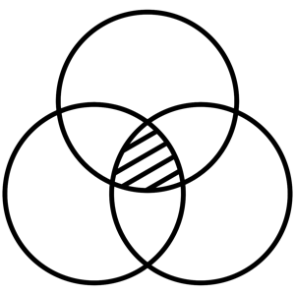
Venn diagram

Slide 32
A Venn Diagram with 3 intersecting circles labeled in a clockwise direction, Egg, Milk and Flour.
The Flour and Egg circles are positioned above the Milk circle to create a triangular shape. The intersections, in a clockwise direction, are as follows:
​Egg intersects with Milk to create Omelette.
Milk intersects with Flour to create Batter.
Flour intersects with Egg to create Pasta.
Egg, Flour and Milk intersect to create Pancake at the centre of the Venn diagram.
FLOUR
EGG
PASTA
PANCAKE
BATTER
OMELETTE
MILK

Slide 33
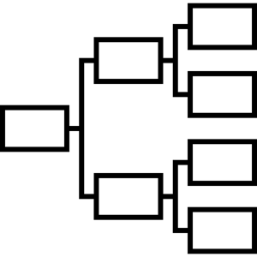
flowcharts

Slide 34
FREDDIE MERCURY
WANTS
DOESN’T WANT
ISN’T SURE ABOUT
TO BREAK FREE
TO RIDE HIS BICYCLE
YOU TO STOP HIM NOW
LIVING FOREVER
TO MAKE A SUPERSONIC MAN OUTTA YOU
IT ALL. NOW.

Slide 35
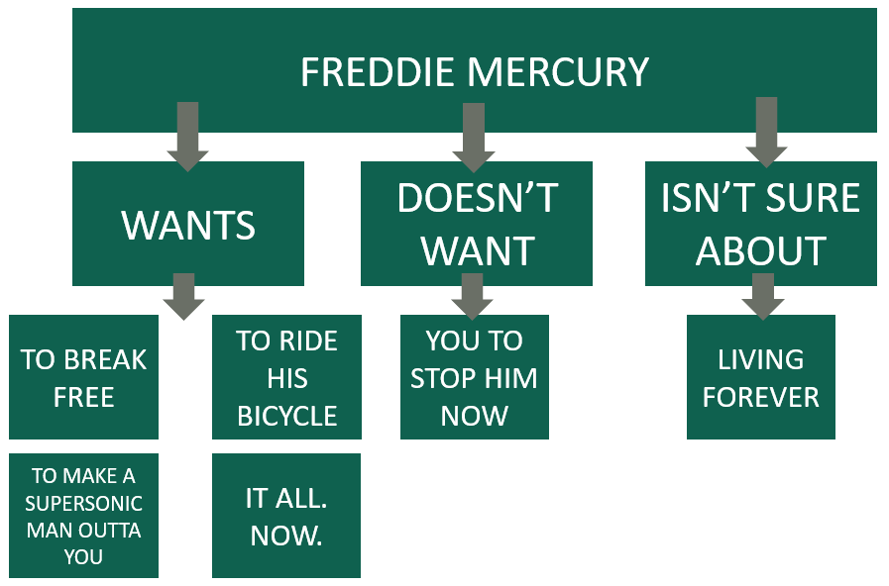
A flowchart illustrates what Freddie Mercury wants through his lyrics. The flowchart has 3 levels and develops from north to south. At the top of the chart is a box labelled Freddie Mercury. The next level contains 3 boxes labelled Wants, Doesn’t Want and Isn’t Sure About. The last level contains 6 options.
The 6 pathways through the flowchart are as follows:
Freddie Mercury wants to break free.
Freddie Mercury wants to ride his bicycle.
Freddie Mercury wants it all, now.
Freddie Mercury wants to make a supersonic man out of you.
Freddie Mercury doesn’t want you to stop him now.
Freddie Mercury isn’t sure about living forever.

Slide 36
equations
a brief
note on

Slide 37
I am a great fan of science, but I cannot do a quadratic equation.
Terry Pratchett

Slide 38
MathSpeak
https://www.seewritehear.com/accessible-mathml/mathspeak/examples/grammar-rules/

Slide 39
E = mc²
Upper E equals m c superscript 2

Slide 40
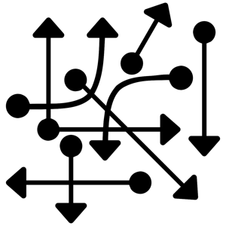
x_{t+1}=kx_{t}(1-x_{t})
X Subscript t plus 1 equals k x Subscript t baseline left parenthesis 1 minus x Subscript t right parenthesis

Slide 41
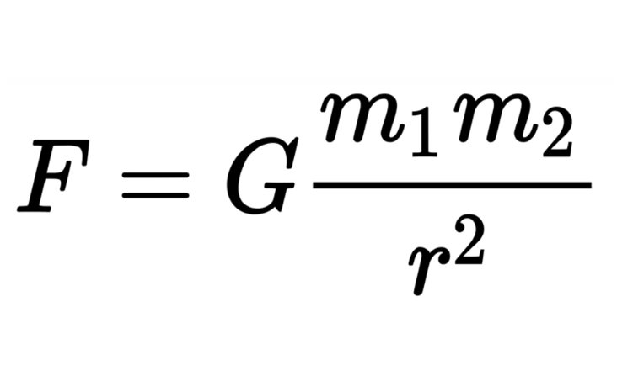
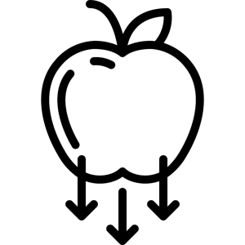
Upper F equals upper G StartFraction m subscript 1 m subscript 2 over r superscript 2 EndFraction.

Slide 42
Upper K Subscript r equals StartFraction 1 over 3 EndFraction Integral Subscript 0 Superscript Infinity baseline left-pointing angle bracket v right-pointing angle bracket Lambda Subscript v baseline upper C Subscript v baseline d v equals StartFraction c over 3 EndFraction Integral Subscript 0 Superscript Infinity baseline lambda Subscript v baseline upper C Subscript v baseline d v.

Slide 43
recap

Slide 44
rules
SELECT
YOUR
FOCUS
CREATE STRUCTURE
CAPTURE THE DETAIL
LISTS ARE FRIENDLY
DESCRIBE,
DO NOT INTERPRET
PUNCTUATION
CREATE
LOGICAL PATHWAYS
IDENTIFY TRENDS
WALK
IN THE
USER’S
SHOES
TEST
THE
ACCURACY

Slide 45
recipe

Slide 47
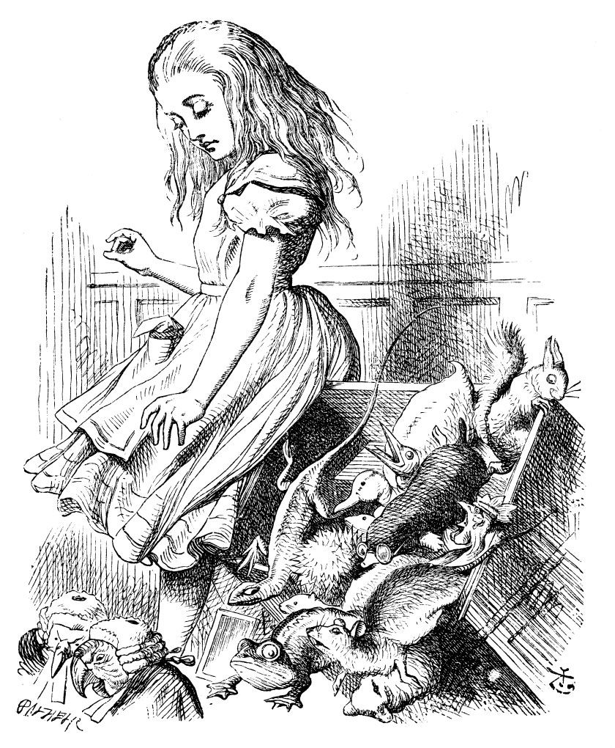
What is the use of
a book, without pictures or conversations?
said Alice.

Slide 48
description ends

Slide 49
QUESTIONS
huw@textboxdigital.com
@textboxdigital
textboxdigital.com

Slide 50
Living Paintings: Touch to See Books and the Open University’s Arts and Humanities curriculum
Jenny Moakes, Production Manager in FASS
Notes:
Introduction – I am Jenny Moakes and I’m the production manager in FASS, and the lead for production accessibility in faculty. I have worked in this role since November 2015.

Slide 51
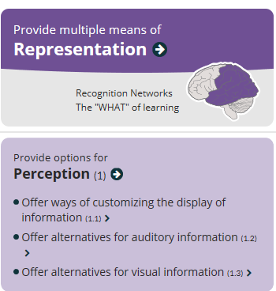
How do I enrich students’ learning?
The Universal Design for Learning¹ guidelines promote multiple means of representation in learning.
In providing support for visually impaired students a reliance on image descriptions is the norm.
Living Paintings² made it possible to offer something different through their library of Touch to See Books.
Notes:
1. http://udlguidelines.cast.org/?utm_medium=web&utm_campaign=none&utm_source=cast-about-udl. Accessed 5.12.19
2. https://www.livingpaintings.org/ Accessed 5.12.19

Slide 52
73.4 miles from the OU….
In Kingsclere, Newbury, Berkshire is the charity Living Paintings, founded in 1989 by Alison Oldland MBE.
Alison had been a lecturer in Art History and was inspired to produce descriptions of paintings for the blind and visually impaired. She then decided to add relief images to the descriptions and Touch to See Books came about.
“As Chairman it gives me great pleasure to have seen this idea, which came to me more by chance than good management, grow into something which, to quote a blind member, “breaks down the barriers in a sighted world”. Alison Oldland MBE
Notes:
Information from Living Paintings ‘Who we are’, https://www.livingpaintings.org/who-we-are/history accessed 5.12.19

Slide 53
A History of the World in 100 Objects
A105 Voices Texts and Material Culture adopted the Living Paintings Touch to See Book, A History of the World in 100 Objects as an option for TMA 01 from 17B presentation for visually impaired students
A227 Exploring Religion adopted the same book as a reasonable adjustment from its first presentation in 17J

Slide 54
Did this work and was it a success with our students?
Issues
No way of knowing how many students took up the alternative
No feedback or quality assurance mechanisms focussing on alternative assessment (except academic expertise in module team)
As such no real review can be done

Slide 55
National Gallery 2 and Architecture 08
A112 Cultures, a module which replaces A105 (alongside sister A113) in 20J is considering adopting two Living Paintings Touch to See Books to help enrich its Art History curriculum for visually impaired students (UK)
How can we get feedback on VI and other alternatives?
How can we make sure that our chosen alternative approaches are what our students need and want?
How can we be more rigorous in this area and assess how our alternatives impact on student experience?
How do we raise the profile of alternatives that really help, both across this University and in other Universities?

Slide 56
Thank you
Notes:
Study of a Figure Outdoors: Woman with a Parasol, facing left, 1886. Musée d'Orsay, Wikipedia https://en.wikipedia.org/wiki/Claude_Monet accessed 5.12.19 (‘free to share and use’ licence)

