Slide 1
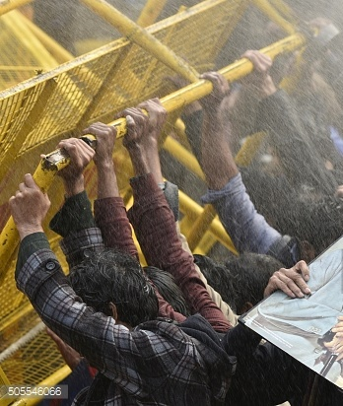
The Micro skills of Compassion
in Group work
Dr Theo Gilbert,
Assoc. Prof. Teaching and Learning
Learning and Innovation Centre
University of Hertfordshire
t.1.gilbert@herts.ac.uk

Slide 2
Here’s what we’ll focus on.
Understanding what compassion is.
(The Compassionate Mind Foundation).
3. How compassion evolved in the brain.
4. Compassion’s saboteur:
The reptilian brain’s threat system.
Two threat-driven behaviours to watch for
without blame in team/group work
How the science of compassion can transform the quality of individual social and learning experience of group work whether online or offline.

Slide 3
If compassion is not an emotion, what is it?
Noticing distress or disadvantaging of oneself and/or others
AND
Doing something (smart) to reduce or prevent that.

Slide 4
National Union of Students’ (2009) explored why “Black students are less likely to be satisfied with their educational experience and to attain first-class degrees in comparison to their White peers” (p4).
A survey of 938 black students:
“with 23 per cent describing it as ‘cliquey’…
17 per cent as ‘isolating’…
8 per cent as ‘hostile’…
and respondents “often speaking of
alienation and exclusion“ (p5).
“spawned from inside the classroom”
“feeling left out of discussions and debates” (p4)

Slide 5
The Snowflake Generation ?
Highest levels of HE student anxiety and depression in the UK (You.Gov, 2016)
Highest numbers of student suicides (Office of National Statistics, 2017).

Slide 7
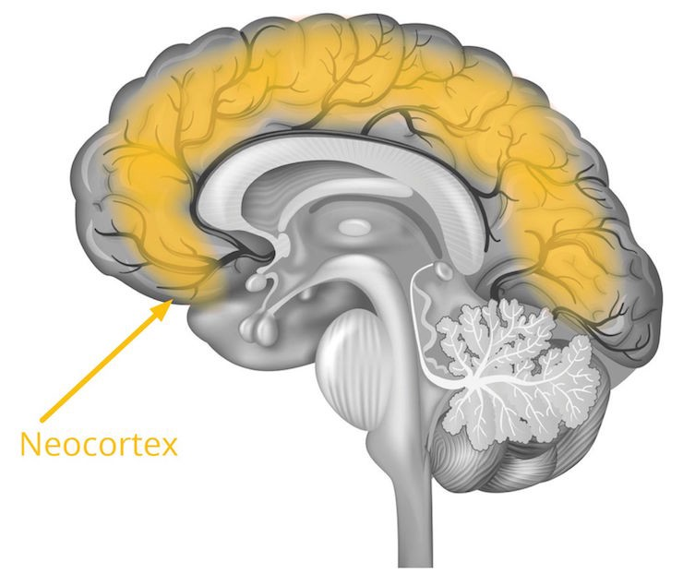
Malik, M. (2018) Machine Learning of Human brain. Towards Data Science. https://towardsdatascience.com/machine-learning-of-human-brain-739ab0419612

Slide 8
If compassion is not an emotion, what is it, including in education?
Noticing, (not normalising), distress or disadvantaging of oneself and/or others
AND
Doing something (smart) to reduce or prevent that.

Slide 9
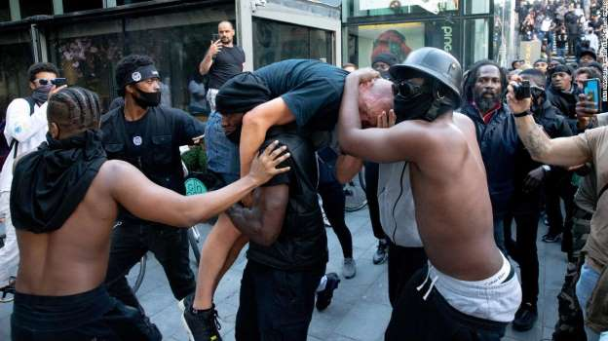

Slide 10
Group work meetings: 2 recurrent features
Group work in the classroom
and online…

Slide 11
GroTTeo he up work meetings: 2 recurrent features
The two most problematic
(and common)
student-reported behaviours
in group/team work.

Slide 12
Group work meetings: 2 recurrent features
Non contributors
Monopolisers

Slide 13
Strategies for including others
Language use for international students
Silences: the group’s just breathing and thinking…
Not normalising seeing others talked over.
Disrupting cliques and dominating pairs.
Bringing others into the discussion: Tone and name.
(And tips for being compassionate to yourself too.)
Letting people stay out of the discussion – when they need to.
Thanking each other. The power of gratitude for bonding teams.
Checking your own, as well as others’ body language.
Working with non-readers who haven’t prepared for the meeting.

Slide 14
Suggestions for students:
You could invite them by name into the discussion – ask for their opinions. “What do you think, Sara?”
When they are pushed out of the discussion by confident speakers who like to talk over others, find another chance to invite the shyer ones back in later.
Tell them that when they speak, if they suddenly are shy and have no more to say, they can ‘pass the hot potato’. That is, they can quickly say to any other student “So what do you think, Keisha?”

Slide 15
Core Assessment/Marking Criteria for use of the Micro Skills of Compassion
in discussion group work (Allocated 10% - 35% of marks in current HE practice)
Category of Assessment | Distinction (70% +) | Commendation 69-60%) | Pass (59-50%) | Marginal fail F (49-40%) | Clear fail (below 40%) *
1.1 2.1 2.2 Interpersonal and discussion skills. | Excellent use of eye contact , voice tone and inclusive body language; inviting, encouraging and acknowledging the contributions of others; asking for clarity or elaboration; checking the understanding of the group. | Very good use of eye contact, voice tone and inclusive body language; eliciting, encouraging and acknowledging the contributions of others; asking for clarity or elaboration; checking the understanding of the group. | . Good use of eye contact, voice tone and inclusive body language; eliciting, encouraging and acknowledging the contributions of others; asking for clarity or elaboration; checking the understanding of the group. | . Body language signals little interest in what is said by others or may focus on one or two other students only. Either monopolises or makes little contribution to discussion. Speaks too fast, or inaudibly. | Body language signals little or no interest in what is said by others or may focus on one other student only. Either monopolises or makes little contribution to discussion. Speaks too fast, or inaudibly.

Slide 16
Two Key questions to begin the module.
What do I do in this seminar/group work to develop my fellow students’ social and learning experiences that they most value in me?
What do my fellow students do in this seminar/group work to develop my social and learning experiences that I most value in them?

Slide 17
S13: And ….you realise, "Well no, we’re also responsible for making sure other people have things to say and want to talk."
S13 PG female, second year/run of stage three, focus group transcript, p9, lines 294-297

Slide 18
Academic Outcomes
The same sample of students (n=38) completed both assignments on a single UG Business module

Slide 19
Compassion focused Pedagogy for interculturalising students
“When I go into seminars, I find any other Muslim people there…. Most of the others, I’m probably not gonna talk to them to be honest.
So I was thinking, ‘Oh my God. What if no-one talks to me?’ But as soon as I got into a group, I was fine, I was fine… We just got into the discussion and …it flowed really well.” (S28)

Slide 20
Compassion for higher cognitive processing …and interdependent self.
“We were sort of analysing …I know I was. I was like watching each other. What’s the body language like?” (BAME S24)
“I felt not as one person, but I felt as a person within an entity and the entity was my group… …. like we’re all focused on it [the task].” (BAME S29)

Slide 21
Computer science undergraduate module (27students)

Slide 22
Academic Results: After Compassionate micro skills taught for group work (228 computer science students) With thanks to Dr Martina Doolan, NTF

Slide 23
Impact of Compassion focused Pedagogy on student outcomes
“…on their piece of work, I would listen to how they achieved this… how valued their input is. I also made sure I was showing gratitude.” (S185)
“….during discussions I always made sure to leave spaces for other people.” (S100)
“I was worried being the oldest person and the only non-native English person… ….having ten years of working experience with people from different cultures and backgrounds, I never found it as smooth as this time. Outside of university, we’re still hanging out together.” (S110)

Slide 24
An at glance overview for teaching staff:

Slide 25
Step One - Seminar one
1. What is compassion?
2 . Small group → whole
group consensus on:
a. Noticing unhelpful
seminar behaviours.
b. How to address
these compassionately.
Step Two
- Homework:
1. After each weekly lecture, students read independently on the topic of the lecture.
- in weekly seminars
2. In small groups, students share the research they have each done, presenting for discussion one at a time.
3. Tutor facilitates students to support each other with the micro-skills of compassion.
Step Three - final assessed seminar
1. The final small group discussions, at the end of the module, are filmed and each student is assessed according to criteria seen in slide 10, above.

Slide 26
‘I’m convinced that it’s compassion …I'm closer to this group of students than to any group I've taught in years. Many of my students are saying it’s the most exciting learning experience they’ve had at university. They didn't know, they said, that learning could be like this…This is life-changing work.’
Prof Karen Edwards, University of Exeter

Slide 27
‘The feedback from this session was absolutely phenomenal. I had about 30 emails from students saying how much it had affected them; how much they were more compassionate to each other.’
Debbie Sharp, Midwifery, University of Hertfordshire
‘I showed my Business PG students the compassionate micro skills to use in their group work.
They were so grateful I could have cried.’
Norton-Bertram-Smith, University of Aberdeen

Slide 28
https://compassioninhe.wordpress.com
See ‘Join Us’ in the above website (of free resources). We are compassion-in HE colleagues from around 60 universities so far, working to support each other in getting the science of compassion on the HE curriculum.
Dr Theo Gilbert
Associate Professor, Learning and Teaching
Learning and Teaching Innovation Centre
University of Hertfordshire
t.1.gilbert@herts.ac.uk
Skype: theogilbert58
Phone: 07890 296148

Slide 29
For more info on this:
Duhigg, C. (2016). What Google learned from its quest to build the perfect team. The New York Times Magazine. Available at: http://www.nytimes.com/2016/02/28/magazine/what-google- learned-from-its-quest-to-build-the-perfect-team .
Gilbert, T., Doolan, M., Beka, S., Spencer, N., Crotta, M & Davari, S. (2018) Compassion on university degree programmes at a UK University: The neuroscience of effective Group work. Special Issue: Neuroscience of learning and development: Implications for the design and evaluation of student learning and development. Journal of Research in Innovative Teaching and Learning ISSN: 2397-7604 Emerald Publishing. https://doi.org/10.1108/JRIT-09-2017-0020
Gilbert, T. (2016) Assess compassion in Higher Education? Why and how would we do that? LINK, 2(1). Available at: www.herts.ac.uk/link/volume-2,-issue-1/assess-compassion-in-higher-education-how-and-why-would-we-do-that/
Gilbert, T. (2017b) When looking is allowed: What compassionate group work looks like in
a UK university. In P. Gibbs (Ed.) The Pedagogy of Compassion at the Heart of Higher Education. Springer: London. Chapter 13, pp 189-202.
Gilbert, T. (2018, Jan 19) Embedding and assessing compassion on the university curriculum. University of Hertfordshire Video file: Available YouTube: 21:12. Available at:
https://www.youtube.com/watch?v=3jFVTCuSCOg
Gilbert, T (2017) Career advice: should universities award credit for compassion?
Sept, 21, 2017 Times Higher Education Supplement. Available at: https://www.timeshighereducation.com/news/career-advice-should-universities-award-credit-for-compassion#survey-answer
National Union of Students (2010) Race for Equality. Available at:
https://www.nus.org.uk/PageFiles/12350/NUS_Race_for_Equality_web.pdf

