Slide 1
ARE VIRTUAL INSIGHT VISITS AN EFFECTIVE WAY OF ENGAGING LEARNERS?
DAVID CONWAY, CHRISTINE GARDNER, JANET HUGHES
Careers and Employability Services and School of Computing and Communications

Slide 2
Off site visits in education
Field trips, insight visits and museum visits are commonly used within education to expose learners to real world environments and/or settings.
Off site visits have wide ranging benefits for students including:
Reinforcing and expanding upon existing learning (Chang, 2007; Manner, 2018)
Improved ability to relate theory to professional practice (Higgins et al., 2012)
Provide opportunity to practice academic and professional skills (Kali et al., 2014)
Enhancement of motivation, interpersonal relationships, cultural value (Sachatello-Sawyer et al., 2002; Jakubowski, 2003)
Considering the benefits of well planned visits, it can be accepted that they can enhance:
teaching and learning
student support
employability

Slide 3
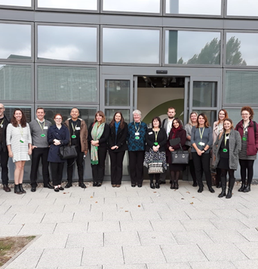
Distance learners and technology
Participating in off site visits is not possible for many distance learners
Distance learning providers may not be able to deliver off site visits at sufficient scale
Virtual visits and museum tours are increasingly common:
Guggenheim – Google Street view and paid tours using ZOOM
NASA – Videos with comment section for questions to experts and chat rooms
However there may be limited opportunities for guided discovery and social cognitive learning
Advances in technology make live interactive virtual visit ‘webcasts’ possible, but to date they have not routinely been used to their potential.
Open Labcasts and fieldcasts are a good example of webcast use (e.g. S206 Environmental Science)

Slide 4
Aims and objectives
Aim
Investigate if a live interactive webcast at Bletchley Park Museum using Stadium Live technology currently used at the OU is a resource-effective way of enhancing the Level 1 Computing and Communication student experience
Objectives
• Explore and evaluate the design and delivery process (can it be improved?)
• Investigate the opportunities and limitations (do they provide value?)
• Evaluate impact of webcasts on student experience (is there enhancement?)

Slide 5
Method (original)
All students studying TM111, TM112, XTXY112, T122, TMXY122, TMXY125, TM129 and TMXY130 invited to participate in webcast (J and B presentations)
Webcast scheduled to occur between J presentation modules
Webcast content and structure linked to TM111 and TM112 learning
Project evaluated by:
Action research diary completed during webcast production
Total cost of production divided by total number of students (i.e. cost per student)
Analysis of participant demographic (e.g. geographical location, index of multiple derivation)
Student feedback survey – four 1-5 Likert scale questions (1 = not at all; 5 = a lot) and three true or false questions

Slide 6
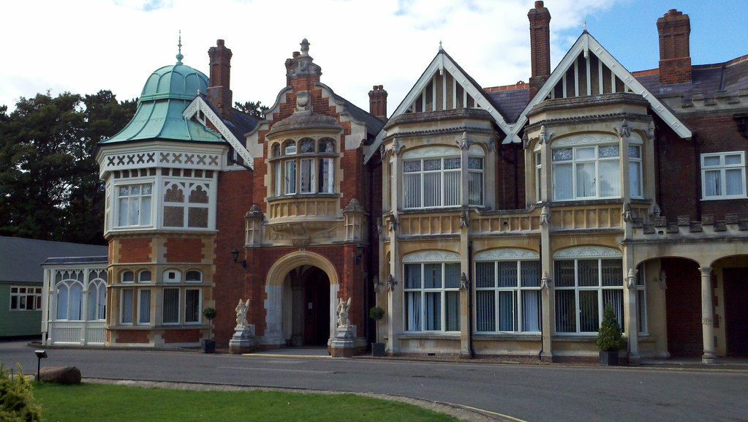
CC Number 10, Flickr
Courtesy of Bletchley Park Trust and CC Noun Project
CC Microbiz Mag

Slide 7
Adjustments to project design
Informed by Bletchley Park Trust that we must deliver webcast by the 1st October on 21st August
Decision made to reduce complexity of webcast
Live 30 minute Enigma demonstration from Bletchley Park Block B with use of onscreen widgets
Covid compliant (e.g. Covid risk assessments, increase visit scrutiny)
Webcast changed to become welcome back activity for returning Level 2 Computing and Communication students
x1 technology test and x1 rehearsal at Bletchley Park

Slide 8
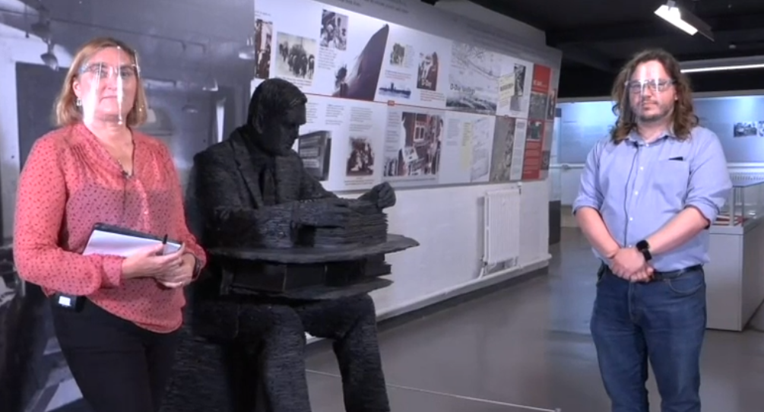
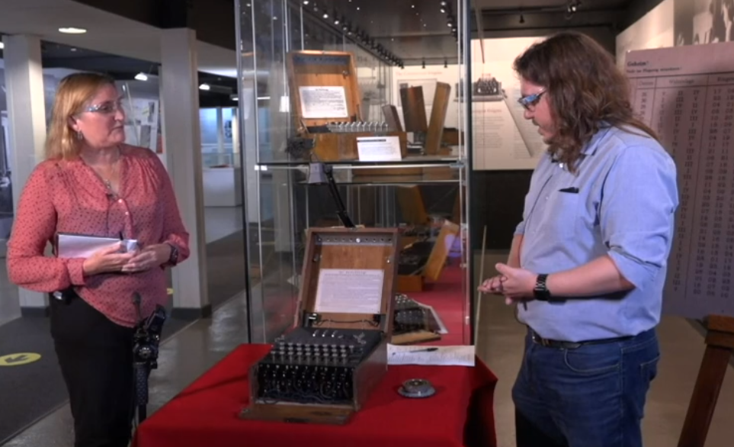
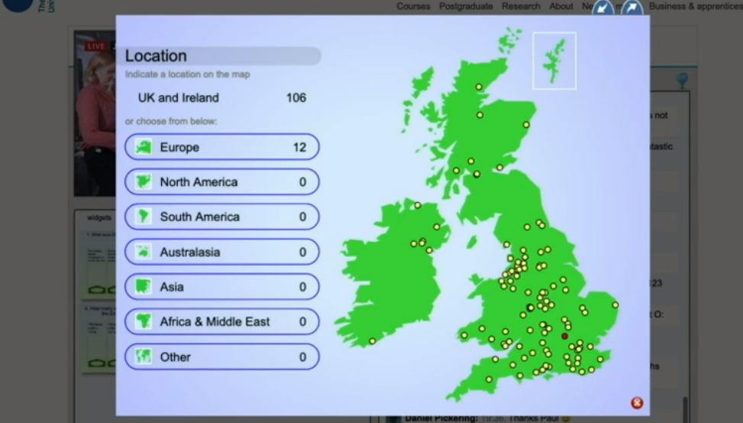
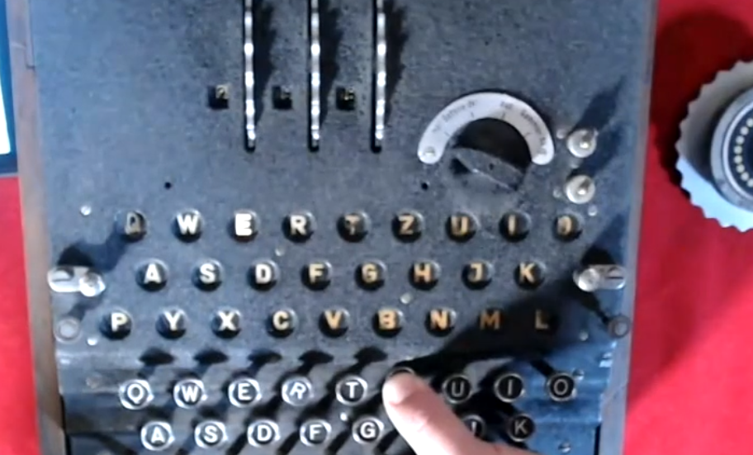
29/9/2020

Slide 9
Results
101 students (164 people in total) participated during the live broadcast
Age: mean (SD) 38±14
Gender: 75 male, 25 female, 1 unknown
Ethnicity: 93 white, 1 Arab, 1 Asian, 1 Mixed , 2 Black African, 3 Unknown
Disability: 80 none declared, 20 declared, 1 unknown
The webcast cost an equivalent of approximately £18 per student
**Broadcast would have cost between £2500 and £2800 if full visit was delivered as originally planned**
42% of student participants were identified as being in the lowest 50% of the Index of Multiple Deprivation.
64% of student participants resided over 2 hours in travel distance from Bletchley
30% - Scotland, Wales, Northern Ireland and Europe

Slide 10
Results
Student survey Likert results (13 from 68 surveyed, response rate 19%) reported that the webcast:
supported previous teaching and learning: ‘somewhat’
increased my motivation towards OU study: ‘quite a lot’
prepared students for their next module: ‘somewhat’
improved my overall experience as an OU student: ‘quite a lot’
(median values)
The student survey also found:
7 of the 13 respondents would find it difficult to visit Bletchley Park Museum in person, whereas 3 would have had no difficulty.
All the student survey respondents said they now want to visit Bletchley Park and would attend relevant virtual visits/webcasts in future

Slide 11
Student feedback
‘Helped put a physical view on the theory studied. Cryptography’
‘Fired my enthusiasm for the subject.’
‘Think this one could have been longer, or perhaps make a short series on the same subject?’
‘Reduce participation numbers but increase sessions. Most user comments were ignored by the hosts.’
‘I had technical issues and I wish I could watch it again because there were some parts I could not follow.’
‘I would even join if they were not relevant to my area of study but were relevant to the subject of computing and IT.’

Slide 12
Discussion
Live interactive webcasts off campus are possible and reproducible, even during a pandemic.
Interactive webcasts can be cost effective
Benefits of interactive webcasts include:
Enhancement of student motivation and student experience
Ability to offer engaging insight visits at scale across wide geographical areas
Promotion of webcast location (encourage visitors to site, not replace)
Interactive webcasts may widen access to off-site experiences (further study required)
Close, relevant and authentic links to future learning are needed in ‘welcome’ and ‘bridging’ webcasts for students to feel that it is preparing them for upcoming study

Slide 13
Conclusions and Recommendations
Results indicate that live interactive webcasts may be a resource effective way of engaging computing and communication students.
If the purpose of a webcast is to augment previous or prepare for future teaching and learning, links to module/qualification content must be clear and explicit.
It can be recommended that future off site insight webcasts are held as part of ‘welcome’ and ‘bridging’ student activities at the OU as they can:
Enhance student satisfaction
Increase learner opportunity to engage with a range of ‘real world’ environments
Foster and build sense of student community
Support student success

Slide 14
Acknowledgements and references
Tom Briggs - https://tkbriggs.co.uk/contact/
Kate Travers (Head of Learning Bletchley Park)
Bletchley Park Trust
Trevor Collins and KMi
A recording of the webcast can be watched here -https://player.open.ac.uk/share/5da0d3d6eb
Chang, Eunjung (2007). Making Personal Meaning from a Museum Experience: Undergraduate Students’ Art Learning Experiences at the Indiana University Art Museum. PhD Thesis. Indiana University. Available at https://search.proquest.com/openview/79d332901f768cdc45f0b7950ec8cd6f/1?pq-origsite=gscholar&cbl=18750&diss=y (6/10/2020).
Higgins, Noelle, Dewhurst, Elaine and Watkins, Los. (2012). ‘Field trips and teaching tools in the Law curriculum’. Research in Education. 88, p102-106.
Jakubowski, Lisa Marie (2003) ‘Beyond book learning: Cultivating the pedagogy of experience through field trips’. Journal of Experiential Education. 26 (1), pp 24-33.
Y. Kali, O. Sagy, T. Kuflik, O. Mogilevsky and E. Maayan-Fanar. (2015) ‘Harnessing Technology for Promoting Undergraduate Art Education: A Novel Model that Streamlines Learning between Classroom, Museum, and Home’. in IEEE Transactions on Learning Technologies, vol. 8, no. 1, pp. 5-17, 1.
Manner, Barbara (1995). ‘Field Studies Benefit Students and Teachers’. Journal of Geological Education. 43 (2), p 128-131, DOI: 10.5408/0022-1368-43.2.128.
Sachatello-Sawyer, B., Fellenz, R. A., Burton, H., Gittings-Carlson, L., Lewis-Mahony, J., & Woolbaugh, W. (2002). Adult museum programs. Walnut Creek: Altamira

