Slide 1
Business Innovation
Andrew Law
Nov 2020

Slide 2
Context
We need to retain and build on OU brand and values:
Adult, engaging learning - with research informed pedagogy and content
Flexible, part-time learning, open and on massive scale
Support for life-long learners, wanting a more fulfilling life and work
Build on reputation for supporting low-skills, low-confidence and excluded

Slide 3
Context
We need diversification, but at present it needs to be delivered with (relatively) low:
Demands on CAU capacity
Demands on IT capacity
Investment demand
Disruption to BAU

Slide 4
Enablers
We have content
< 3% of module content is released onto OpenLearn, we could release more, for fee.
We have a production strategy
Making future content more distributable, reusable, smaller chunks for all of the above.
We have platforms of mass delivery
OpenLearn+ could quickly serve B2B, B2G, B2C with particular (but not exclusive) focus on low-confidence/ low-skills and the UK.

Slide 5
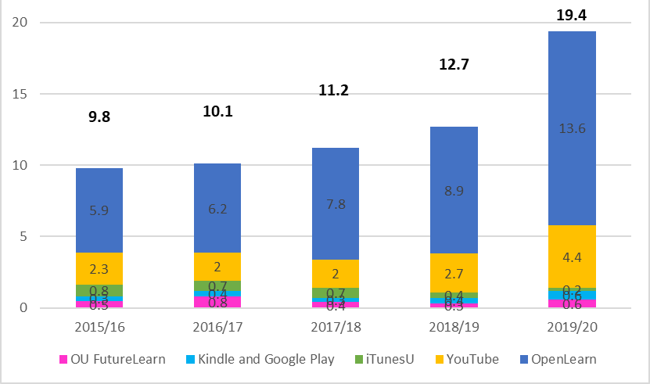
Where are people visiting OU content?

Slide 6
Ideas: Learning without strings (B2C/B/G)
These short courses would not have the restrictions of 100hr+, for credit and with support micro-credentials.. These OL+ courses, would be shorter, non-credit, roll-on, roll-off courses.
These would not need the investment in time or money required by bespoke short courses. However, OL+ could be used to distribute all forms of content including those proposed by central marketing .
Examples:
The OU as a national skills for work provider – See Skills for Work section on OL. Extending the national rollout of DWP JobCentre Plus proposition, replication of similar programmes focussed on supporting members of particular sectors, Unions, Trade memberships , Alumni, etc.
Enriching lives, feeding a thirst for learning, - See Skills for Life section in OL includes wellbeing (nutrition, mental health), leisure (history, psychology, arts, creative writing), family learning (how do children learn, grow, develop). Responding to the growth in ‘grey pound’ and concern to keep brains active, Alumni, etc.
OU VLE
Low cost
FREE
Enquirers
FEE
OpenLearn+
Income
Content with services (support, accreditation)
Content only
‘Learning without Strings’

Slide 7
Ideas: Learning as a service (B2G/B)
B2B: Learning as a Service:
Curation of OL/OL+ materials supporting a particular sector, community or organisation within a dedicated micro-learning portal (initially on OL/OLC – later ideally via commercial VLE).
Examples:
Focussed Sector, Location or Organisation Support – building on OU strong brand and public sector association focus on support of key sectors such as health, care, social work, teaching, public sector management and leadership.
Specialist Redundancy Services – curated suite of training and consulting services, which companies (or a region) could deploy as part of their regeneration programmes. Building on current DWP offer, with local customisation options
FE support: Open and distance learning capacity building for staff, development of distance learning skills (with options to license in student teaching content). Could be done with low impact on CAUs if exploiting existing content (MOADE etc).
£ VLE
OpenLearn+
‘Learning as a service’
Subset of content curated for and targeted at an organization/sector
‘Learning as a service’
(on commercial VLE – and/or visible within clients VLE)

Slide 8
Ideas: Extending the range
Open School
Open College
Open University
GCSE? Extending the range of content levels offered through partnership (some will overlap with FE/College provision), or a grander, national plan with BBC etc.
Functional Skills: Specific focus on supporting the significant need in Level 1-2 English and Maths diagnostic, learning, support, and exams.
Higher Tech Qualifications: We could be a ‘knowledge’ curriculum provider in partnership with an IoT or a National College – providing online curriculum and (optionally) online support.

Slide 9
Ideas: Extending the transaction formats
£ VLE
Third Party
OpenLearn+
B2C Individual sales
B2C Subscription
B2B Learning as a benefit
B2B Seat licenses
B2B Licensing
B2C Revenue share

Slide 10
Outcomes
Benefits
Income – prime focus (monetary)
Diversity of income (more resilient, more opportunity)
Users – serving more users in need (mission support, brand reinforcement)
Partners - developing new relations with organisations and sectors (brand enhancement)
Innovation - of product line (more resilient, more opportunity)
Minimal Disruption
Academic capacity: Content will mainly be adapted from existing modules
IT: The paywall for OL+ has already been designed and built. The £VLE is a low investment bi-product of the already necessary work to move of our existing VLE to the cloud
Investment: No new systems need to be built and content is being adapted not designed and developed
BAU disruption: The impacts on BAU (and other business developments) should be low.

Slide 11
Business Innovation Hub (BIH)
BIH
Ideas
Enablers
Market Test
Capability

