Slide 1
Impact of the OpenLearn Create course ‘Support Through Court: Domestic Abuse’
Elizabeth FitzGerald and Hugh McFaul

Slide 2
Our talk today
Introduction to the Open Justice Centre and Support Through Court
The collaboration and the OpenLearn course creation
The impact of the OpenLearn course
The role of universities in the community

Slide 3
The Open Justice Centre and previous OER production

Slide 4
Support Through Court
An award-winning charity with 36 staff members and over 800 dedicated volunteers, operating from 20 courts and associated offices across England and Wales
They aim to reduce the disadvantage of people facing the civil or family justice system without a lawyer, enabling them to access justice
They believe that no one should face court alone and so work to provide immediate support to everyone who comes to them
Their trained volunteers provide emotional and practical support to clients throughout the court process
OU students volunteer as part of W360: Justice in Action

Slide 5
The collaboration and the OpenLearn course creation
Ministry of Justice funded project
Focus on domestic abuse
Perpetrators and victims
Volunteer training traditionally done face-to-face
Desire to investigate online training – legacy for MoJ project

Slide 6
The collaboration and the OpenLearn course creation
Collaboration with Open Justice Centre to design and write a new OpenLearn course on Domestic Abuse
STC staff included OU law student
OU staff included family law solicitor
Genuine co-production
Combines substantive law and soft skills

Slide 7
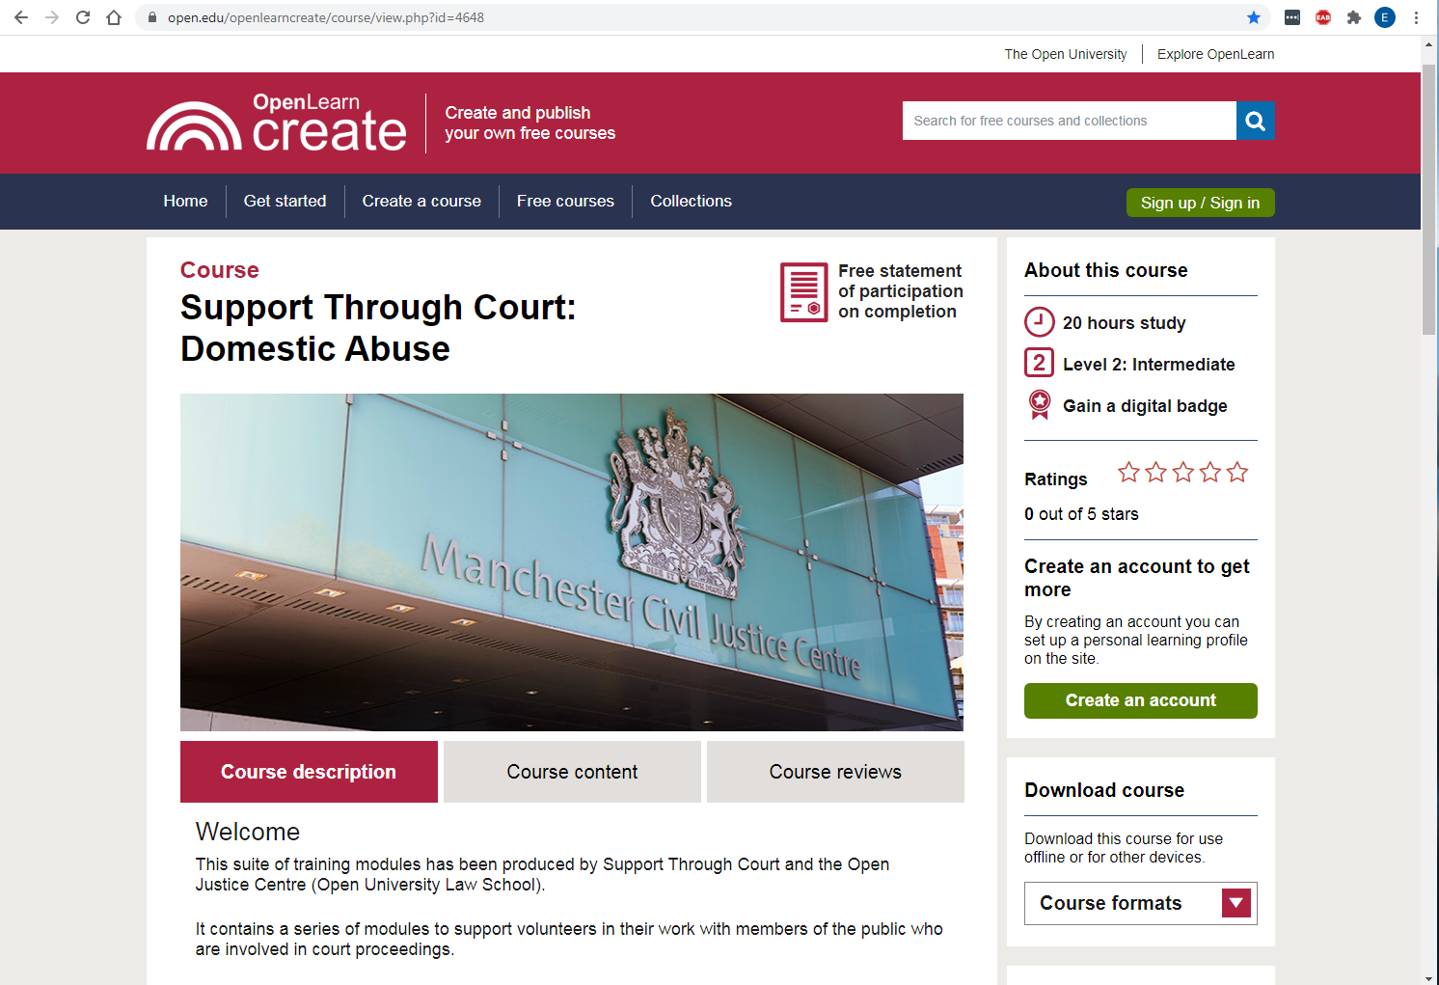

Slide 8
The impact of the OpenLearn course (1)
Mandatory for all STC volunteers
Part of induction training for new team members
Reached beyond STC to related organisations and individuals
STC considering extending online learning to other areas of law including housing and issues relating to families/children

Slide 9
The impact of the OpenLearn course (2)
Currently investigating the impact at micro (learner), meso (course designer/creator) and macro (STC management)
Some interesting initial findings around
the perspectives of alleged perpetrators, in both access to this course and how volunteers work with them
the digital divide still being a barrier to access
the importance of this resource during COVID-19 lockdown, where both F2F training has had to be reduced, and domestic violence has increased

Slide 10
The role of universities in the community
Wider questions around the role of universities in terms of their responsibilities to the community
Do we have an obligation to share knowledge or provide opportunities to access knowledge?
Professional/personal development as a form of knowledge exchange – links across to KEF in terms of public and community engagement

Slide 11
Thanks for listening
Elizabeth FitzGerald – elizabeth.fitzgerald@open.ac.uk
Hugh McFaul – H.J.Mcfaul@open.ac.uk
https://www.open.edu/openlearncreate/course/view.php?id=4648
https://www.open.ac.uk/open-justice
https://www.supportthroughcourt.org

