Slide 1
Online practices and tools for engaging research and communication
Ann Grand, Trevor Collins, Richard Holliman and Anne Adams

Slide 2
Overview
Public engagement with research (RCUK Catalyst)
Practices at the OU
Staff survey and interview findings
Discussion: futures?
Available tools at the OU
Options (within and without the university)
Discussion: what support would you value?
Summary (so what)

Slide 3
Public engagement with research
RCUK funded catalyst for public engagement with research (April 2012 to March 2015; £300K; 1 of 8)
Embed public engagement with research within the University’s culture
PI: Prof Tim Blackman (PVC-RSQ)
Champion: Dr Richard Holliman (50% FTE)

Slide 4
Public engagement
EDGE tool
Levels (or scale) of public engagement
Embryonic, Developing, Gripping, Embedding
Challenges
Purpose (mission, leadership, communication)
Process (support, learning, recognition)
People (staff, students, publics)

Slide 5
Public engagement
with research
NCCPE says “Public engagement describes the myriad ways in which the activity and benefits of higher education and research can be shared with the public. Engagement is by definition a two-way process, involving interaction and listening, with the goal of generating mutual benefit.”
So, within the context of OU research = the ways our research can be shared with individuals and groups beyond the immediate research community for mutual benefit.

Slide 6
Overview
Public engagement with research (RCUK Catalyst)
Practices at the OU
Staff survey and interview findings
Discussion: futures?
Available tools at the OU
Options (within and without the university)
Discussion: what support would you value?
Summary (so what)

Slide 7
Public engagement with research
Surveys: CROS (research staff) and PIRLS (leaders)
Define ‘public engagement with research’
Describe a successful activity involving PER
What publics have connections with your research?
CROS (n=57); PIRLS (n=114)
Notes:
Excellent public engagement with research is reflected in the different ways that researchers meaningfully connect and share research with various stakeholders, user communities and members of the public. Done well, public engagement with research will generate benefits, changes and effects for all participants as they share knowledge, expertise and skills. Excellence will be demonstrated partly through recognition of the contributions that all participants make to the shaping of research agendas, the processes of conducting research, and in the products of that research.
Institution-specific questions on CROS and PIRLS surveys
The Open University is working to create a culture in which public engagement with research is embedded within strategic planning for research and the operational practices of researchers at all levels. In fewer than 150 words, how would you define ‘public engagement with research’?
Please describe, in general terms, a successful activity involving public engagement with research in which you have participated and the criteria you used for judging the success of the activity.
(a) Could you describe what non-academic communities or people you consider have connections with your research, either currently or in the past?
(b) Could you describe what types of publics would you like to engage with your research?
(c) Are there publics that you would not choose to engage with? If so, please describe why this is the case;
Please describe your three most important reasons for engaging with the non-academic communities or people that you listed in question (iii).

Slide 8
Public engagement with research
Surveys: CROS (research staff) and PIRLS (leaders)
Define ‘public engagement with research’
Describe a successful activity involving PER
What publics have connections with your research?
Notes:
Headline figures
Ideas are ‘transferred’ into public understanding, information is ‘conveyed’ and lectures are ‘given’. As Davies (2008) argued, some scientists persist in perceiving science communication as difficult, dangerous and framed within an over-arching context of one-way transfer. On the other hand, rejecting linear one-way communication as somehow inferior to dialogue ignores ‘the public’s appetite for information, as well as the empowerment that an understanding of the nature of science can offer’ (Trench, 2008, p. XX).

Slide 9
Public engagement with research
Surveys: CROS (research staff) and PIRLS (leaders)
Define ‘public engagement with research’
Describe a successful activity involving PER
What publics have connections with your research?
Notes:
Is a conceptualisation of public engagement as a one-way process leading to researchers tending to favour one-way activities, or vice versa?
Researchers ‘have begun to “talk the talk of engage­ment,” but have not started to “walk the walk”’ (Britner, 2012, p. 61). The move from deficit to dialogue is neither complete nor irreversible (Trench, 2008) and moments of deficit can yet be found even in activities carefully labelled as dialogic
Note very few mentioned digital

Slide 10
Public engagement with research
Surveys: CROS (research staff) and PIRLS (leaders)
Define ‘public engagement with research’
Describe a successful activity involving PER
What publics have connections with your research?
Notes:
Seventy per cent (n=119) named at least one public and 57% (n=70) named more than one; only 1% (n=2) said they had not engaged with any public.
Groups with which they would not wish to engage; 65% (n=51) answered with various versions of ‘none’ - willingness to work with a range of audiences. No one group predominated although governments (4%, n=3), the media/journalists (4%, n=3) and interest groups (9%, n=7).
Responses to the question of which publics they would like to engage with very often the same as those they would like to engage with. Twenty-one per cent (n=25) simply said ‘the same’ (or equivalent) and 60% (n=70) named at least one of the same communities.

Slide 11
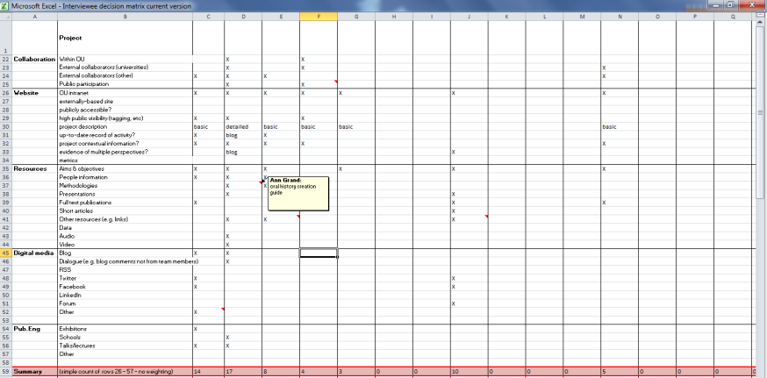
Digital engagement
Interviewee selection
Organisational data
(faculty, funder, collaborators, % through project)
Projects funded above £50,000; active or within one year of completion
73
Evidence of digital (and ‘traditional’) engagement
Resources available
Notes:
Easy to cherry-pick “good” projects, highly digitally-engaged but wanted cross-university, and widely representative projects
A descriptive decision matrix - criteria projects funded above £50,000 and were either active or within one year of completion - 73 projects.
Organisational data : university faculty/institute, funder(s), collaborators (if any) and project start and end dates.
Existing levels of digital engagement (from project websites or intranet pages
public accessibility and visibility of website, content of website/intranet page (for example, an up-to-date record of activity), resources available (for example, videos), use of digital media (for example, a project blog) also any evidence of ‘traditional’ engagement (for example, schools’ lectures).

Slide 12
Digital engagement
Proportionate to number of projects in faculty
Interviewees
Covered all funders
PhD students, RAs, RFs, Lec., SLs, Profs.
15
High, medium and low digital engagement
Seven women, eight men
Projects at all stages of lifecycle
Notes:
Sample of fifteen projects (i) proportionately representative of the number of projects existing in each faculty; (ii) contained projects from a range of funders (all seven of the UK research funding councils, various charitable trusts, EU funding and industrial funding were eventually represented); (iii) contained projects considered to demonstrate high, medium and low levels of digital engagement; and (iv) contained projects at the beginning, middle and end of their life.
Interviewees at all career stages including PhD students, research associates, research fellows, lecturers and senior lecturers and professors.
Seven women and eight men.

Slide 13
Digital engagement
Researcher interviews
Questions focussing on:
Public(s)
Processes
Participation
Performance
Purposes
Politics
Notes:
Public
what does ‘public engagement with research’ mean to you?
within [project] do you feel you are encouraged (‘encourage others to) to engage with the public, community organisations, industry, stakeholders, end users etc.?
can you give any examples of any activities incorporating public engagement with research in which you have participated?
what kinds of communities have engaged with your research (e.g. school pupils, university students, journalists, the ‘general’ public …)?
Does research feed into teaching (if appropriate)
Processes
what digital technologies, electronic means or social media tools do you and your colleagues use to support communication, collaboration or dissemination (for example, electronic lab notebooks, email, wiki, common document repository, twitter, facebook …)?
to what extent do you think it is important (or not) to use digital mechanisms to engage with public audiences?
have you had any responses or feedback from your digital activities from public groups?
Participation
how would you characterise the participants of your digital engagement activities?
do you have any evidence to support this characterisation?
Performance
does your research group (department/faculty) have any mechanisms to support researchers who want to engage with public audiences?
have you had any training in facilitating public engagement with research, either by traditional or digital methods?
do you think the methods for facilitating public engagement with research are different for digital and traditional routes?
how do you evaluate the effectiveness, impact and reach of your digital engagement activities?
what mechanisms support the creation of digital engagement activities?
what are the barriers against supporting public engagement with research?
Purposes
to what extent do you think there is a shared understanding of the purpose, value, meaning and role of engagement among your colleagues/ the wider OU staff?
how would you describe the value placed on public engagement in your research group (department/faculty)?
are there public engagement leaders within the university to whom you feel you can look for support?
Politics
for you, where do the boundaries between research and public engagement with research lie?
What about ‘impact’?
do you feel the OU recognises and rewards staff involvement in public engagement within recruitment, promotion, workload planning and reviewing?

Slide 14
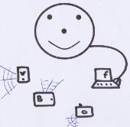
What does the digitally-engaged researcher look like?
“I have a Twitter account but I’m not an avid Twitter user. I’ve tried to use it more and I’ve got slightly better but I wouldn’t say it’s made any impression on the outside world, really. I have a Facebook account, but that’s just for keeping in touch with my research students; it doesn’t make any impact externally.
A colleague and I made some videos with a little hand-held camera of the work we did in [country] and they’re on YouTube, where they’ve got not very many hits.
So we’ve done that, the sorts of things we’ve been asked to do by the university but to my knowledge, we haven’t gone viral!”
Interviewee 13
“we don’t do a large amount of [engagement] … My priority is to get on with the research, deliver publications, further knowledge, rather than spend all the time packaging up a small amount of work for general consumption.”
Interviewee 4
“now individuals have the power to disseminate information through several channels – people have a Twitter account, Facebook accounts, blogs – these are not properly monitored, there is hardly any quality control.”
Interviewee 15
“a number of us have personal blogs, that we blog about our work and use our social networks … a combination of Twitter, LinkedIn, Facebook, to tell the wider community about the work that we’re doing … [X] uses his blog as his research journal but also as a way to disseminate what he’s found out and get people interested. Similarly, I have a blog that tries to capture both my research and teaching interests and combine them…” Interviewee 6
“We have our individual profiles on the Internet and our research centre has a webpage but … … what I find difficult is to keep them up to date myself. I learn how to change the webpage or something like that and a year later I have forgotten, so it becomes ‘I’ll do it another time’. For example wikis and things like that, we are not so digitally savvy, in our group.”
Interviewee 2
The fully-wired
The dabbler
The brave trier
The unimpressed
Notes:
Coded on Nvivo – grounded theory approach
Emergent categories
Communities of researchers – co-creating digital content
NB No hierarchy – one isn’t ‘better’ or more aspirational than another
FW
Online academic persona fully developed
Uses multiple tools for multiple purposes – or sometimes two purposes at once
blog as journal and dissemination
Strategic use of tools; Might be project-oriented
BT
Thinks digital engagement is the right thing but uncertain about their competence
Int 13 had been asked to set up Twitter by his HoD
But on SecondLife – virtual world for his students – had chance meetings, discussions, - useful stuff
D
Just starting or slightly reluctant digital engager
Very focussed on the time it takes
Uses media for particular purposes then forgets about them – e.g. for job ads
U
No digital engagement/doesn’t see the value of engagement
Sees engagement as extra work
Only small part of work is translatable for public
What matters is the research itself, or teaching, or contributions to management. Interviewee 2
there can be diminishing returns. If people just can’t do it, there are just diminishing returns. Interviewee 10

Slide 15
Forecasting – outcomes of engagement
Audiences/communities/stakeholders/publics
what communities would you (or your research group) like to be engaging with:
in a year’s time?
in five years’ time?
in ten years’ time?
How would you (or your research group) like to be engaging?
in a year’s time?
in five years’ time?
in ten years’ time?
Notes:
‘How’ can include co-creation, collaboration, etc. Would like it to be digital but if they can’t manage that, any engagement

Slide 16
Overview
Public engagement with research (RCUK Catalyst)
Practices at the OU
Staff survey and interview findings
Discussion: futures?
Available tools at the OU
Options (within and without the university)
Discussion: what support would you value?
Summary (so what)

Slide 17
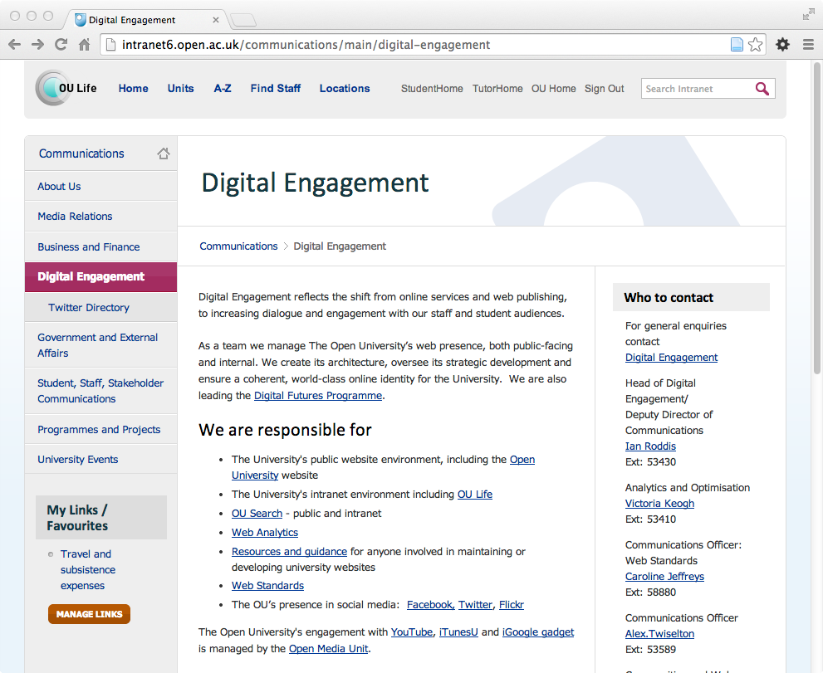
Available tools within the OU
OU Communications
http://intranet.open.ac.uk/communications
Who: Digital engagement team
http://intranet6.open.ac.uk/communications/main/digital-engagement
digital-engagement@open.ac.uk

Slide 18
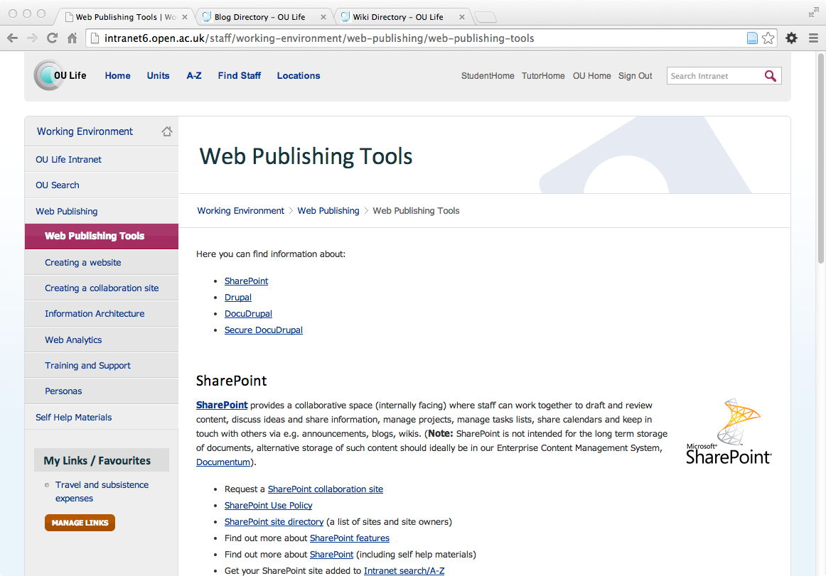
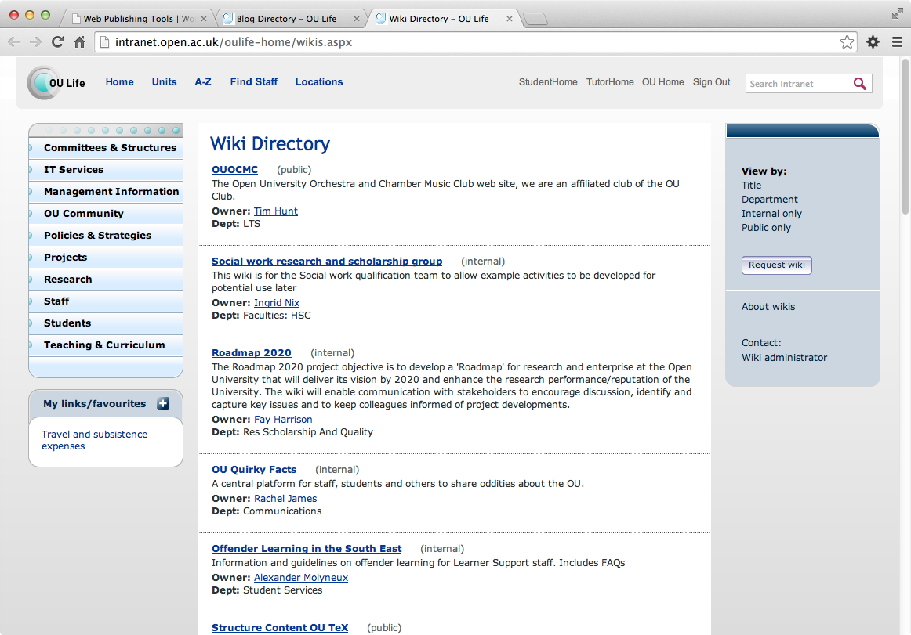
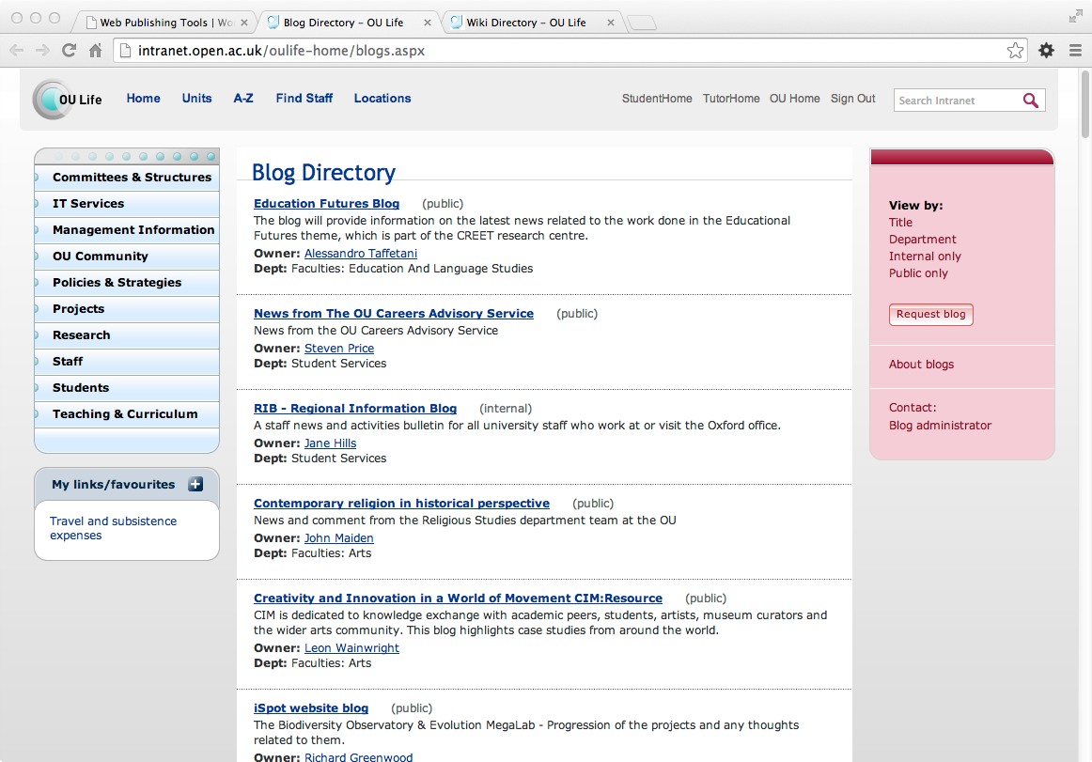
Available tools within the OU
Sharepoint (file sharing)
Drupal (content management system)
DocuDrupal (Documentum & Drupal)
Secure DocuDrupal
MediaWiki (wikis)
WordPress (blogs)

Slide 19
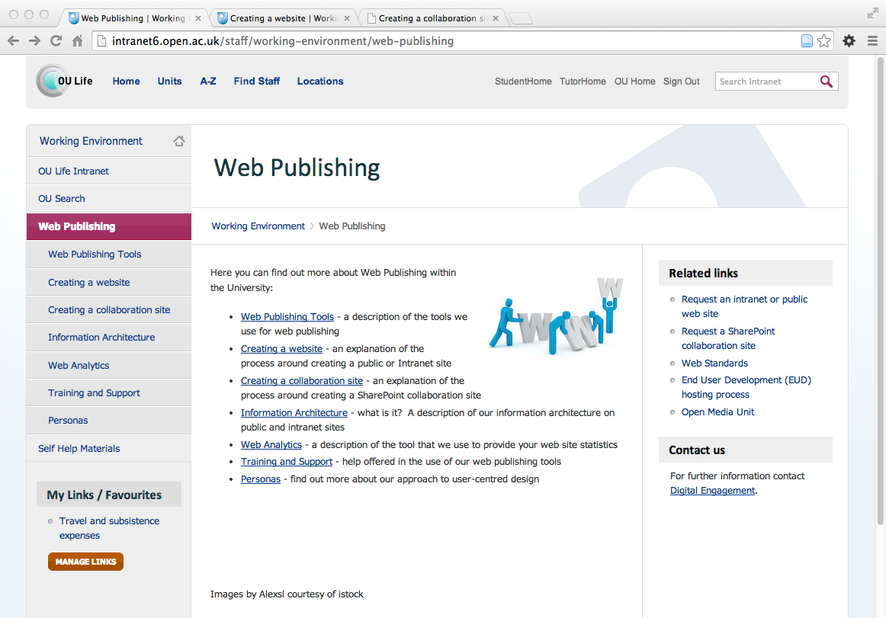
Available tools within the OU
Intranet: OU Life - A-Z
web publishing
wikis
blogs

Slide 20
Available tools outside the OU
Hosting services
websites (http://www.weebly.com)
wikis (http://wikkii.com)
blogs (http://wordpress.com)
Social services
Twitter, Facebook, …
Media services
Flickr, YouTube, SlideShare, …

Slide 21
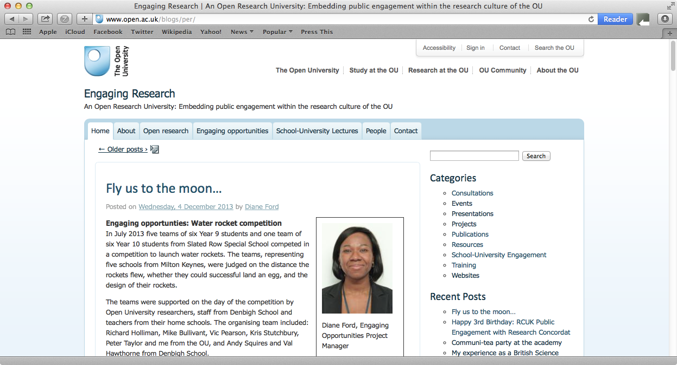
Existing OU WordPress service
WordPress (3.0.4 ~ Dec 2010)
OU ICE theme (v1)
image alignment broken
SAMS authentication
OUCU accounts only
without maintenance will become a security vulnerability (unsustainable)

Slide 22
OU blog service sustainability
WordPress blog service options
continue existing OU hosted WordPress service
replace OU WordPress service with alternate (e.g. Drupal or SharePoint)
update OU hosted WordPress service
wordpress.com (free) sites
externally hosted (pay) sites

Slide 23
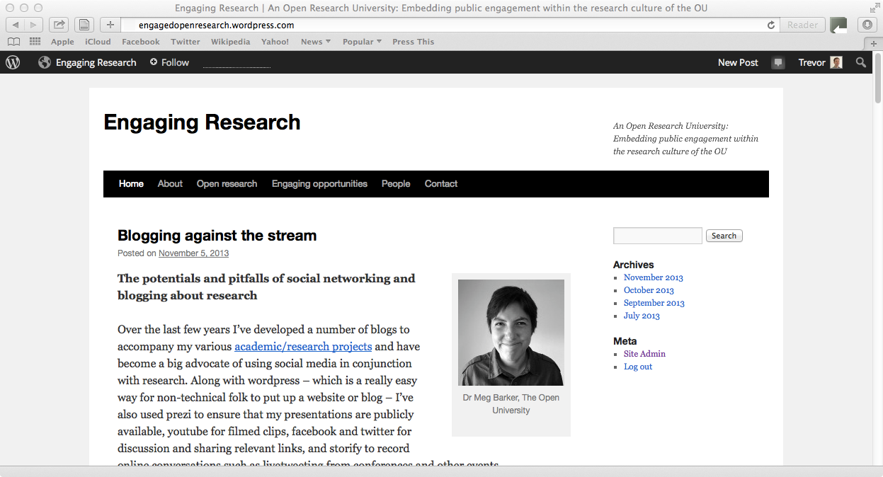
Example wordpress.com site
WordPress maintained free service
wordpress.com address
basic customisation
3GB limit
adverts may be included
Features
social media integration
media shortcodes
WordPress stats

Slide 24
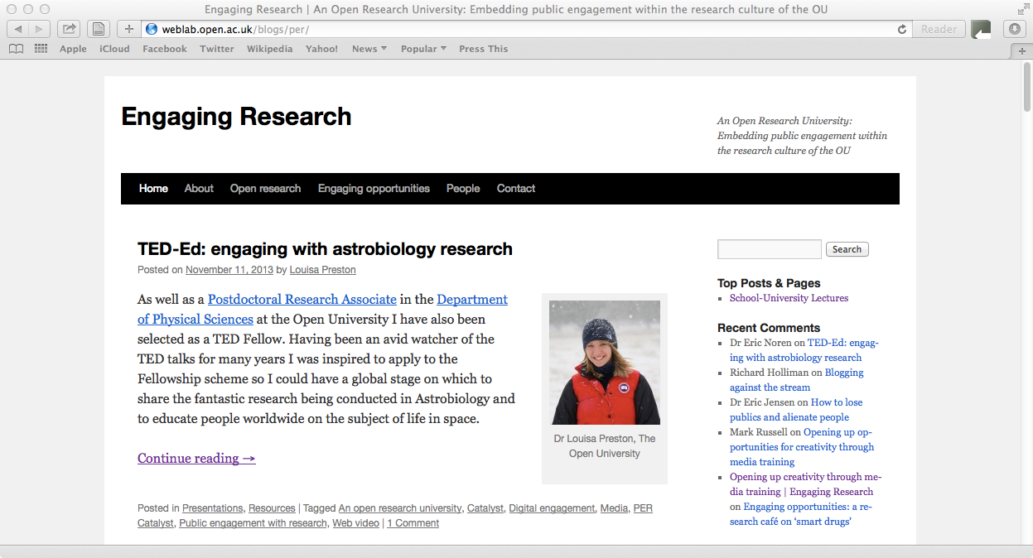
Example self hosted site
Self hosted WordPress service
www.open.ac.uk/blogs addresses
customisation and extensions
OU themes
Features
social media integration
media shortcodes
WordPress stats
university analytics

Slide 25
The within OU or without trade-off
OU hosted services
address: open.ac.uk
customisation and extensions
flexible templates
OU branding and authority
university wide analytics
External (free) services
corp. address: wordpress.com
limited customisation and extensions
pre-selected generic templates
space constraints (e.g. 3GB)
adverts may be included
site specific analytics (cloud)

Slide 26
What would you value?
In pairs or small groups discuss what do you already use or need with regard to online engagement with research…
technology support (e.g. blogs, websites, flickr, twitter)
social support (e.g. shared practices, training courses, exemplars)
policy support (e.g. precepts, standards, policies, unit plans)

Slide 27
Overview
Public engagement with research (RCUK Catalyst)
Practices at the OU
Staff survey and interview findings
Discussion: futures?
Available tools at the OU
Options (within and without the university)
Discussion: what support would you value?
Summary (so what)

Slide 28
Summary (so what)
Practices
Concepts of engagement
One-way, dialogic, collaborative
Communities engaging with research
Sharing skills:
‘communities of practice’
Tools
Who provides
OU Communications unit - digital-engagement team
What tools are available
SharePoint, Drupal, DocuDrupal, Secure DocuDrupal,
(wikis and blogs)
How to create a site
complete online form

Slide 29
Postcards from the edge
Comments and constructive criticisms on a postcard
One thing you didn’t know…
One thing we have missed…
One thing we should prioritise in the near future…
Follow-up?
Would you like to receive a follow-up email in three months (12th August) about our progress? Yes/No (if yes – please give us your email address)

