Slide 1
Planning for and evaluating school-university engagement with research Richard Holliman and Gareth Davies http://www.open.ac.uk/blogs/per
Notes:
Dr Richard Holliman, Science Faculty, Open University
9 March 2009
1

Slide 2
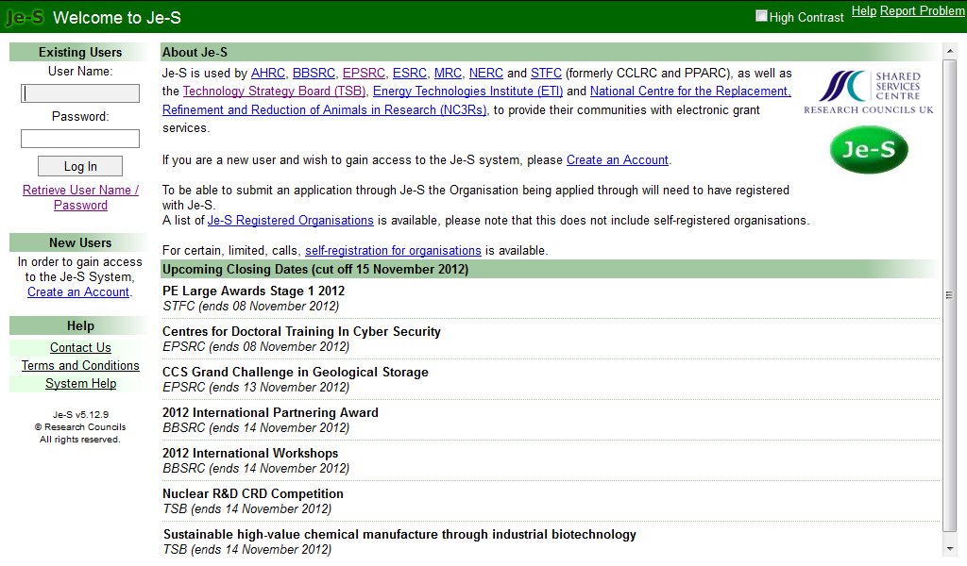
Je-S: https://je-s.rcuk.ac.uk/JeS2WebLoginSite/Login.aspx

Slide 5
what do RCUK mean by economic and societal impact?
“...demonstrable contribution that excellent research makes to society and the economy [...]
fostering global economic performance, and specifically the economic competitiveness of the UK
increasing the effectiveness of public services and policy,
enhancing quality of life, health and creative output.”

Slide 6
reviewing pathways to impact
Common characteristics of problematic quality Pathways to Impact | Common characteristics of high quality Pathways to Impact
Vagueness, lack of specificity and clear deliverables. Activities are not project specific, but routine activities for University research posts or too much focus on track record. Lack of consideration of broader beneficiaries, likely impacts and appropriate mechanisms. Activities narrowly focused and end focused. | Good consideration of the relevant beneficiaries, user needs and tailored activities Clear description of deliverables and milestones. Involvement of users from the outset. Clear commitment for realising both academic and non academic research impacts.
Notes:
6
We have looked at Pathways that had been rated highly during peer review, and also those that had scored poorly, and pulled out some common characteristics, this is included in our guidance and communications.

Slide 7
RCUK updated advice

Slide 8
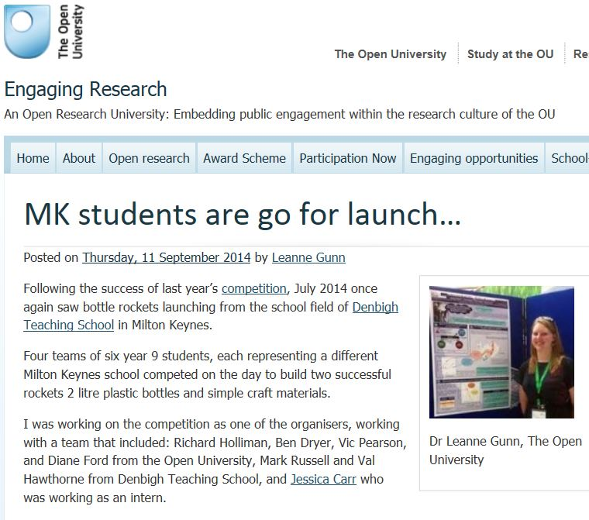
A rewarding experience

Slide 9
Engaged research
Engaged research encompasses the different ways that researchers meaningfully interact with various stakeholders¹ over any or all stages of a research process, from issue formulation, the production or co-creation of new knowledge, to knowledge evaluation and dissemination.
1. Stakeholders may include user communities, and members of the public or groups who come into existence or develop an identity in relationship to the research process.

Slide 10
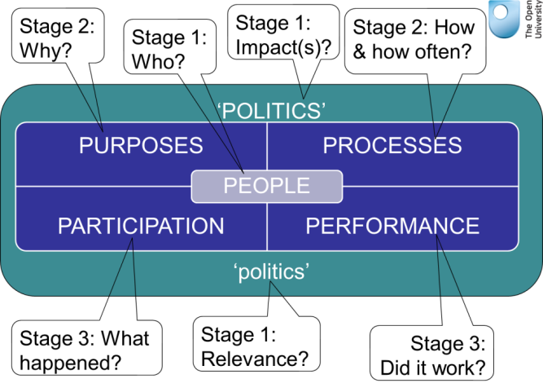
Group 1

Slide 11
Timeline of the events associated with the SUPI Science Matters lectures
Four short talks
Planning meeting
Video archives
Dry runs
Blog posts
Intro
Talk 2
Talk 4
Talk 1
Talk 3
Q&A

Slide 12
STAGE 1

Slide 13
Researchers engage with a range of professional agencies in different sectors : they can also engage directly with members of the public. This diagram ‘maps’ the different external groups with whom they might engage
Publics
Media
Public sector
Schools, colleges and lifelong learning
Communities of interest
Cultural and leisure services
Communities of place
Health and well being agencies
Non Governmental Organisations
Quangos and govt agencies
RESEARCHER
Community and 3rd sector
Policy community
Community organisations and societies
Local / regional / national govt
Local authorities / strategic bodies
Voluntary organisations and charities
Businesses and industry
Stage 1: who?
Social enterprises
International community
Business community
Notes:
13

Slide 14
Stage 1: who?
Select the end-users you consider have connections with your research
Which end-users would you like to engage with your research?
Are there end-users that you would not choose to engage with? If so, please describe why.

Slide 15
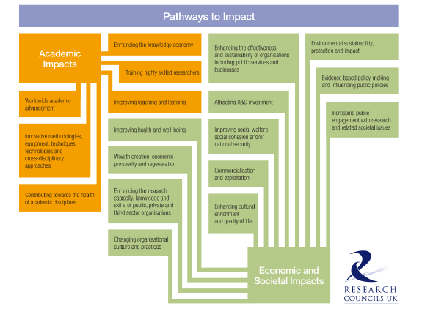
Stage 1: pathways & relevance?

Slide 16
Stage 1: pathways and relevance
What types of impact would you like to generate?
What types of impact do you think your end-users would value?
How likely do you think you will be in generating research impact in these areas? (Alternatively, how risky are your selections?)

Slide 17
STAGE 2

Slide 18
Stage 2: why?
Why are you engaging?
What are the aims and objectives of your engaged research?
Try to list SMART objectives:
Specific, Measurable, Achievable, Realistic and Timely
Use the Engaging Opportunities ‘Pathways to impact’ plan

Slide 19
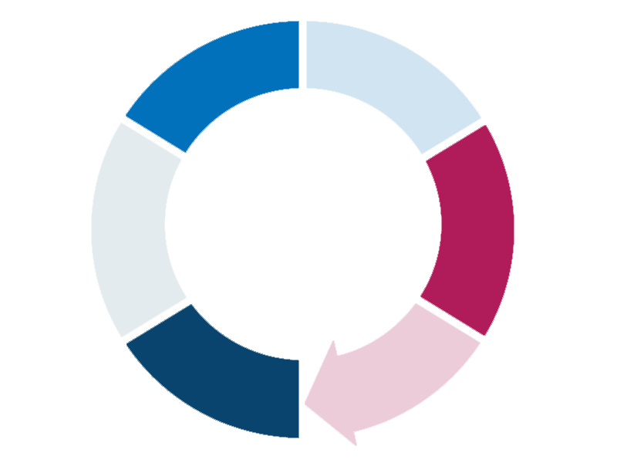
In what ways are you engaging
with your stakeholders?
Are you engaging effectively
with them?
Are you evaluating your activity,
and reflecting on how this work
might be adapted to better
meet stakeholder needs?
WHEN: Think about when in your research cycle….
Are you ensuring stakeholders
have access to your work in
accessible and relevant ways?
•Are you building capacity with
your stakeholders?
Intermediate
Research
Initial Research
Are you sharing
your results
effectively?
•Are you reflecting
the needs of your
stakeholders in your
work?
•What have you
changed?
•Are you capturing
the
impact of your
engagement?
Have you
engaged your
stakeholders?
Have you
allocated
resources to
support
stakeholder
engagement?
Stage 2: when (and how often)
Proposal
Final Research
Have you
considered who
your stakeholders
are?
How have/will you
engage them in
your work?
•Are you maintaining a
relationship with your
stakeholders?
•How will you maximise
the impact of your
research?
•Have you captured the
learning from the project?
Conception
Post project
How have you considered the
pathways to impact, and ensured that
these are integrated into your project?
Notes:
19

Slide 20
Stage 2: How and how often?
How will you involve your end-users in meaningful ways?
When, how often, where, through using what mechanisms?
Use the examples to help select relevant mechanisms

Slide 21
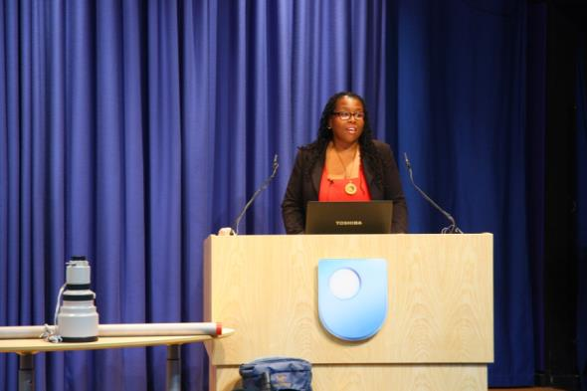
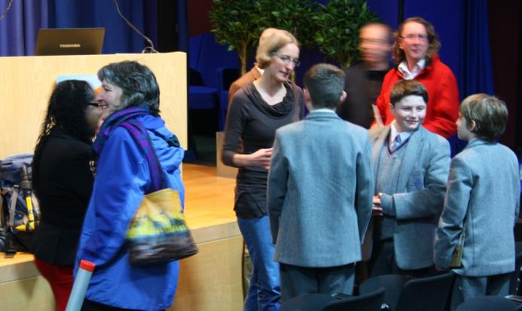
lectures and lecture demos

Slide 22
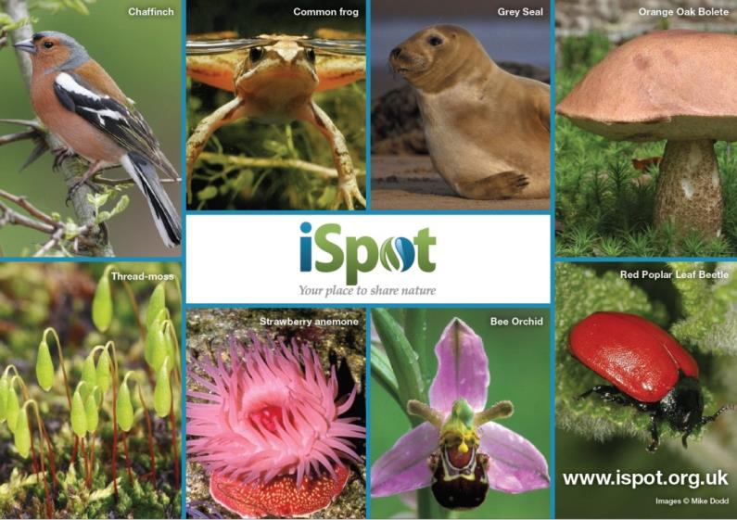
citizen inquiry

Slide 23
research cafés

Slide 24
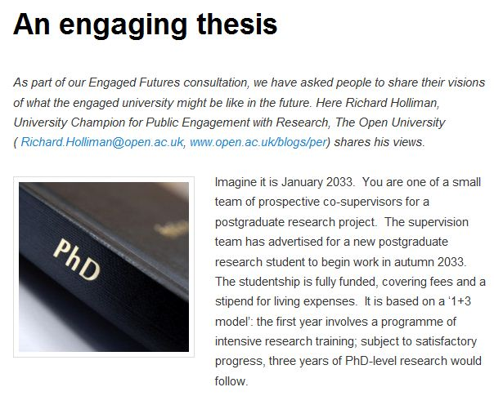
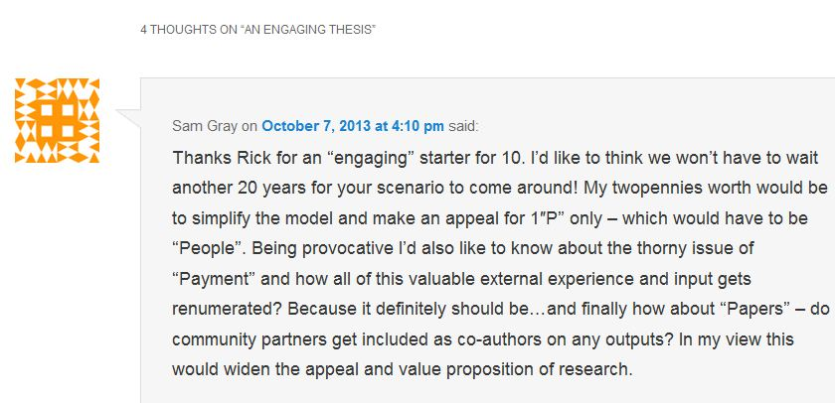
‘written’ materials: books, papers, web

Slide 25
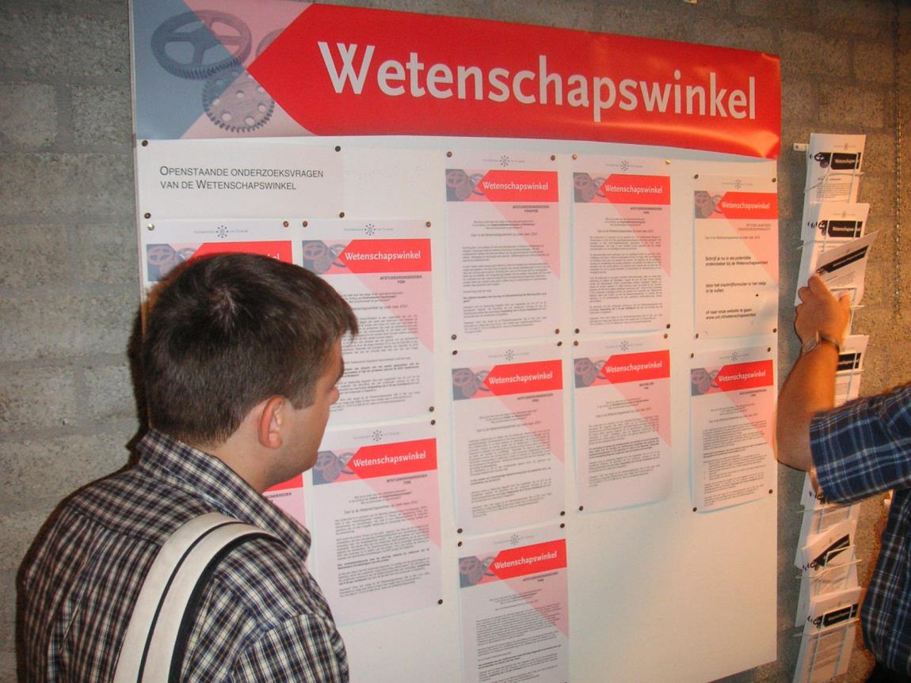
knowledge shop: responsive research

Slide 26
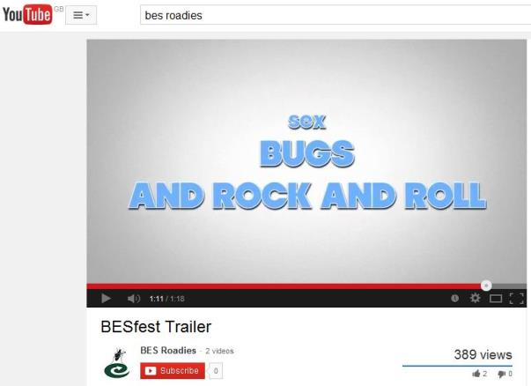
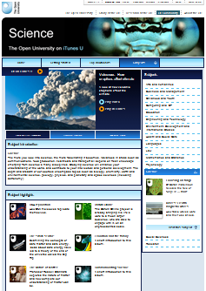
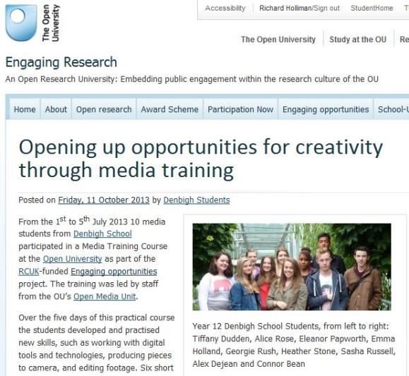
AV science (TV, web video)

Slide 27
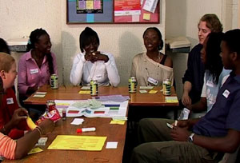
DEMOCS: influencing decisions

Slide 28
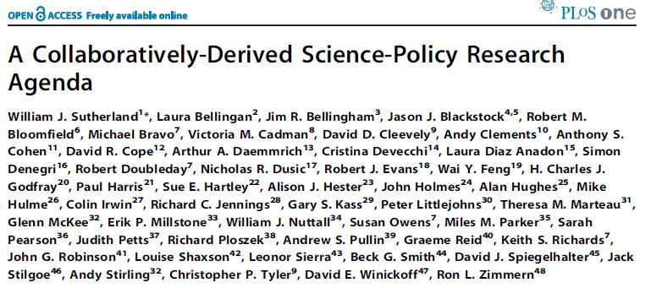
Stakeholder workshop

Slide 29
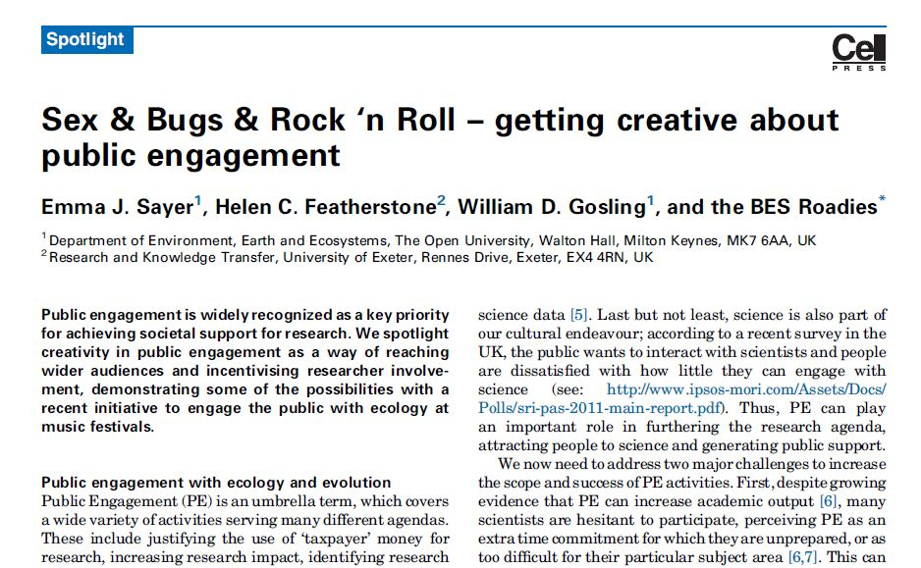
Festival: portable exhibit

Slide 30
Citizen jury

Slide 31
Advisory board

Slide 32
STAGE 3

Slide 33
Stage 3: what happened; did it work?
What measures have you put in place to record how your end-users participated? (How will you ensure they’re happy to have this information recorded?)
How will you know what worked? What plans do you have to improve future practice, and share your findings with other researchers?
How will you collect evidence of research impact?

Slide 34
Timeline of the events associated with the SUPI Science Matters lectures, where evaluation is shown in green text
Four short talks
Field notes + video footage + pre-n-post evaluation forms
Planning meeting
Field notes
Video archives
Stats
Dry runs
Field notes
Group-interview with students at their school
Blog posts
Researchers reflections
Intro
Talk 2
Talk 4
Post-interview with researchers
Talk 1
Talk 3
Q&A

Slide 35
Research objectives to be met by the Science Matters Lectures | Data Collection Methods
 | Pre-n-post stats | Eval.form.st.pre-n-post. | Eval.form.teach.pre-n-post. | Eval.form.mp.pre-n-post. | Post.int.res. | Group.int.st.post. | Focus.group.ol
To deliver up to 16 lectures or lecture demonstrations a year (48 in total)? (Obj. 1a) | ü
To address a range of academic disciplines (Obj. 1b) | ü
To engage ca. 2400 attendees (av. of 50 per lecture), majority being students studying at KS 3, 4 & 5 (Obj. 2) | ü
To post details of the lectures, along with copies of slides on an OU-hosted website (Obj. 3) | ü
To extend access to the three Christmas lectures (hosted at the OU) via a recording hosted on the OUs open access Stadium site (Obj. 4) | ü
To record the number and type of attendees (students, adults, teachers) (Obj. 5) | ü
To assess how significantly it can: inspire young people to consider a range of careers in research (Obj. 6a) |  | ü | ü | ü |  | ü | ü
To assess how significantly it can: raise awareness of different types of academic research (Obj. 6b ) |  | ü | ü | ü | X | X | ü
To assess how significantly it can: promote role models of successful researchers (Obj. 6c) |  | X | ü | ü |  | ü | ü
To assess how significantly it can: generate awareness of the nature and challenges of contemporary research (Obj. 6d) |  | ü | ü | ü | ü | ü
Use feedback from participants to improve future performance (Obj. 7) |  | X | ü | ü | X | ü | ü

Slide 37
Stage 4: Reflect back on Stages 1-3 Do you need to revise anything? Have you thought about resources?

Slide 38
take home messages (1)
there’s no one route to engaging research
‘the media’ is not the (only) solution
be imaginative and bold
think through risks, ethics, attribution
share ideas/learn from each other, supervisors…
…also from your publics
size isn’t everything (build partnerships)
volunteer to review plans for others

Slide 39
take home messages (2)
plan for multiple pathways (social and economic)
justify the resources for your plans
plan for evidence (generation/data collection)
Develop a public profile for your engaged research
see Bethan’s examples
Pre- and post- engagement

Slide 40
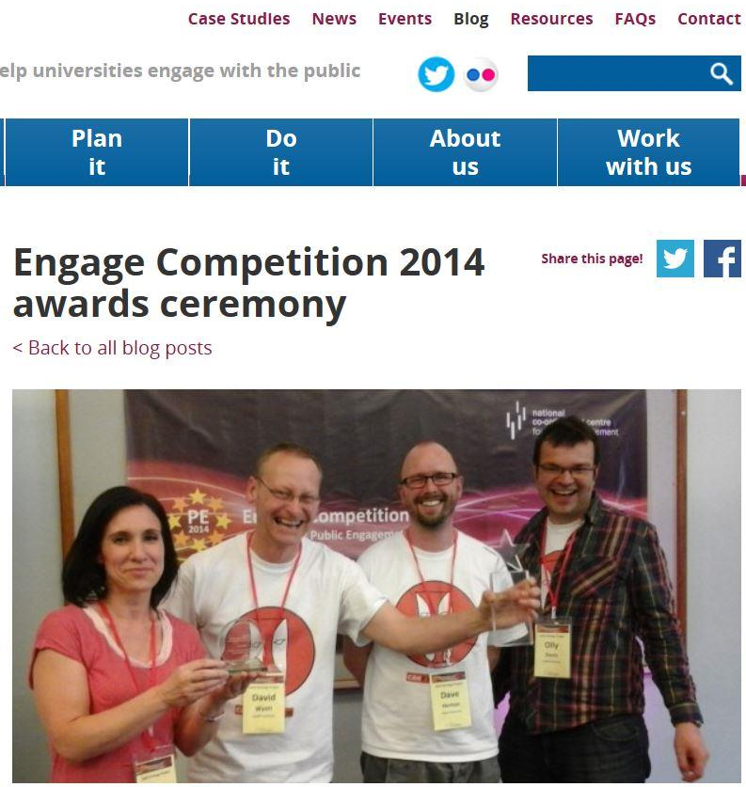
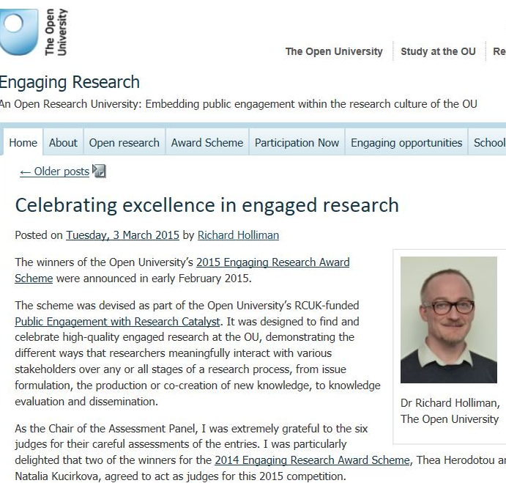
take home messages (3)

