Slide 1
Open Access Publishing: can you afford not to?
Tony Coughlan & Nicola Dowson
Notes:
Nicola

Slide 2
Open Access Publishing
Open access aims to make peer-reviewed literature available to anyone, free of charge, at the point of access.

Slide 3
Models of Open Access Publishing
Green: authors self-archive a version of their published article in an institutional or subject repository, or on their personal website. Usually there is an embargo period applied to accessing the full-text of the article.
Notes:
Nicola

Slide 4
Why deposit the full-text on ORO?
Ensure eligibility for the next REF – the full-text of journal articles and published conference proceeding must be deposited on ORO within 3 months of acceptance (applies to publications accepted after the 1st April 2016)

Slide 5
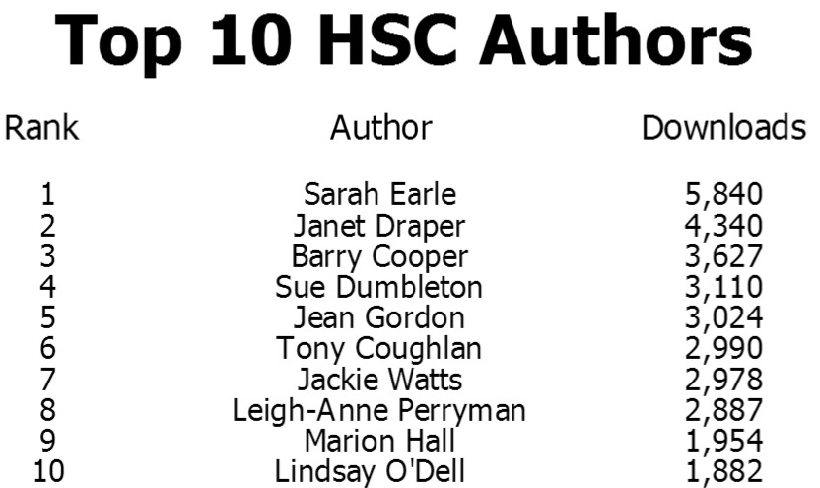

Slide 6
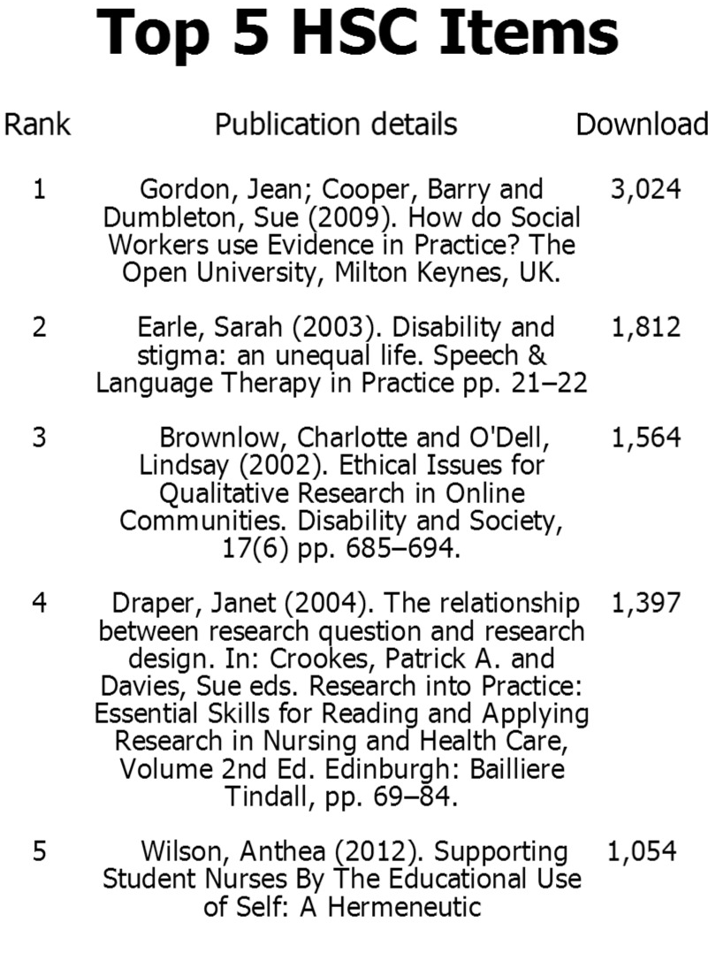
Notes:
Nicola

Slide 7
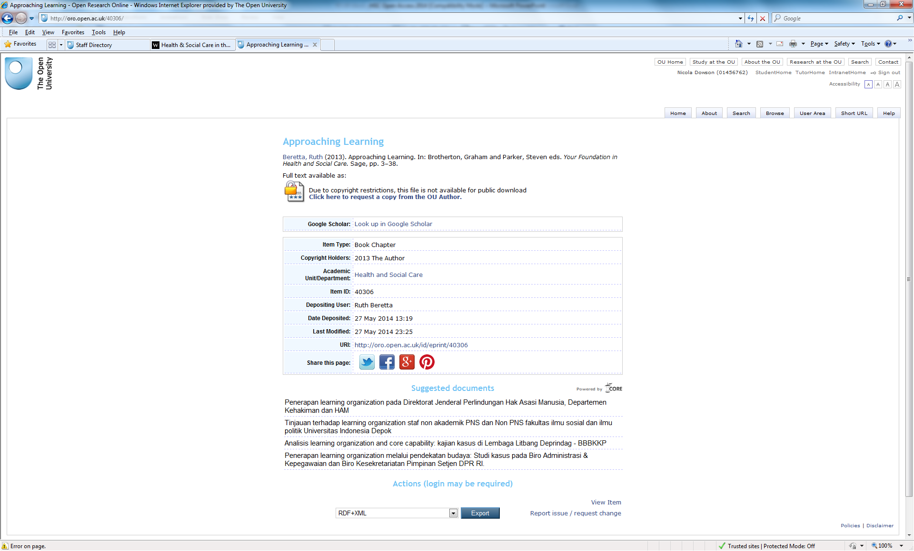

Slide 8
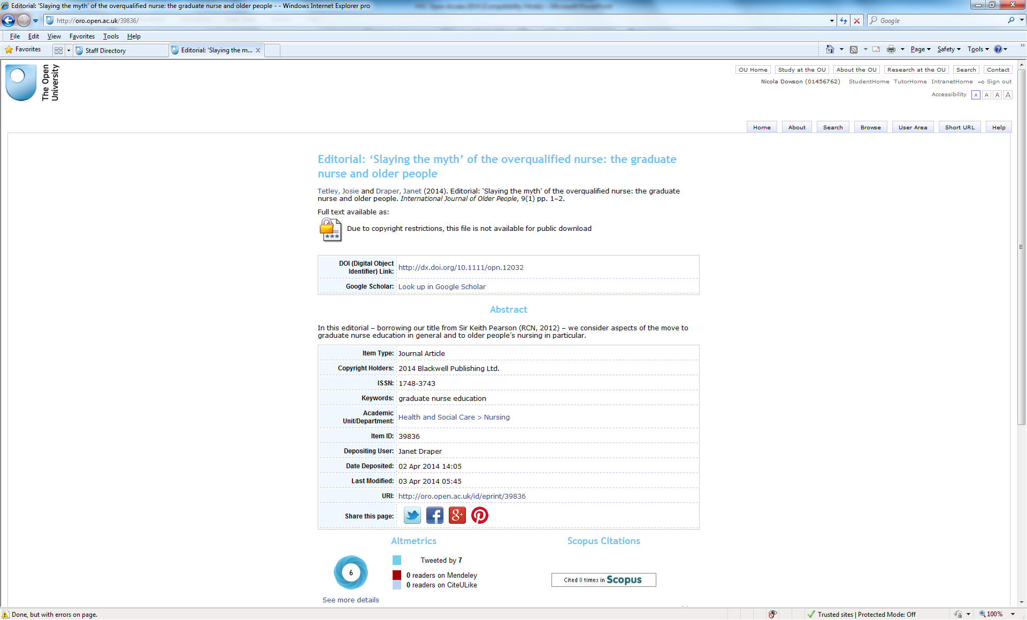

Slide 9
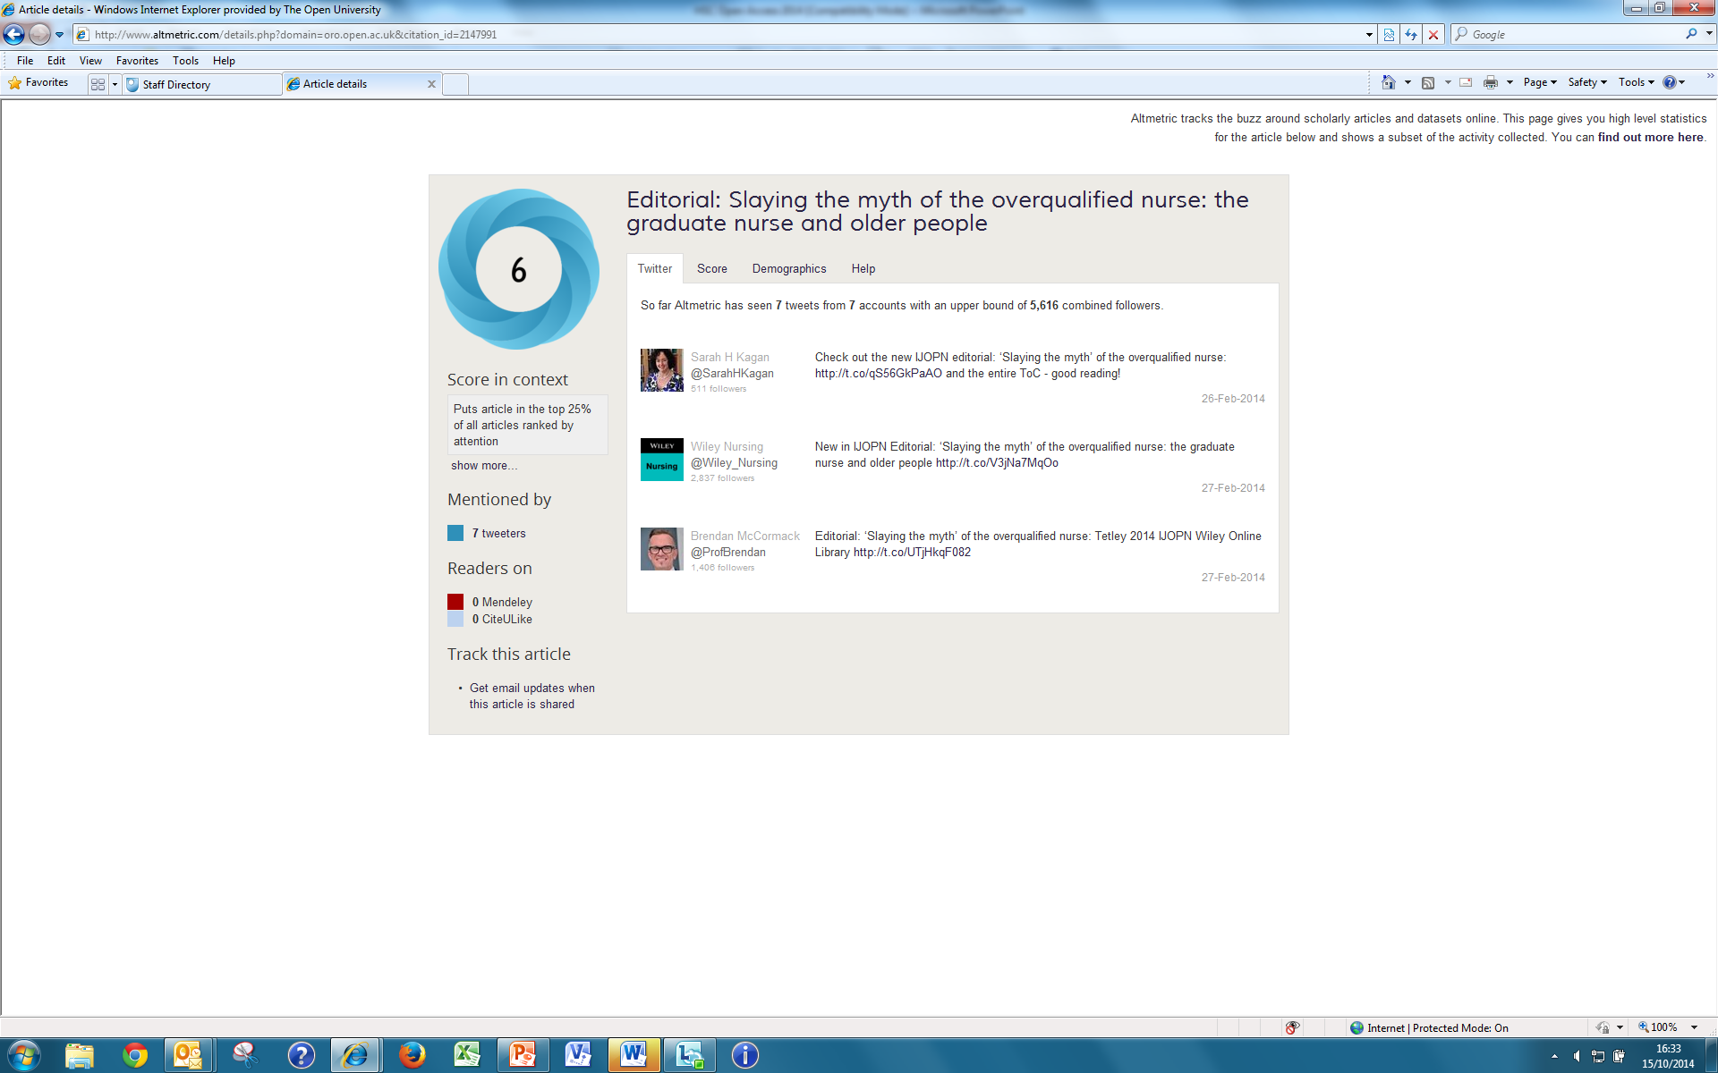

Slide 10
Models of Open Access Publishing
Gold: authors publish in an open access journal that provides immediate access to the full-text. Usually this involves the payment of an Article Processing Charge (APC) by the author or the author’s institution.

Slide 11
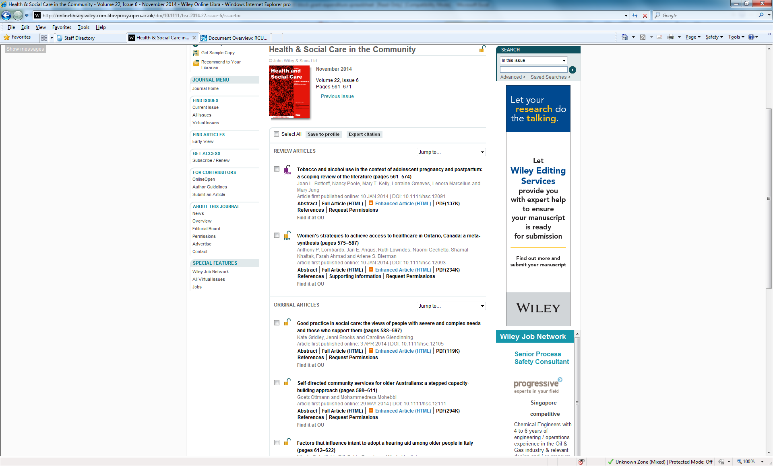

Slide 12
Finding Open Access journals
Begin at http://doaj.org

Slide 13
Example O-A journals via DOAJ
Online Journal of Issues in Nursing
International Journal of Nurse Practitioner Educators
Journal of the Society for Social Work and Research
The Journal of Social Work Values and Ethics
Advances in Social Work
International Journal of Social Pedagogy
Health and Interprofessional Practice
Life Span and Disability
Disability Studies Quarterly
Canadian Journal of Disability Studies

Slide 14
Funder Policies
RCUK – require open access, OU has a block grant to pay Article Processing Charges, administered by Library Services
Check funder policies when writing bids to see if you can write Open Access costs in

Slide 15
Social Media

Slide 16
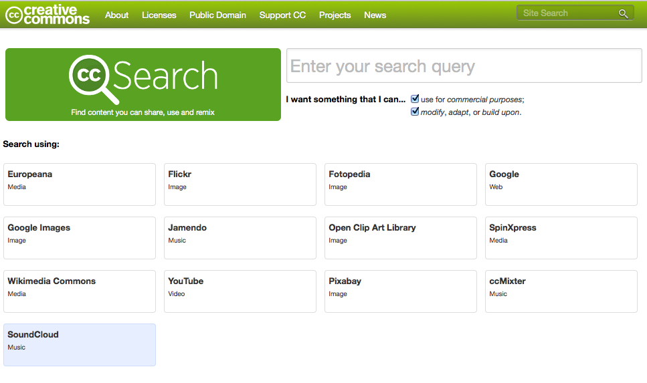
Using OA in teaching
Notes:
Aim to use open-access content in teaching, for example when authoring or re-writing modules. Using open access content is cheaper, quicker, and means that there is a greater likelihood of your work being re-used in OpenLearn, iTunes or MOOCs. To find open-access pictures and videos, start at Creative Commons http://search.creativecommons.org. For open-access literature, begin with the Directory of Open Access Journals (DOAJ) http://doaj.org.

Slide 17
Getting help
Library Services Open Access intranet site http://intranet6.open.ac.uk/library/main/supporting-ou-research/open-access-publishing
Email: library-open-access@open.ac.uk

