Slide 1
Research Data Management
Isabel Chadwick
Research Data Management Librarian
rdm-project@open.ac.uk
Top 10 things you need to know

Slide 2
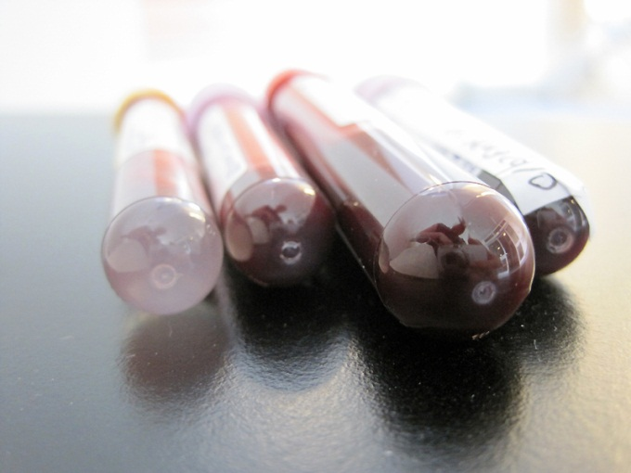
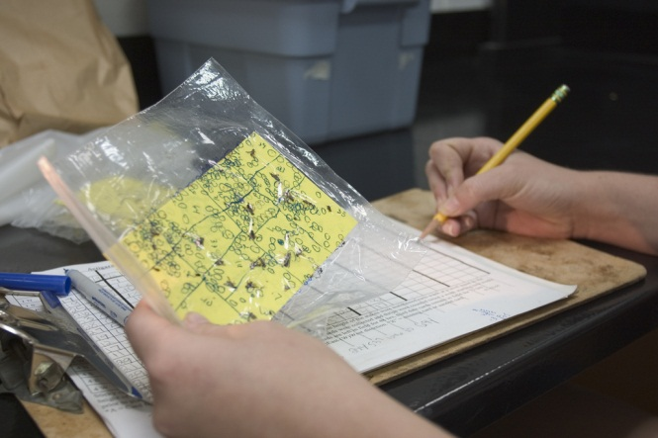
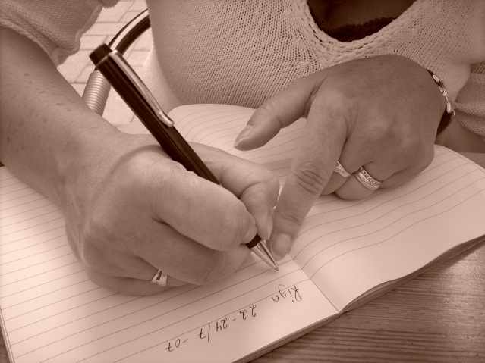
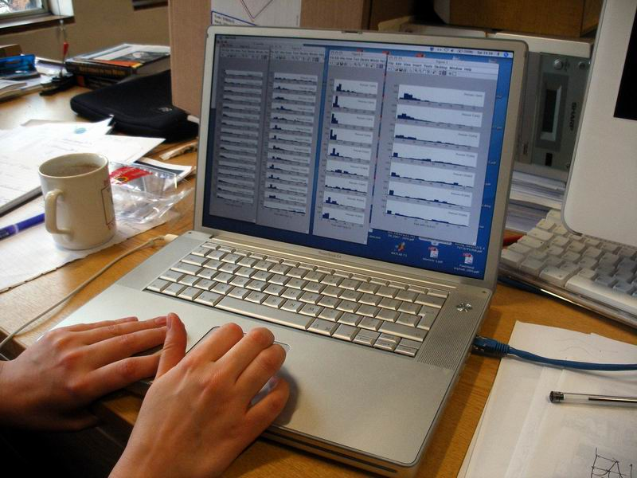
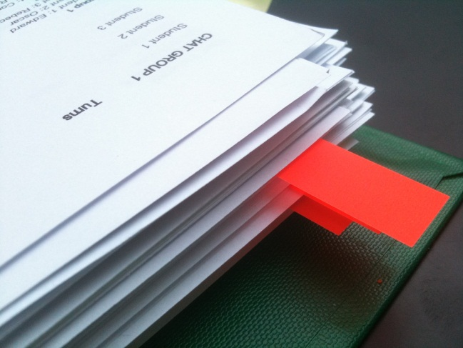
It covers more than you might think
10

Slide 3
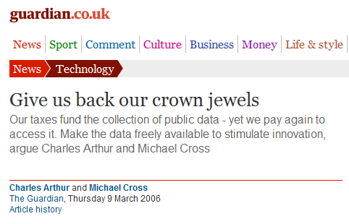
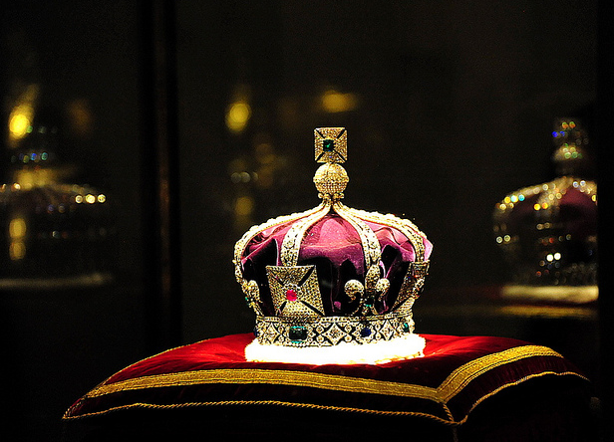
Data has a much higher profile than it used to have
http://www.flickr.com/photos/lifes__too_short__to__drink__cheap__wine/4754234186/
9

Slide 4
The OU has a policy
http://intranet.open.ac.uk/research-school/strategy-info-governance/docs/CoPamendedJuly2013mergedwithappendix-forintranet.pdf
8

Slide 5
Many funders have requirements
7

Slide 6
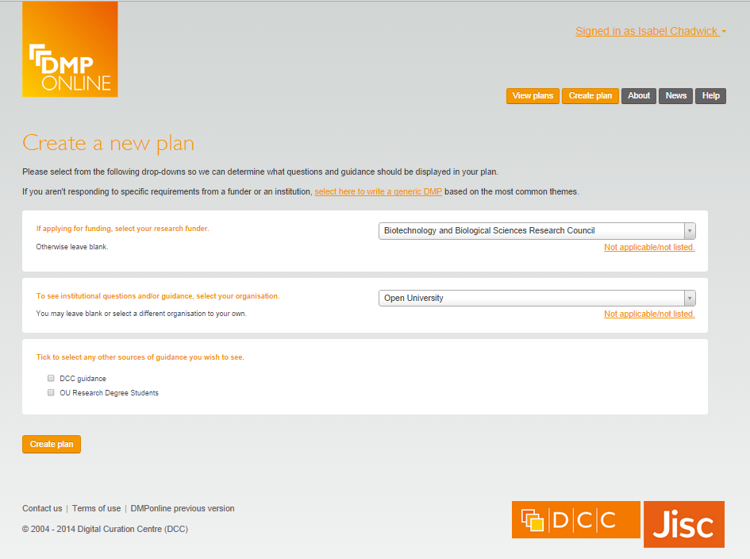
Planning is indispensable
https://dmponline.dcc.ac.uk
6

Slide 7
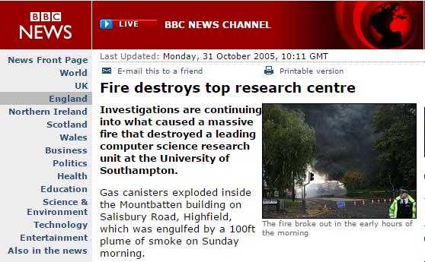
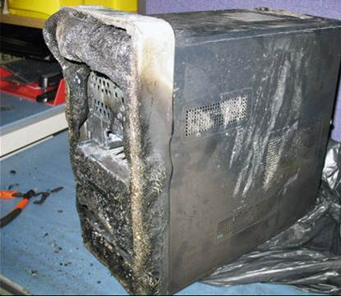
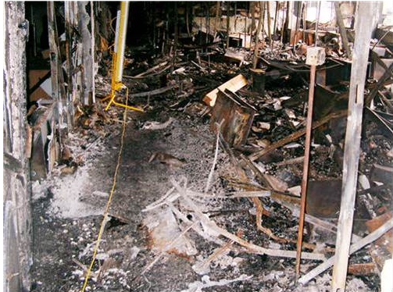
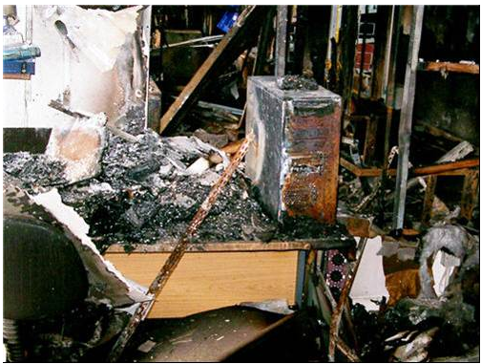
Backing up is easier than replacing
http://news.bbc.co.uk/1/hi/england/hampshire/4390048.stm
5

Slide 8
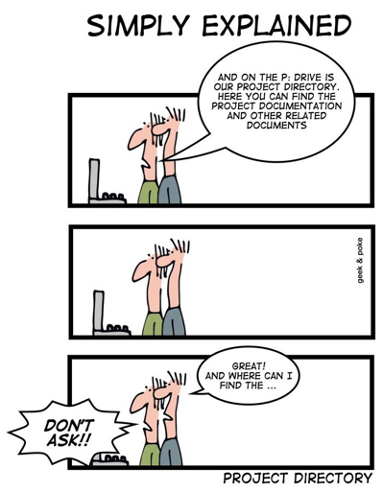
Keeping proper records reduces stress later
http://www.datamation.com/news/tech-comics-nasty-emails-2.html
4

Slide 9
Data sharing is a good career move
www.nytimes.com/2010/08/13/health/research/13alzheimer.html?pagewanted=all&_r=0
3

Slide 10
The OU is building tools to help you
2

Slide 11
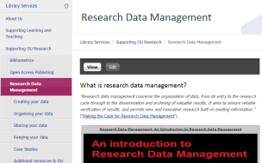
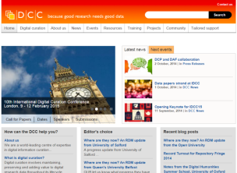
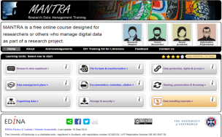
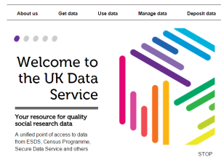
Guidance is available
RDM Intranet site:
http://intranet6.open.ac.uk/library/main/supporting-ou-research/research-data-management
Digital Curation Centre
www.dcc.ac.uk
MANTRA
http://datalib.edina.ac.uk/mantra/
Presentation adapted from University of Oxford’s Top Ten Things Researchers need to know about RDM: http://damaro.oucs.ox.ac.uk/training_materials.xml
UK Data Service
ukdataservice.ac.uk
The Orb
www.open.ac.uk/blogs/the_orb
Send enquiries to: rdm-project@open.ac.uk
1

