Slide 1
My research profile: role of ORO
Shailey Minocha
Faculty of Mathematics, Computing and Technology
22nd October 2015
Notes:
Professional profile
Additional website related to my research identity

Slide 2
‘my’ web-page
Notes:
Academic identity
A page that holds my vital research credentials

Slide 3
my ‘portfolio’ on LinkedIn, in the signature of my emails
Notes:
heading of publications in the signature of my emails…

Slide 4
in networking events, presentations and in papers
Notes:
A simple URL to point to the repository

Slide 5
ORO feed in departmental and faculty web-pages

Slide 6
who is accessing? number of downloads
Notes:
Locked vs open access items

Slide 7
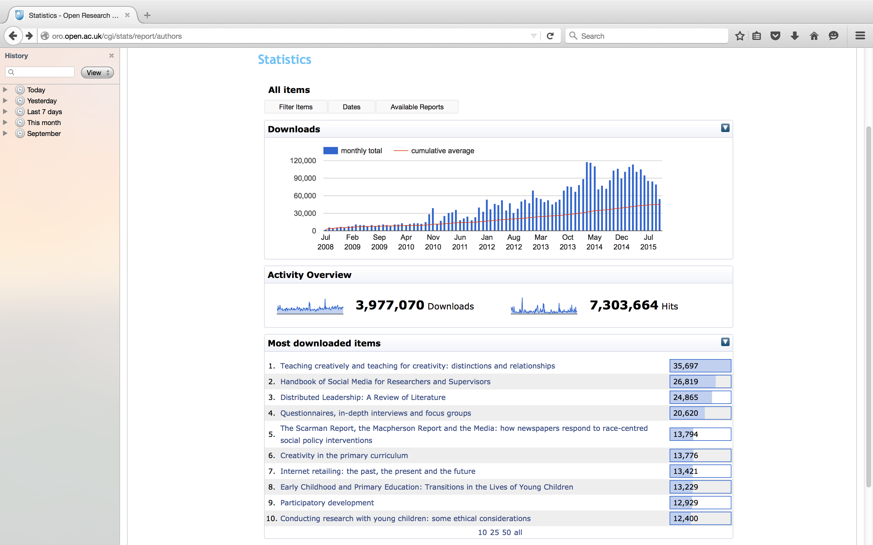
ORO statistics
Notes:
Why are doing well?
What are colleagues looking at?

Slide 8
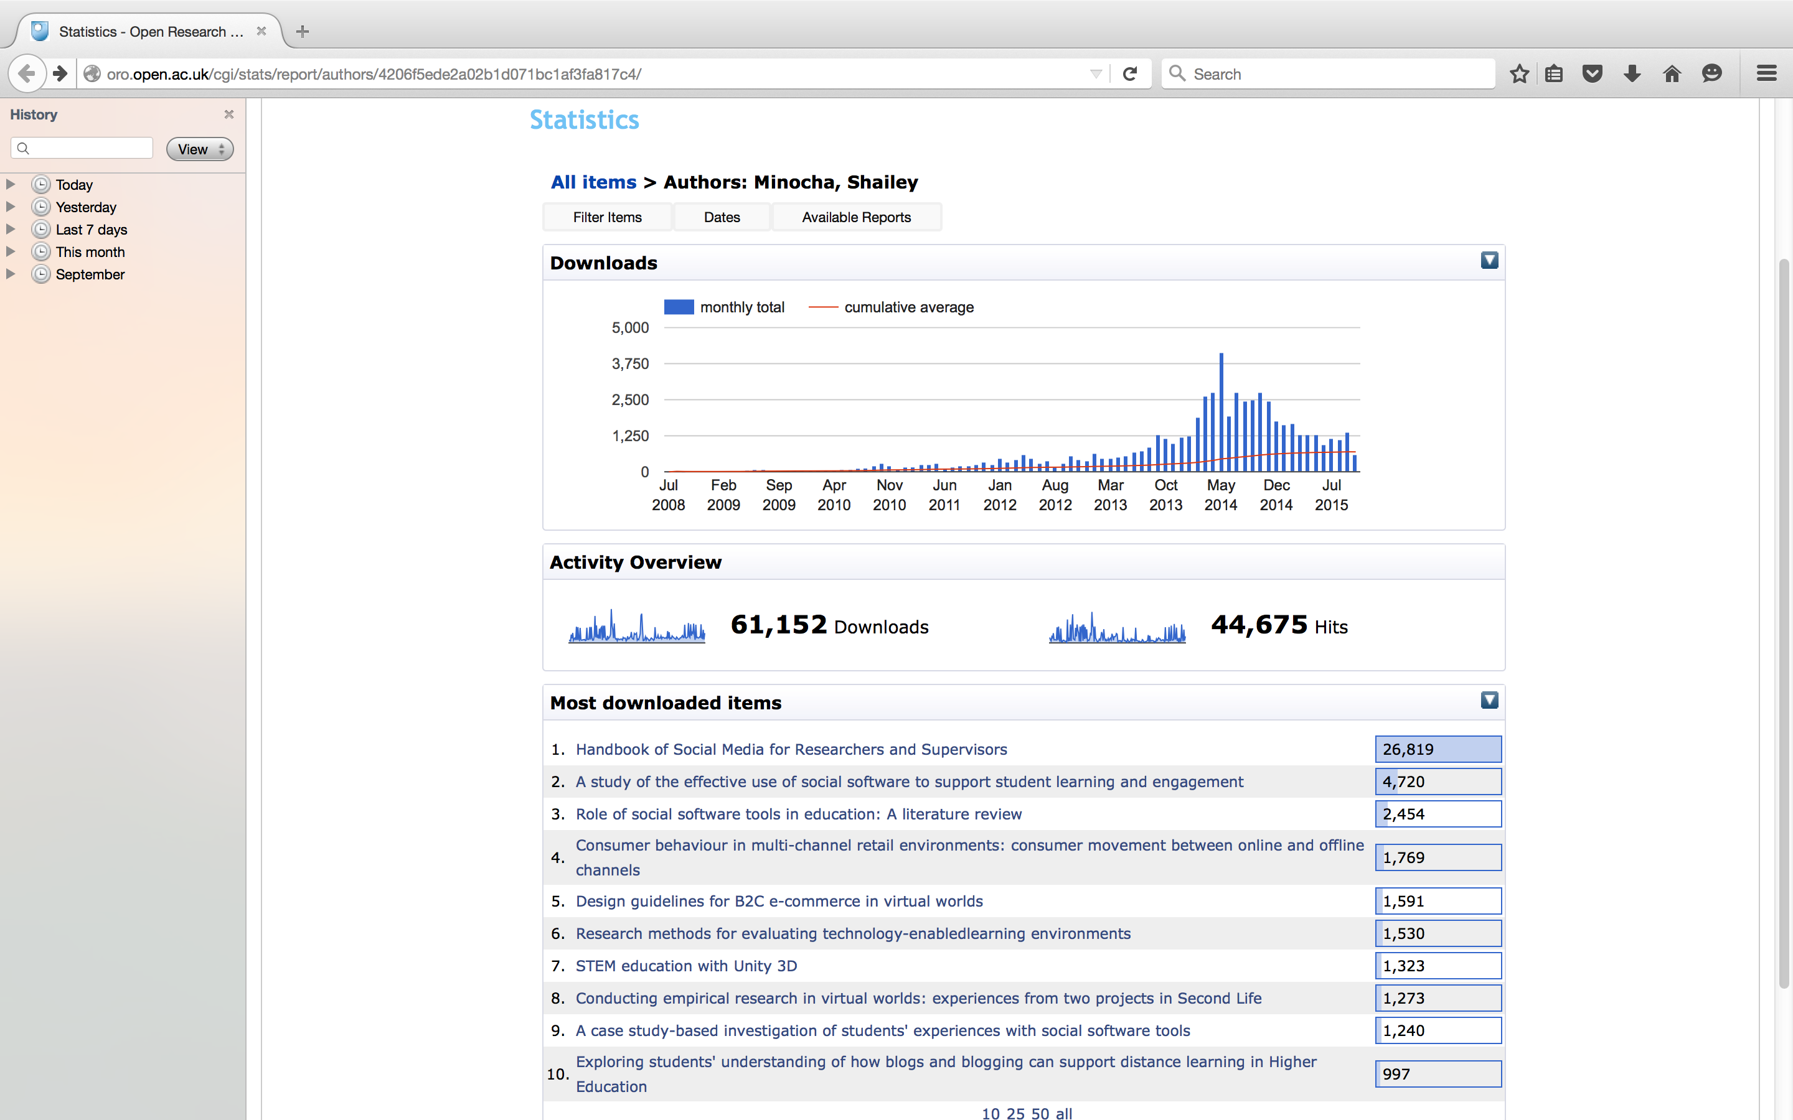
Author statistics
Notes:
What is it about your work that interests people?

Slide 9
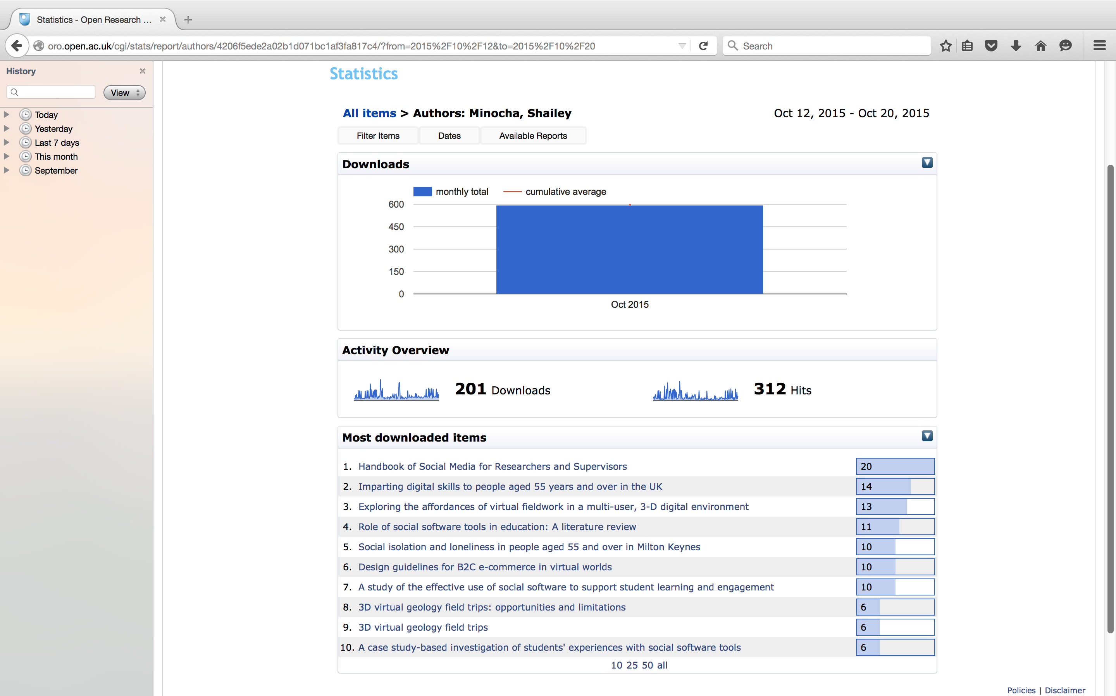
Author statistics over a time-period
Notes:
Latest activity
Perhaps how the publicity may have helped
Should you be advertising it more as it is creating interest
I am unsure how we can use this evidence to plan our publicity efforts

Slide 10
designing an ORO entry e.g. related links, keywords, comments for the Library Staff
Notes:
ORO entry – how thoroughly you design it
I key in all the entries myself
Keywords
Links to other papers
Links to author profiles
Links to websites and other resources on the Web
It becomes a package rather than just an ORO entry

Slide 11
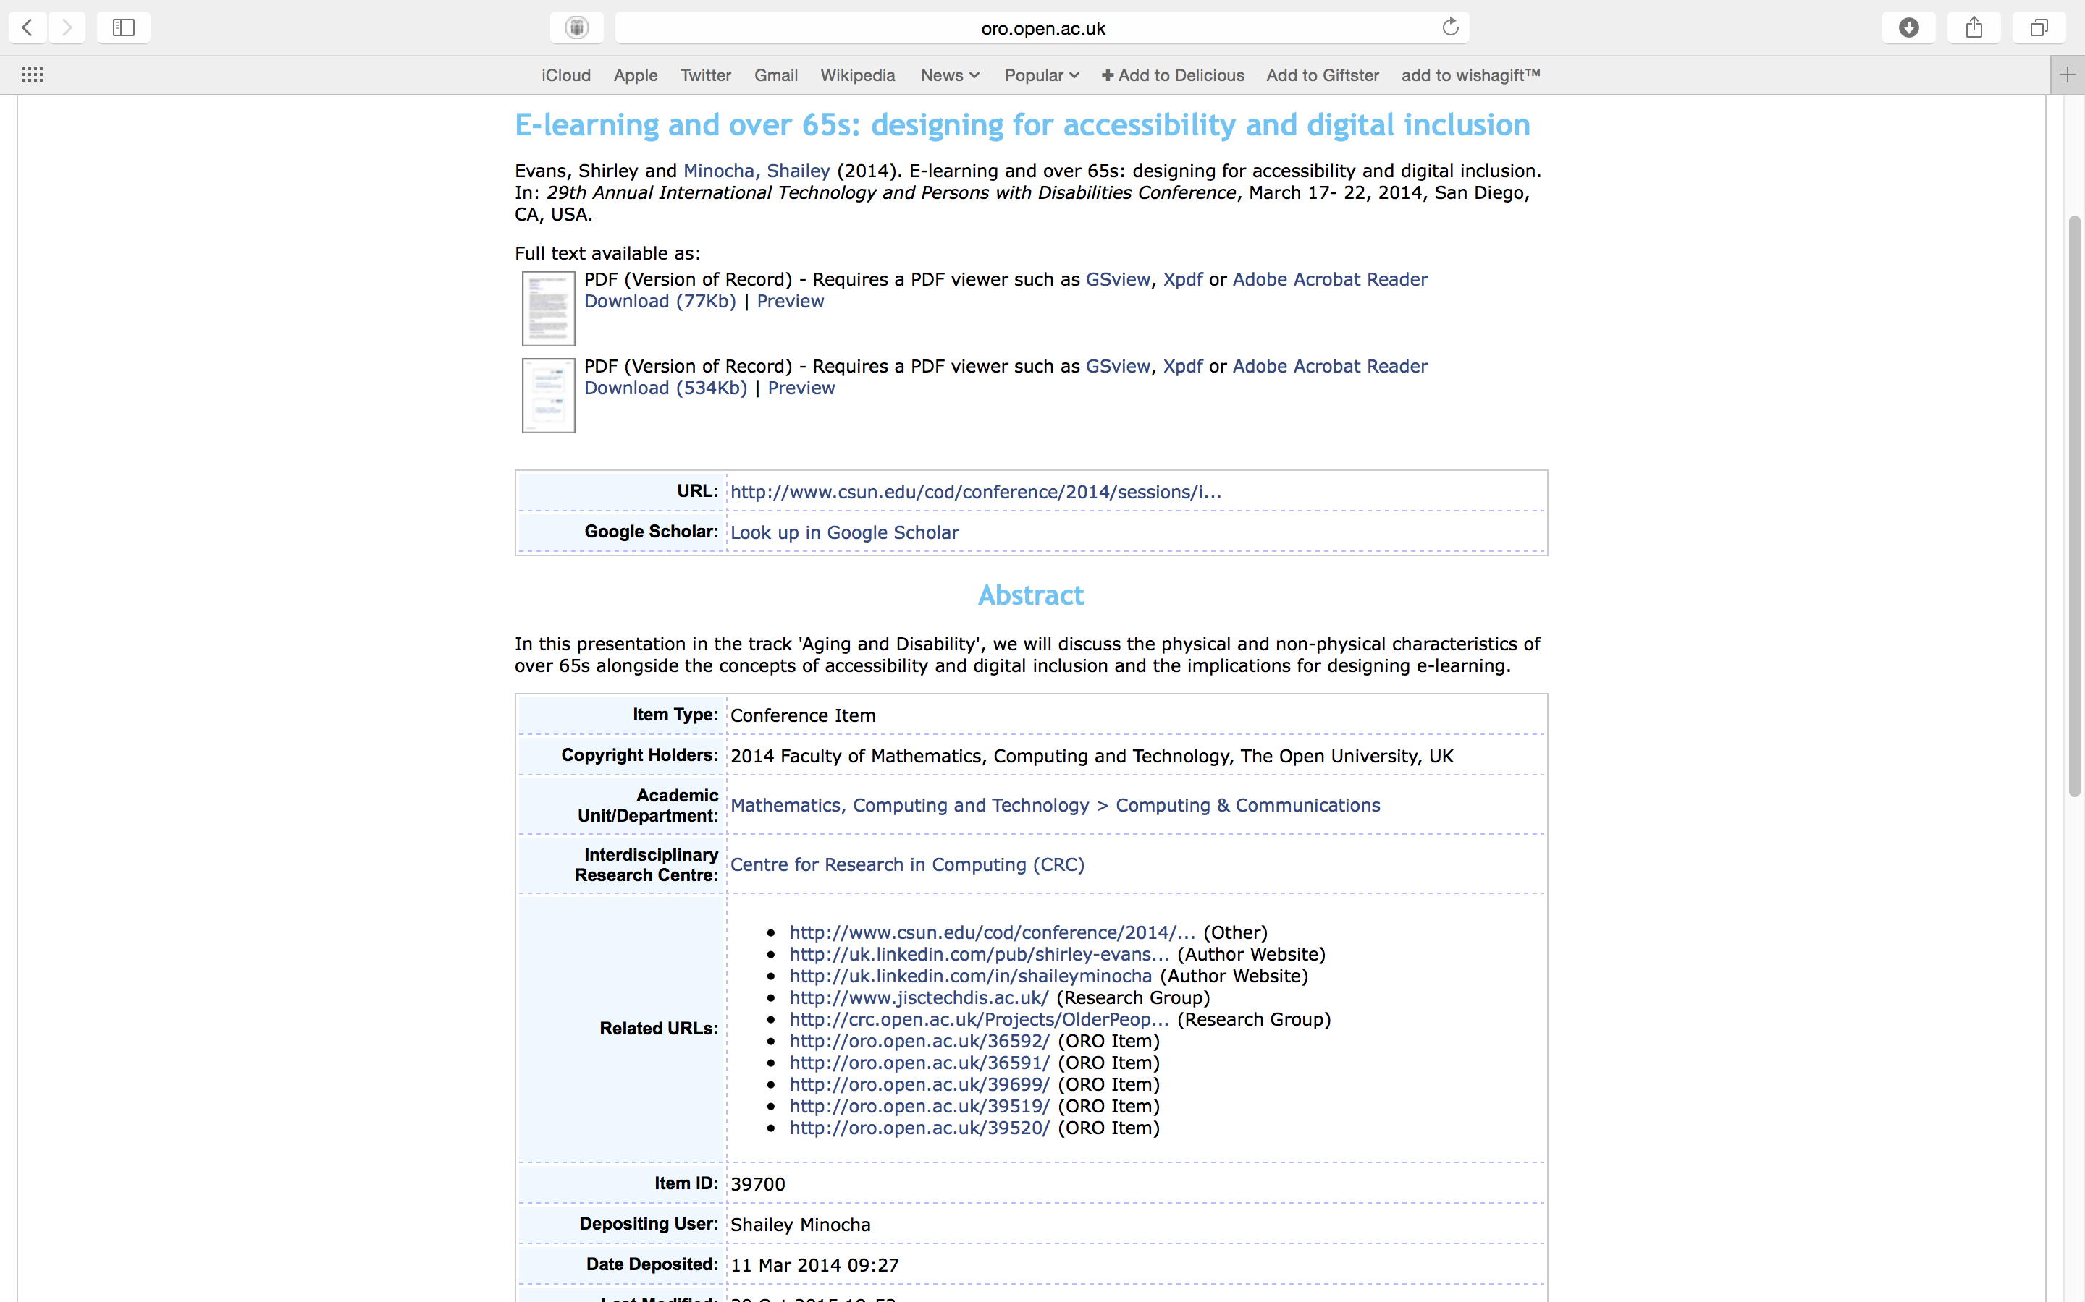
An example of an ORO entry

