Slide 1
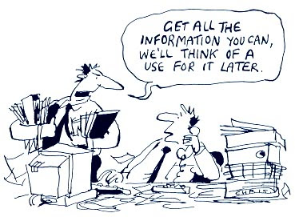
Bridging the research-practice gap in policing
Dr Nicky Miller, Director of Knowledge into Practice (CPRL) Jonathan Cumberbatch, Vice Chair of Staffordshire Police's Evidence Based Practice and Innovation Board Adam Yates, DI Lead Support to Staffordshire Police's Evidence Based Practice and Innovation Board

Slide 2
Why does it matter?
Professionalisation agenda with focus on evidence-based practice as part of the national curriculum for new recruits
EBP is about the creation, sharing and use of the best available evidence to inform and challenge policing policies, practices and decisions (College of Policing, 2014)
32% of social science academic research is never cited
(Remler, 2016)
It takes 17 years for 14% of research to be implemented into practice
(Balas, 2000)
Research
Practice
Research-Practice gap is not unique to policing but covers many professions
(e.g. Bansal et al., 2012; Leach & Tucker, 2016)
Multiple studies report positive attitudes to research in a policing context but the research practice gap cannot be achieved by understanding attitudes alone
(e.g. Telep, 2017; Fleming, 2017; Lumsden & Jackie, 2018; Kalyal, 2019)

Slide 3
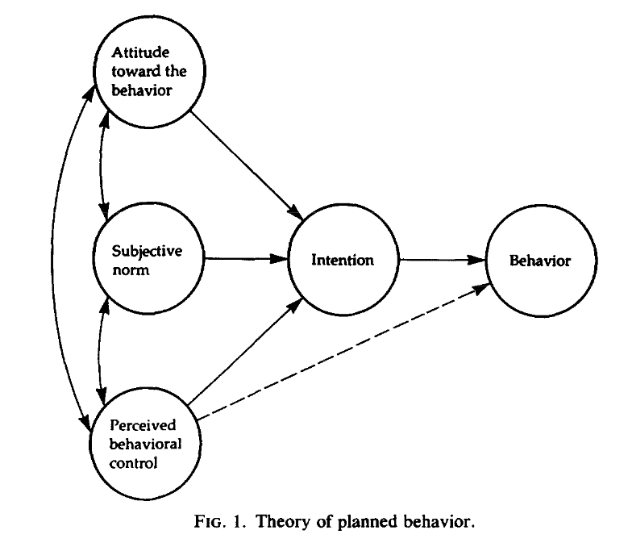
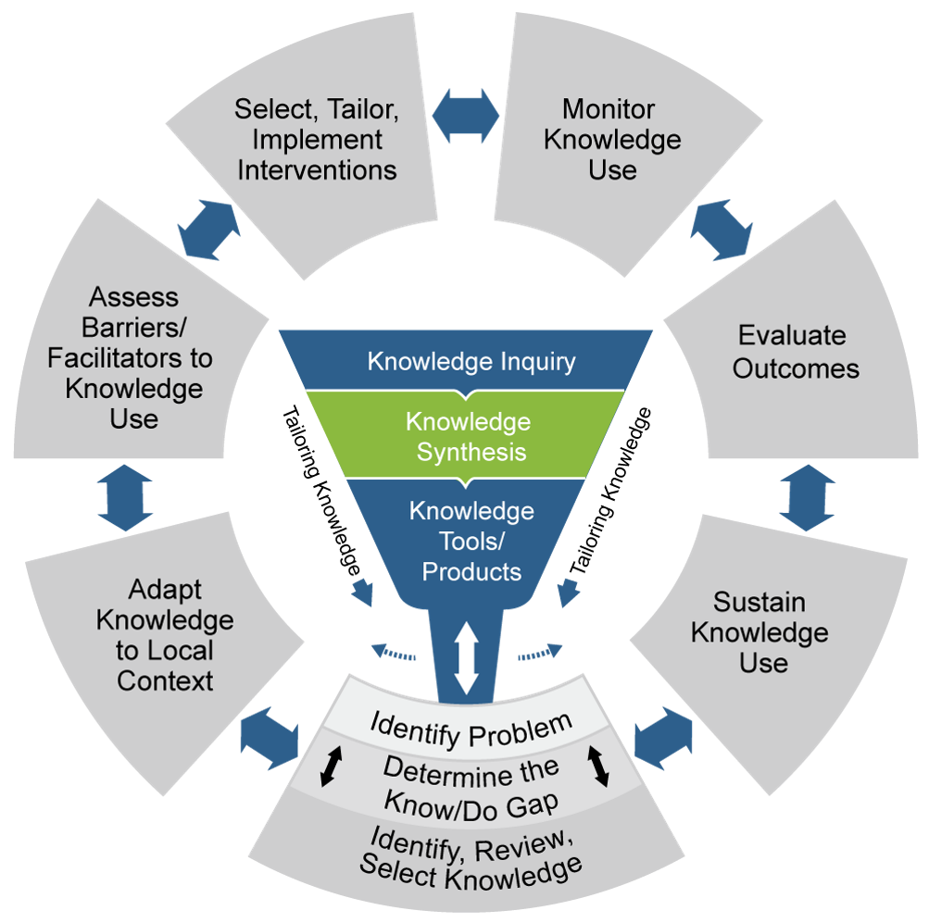
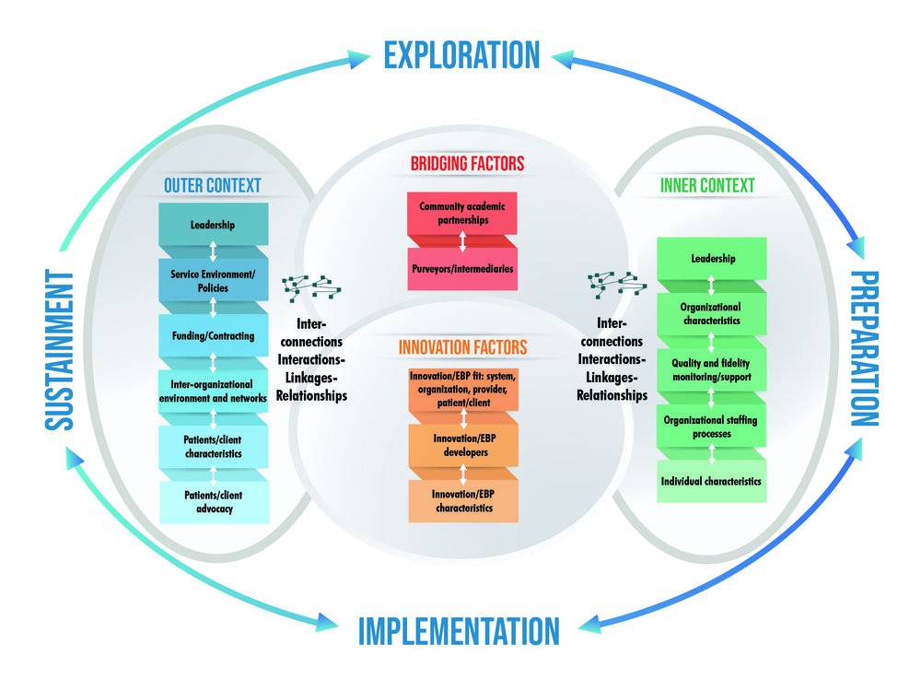
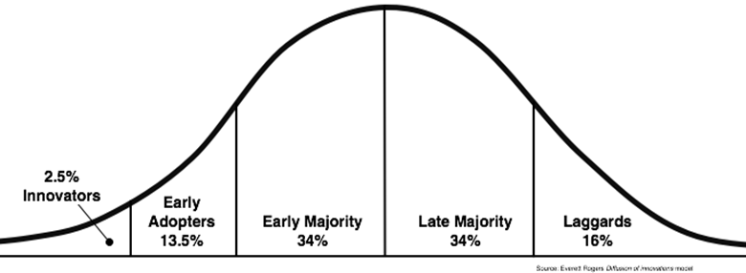
Awash in theories, models and frameworks but still the gap persists…….
The Knowledge to Action framework Graham et al., 2006
Diffusion of Innovation Theory, Rogers 1962
The EPIS Framework Aarons et al, 2011
Strifler et al., 2018 identified 159 knowledge translation theories, models and frameworks to inform Knowledge Mobilisation.
To move evidence-based interventions into practice, several strategies may be required.

Slide 4
Research into Practice and Practice into Research?
Exploring the role & impact of the CPRL in supporting & mobilising the use of research evidence into policing & academic practice
Examining how research evidence is generated, disseminated and used by policing partners
Identifying the individual and organisational factors that support or hinder research use within the CPRL and by policing partners
Assessing effectiveness of the different
knowledge mobilisation interventions used by
the CPRL to promote and support the use of its research into practice
Surveys
Focus groups
Interviews
Mapping Kmob.

Slide 5
Ladder of Research Utilisation
(Landry, 2001a and b)
6 | Application Research gave rise to applications & extensions by practitioners
5 | Influence Research results influenced the choice and decisions of practitioners
4 | Effort Efforts were made to adopt research results by practitioners
3 | Reference Research is cited in reports & strategies by practitioners
2 | Cognition Research reports have been read & understood by relevant practitioners
1 | Transmission Research results transmitted to practitioners
Barriers to research use operate at different levels:
Individual
Organisational
Research Quality
Presentation of Research
Notes:
5

Slide 6
Barriers to Research Use
Individual
Organisational
Research Quality
Research Presentation
Police unaware of research
Police isolated from knowledgeable colleagues with whom to discuss research
There is not a documented need to change practice through research
Police do not feel capable of evaluating the quality of research
Police are unwilling to change or try new ideas
Police see little benefit for themselves in research use
Police do not see the value of research to practice
)
Experience of collaborative research with police
Consideration of useful products to inform ways of working at outset of research process
Insufficient time on the job to implement new ideas
Inadequate resources to support the translation of research into practice
Not enough time to read research
No authority to change practice
Research results are not generalisable to local context
Senior leaders not supportive of implementation of research to practice
Supervisors will not cooperate with implementation of research to practice
)
Experience of collaborative research with police
Consideration of useful products to inform ways of working at outset of research process
Research reports are not published fast enough Research is not replicated
Research reports contain conflicting results
Research has methodological inadequacies
Conclusions drawn from research are not justified
It is hard to believe the results from research
)
Experience of collaborative research with police
Consideration of useful products to inform ways of working at outset of research process
Research is not readily available
Research is not reported clearly
Relevant literature is not compiled in one place
Statistical analyses are not understandable
Findings from research are not relevant to practice
)
Experience of collaborative research with police
of research process
67%
51%
52%
68%
69%
65.5%
61%
48%
58%
51%
Adapted from the Barriers Survey, Funk et al, 1991

Slide 7
Thematic analysis of barriers
“We’re constantly chasing the curve so in reality most people probably are too busy trying to get the job done to engage in any research. We’re too busy reacting to do any planning”
Barriers
Lack of resources
Accessibility
Police Culture
Senior Leadership
Credibility of research evidence
Research into Practice
Capability
“The professional expertise and the credibility of being a practitioner based in a force always seems to take precedent over academic research which is the problem that a lot of us have in trying to embed research into practice"
“Police officers often aren’t aware of the research being conducted” and “academic research and language is often not compatible with policing vernacular”
“senior leaders need to be held to account for not supporting or understanding research”
“an inability to adapt or alter current culture” & “suspicion of those conducting research… it is research for research’s sake, research for promotion”
“I don’t think that they have the confidence to recognise good research and/or challenge bad research”
“we do really good research…..but the way it falls down is the investment in the implementation or people coming out and really explaining how these things are supposed to be implemented“

Slide 8
Police Practice should be informed by:
6%
52%
31%
11%
90:10 split in favour of professional experience
50:50 split between research and professional experience
25:75 split in favour of professional experience
75:25 split in favour of research
Based on Responses to Police Survey

Slide 9
Receptivity to research?

Personal attitudes
Research is important to policing
I would change my ways based upon research
Research helps to build a scientific base for policing
Organisational
Subjective norms
My peers dismiss research
I’m not encouraged to use research in my decision making
Behavioural Intention
I will use research to inform my next problem solving plan
Behaviour
I use research to inform my tactics

Individual
Individual
Perceived behavioural control
I would use research if I had to evidence it in my PDR

Theory of Planned Behaviour, Ajzen 1991

Slide 10
Intervention Mechanisms
Awareness - building awareness and positive attitudes towards research evidence use
Interaction - Facilitating interactions between decision-makers and researchers
Skills - developing the skills to access and make sense of research evidence
Structure & processes - influencing decision-making structures and processes
Agreement - building mutual understanding and agreement on police relevant questions
Access & Communication - Providing communication of and access to research evidence
Langer et al., 2016

Slide 11
Interactive Workshop Exercise
There are a series of flip charts spread around the room, each of which relates to each of the six intervention categories to help embed research into policing practice and decision-making
Using your sticky notes, please jot down 1 idea or example per sticky note of what could be done in force against each of these. Place your ideas on the relevant flip chart
Discuss and share ideas
Using the coloured dots please indicate which of these you think might be the most realistically achieved AND have the most impact

Slide 12
Case Study: Staffordshire Police

Slide 13
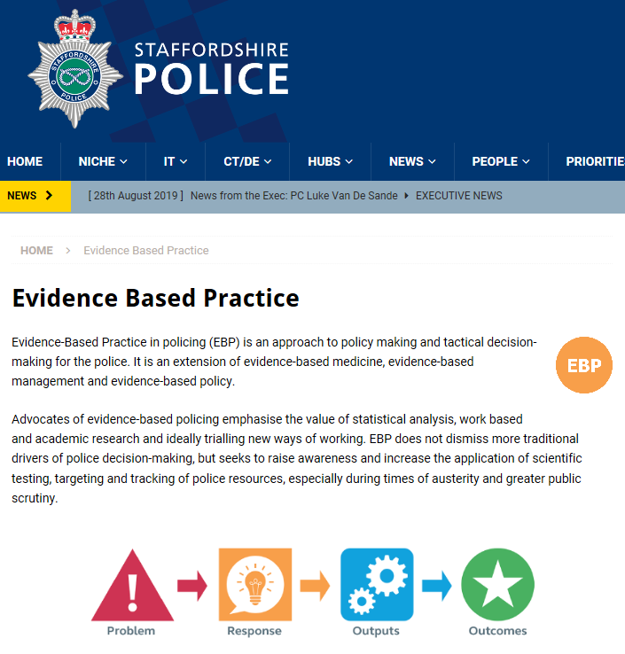
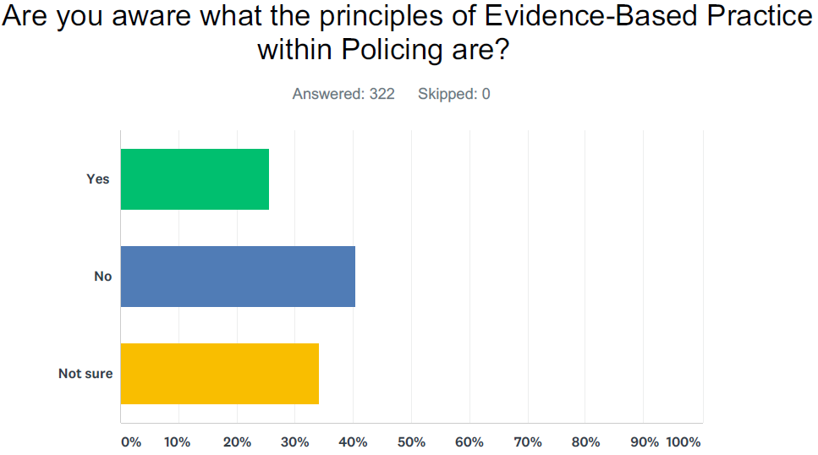
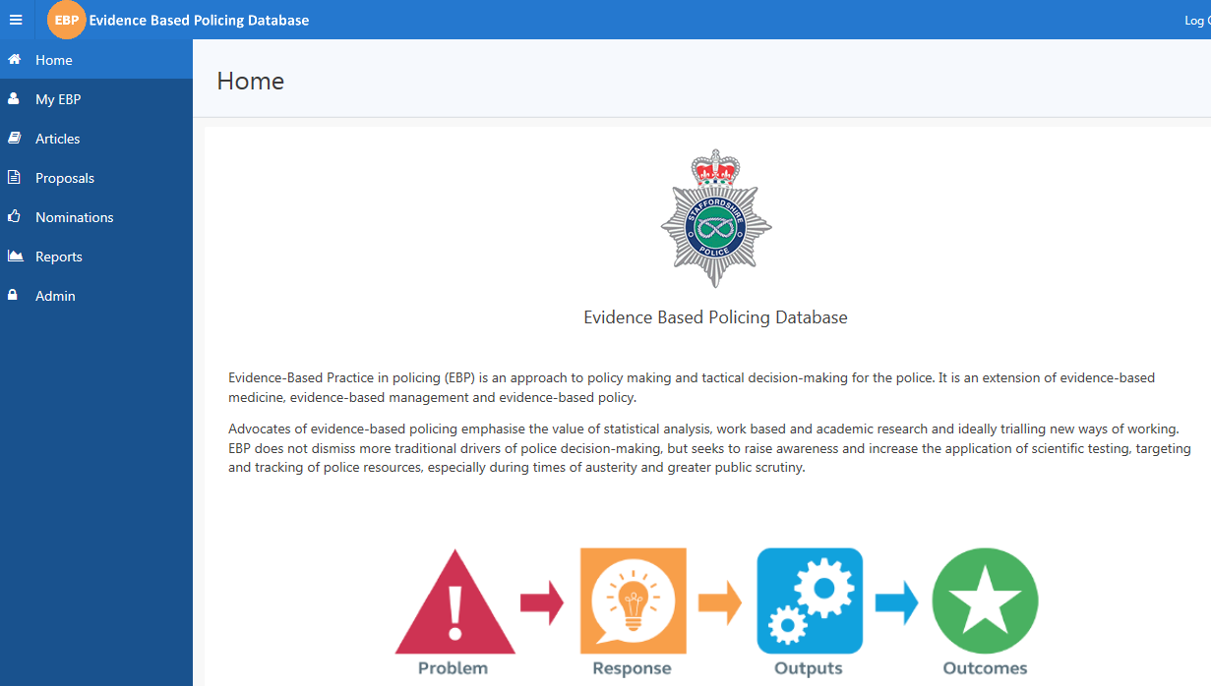
Staffordshire
Evidence Based Practice
and Innovation
2019 – 2023
Traction - EBP into Policing
Vs
Functional Delivery
ToR
Benchmarking
Academic Partners
Email & Twitter
Internal Comms

Slide 14
EBP – 4 Year - Journey
Board Launch
CPD – Moderate Interest
EBP Set-Up
Rotating Door of Chairs
Diminishing Board Attendance
PEQF
Research
Recruitment
IA
ISA
Internal
Bursary
OU - CPRL
EBP into Policing Review
Budget
External
Bursary
Science & Technology in Policing
Recruitment
of Interested
People
Academic
Partnerships
Chair –
Continuity
2019
2023

Slide 15
OPERATIONALISING EBP – ACTION PLAN
Work Shops – attending – EBP Chair, L&D, Organisational Learning, CoP, Interested Parties, OU CPRL
Awareness – building awareness and attitudes
Agree - building mutual understand and agreement. Breadth and depth of research priorities for Staffordshire
Access & Communication
Interaction
Skills
Structure and Process

Slide 16
Research into practice interventions
Mechanisms
Awareness
Named EBP leads who promote research evidence through alerts, portals and emails
01
02
03
04
05
06
07
01
EBP and research evidence not a priority for many forces
Interaction
Structure & Process
Access & Communication
Use Evidence Champions, PCDA students, internal sponsors, senior leadership to actively promote research and encourage its use.
Host force research exhibitions showing impact; workshop demonstrations
Consider researchers in residence
Awareness
Agree
Skills
Placeholder
Awareness

Slide 17
Awareness - building awareness and positive attitudes towards research evidence use
“The purpose of the Thames Valley Police Journal is to ensure the diverse range of academic work undertaken within the organisation is captured and shared to inform the evidence based development of policy and practice.”
Notes:
This is not an academic journal, but a practitioners journal with articles written by a range of officers with varying levels of academic experience, and it is all the better for that. Evidence based policing is not a purely intellectual exercise; it is a way of thinking which asks those in all ranks and roles to consider: What do we know about what works? How can I apply that to my day to day work for the benefit of the public? Where are there opportunities for me to help better understand what works and to share that with others? No single piece of research can hold the solution to what are often complex problems, but by sharing our work we hope to make our contribution to the growing body of knowledge which informs police practice now and in the future
The purpose of this journal is, at least, three fold. 1. Those engaged in academic research in the Thames Valley to be able to share that work with colleagues across the force and further beyond. The sharing and debating of ideas is the fuel which allows the research base to grow. 2. To encourage people to bring those thoughts together more formally and share them – so the journal provides space for literature reviews and discussion pieces to allow ideas to be explored and developed more fully. 3. To encourage an evidence based approach throughout the organisation, and the sharing of those thoughts and experiences. There is therefore part of the journal dedicated to sharing the experience applying an evidence based approach to operational policing

Slide 18
Research into practice interventions
Mechanisms
Agree
Partnerships between forces & academia
EBP Boards with academic reps
01
02
03
04
05
06
07
01
Reactive to research requests, usually driven by academics
Force research portfolios very broad
Cooperating rather than collaborating
Interaction
Structure & Process
Access & Communication
Awareness
Agree
Skills
Placeholder
Awareness
Explore ways to narrow down force research portfolio to enable key knowledge gaps to be filled AND to operationalize research
Proactive horizon scanning to inform research portfolio
Collaborate with researchers

Slide 19
Research into practice interventions
Access & Communication
Mechanisms
Targeted emails (segmentation)
Research repositories
Use of available national resources
EBP Champions
Range of products from research – briefing papers; posters; infographics
01
02
03
04
05
06
07
01
Inconsistent / ad hoc communications
Provide opportunities but no tracking of engagement and impact
Interaction
Structure & Process
Access & Communication
Awareness
Agree
Skills
Placeholder
Awareness
Develop mix of online, hybrid and F2F events that include regular, frequent and bite sized sessions
Work with researchers to develop actionable messages from research
Consider a suite of ‘pull’ interventions

Slide 20
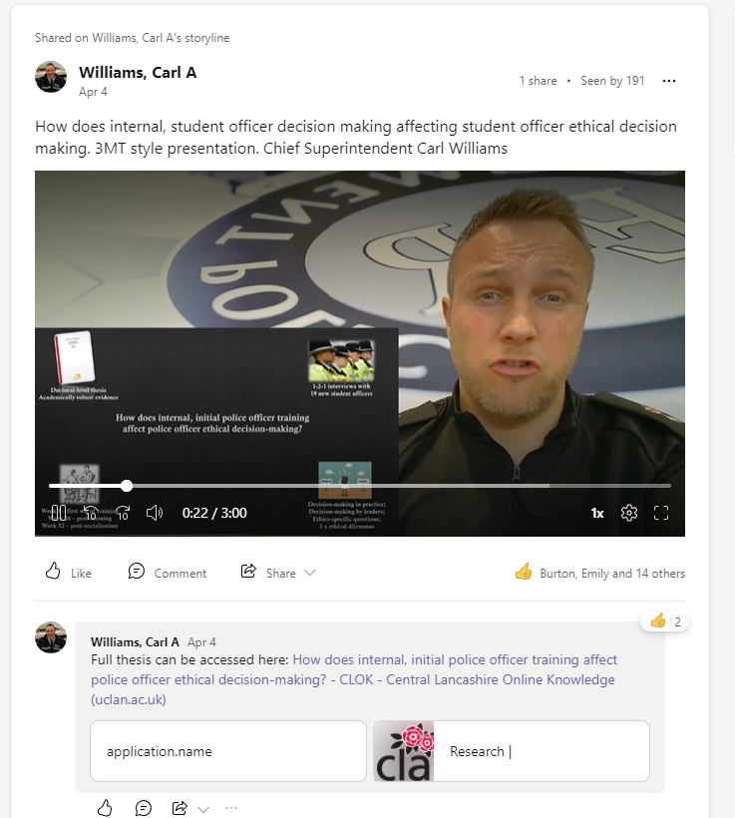
Access and Communication - Providing communication of and access to research evidence
Gwent Police – production of 3-minute film clips
available force wide to all staff for those that do well
in their undergraduate dissertations and/or
for those that conduct any post-entry academic
qualification with the force.
Thanks to Carl Williams

Slide 21
Research into practice interventions
Mechanisms
Interaction
Work with academia to produce research
Opportunities for interaction through SEBP, Knowledge Hub, CPRL etc.
01
Internal links with L&D and POP teams (although inconsistent)
Attendance at networking events (online and F2F) but limited follow up
01
02
03
04
05
06
07
Interaction
Structure & Process
Awareness
Access & Communication
Engage student officers & explore use of masters’ students
Standing MOUs & data sharing
Resident researchers & practitioner fellows
Consider level/type of Force representation at partnership meetings
Work across force departments
Agree
Skills
Placeholder
Awareness

Slide 22
Research into practice interventions
Mechanisms
Skills
Research skills built into PCDA and demonstrated through Year 3 project
Opportunities for senior level staff to develop research skills
01
01
02
03
04
05
06
07
Lack of opportunities for development of research skills of other officers & staff
Interaction
Structure & Process
Awareness
Access & Communication
Agree
Skills
Placeholder
Work with academic partners to develop research skills programme
Lunch & Learn sessions
Awareness

Slide 23
Research into practice interventions
Structures & process
Mechanisms
EBP/Research Governance Boards
Structures in place to co-ordinate and track research projects
Senior leadership support (but varies)
Lack of structures and process to monitor use & impact of research
01
02
03
04
05
06
07
01
Interaction
Structure & Process
Balance involvement against implementation
Ensure processes & resources in place to translate & operationalise research
Allocate an internal sponsor to combat ‘Board ping pong’
Senior leaders to demonstrate behavioural norms
Realise the impact of research
Access & Communication
Awareness
Agree
Skills
Placeholder
Awareness

Slide 24
Any Questions?
Nicky.Miller@open.ac.uk
Jonathan.cumberbatch@staffordshire.police.uk
Adam.yates@staffordshire.police.uk

