Slide 1
EMPLOYABILITY CONFERENCE 2022
Employability: expanding the narrative for a rapidly changing world – continuing the conversation
Reimagining Success in HE: Taking a ‘Long Win’ Approach
Dr Cath Bishop

Slide 2
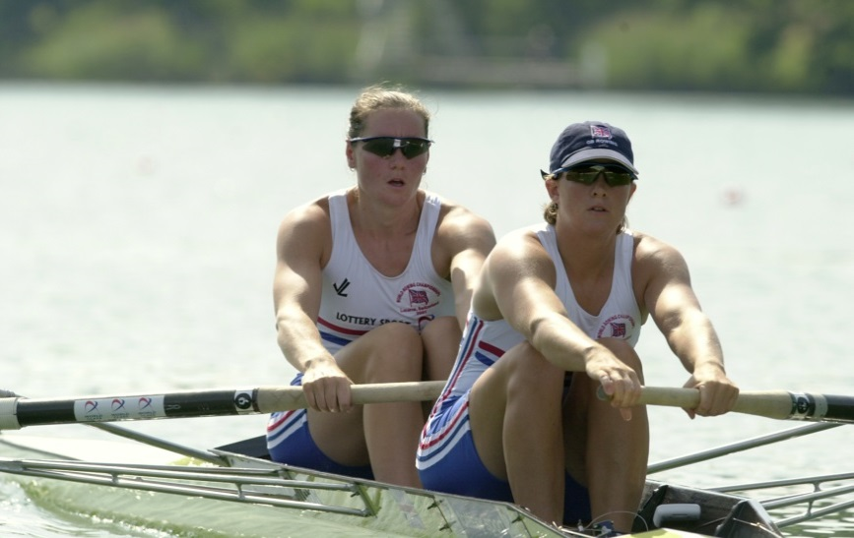
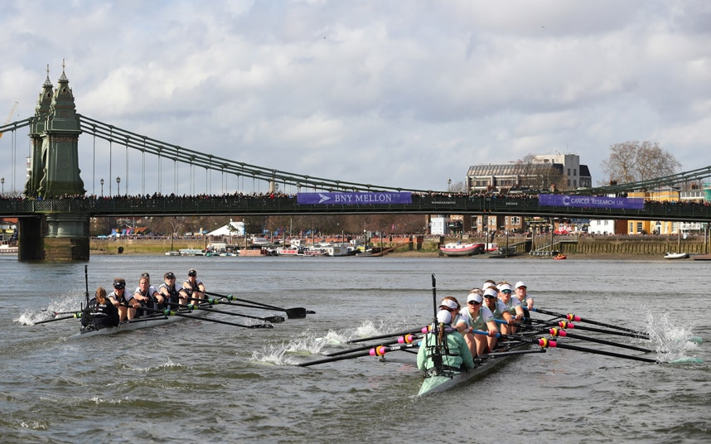
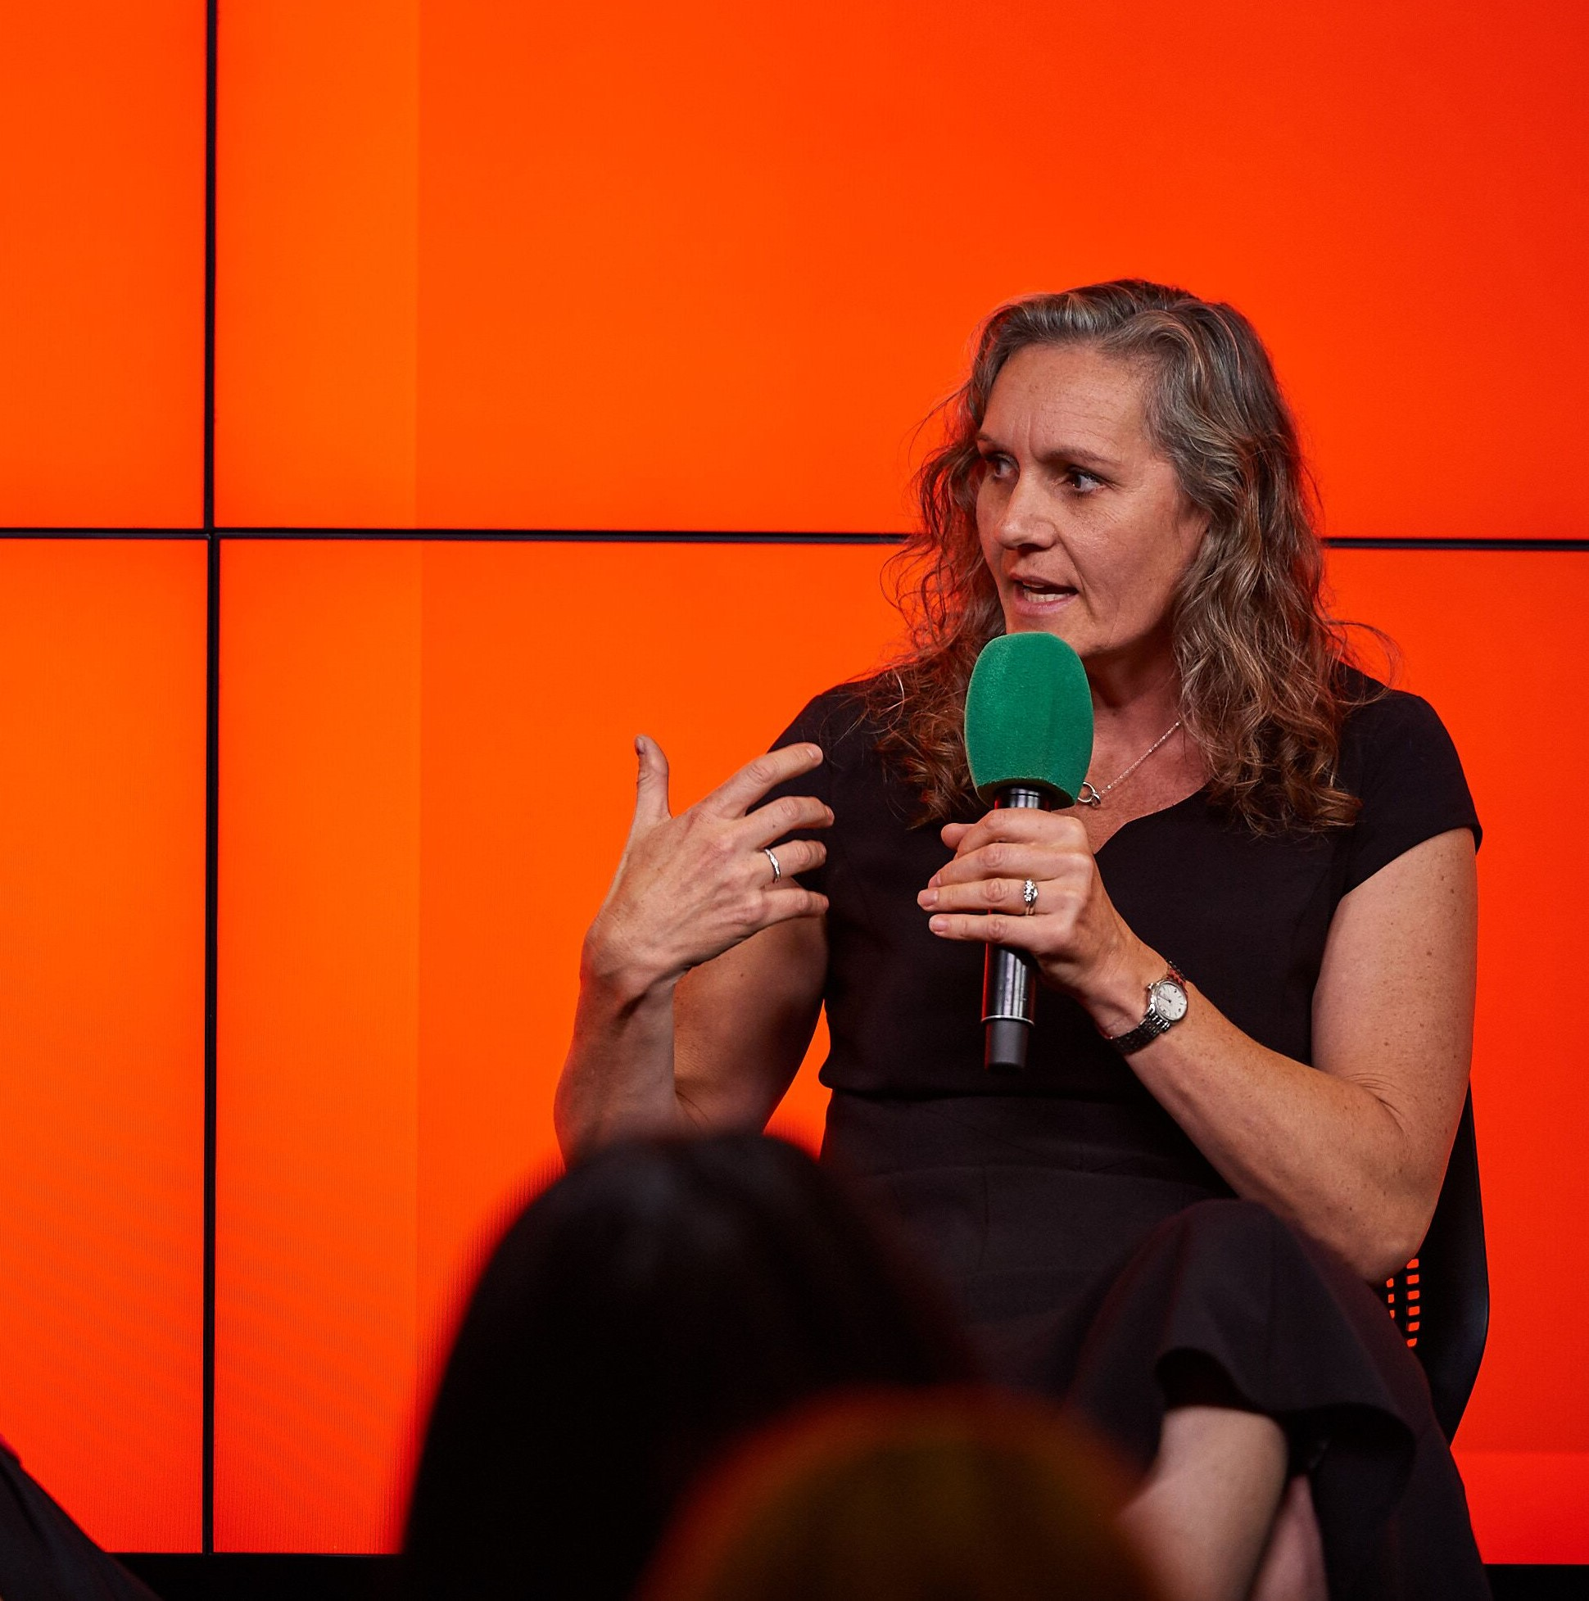
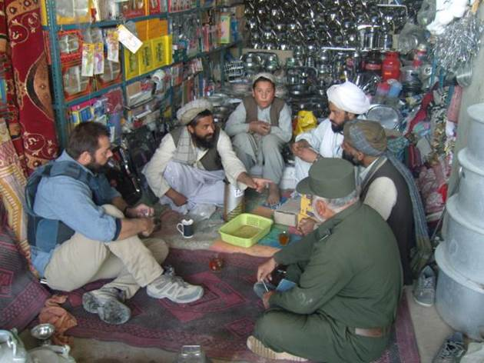
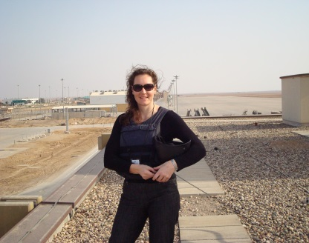
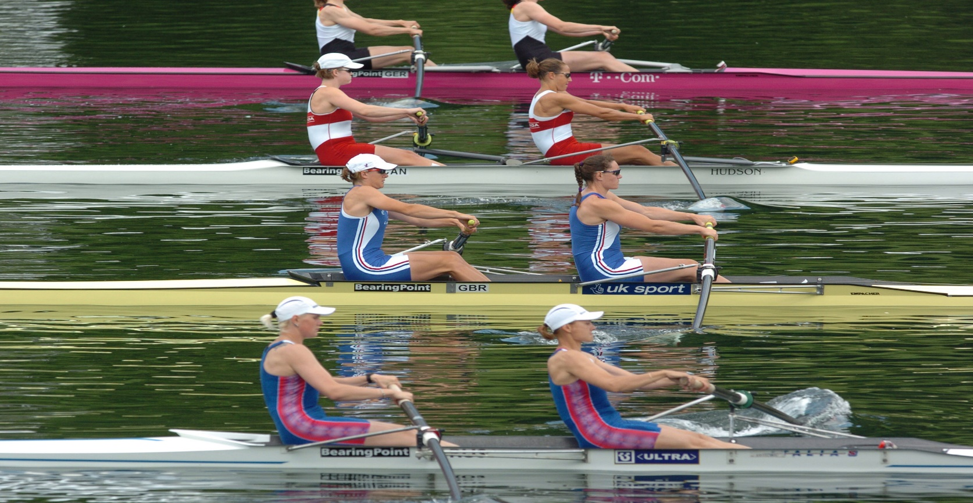
Reimagining Success in HE: Taking a ‘Long Win’ Approach
Dr Cath Bishop @thecathbishop

Slide 3
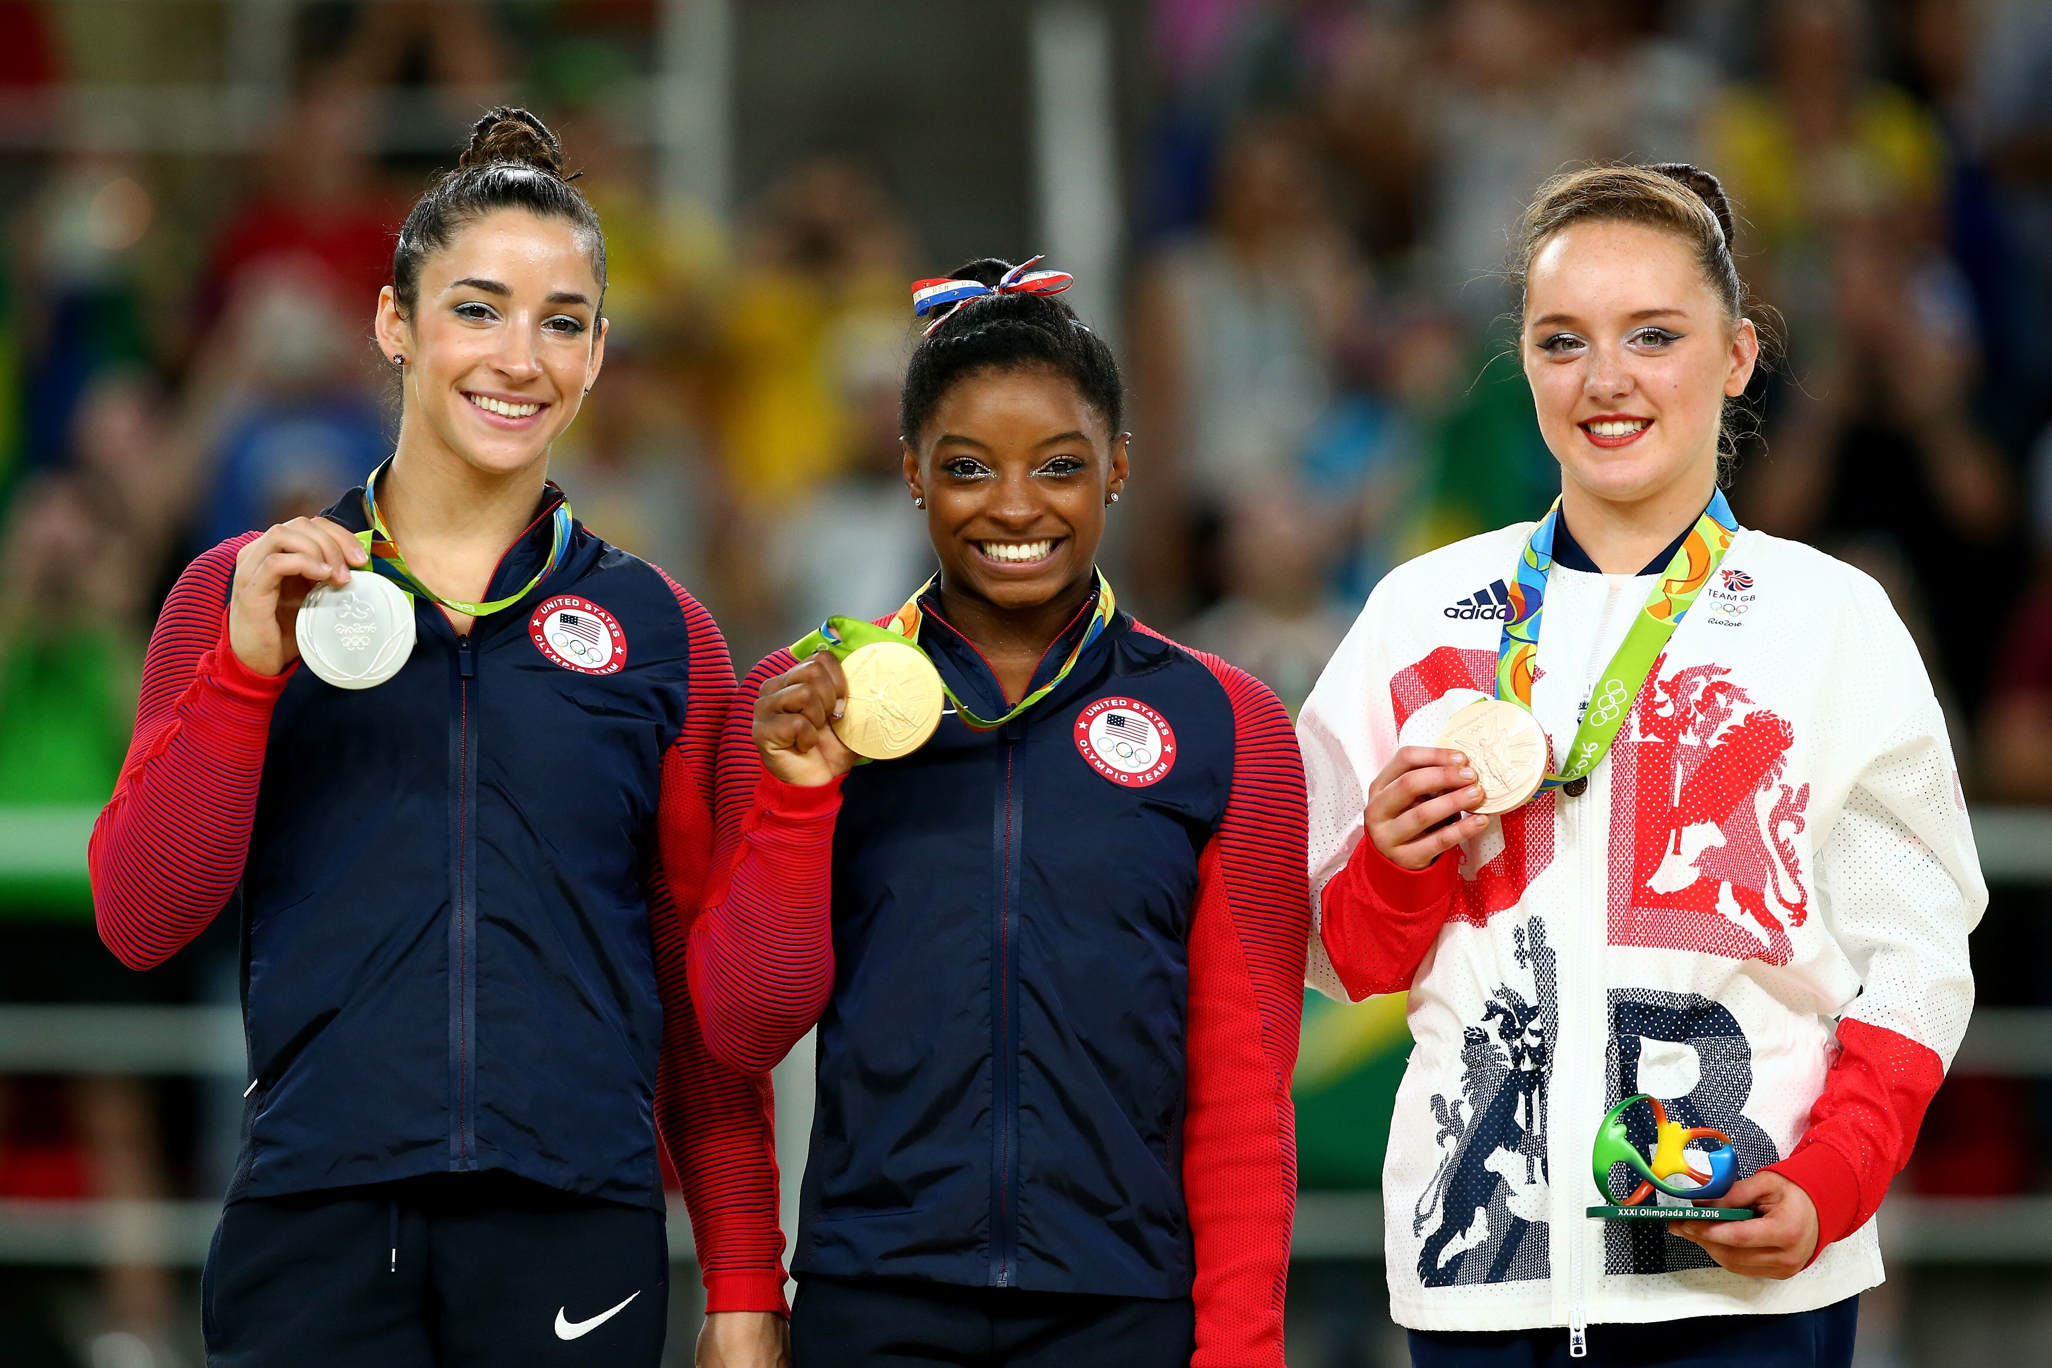
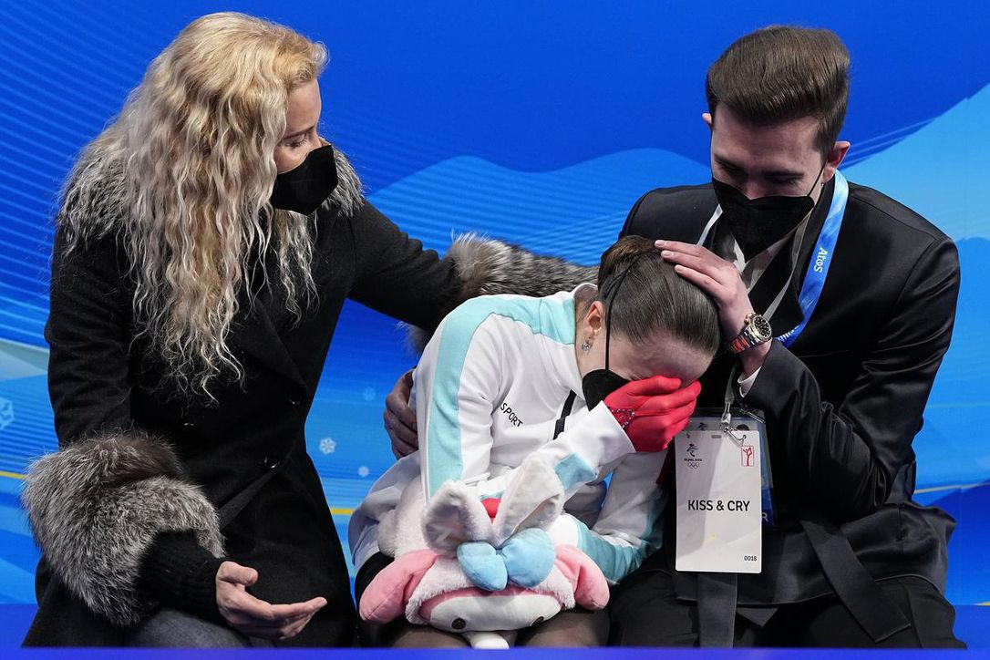
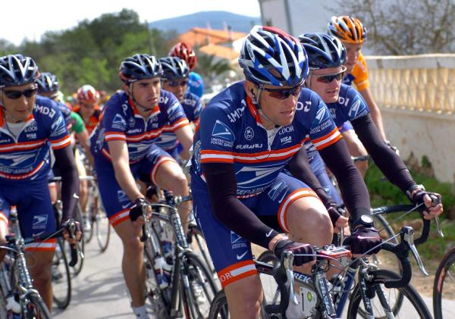
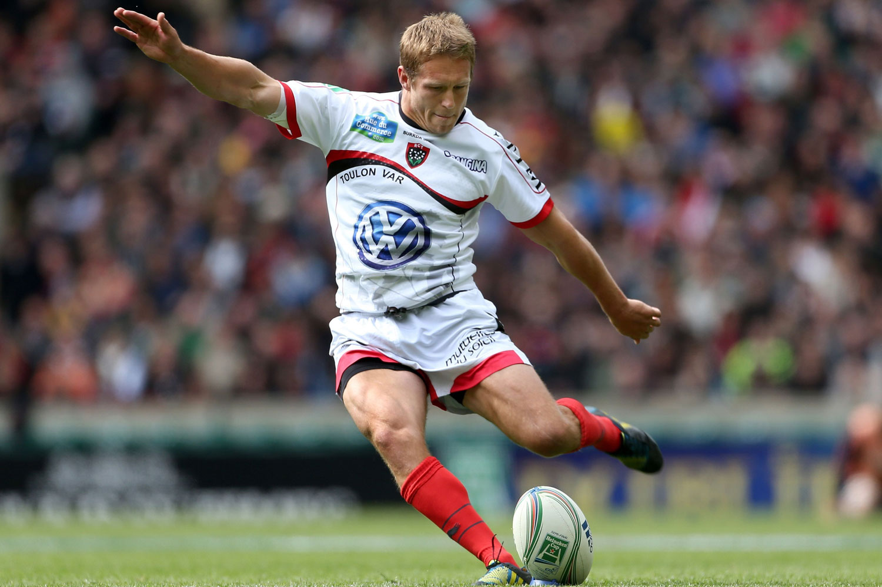
Coming first does not always equal success
CULTURE
Notes:
PROACTIVE

Slide 4
When success is defined
in narrow, short-term, transient, temporary terms (a moment crossing the line, a league table position)
through inhuman terms (medals, rankings, grades, certificates)
imposed & set by others…
Then what follows is a success that is at best fleeting and rarely any lasting value…
Notes:
PROACTIVE

Slide 5
The Real Life of Leaders, Teams & Organisations
Roles
Mindset
Responsibilities
Behaviours
CULTURE
Results
Relationships
Where leadership, resilience, performance & wellbeing all develop…

Slide 6
Reimagining Success through The 3 Cs…
THE LONG WIN
Clarity
Constant Learning
Mindset
Behaviours
CULTURE
Relationships
Connection
©Cath Bishop

Slide 7
CLARITY
Clarity
What gets you out of bed in the morning?
What’s your purpose? (Why?)
What does success look like on a daily basis? (How?)
What experience do you want (others) to have? (Stories…)
©Cath Bishop

Slide 8
Growth Mindset
Reflection
‘Mastery’ mindset
Reframing
Constant Learning
Review
Feedback
Marginal Gains Thinking
The ‘Progress Principle’
Challenge assumptions & bias
Stories
Co-operative Learning, Co-creation, Design Thinking

Slide 9
Resilience…
“Resilience is not simply a person’s ability to ‘bounce back’, but their capacity to adapt in the face of challenging circumstances” (MIND)
“The capacity to remain flexible in our thoughts, feelings, and behaviours when faced by a life disruption, or extended periods of pressure, so that we emerge from difficulty stronger, wiser, and more able.” (Carole Pemberton)
Notes:
Flexible, supportive, collaborative

Slide 10
HOW TO BE EFFECTIVE UNDER EXTREME PRESSURE
UK Government study:
Within a proactively supportive environment…
Flexibility and adaptability
Self-awareness under pressure
3. Authentic, collaborative relationships

Slide 11
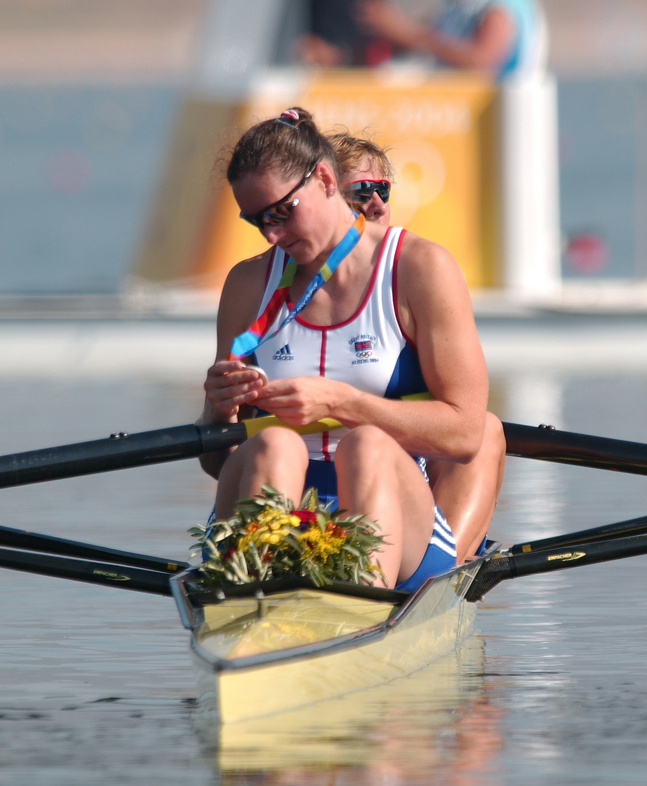
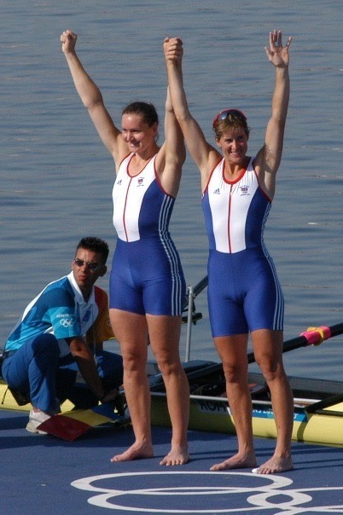
Connections
Alex Danson (hockey Olympic Champion, 2016): “It’s not the winning, it’s how you win, the people you win with, the group of people you are connected to… I think that human connection is the ultimate marker of success.”

Slide 12
THE LONG WIN
Storytelling
What are the stories that you and your students tell about the experience of HE looking back?
What are the stories that you would like (others) to tell about their experience of HE?
Clarity
Constant Learning
Mindset
Behaviours
CULTURE
Relationships
Connection
©Cath Bishop

Slide 13
Clarity
Constant Learning
Connection
What’s possible, together?
www.cathbishop.com @thecathbishop

Slide 14
Clarity
Constant Learning
Connection
What does the Long Win look like for you & your colleagues & students?

Slide 15
THANK YOU

