Slide 1
EMPLOYABILITY CONFERENCE 2022
Employability: expanding the narrative for a rapidly changing world – continuing the conversation
We need to talk about Albert
Dr Ken Fox, School of Creative Arts & Industries, Canterbury Christ Church University

Slide 2
We need to talk about Albert
Sustainability is Employability
The introduction of the Albert certificate (sustainable media production practices) to a Year 3 employability module
Dr Ken Fox, School of Creative Arts & Industries, Canterbury Christ Church University

Slide 3
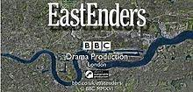
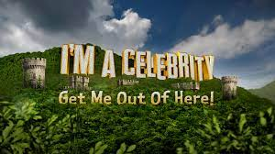
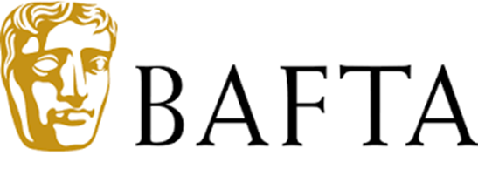
Media productions using the Albert protocol and logo

Slide 4
Universities and colleges involved in the Albert Educational Partnership A growing list 29 so far as of 2022

Slide 5
Albert certificate embedded in existing employability module as part of assessment

Slide 6
Assessment Tasks for Albert Certificate
Assessment 1: Climate Change Science Quiz (The Science of Sustainable Productions)
Assessment 2: Make a Commitment to Sustainability ( The Science of Sustainable Production)
Assessment 3: Using the albert Footprint Calculator ( Sustainable Production)
Assessment 4: Present an Editorial Storyboard /Elevator Pitch or Ideas (Planet Placement)

Slide 7
Ongoing Learner Development
Ongoing learner development is promoted through Assessment 2 as students are required to write or record a personal commitment to sustainability which will evidence their commitment to creating a greener industry in a future role they would like to hold.
They do this work having completed their own personal carbon footprint which is embedded in the workbook.

Slide 8
Sense of Commitment to sustainable actions
Evidence that the students are willing to take personal responsibility can be seen in their Commitment to Sustainability statements.
The focus of the questions offers them the opportunity to be more hopeful in terms of what they contribute in their own lives and in their prospective careers in the creative industries.

Slide 9
Example of Commitment to sustainability
Student A Commitment to Sustainability
January 1st, 2020, I decided to become a vegetarian. I think, so far, this is the most significant step I have taken towards making a difference to climate change. Leaning into a plant-based diet has had wonderful personal effects on my health and wellbeing, as well as my attitude towards the meat industry and its impact on the environment. I am not looking back on this and intend to remain a vegetarian. I’ve recently discovered various dairy-free products and foods that are entirely vegan which can further the positive impact I make personally.
ALBERT is a wonderful resource of information and knowledge. Third year seems a bit late in my university life to learn about it. I think the university could introduce this immediately on their media courses. Promoting ethical, professional work cannot be understated.

Slide 10
How sustainability and employability align
Transferable skills (learning about the science of climate change)
Self-reflection (working through their own carbon footprint)
Completing the carbon calculator and drawing up an action plan
Pitching and editorial skills

Slide 11
CBI list of graduate employability skills
Self-management (Assessment 2, 3, 4)
Business and customer awareness (Assessment 4)
Team-working (In class activities)
Problem solving (Assessment 2 & 3)
Communication and Literacy (Assessment 2,3 & 4)
Application of Numeracy (Assessment 3)
Application of Information Technology (Using Pebblepad as eportfolio)
International / Cultural Awareness (All assessments Sustainability awareness)
Foreign Language Skills

Slide 12
Sustainability and Employability contested terms
Some of the discourse and assumptions around employability as it is located in higher education need to questioned.
Albert provides an opportunity where self interest and public interest align

Slide 13
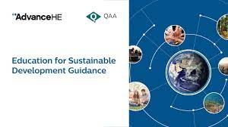
Advance HE Ed for Sustainable Development

Slide 14
Covid: The Great Disruptor
Covid has been the great disruptor and it may be that out of this shock to societal systems, including education, more effective forms of pedagogy might emerge that move forward, rather than look back, with a renewed sense of purpose about how gaining employment and saving the planet are inextricably linked.

Slide 15
Useful Websites
https://wearealbert.org/
https://www.greenshoot.com/green-screen
https://www.green.film/

Slide 16
THANK YOU

