Slide 1
EMPLOYABILITY CONFERENCE 2022
Employability: expanding the narrative for a rapidly changing world – continuing the conversation
Career Stage Framework: Meeting students where they are in their employability journey
Laura Brammar, Senior Careers Consultant, ULCS
Liz Wilkinson, Senior Careers Consultant, ULCS

Slide 2
Employability Conference 2022: OU in association with NTU
Career Stage Framework: Meeting students where they are in their employability journey

Slide 3
Who are we?
Award-winning Senior Careers Consultants University of London Careers Service
Design, develop and deliver a range of live and asynchronous careers development support to undergraduates and postgraduates within the UoL Distance and Flexible Learning programmes.
Won 2020 University of London Roger Mills Prize for Innovation and Learning in ODeL environment for our work with DFL students
Won 2015 AGCAS Excellence Award for use of Technology for Enhance Your Career and Employability Skills MOOC
Won 2015 AGR Best Preparation for Work in Higher Education for micro-placement model
Work published in range of professional and academic journals, including including the and Journal of the National Institute for Career Education and Counselling, Phoenix and Australian Journal of Career Development.
Combined experience of 50+ years in the HE Careers and Employability landscape
Current work with UoL Distance and Flexible learners a mutual careers highlight!

Slide 4
Context of the Career Stage Framework (CSF)
Assumptions - Many HE careers services are geared towards students with limited amounts of work experience.
Reality - Many DFL, PT and PG students already have extensive experience in the workplace.
Potential Disconnect - where we presume our students to be on their employability journey and where they actually are – may limit effectiveness of careers education
Our learners - The 45,000 DFL students – 180 different countries, diverse range of work place experience
Our approach- Extensive work with this cohort in a global, virtual classroom led the development of the Career Stage Framework (CSF)

Slide 5
What is the CSF?
CSF segments the students into three distinct groups, each at different stages of their career journey:
Career Starters – those at the beginning of their career journey, wanting to launch their career
Career Developers – those with some experience, wanting to enhance their career
Career Changers – those with significant experience, wanting to change their career

Slide 6
CSF – Diversity of UoLW students
Career Stage | Work Profile | Likely Objective
Career Starters | Limited work experience | Some substantive work experience
Career Developers | Extensive work experience | Advancement/Shift/ Specialisation
Career Changers | Substantial work experience in one sector | Career Pivot to new sector, employment or entrepreneurship
Notes:
This careers stage segmentation has emerged from our delivery of live careers support to students and is informed by their self-reporting
Distinctive feature: diversity of career stages and career objectives, often on the same programme

Slide 7
How do we use the CSF?
To design our live, synchronous sessions – we offer programmes of delivery aimed at specific CSF cohorts
To deliver our live, synchronous sessions – we encourage our students to self identify as one of the CSF cohorts during live delivery
To evaluate our live, synchronous sessions – we collect data on CSF at point of registration and during our feedback sessions
To inform our asynchronous learning materials – we build our careers micro-modules around a CSF approach

Slide 8
CSF Targeted Interventions Spring 2021: Enhance your Career Stage Webinar Series: Session 1: Zero Experience yet need Experience? How do you bridge the gap? (Career starters) Session 2: Ready for promotion? How can you prove it? (Career developers) Session 3: Experienced but changing to a different field? How can you show the connection? (Career changers) Session 4: Want to work for yourself? How can you make it happen? (Career starters/developers/changers)

Slide 9
CSF – woven into our data
Also plans to include Careers Stage questions in Careers Registration data collection from 2022

Slide 10
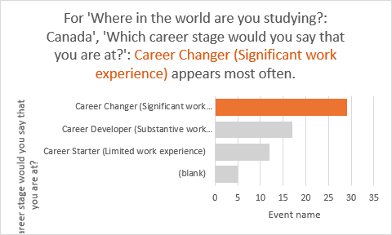
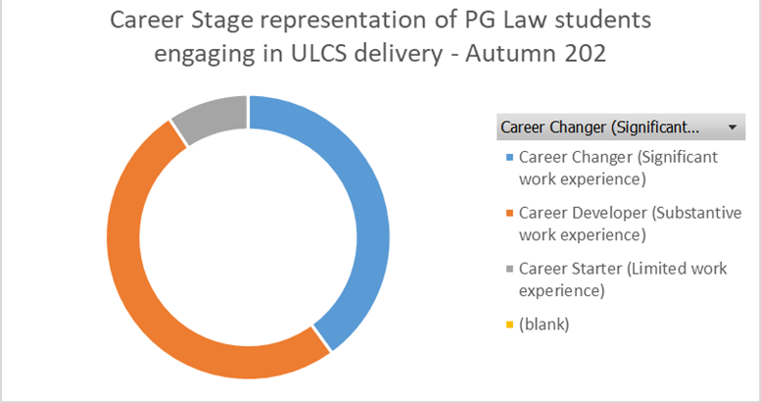
CSF – woven into our data

Slide 11
Evidence is students connect with the CSF
All three Career Stages strongly represented in our student cohort.
Students self reported as 45% CS, 29% CD and 26% CC (2236 webinar registrants, Autumn 2021)
Students readily self identify with a CSF cohort in live delivery
Student Voice qualitative data shows student choose mode/subject of study for career development, including career change
Many join our programmes with substantive work force experience in the work force - personal constructs and perspectives
They have already been on a careers education journey

Slide 12
How is this changing our professional practice? Making every minute of careers education count Targeting and labelling by Careers Stage Facilitating cross-CSF student peer learning and knowledge transfer Using the CSF lens to look at other student data
Source: https://www.greenpeace.org/usa/oceans/preventing-plastic-pollution/

Slide 14
Link to article https://lnkd.in/d2JZiJ3u

Slide 15
Expanded CSF series – e.g. Career Starters Series (e.g. understanding assessment centres), Career Developers Series (e.g. quantifying your achievements on your CV), Career Changers Series (e.g. explaining gaps in your work history) Triaging additional small group/1:1 support - e.g. Career Drop ins for Career Changers Facilitating peer to peer support/students as co-creators – Career Changers/Developers share industrial insights with Career Starters
CSF Future Plans

Slide 16
Thoughts for you to consider:
• How might you collect careers stage data? Are there particular programmes (mode/subject/level) where you are most likely to find this type of diversity?
• Ask your students how they define their careers stage and what it means to them?
• Ask students what message your careers and employability service sends to those who already have some work experience in either their preferred sector or other industries?
• How can you encourage students to bring their work experience and their “insider knowledge” into the room and create informal careers discussion spaces for cross- Career Stage peer learning?

Slide 17
Any questions?
Thank you

Slide 18
THANK YOU

