Slide 1
EMPLOYABILITY CONFERENCE 2022
Employability: expanding the narrative for a rapidly changing world – continuing the conversation
Learning to tell a powerful graduate story
Anne Owen and Angela Vesey
School of Social Sciences, Nottingham Trent University

Slide 2
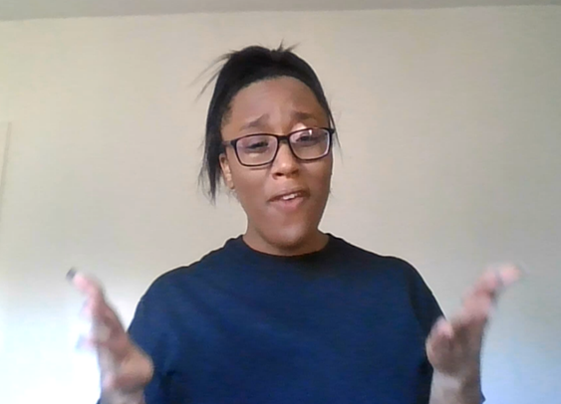
Learning to tell a powerful graduate story
Employability Conference 2022
Anne Owen and Angela Vesey, School of Social Sciences, NTU.
.

Slide 3
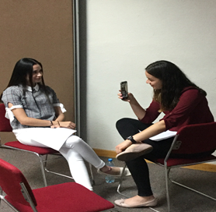
Our aim for today
To share an approach to learning and teaching where impactful oracy is key to promoting student employability, challenging assumptions and raising aspirations.
Now to an example...
Anne Owen and Angela Vesey, NTU 2022

Slide 4
Energising STAR Challenging assumptions and creating possibilities
Anne Owen and Angela Vesey NTU, 2022

Slide 5
Reflective practice involves making a dual stance, being on the one hand, the actor in a drama and on the other hand, the critic who sits in the audience watching and analysing the whole performance”
(Osterman and Kottkamp, 2004:23 in Bassot,2013:133)
Anne Owen and Angela Vesey, NTU, 2022

Slide 6
What did we do?
Written Reflection
Discipline Knowledge
Abstract to personal
Graduate LMI
Personal Development Planning
Audio Responses
Modelling
Story-telling, Scenarios
Challenging assumptions
Rehearsal, Reframing
Feedback/forward
Elevator Pitch
Techniques
Performance
Finding voice
Trying on for size
Belief
Reflective, Collaborative, Personalised, Coaching & Synoptic assessment
Anne Owen and Angela Vesey, NTU, 2022

Slide 7
Our Final Words
Anne Owen and Angela Vesey, NTU 2022

Slide 8
THANK YOU

