Slide 1
EMPLOYABILITY CONFERENCE 2022
Employability: expanding the narrative for a rapidly changing world – continuing the conversation
Rethinking the Relations Between Graduate Employability and Employment
Dr Jason Brown, Career Ahead, University of Southern Queensland

Slide 2
Rethinking the Relations Between Graduate Employability and Employment
Dr Jason Brown | Career Ahead | University of Southern Queensland

Slide 3
Dispositional Employability
Dispositional employability is a psychosocial resource that facilitates the enactment of proactive behaviours directed toward obtaining employment.
Dispositional employability is proposed to be an antecedent of career adaptability.
Fugate & Kinicki (2008)
Fugate & Kinicki (2008) propose that individuals who have high levels of dispositional employability exhibit:
Openness to change at work
Resilient through sense of control
Optimistic about future career
Proactive in seeking out information and opportunities
Motivated toward career planning
Fugate, M., & Kinicki, A. J. (2008). A dispositional approach to employability: Development of a measure and test of implications for employee reactions to organizational change. Journal of Occupational and Organizational Psychology, 81(3), 503–527. https://doi.org/10.1348/096317907x241579

Slide 4
CCT Career Adaptation Model
Adaptivity
Adaptability
Adapting
Adaptation
Savickas, M. L. (2005). The theory and practice of career construction. In S. D. Brown & R. W. Lent (Eds.), Career development and counseling: Putting theory and research to work. John Wiley & Sons.

Slide 5
Research
Summary of three studies examining relations between employability and outcomes

Slide 6
Career Adaptation Model Applied to Employability
ADAPTIVITY
Study 1: Graduate skills and qualities
ADAPTABILITY
Study 2: Career adaptability, career optimism, perceived knowledge
ADAPTING
Study 2: Job search self-efficacy
Study 3: Career adaptive behaviours
ADAPTATION
Study 1: Employment
Study 2: Dispositional Measure of Employability
Study 3: Concern, Control, Curiosity, Confidence

Slide 7
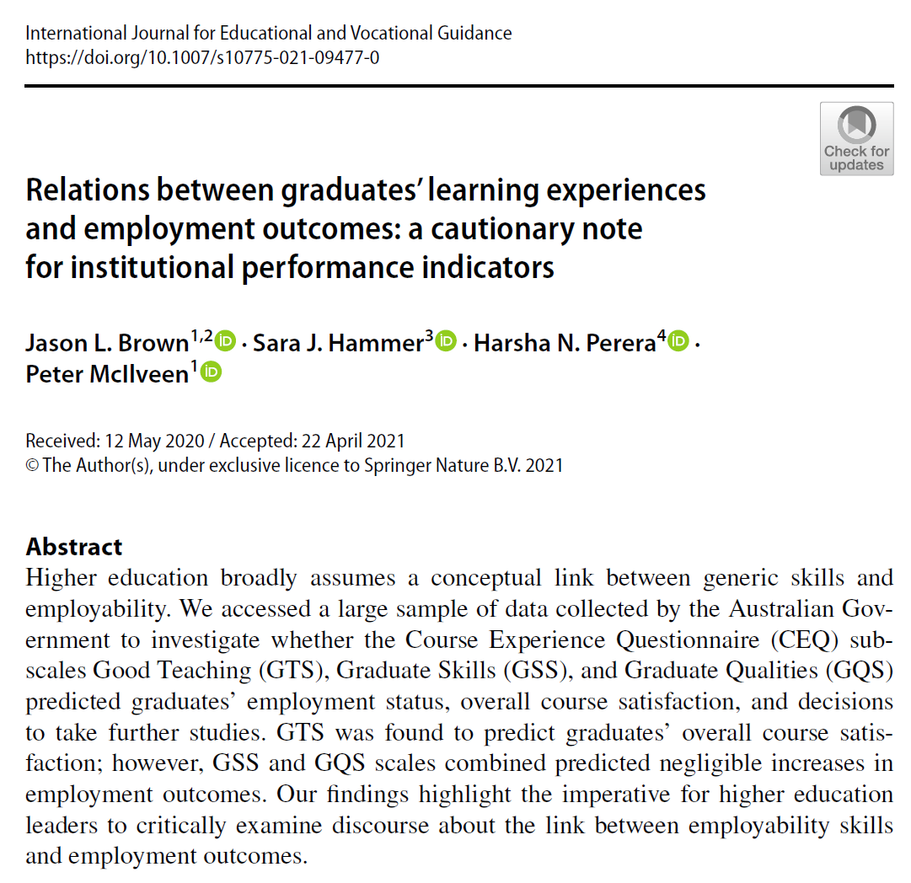
Study 1
This quantitative study aimed to test the assumption in the employability literature of a conceptual link between generic skills and employment.

Slide 8
Relations Between Skills + Employment
Participants N=110,685 graduates from the Australian Government’s Graduate Outcome Survey 2015-2017
Measures Course Experience Questionnaire (Good teaching, Graduate Skills, Graduate Qualities) and Graduate Outcomes
Data Analysis Confirmatory factor analysis (CFA) to test measurement models
Probit regressions to test relations between measures and employment outcome variable
CFA A three-factor CF-CFA provided an acceptable fit to the data; however, the correlation between the GSS and GQS factors was .989.
A 2-factor BF-CFA accepted containing the GTS and a combined GSQS
χ² (162) = 10077.496, p < .001, CFI = .976, TLI = .968, RMSEA = .024, 95% CI [.024, .025].

Slide 9
Relations Between Skills + Employment
Relations between Good Teaching Scale (GTS) and Graduate Skills & Qualities Scale (GSQS) and Employment
Probit regression coefficients:
γ = 0.086, SE = .006, p < .001
Predicted probability of employment: A +1 SD increase in GSQS increases probability of employment from 87% to 88%

Slide 11
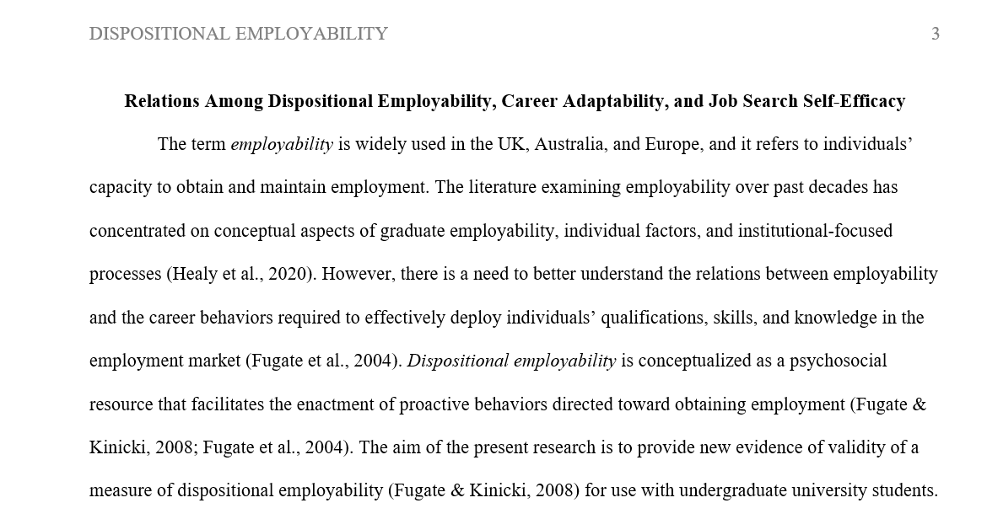
Study 2
This quantitative study aimed to test the relations between dispositional employability (adaptivity) and career adaptability and job search self-efficacy (adapting).
Note: Manuscript under review

Slide 12
Dispositional Employability, Career Adaptability and Job Search Self-Efficacy
Participants N=719 students from a multi-campus university in Australia. M_{age} = 21.6; 78% female; 95% undergraduate; 79% employed
Measures DME (Fugate & Kinicki, 2008); CFI-9 (McIlveen et al., 2012); JSSE (Saks et al., 2015)
Data Analysis Confirmatory factor analysis (CFA) to test measurement models
Hierarchical regressions to test relations between DME and career adaptability, and between DME and job search self-efficacy
CFA A correlated factor model containing all latent factors:
χ² (887) = 2029.34, p < .001, CFI = .943, TLI = .936, RMSEA = .042, 95% CI [.040, .045], SRMR = .052

Slide 13
Dispositional Employability, Adaptability and Adapting
Adaptability DME positively related to all three subscales of CFI-9
Career adaptability F(7, 706) = 74.20, p < .001; R² = .42
Perceived knowledge F(7, 706) = 21.71, p < .001; R² = .18
Career optimism F(7, 706) = 67.81, p < .001; R² = .40
Adapting DME positively related to all three subscales of JSSE
JSSE Outcomes F(7, 706) = 72.56, p < .001; R² = .42
JSSE Active Behaviour F(7, 706) = 53.76, p < .001; R² = .35
JSSE Passive Behaviour F(7, 706) = 67.95, p < .001; R² = .40

Slide 14
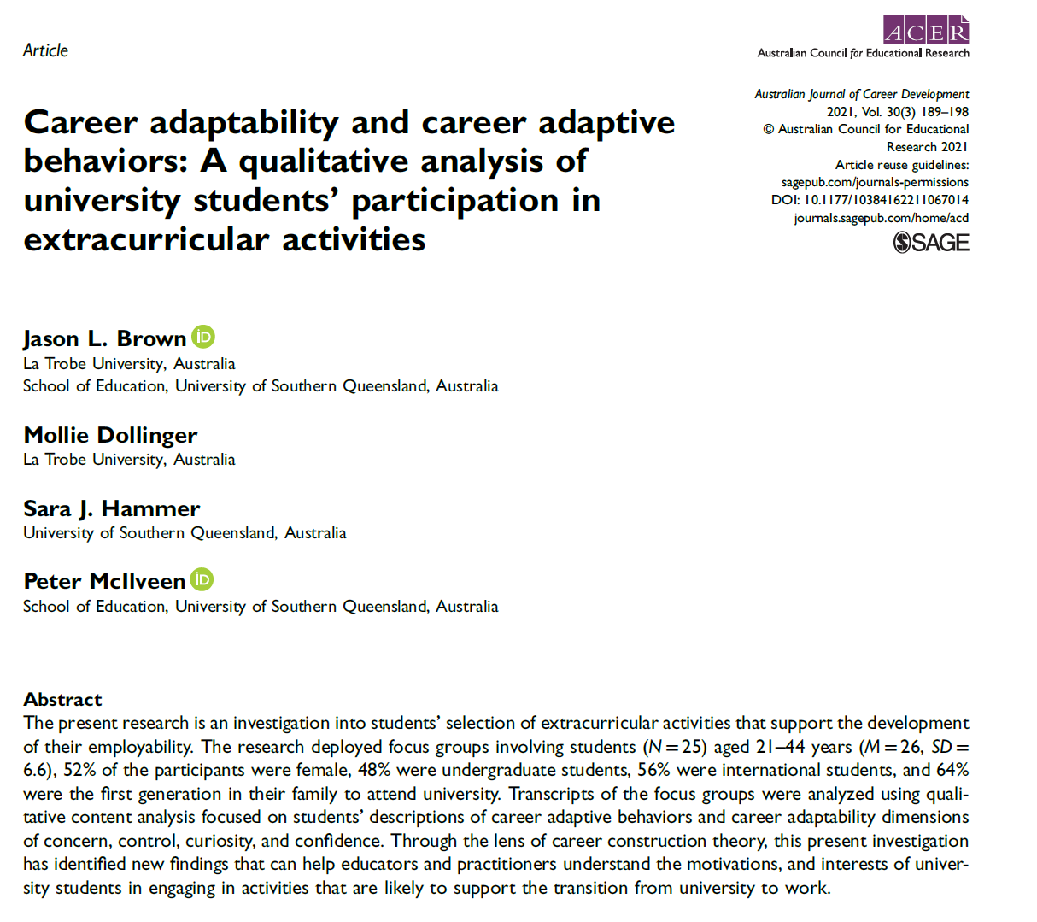
Study 3
This qualitative study aimed to better understand university students’ decisions to engage in extra-curricular activities as a strategy to develop their employability

Slide 15
Career Adaptability Dimensions and Influence on Career Adaptive Behaviour
Participants Students engaged in the University’s Employability Award (N = 25)
Aged 21 to 44 years (M=26, SD=6.6)
52% female; 48% undergraduate students; 56% were international students, and 64% first generation students
Method Students participated in one of 7 focus group discussions
Data Analysis Qualitative content analysis
Research questions
RQ1: Which career adaptive behaviours do students identify as supporting their development of employability?
RQ2: What are the qualitative differences between each dimension of career adaptability on engagement in career adaptive behaviours?

Slide 16
Career Adaptability Dimensions and Influence on Career Adaptive Behaviour
Career Adaptive Behaviours | Concern | Control | Curiosity | Confidence
Human Capital (e.g., employment, volunteering, work experience, skill development) | Concerned about labour market competitiveness; able to identify activities to support employability | Purposeful engagement in activities connected to a career goal | Engagement in exploratory activities | Engagement in activities that signal developing professional capabilities
Social Capital (e.g., networking, mentoring, student clubs and societies) | Planning on engaging in activities to build social network | Engagement in transactional activities to build social network | Engagement in exploratory activities to build social network and gather career information | Engagement in relationship building networking behaviours
Brown, J. L., Dollinger, M., Hammer, S., & McIlveen, P. (2021). Career adaptability and career adaptive behaviors: A qualitative analysis of university students’ participation in extracurricular activities. Australian Journal of Career Development, 30(3), 189–198. https://doi.org/10.1177/10384162211067014

Slide 17
Rethinking Employability

Slide 18
Rethinking Employability
Employability
development
Outcomes
Every graduate is employable, so what do we mean by employability?
More to employability than generic skills / attributes
We must use theory to inform research and design employability programs
Employability awards develop employability (esp. career adaptability), they do not cause employment
Employment can only be achieved through job search behaviour
Employment is not the only outcome of employability
What else is important?
Career identity
Career satisfaction
Job quality
and more…

Slide 19
Thank you
Dr Jason Brown
Jason.Brown@careerahead.com.au
linkedin.com/in/DrJasonLBrown
twitter.com/DrJasonBrown

Slide 20
THANK YOU

