Slide 1
EMPLOYABILITY CONFERENCE 2022
Employability: expanding the narrative for a rapidly changing world – continuing the conversation
Psychological Wellbeing and Sustainable Careers: Insights from Graduates in India
Nimmi P. Mohandas, Adi Shankara Business School, ASIET, India William E. Donald, Southampton Business School, University of Southampton, UK and Ronin Institute, USA

Slide 2
Employability Conference 2022
Psychological Wellbeing and Sustainable Careers: Insights from Graduates in India
1. Nimmi P. Mohandas
Adi Shankara Business School, ASIET, India 2. William E. Donald
Southampton Business School, University of Southampton, UK
Ronin Institute, USA
Future-Focused Employability Employability Conference 2022
Notes:
Hello, and a very warm welcome to this Lightning Talk titled Psychological Wellbeing and Sustainable Careers: Insights from Graduates in India.
Our research team includes Dr Nimmi Mohandas and Dr Will Donald.

Slide 3
Study Purpose & Framework
Purpose of Study
To understand the roles that Protean Career Attitude and Perceived Employability play in determining Psychological Wellbeing.
Definitions
Protean Career Attitude (PCA) (Hall, 1976)
Perceived Employability (PE) (Vanhercke et al., 2014)
Psychological Wellbeing (PW) (Ryff, 1995; Schmutte & Ryff, 1997)
Theoretical Framework
Conservation of Resources Theory (Hobfoll, 1989)
Future-Focused Employability Employability Conference 2022
Notes:
Purpose of Study
To understand the roles that Protean Career Attitude and Perceived Employability play in determining Psychological Wellbeing.
Definitions
The Greek God Proteus could adapt and change shape at will; thus, the Protean Careerist takes ownership of their career and adapts in a manner that serves their own needs (Hall, 1976).
We adopt Vanhercke and Colleagues definition of Perceived Employability as … the individual’s perception of his or her possibilities of obtaining and maintaining employment (Vanhercke et al., p.25).
We adopt Schmutte and RIFEs Ryff’s definition of Psychological Wellbeing as a generalised feeling of happiness that is conceived as ‘progressions of continued growth across the life course’ (Ryff, 1995, p.99).
Theoretical Framework
The theoretical framework draws on the Conservation of Resources Theory whereby the acquisition of personal resources can enable an individual to manage stressful situations to reduce the risk of burnout and achieve career sustainability.

Slide 4
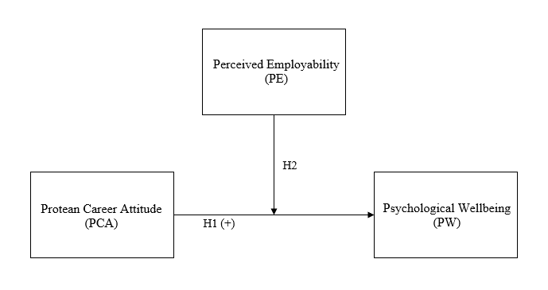
Conceptual Model
Future-Focused Employability Employability Conference 2022
Notes:
Hypotheses
The study had two hypotheses.
Hypothesis 1: PCA positively predicts PW
Hypothesis 2: PE moderates the relationship between PCA and PW

Slide 5
Methodology
Quantitative Methodology
Self-reporting questionnaires (February 2019 to July 2019)
421 graduates in IT sector in India
167 Female (39.7%) and 254 Male (60.3%)
Average age of 29.64
Average of 6.46 years of work experience
Future-Focused Employability Employability Conference 2022
Notes:
Using a quantitative methodology, self-reporting questionnaires were distributed in-person and online between February and July 2019.
Participants came from three cities in India with a high concentration of Information Technology organisations.
421 graduates returned completed surveys.
The gender split was 39.7% female and 60.3% male. Average age was 29.64 years and average years of work experience was 6.46.

Slide 6
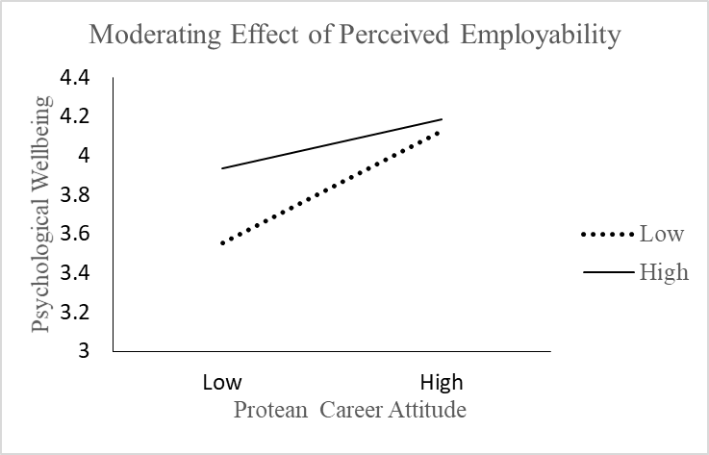
Findings
Future-Focused Employability Employability Conference 2022
Notes:
The findings show that Protean Career Attitude positively predicts Psychological Wellbeing and that the relationship is moderated by Perceived Employability in such a way that the relationship is stronger when Perceived Employability is low. Thus both hypotheses are supported.

Slide 7
Theoretical Contribution
Empirical validation of the Protean Career Attitude and Psychological Wellbeing relationship in a new cultural context (Hong et al., 2020).
Addresses the underrepresentation of non-Western cultures in empirical research exploring Protean Career Attitude (Hennings et al., 2021).
Evidences the moderating role of Perceived Employability on the Protean Career Attitude and Psychological Wellbeing relationship.
Conservation of Resources: Build, retain, and protect (Hobfoll et al., 2012).
Future-Focused Employability Employability Conference 2022
Notes:
Firstly, the findings of hypothesis 1 within the IT sector in India respond to calls to empirically validate the relationship between protean career attitude and psychological wellbeing using a homogeneous sample in a new cultural context; specifically, India.
Secondly, our study responds to calls to address the underrepresentation of non-Western cultures in empirical research addressing protean career attitude.
Thirdly, this study contributes theoretically by empirically evidencing the moderating role of perceived employability on the protean career attitude and psychological wellbeing relationship (via hypothesis 2). This finding is of particular interest because whilst the moderating role of perceived employability has been applied in studies examining job insecurity, emotional exhaustion, and willingness to undertake training, this is the first study to our knowledge to empirically test perceived employability as a moderator of the protean career attitude and psychological wellbeing relationship. The findings support the views of the employability paradox whereby the moderation of perceived employability on the protean career attitude and psychological wellbeing relationship is stronger when PE is low.
Fourthly, we advance Conservation of Resources theory by identifying development opportunities for students to equip themselves with the capability to build, retain, and protect resources to offer career sustainability.

Slide 8
Practical Contribution
University careers advisors
University students
Universities
Organisations
Early career talent
Future-Focused Employability Employability Conference 2022
Notes:
The practical implications apply to career advisors, students, universities, organisations and their employees. Despite our findings coming from India, we believe they can also be of use to other contexts on a global scale – particularly given that the relationship between Protean Career Attitude and Psychological Wellbeing that we found in India has been shown to hold true across countries and cultures.
Our findings suggest that university careers advisors should focus their efforts on helping their students to take ownership of their careers as a mechanism for career sustainability across the lifespan. The acquisition of resources can help students to increase their levels of Perceived Employability, offering opportunities to become more resilient to chance events and career shocks when they inevitably occur during their careers. In effect, our study suggests that sustainable development goals at an individual level should focus on enhancing Protean Career Attitude to improve levels of Psychological Wellbeing. Universities subsequently gain through improved employability outcomes of their graduates, leading to increased league table rankings which can help to attract prospective students and associated revenue. Careers services should therefore highlight the value they can offer to students with lower levels of Perceived Employability to improve the levels of engagement with these students and subsequent outcomes of employability and employment.
Within organisations, we recommend that careers advice continue to be offered to early careers talent. We believe that Individuals need support from career coaches and organisations via training and development opportunities to equip themselves with the capability to build, retain, and protect resources. We also believe such interventions have the greatest return when implemented early in an individual’s career. Moreover, a state of Psychological Wellbeing at the individual employee level has been shown to have benefits relating to organisational sustainability via staff retention.
Organisations may opt to target such investment in career guidance to employees with lower levels of PE to maximise their return on investment. For example, employees could be asked to self-report their Perceived Employability as part of their annual performance appraisal. Where appropriate, resources could then be allocated to align with personal development objectives for the next review cycle. The success of the intervention could then be empirically assessed during the next annual performance appraisal. This captures the importance to the organisation of providing the resources and opportunities for self-initiated change processes in the workplace.

Slide 9
Employability Conference 2022
Future-Focused Employability Employability Conference 2022
Notes:
That concludes the presentation. Thank you.

Slide 10
References (1)
Hall, D.T. (1976), Careers in Organizations, Goodyear, Santa Monica, CA.
Hennings, M., Zhu, Y. and van der Veen, R. (2021), “Developing the capacity for a proactively self-managed career: an analysis of aspiring new-generation employees in Japan”, Asia Pacific Journal of Human Resources, https://doi.org/10.1111/1744-7941.12296
Hobfoll, S.E. (1989), “Conservation of Resources: A New Attempt at Conceptualizing Stress”, American Psychologist, Vol. 44 No. 3, pp. 513-524. https://doi.org/10.1037/0003-066X.44.3.513
Hobfoll, S.E. (2012), “Resource caravans and resource caravan passageways: A new paradigm for trauma responding”, Intervention, Vol. 12, pp.21-32. https://doi.org/10.1097/WTF.0000000000000067
Future-Focused Employability Employability Conference 2022

Slide 11
References (2)
Hong, R., Romans, J.S.C., Koch, J.M. and Ramakrishnan, N. (2020), “Impact of Cultural Individualism and Collectivism on Protean and Boundaryless Career Attitudes and Job Satisfaction”, Journal of Career Development. https://doi.org/10.1177/0894845320922608
Ryff, C.D. (1995), “Psychological Well-Being in Adult Life”, Current Directions in Psychological Science, Vol. 4 No. 4, pp.99-104. https://doi.org/10.1111/1467-8721.ep10772395
Schmutte, P.S. and Ryff, C.D. (1997), “Personality and well-being: Reexamining methods and meanings”, Journal of Personality and Social Psychology, Vol. 73 No. 3, pp.549-559. https://doi.org/10.1037/0022-3514.73.3.549
Vanhercke, D., Cuyper, N., Peeters, E. and De Witte, H. (2014), “Defining Perceived Employability: A Psychological Approach”, Personnel Review, Vol. 43 No. 4, pp.592-605. https://doi.org/10.1108/PR-07-2012-0110
Future-Focused Employability Employability Conference 2022

Slide 12
THANK YOU

