Slide 1
EMPLOYABILITY CONFERENCE 2022
Employability: expanding the narrative for a rapidly changing world – continuing the conversation
Data, Data Everywhere but what do students think?
Lydia Lauder and Dr. Victoria Crowe, The Open University

Slide 2
Data, Data Everywhere but what do students think?
Evidencing employability in careers provision through quality assurance and student voice.
Lydia Lauder and Dr. Victoria Crowe
March 2022

Slide 3
Why do we need to measure what we do in careers guidance?
DRIVERS
But some obdurate challenges too…
INSTITUTIONAL - does the service provide
value for money?
PROFESSIONAL – is what I do is meaningful
and of value to students?
STUDENT – does using CES help the student
in some way?

Slide 4
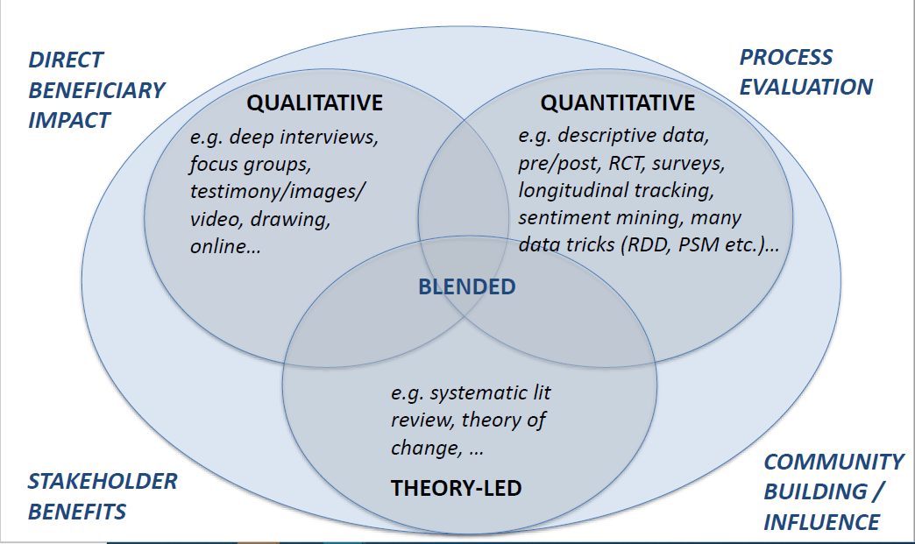
Using theories and research-based approaches to evidence impact.
Theory of Change
‘The theory of change describes the steps that need to take place between what you do and the impact that you hope to achieve. It helps you to think about what you are doing and why. It also helps you to establish a framework for evaluation and quality assurance.’
(Hooley, 2018)
Blended Model, DMH Associates (2020)

Slide 5
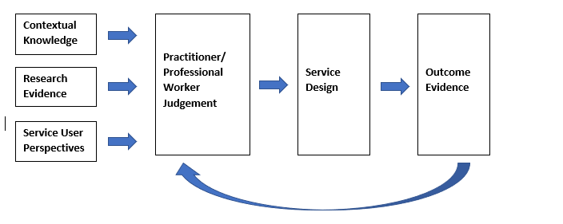
An Integrated Model for Evidence Based Practice (Robertson, 2020)

Slide 6
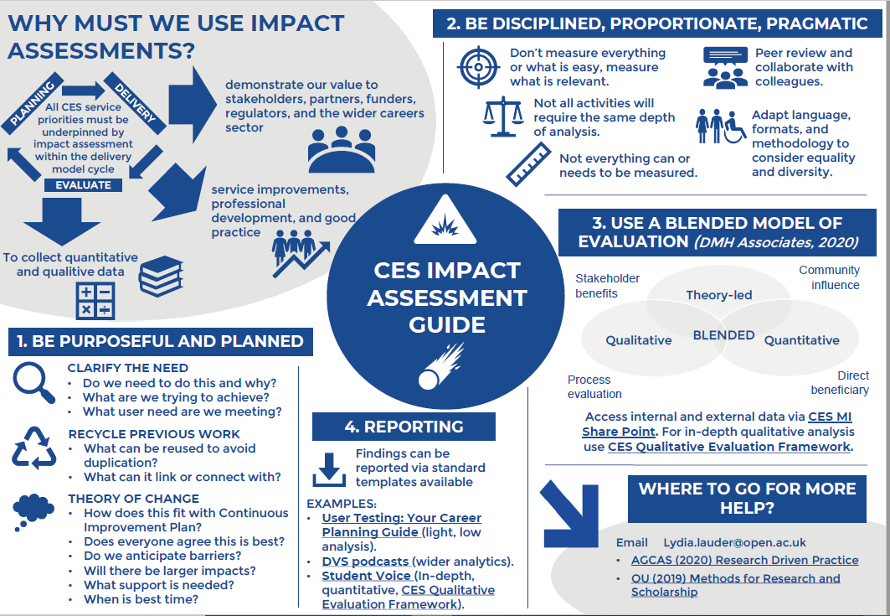

Slide 7
Media removed to allow upload to conference website – full session recordings will be available on the website after the conference

Slide 8
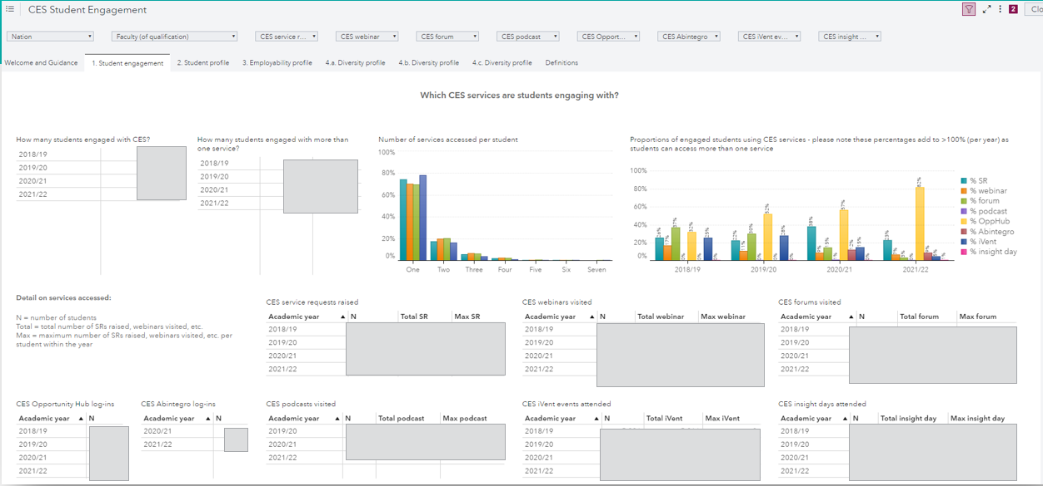
Data Driven Approaches Evidencing Employability – Example

Slide 9
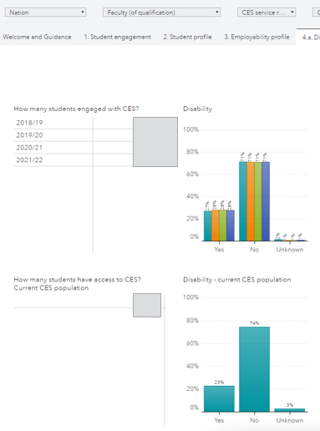
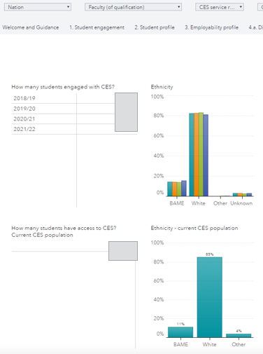
Data Driven Approaches Evidencing Employability – Example

Slide 10
Data Driven Approaches Evidencing Employability – Example

Slide 11
Conclusions
Conclusions
Why holistic evaluation frameworks and tools are necessary to evidence employability.
Providing a meaningful response to the challenge: ‘As students think, we do’!
Holistic evaluation offers a counterbalance to the methodological challenges associated with evaluating careers guidance.
Means for evidencing the multi-level impacts of guidance.
Allow for an ‘interchange between summative economic evaluators and practitioner-evaluators’ (Killeen, 1996b).
Evidence generated in this way at an organisational level can offer proxies for longer-term economic assessments (Maguire, 2004) for policy makers and funders to consider.
Allows for an array of voices to be clearly heard, practitioner, stakeholder, student and alumnus.
However, the outcomes and the process of evaluation itself must be used iteratively within a continuous improvement cycle if employability is to be meaningfully evidenced.

Slide 12
References
DMH Associates (2020) The Career Development Landscape: Evidence and Impact Assessment. https://dmhassociates.org/wp-content/uploads/2020/09/080920-The-career-development-landscape-webinar-FINAL-VERSION.pdf
Fowkes, L., Johnson, L., and Lauder, L., (2021) YOU’VE GOT MAIL! Exploring student and practitioner experiences of the value of email and telephone careers guidance. [Online]. Available at: https://luminate.prospects.ac.uk/exploring-the-value-of-email-and-telephone-careers-guidance (Accessed: 3 March, 2022)
Hooley, T., (2018) Evidence based practice and evaluation in career guidance. ADVENTURES IN CAREER DEVELOPMENT [Online]. Available at: https://adventuresincareerdevelopment.wordpress.com/2018/11/24/7023/ (Accessed: 2 July, 2021)
Robertson P.J., (2020) Evidence-Based Practice for Career Development In: The Oxford Handbook for Career Development. Ed: P Robertosn, P. J., Hooley, T., and McNash, P., Oxford University Press. Available at: https://drive.google.com/file/d/1dJgqJTO74GMNuugk_EfFG09FnOFSRdsP/view
Watch this space! Our work on evidencing employability through quality assurance and student voice at CES is due as a chapter publication within the SAGE Handbook of Graduate Employability (forthcoming Autumn 2022).

Slide 13
Thankyou!
Lydia.Lauder@open.ac.uk
Victoria.Crowe@open.ac.uk

Slide 14
THANK YOU

