Slide 1
EMPLOYABILITY CONFERENCE 2022
Employability: expanding the narrative for a rapidly changing world – continuing the conversation
To create an affordable, calm, creative and collaborative space for students embarking on their higher education journey
Julia De Meo, Jitse van Ameijde, Bishankar K Sarkar
The Open University and Batayon Pathagar, Bangladesh

Slide 2
Batayon Pathagar
“To create an affordable, calm, creative and collaborative space for students embarking on their higher education journey”
Julia De Meo Batayon Pathagar
Jitse van Ameijde The Open University
Bishankar K Sarkar
and students of the Batayon Pathagar

Slide 3
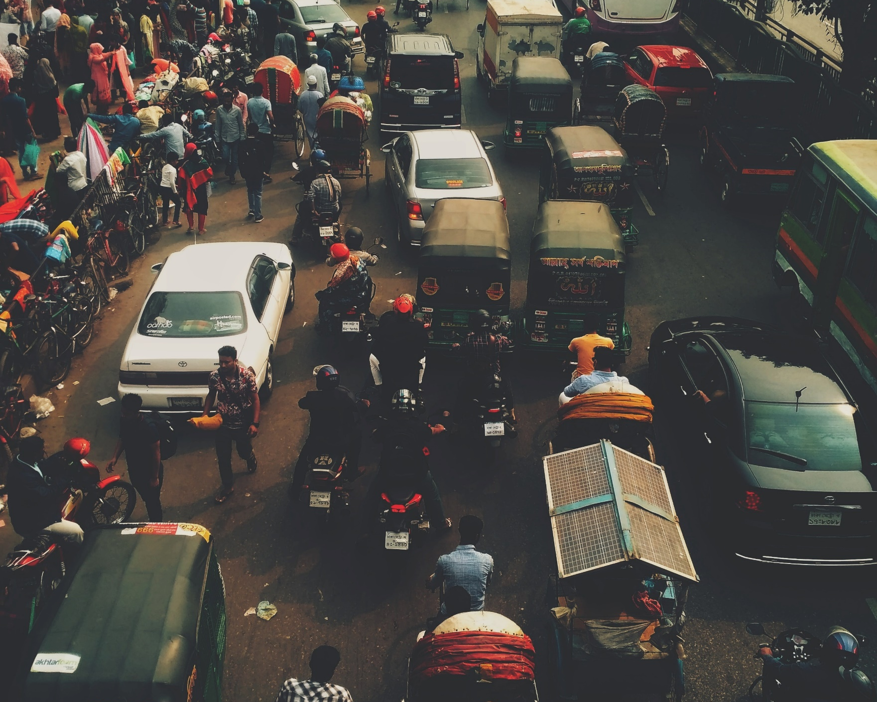
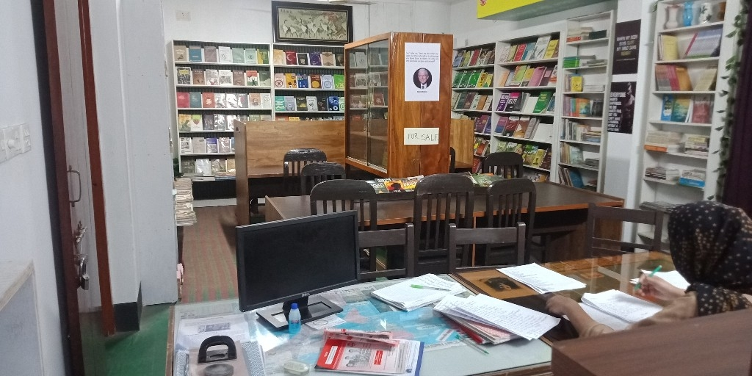
Introduction
Bangladesh is a country full of vibrancy
Of generosity
Of challenges
Where good education is hard to come by
Western charity is unreliable and rarely surfaces
Photo by Niloy Biswas on Unsplash

Slide 4
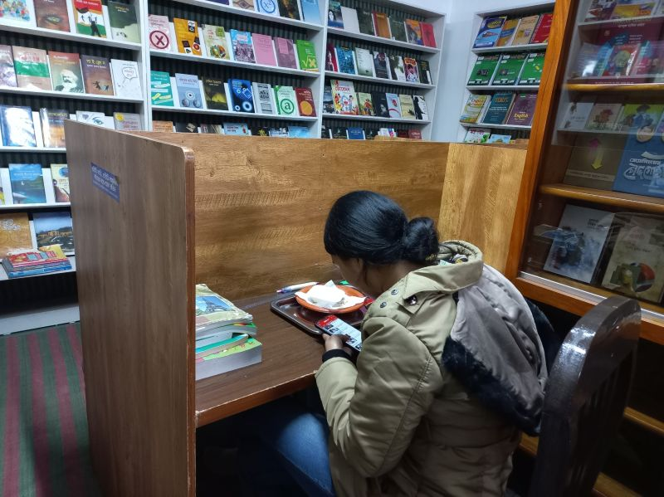
Batayon Pathagar
Batayon Pathagar provides over 200 students with educational facilities including some accommodation, access to online and offline materials, a variety of working spaces; a bookshop and café facilities.
Additionally, a rural library school has been opened creating a pathway into study including coding skills.
Batayon Pathagar has been operating in Dogra for over 18 years providing affordability and a unique style of education.

Slide 5
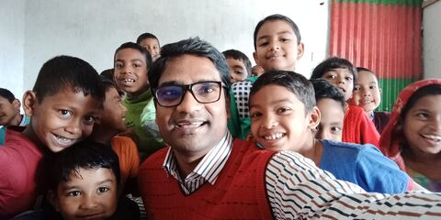
Employability
Students here achieve highly against the OU Employability framework
Student success is an important factor at Batayon Pathagar.
Students are encouraged to achieve their educational goals
Students are encouraged to achieve employment
Students are encouraged to learn a love for reading and learning

Slide 6
Pedagogy comparison – The OU vs Batayon Pathagar
designed vs emergent structure
Imposed vs adaptive collaboration
Teacher-learner vs co-learner relationships
Single cohort vs multiple cohort cross-learning
???
Shared versus individual learning paths

Slide 7
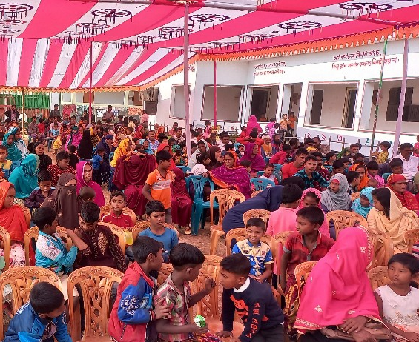
Summary
The power of community backing the incredible vision of Bishankar Sarkar enabled the creation of a library school in a rural area making lifelong learning achievable.

Slide 8
THANK YOU

