Slide 1
EMPLOYABILITY CONFERENCE 2022
Employability: expanding the narrative for a rapidly changing world – continuing the conversation
The Professional Ecology of Careers and Employability Support in Higher Education: Lessons from Australia
Michael Healy, PhD
Head of Career Development and Employability, Career Ahead

Slide 2
The Professional Ecology of Careers and Employability Support in Higher Education: Lessons from Australia
Michael Healy, PhD
Head of Career Development and Employability
March 2022
Notes:
MAKE SURE YOU DELETE ALL INAPPLICABLE COVER SLIDE VARIATIONS.
When writing a proposal, consider the following:
Who is the audience?
Who are our competitors?
Why is our proposal compelling/ different/ better than our competitors?
Is the picture relevant? The image on this slide could be used when pitching to higher education or young adults.

Slide 3
Healy, M., Brown, J. L., & Ho, C. (2021). Graduate employability as a professional proto-jurisdiction in higher education. Higher Education.
https://doi.org/10.1007/s10734-021-00733-4
Documentary analysis of
376 jobs, 2013-2019
Coded by level, criteria, specialty, organisation,
cohort
Careers and employability as a proto-jurisdiction:
elastic and ambiguous arenas where various professional groups lay claim to novel professional expertise
Notes:
It is always worth referencing the importance of the 3 C’s in Career Preparation:
Clarity about what a student wants and what value they can create for an employer
Capability aligned to the requirements of their ideal job
Confidence to execute their job search and to convince employers of the value they can generate within employment
Whilst a great LinkedIn Profile can demonstrate both Clarity (both the candidates intent & potential value add) & Capability (the skills, experience and attributes sought by an employer), it is most valuable to demonstrate confidence – a digital CV that confidently represents a candidate to the employment market
LinkedIn is a ’job search tool’ and all students need a compelling profile when they enter any recruitment process

Slide 4
Job specialisations, levels and terms
44% in careers services
40% full-time continuing
20% leadership
66% general
13% admin
Notes:
It is always worth referencing the importance of the 3 C’s in Career Preparation:
Clarity about what a student wants and what value they can create for an employer
Capability aligned to the requirements of their ideal job
Confidence to execute their job search and to convince employers of the value they can generate within employment
Whilst a great LinkedIn Profile can demonstrate both Clarity (both the candidates intent & potential value add) & Capability (the skills, experience and attributes sought by an employer), it is most valuable to demonstrate confidence – a digital CV that confidently represents a candidate to the employment market
LinkedIn is a ’job search tool’ and all students need a compelling profile when they enter any recruitment process

Slide 5
Notes:
It is always worth referencing the importance of the 3 C’s in Career Preparation:
Clarity about what a student wants and what value they can create for an employer
Capability aligned to the requirements of their ideal job
Confidence to execute their job search and to convince employers of the value they can generate within employment
Whilst a great LinkedIn Profile can demonstrate both Clarity (both the candidates intent & potential value add) & Capability (the skills, experience and attributes sought by an employer), it is most valuable to demonstrate confidence – a digital CV that confidently represents a candidate to the employment market
LinkedIn is a ’job search tool’ and all students need a compelling profile when they enter any recruitment process

Slide 6
Notes:
It is always worth referencing the importance of the 3 C’s in Career Preparation:
Clarity about what a student wants and what value they can create for an employer
Capability aligned to the requirements of their ideal job
Confidence to execute their job search and to convince employers of the value they can generate within employment
Whilst a great LinkedIn Profile can demonstrate both Clarity (both the candidates intent & potential value add) & Capability (the skills, experience and attributes sought by an employer), it is most valuable to demonstrate confidence – a digital CV that confidently represents a candidate to the employment market
LinkedIn is a ’job search tool’ and all students need a compelling profile when they enter any recruitment process

Slide 7
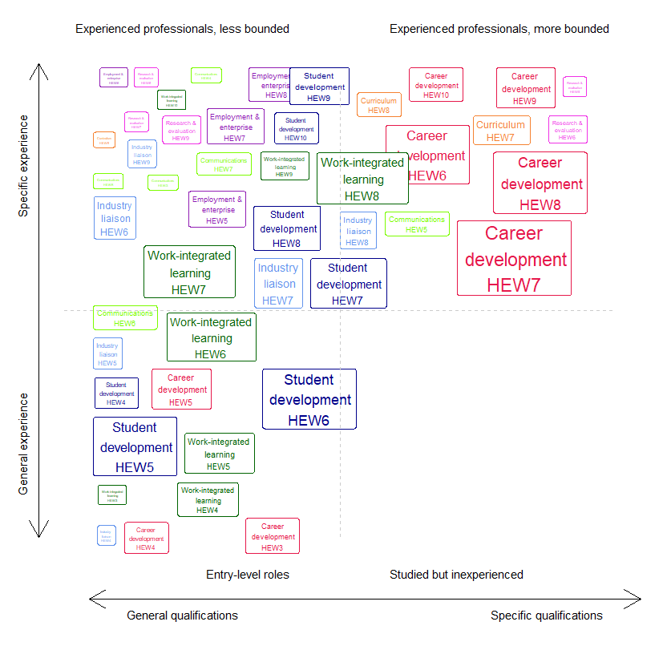
Job requirements: experience and qualifications
Career development and curriculum: qualifications and experience
Other specialisations:
Experience over qualifications
Notes:
It is always worth referencing the importance of the 3 C’s in Career Preparation:
Clarity about what a student wants and what value they can create for an employer
Capability aligned to the requirements of their ideal job
Confidence to execute their job search and to convince employers of the value they can generate within employment
Whilst a great LinkedIn Profile can demonstrate both Clarity (both the candidates intent & potential value add) & Capability (the skills, experience and attributes sought by an employer), it is most valuable to demonstrate confidence – a digital CV that confidently represents a candidate to the employment market
LinkedIn is a ’job search tool’ and all students need a compelling profile when they enter any recruitment process

Slide 8
Conclusions:
Career development: | Other specialties: | Overall:
Strengths in evidence, theory and professional practice | Important expertise and insight Less bounded | Universities are not yet adequately resourcing the development of ambitious, integrated, evidence-based careers and employability strategies.
Sometimes constrained by bounded professional identity | Lack of dedicated credentials and formalised professional networks
Notes:
It is always worth referencing the importance of the 3 C’s in Career Preparation:
Clarity about what a student wants and what value they can create for an employer
Capability aligned to the requirements of their ideal job
Confidence to execute their job search and to convince employers of the value they can generate within employment
Whilst a great LinkedIn Profile can demonstrate both Clarity (both the candidates intent & potential value add) & Capability (the skills, experience and attributes sought by an employer), it is most valuable to demonstrate confidence – a digital CV that confidently represents a candidate to the employment market
LinkedIn is a ’job search tool’ and all students need a compelling profile when they enter any recruitment process

Slide 9
michael.healy@careerahead.com.au
@mojohealy
www.mojohealy.com
linkedin.com/in/mojohealy
March 2022
Notes:
MAKE SURE YOU DELETE ALL INAPPLICABLE COVER SLIDE VARIATIONS.
When writing a proposal, consider the following:
Who is the audience?
Who are our competitors?
Why is our proposal compelling/ different/ better than our competitors?
Is the picture relevant? The image on this slide could be used when pitching to higher education or young adults.

Slide 10
THANK YOU

